Slide 1
BMC’s Strategy for Management of Next Generation IT
Kia Behnia
CTO
BMC Software
Notes:
Slide Objective: present high level agenda: Simplify and automate IT – key challenges, and BMC’s answer to them which we call Business Service Management
Key Points
-- identify the key challenges we are seeing, and why IT has those challenges
-- Next, we will discuss our approach to the problem, Business Service Management
-- we will delve into some of the key initiatives you may have taking place in your organization, and discuss how business service management provides a stepwise approach towards helping you achieve those
Sample Presentation:
Thank you very much for your time. Over the next 30 minutes, we like to share our thoughts regarding the key challenges concerning managing IT, and more importantly, present our point of view for addressing those challenges. Additionally, we like to talk about how business service management could be implemented in your organization by talking about the key concerns you have, and how BSM can be implemented to address those.
1

Slide 2

IT Organizations Under Pressure
Increasing Business Demands
Operational Limitations
Notes:
2
2

Slide 3

Next Generation Datacenter Tech Landscape
Today
Future
Enterprise
Management
Services
Internal delivery and consumption
Internal and External
Virtualization will create more dislocation in how IT is used and managed
The need to address rapidly changing business requirements and maturity of virtualization technology will force a dramatic increase in the rate of change for IT infrastructure and applications
While some vertically integrated technology stacks will emerge, most environments will be multi-vendor and include legacy technology
Management of cloud based offerings (SaaS, IaaS) become critical
Applications
Custom and Packaged
Custom, Packaged, SaaS
Operating Systems
Windows, Linux, Unix, Z-OS
Mostly Windows and Linux
Virtualization
Mostly physical
+ Some virtual
Mostly Virtual VMware, MS, Linux and physical
Infrastructure:
Servers
- Network
Storage
Clients
- Rack mount / Blades
- x86 / RISC / MF
- IPv5 – 1-10GB
- HD / SAN / NAS / iSCSI
- PC / Web
- DC PODS / Blades
- x86 / Mainframe
- IP v6 – 10-20GB
- SSD / SAN / NAS / iSCSI
- PC / Mobile / Virtual / Web
Notes:
3

Slide 4


Virtualization Decouples the Computing Stack
Presentation
Presentation
Presentation Virtualization
Applications
Applications
Operating System
Application Virtualization
Physical Hardware
Operating System
Networking
Storage
OS Virtualization
Physical Hardware
IO Virt
Disk Virt
Networking Virt
Storage Virt
Networking
Storage

Slide 5
Virtualization drives a new economic model for the datacenter, and shifts to automation tools are a requirement
Worldwide IT Spending on Servers, Power and Cooling, and Management/Administration
Physical
Server Installed
Base (Millions)
(US$B)
Logical
Server Installed
Base (Millions)
Virtualization
Management
“Gap”
Source: IDC

Slide 6
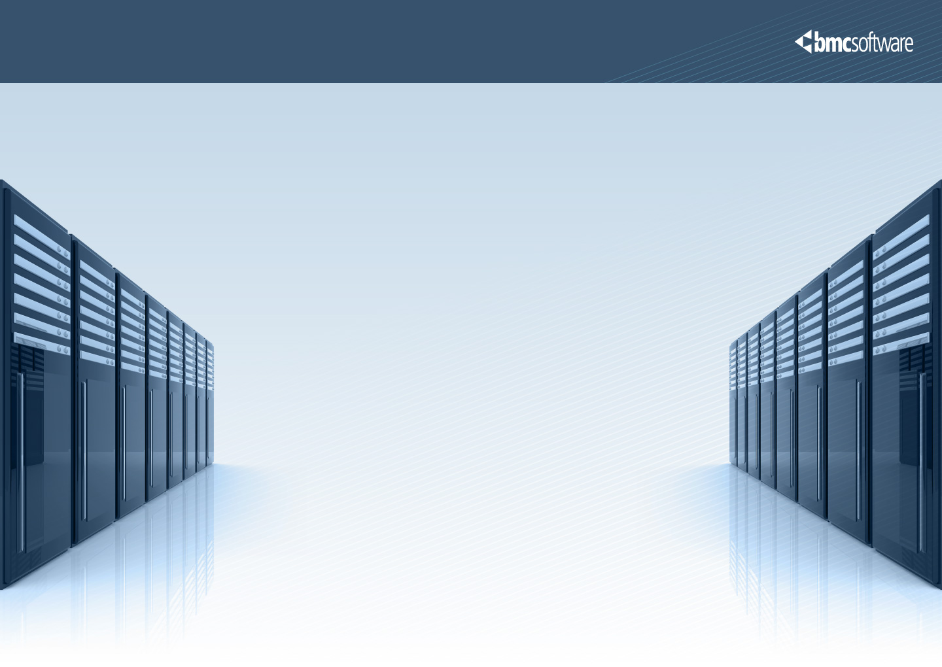
Key Takeaways from Datacenter of the Future
Managing infrastructure / applications from a Business Service viewpoint is critical
IT Organizations will have to manage both internally hosted and external services
As IT infrastructure becomes more flexible, IT managmeent needs to become more dynamic
Virtualization / Cloud computing provides greater agility and cost effectiveness while increasing complexity
Management is a key control point for the next generation datacenter
Notes:
Customer buying behavior important
Management of applications

Slide 7

IT Management Best Practices Are Now Embedded in Solutions
People
  Policy based roles and responsibilities
  Rules and monitors to ensure compliance
  Pre-defined escalations and approvals
  Process models for standardization of activities
Process
  Pre-defined integration of processes associated work instructions / tasks (manual, semi-automated, automated)
Technology
  Management for the heterogeneous dynamic infrastructure and applications

Slide 8
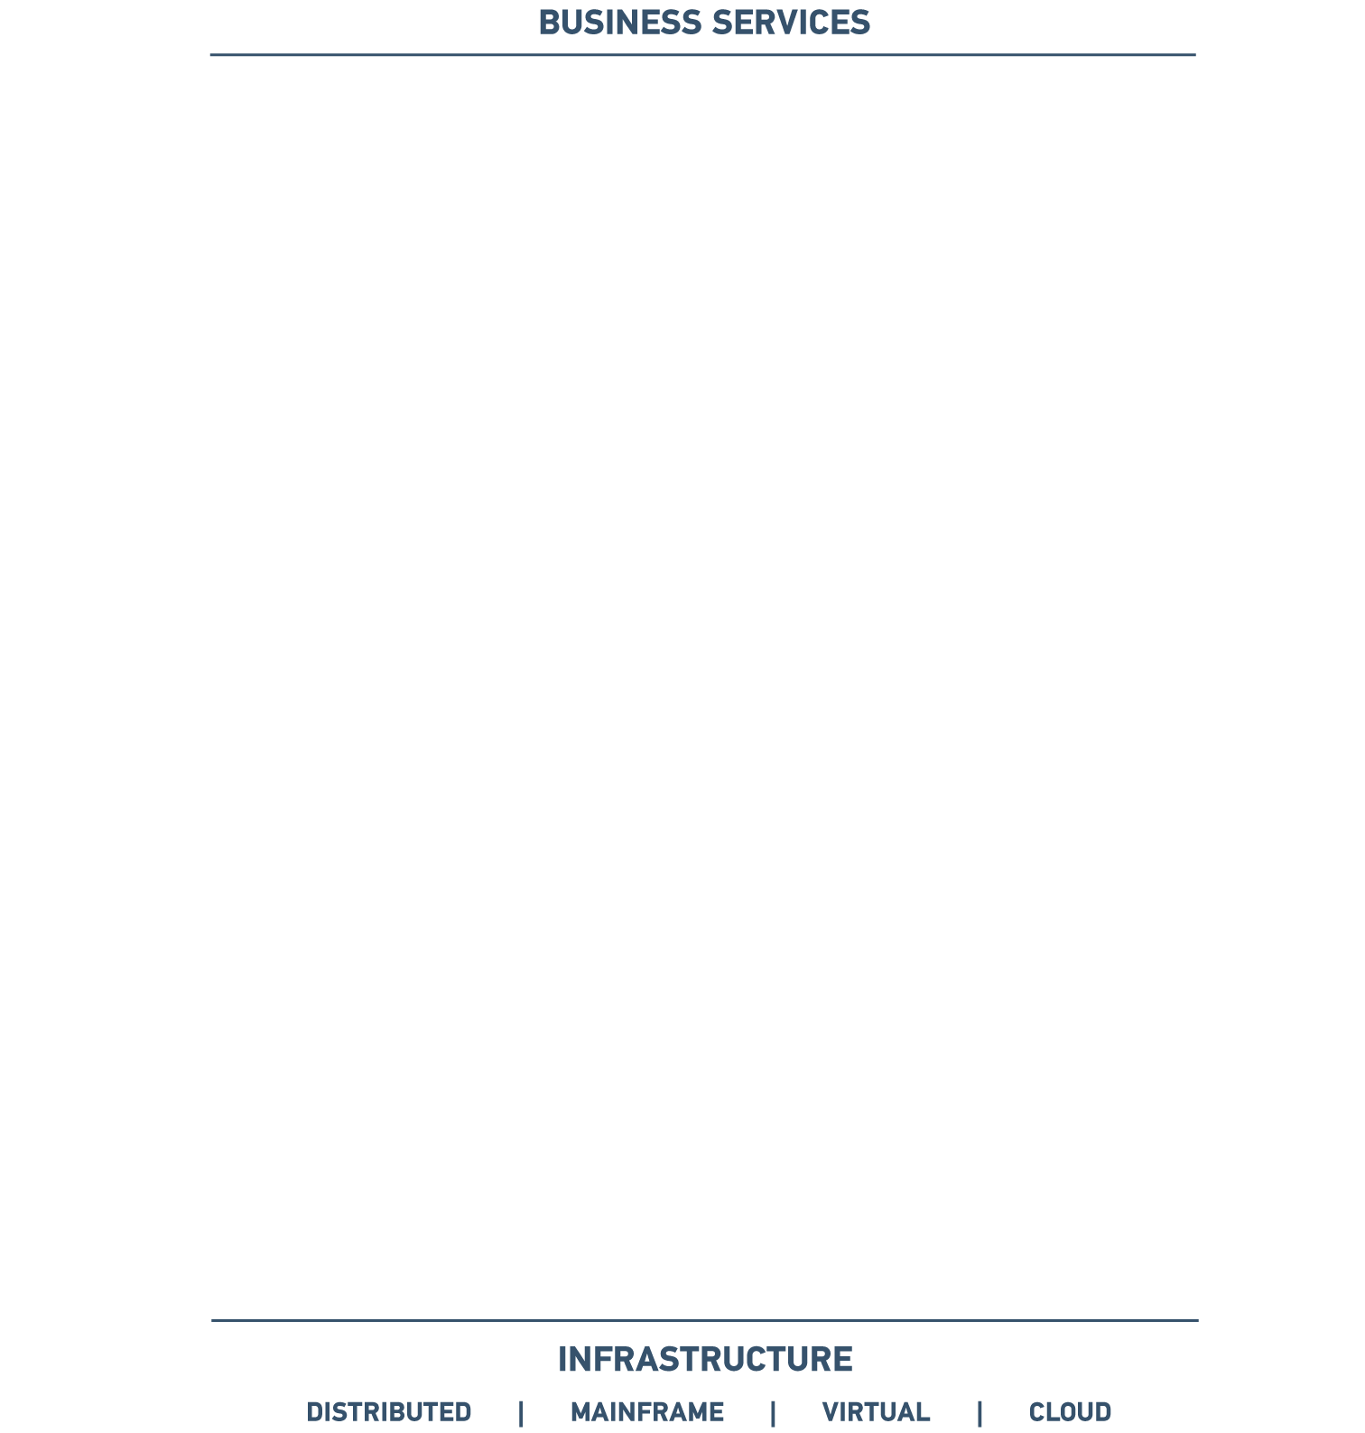
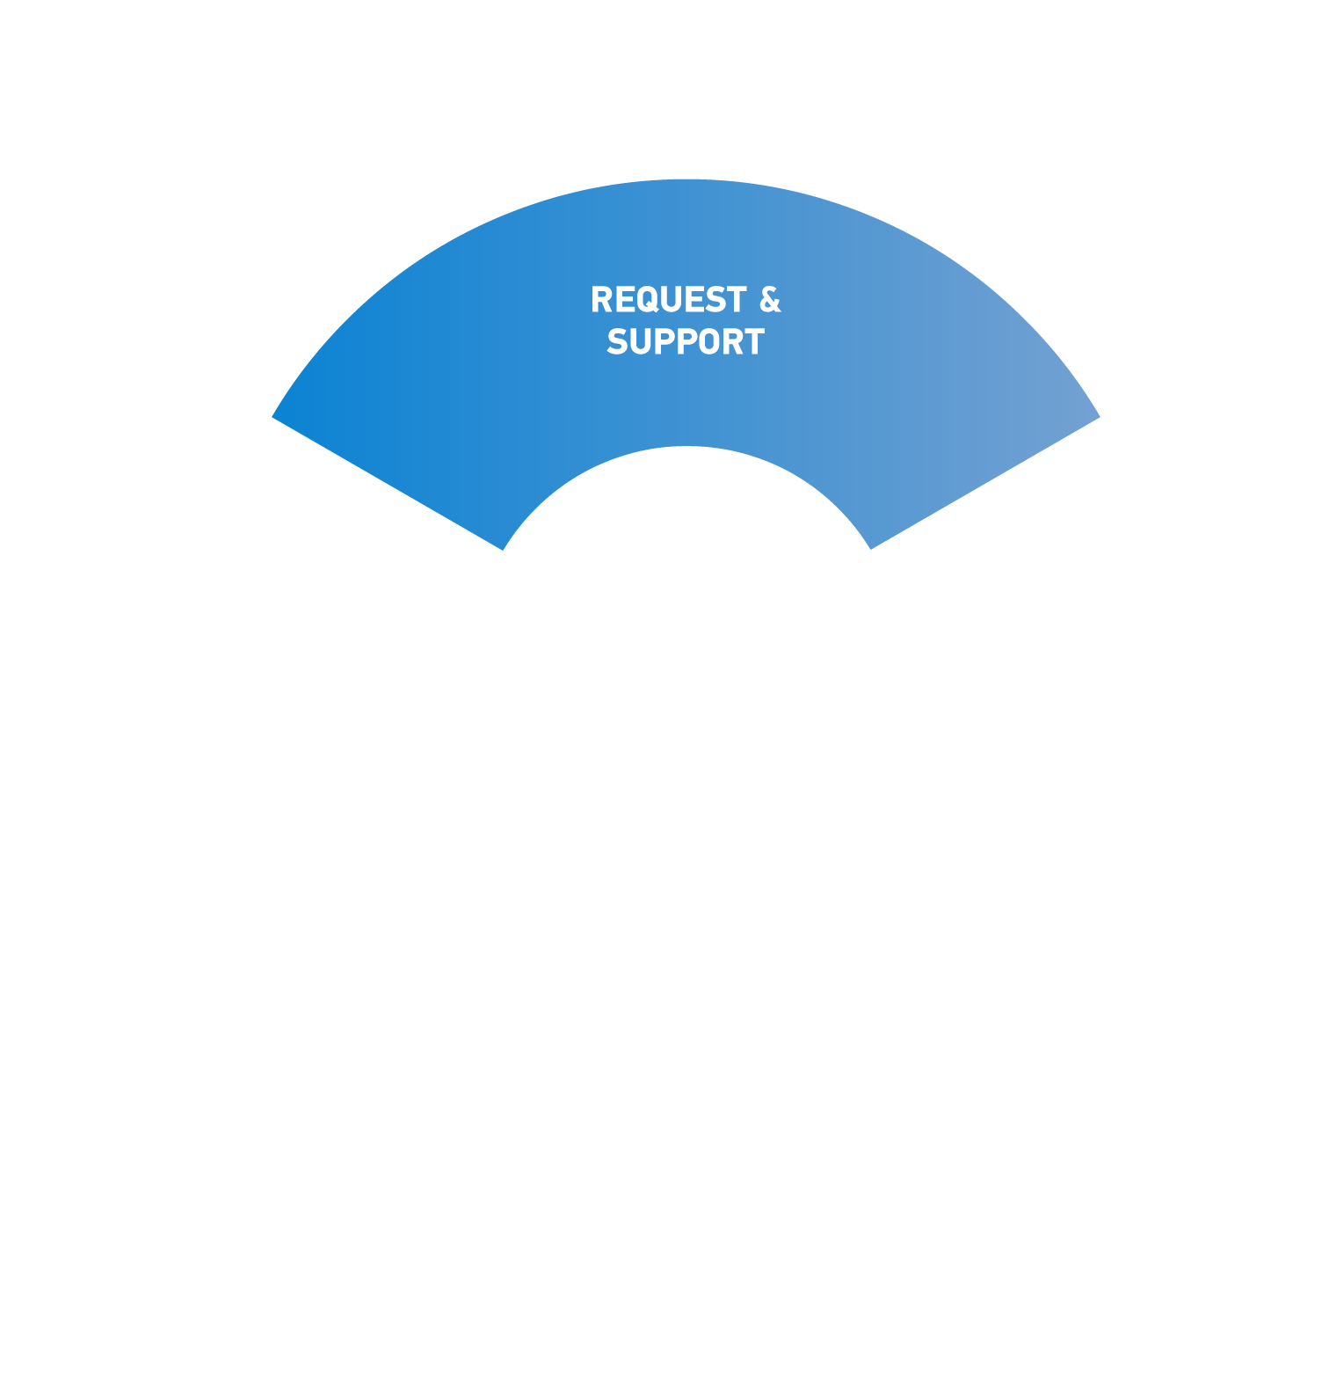
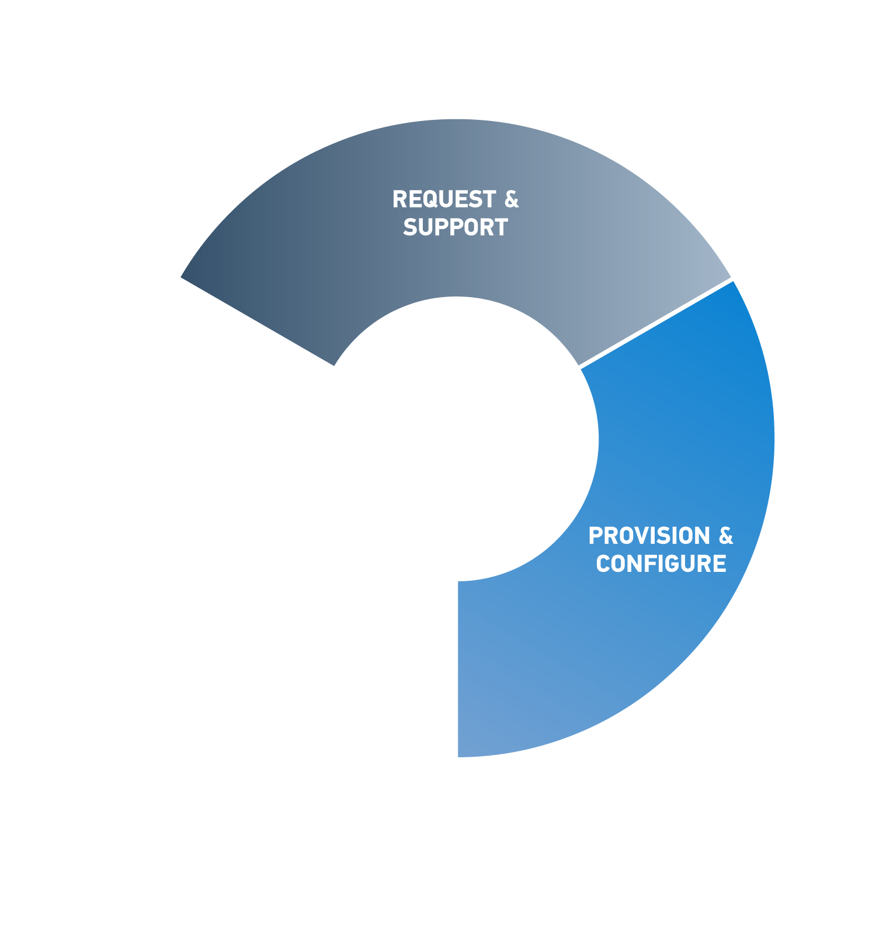
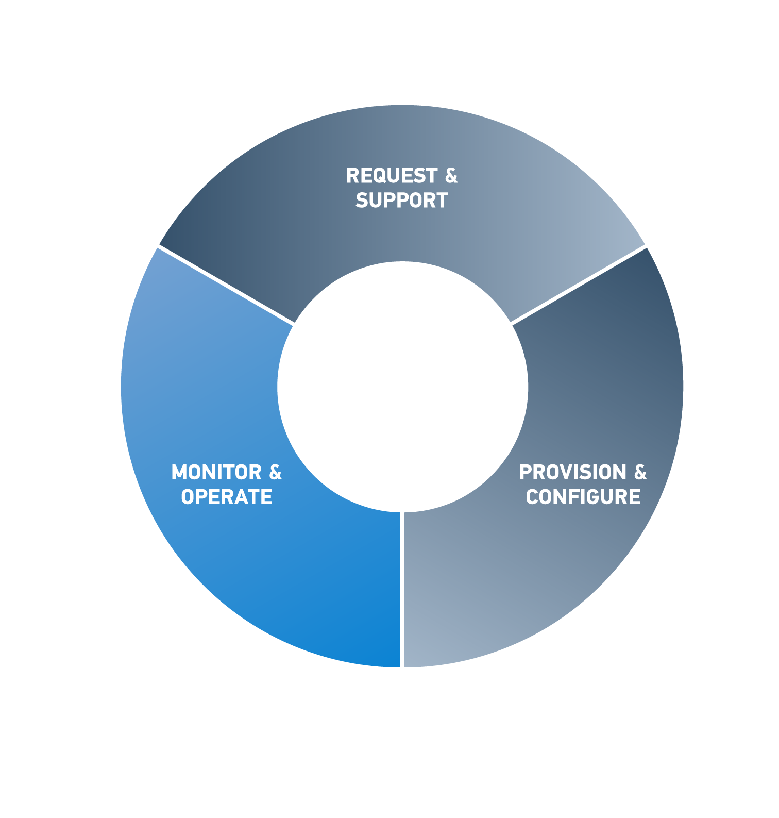
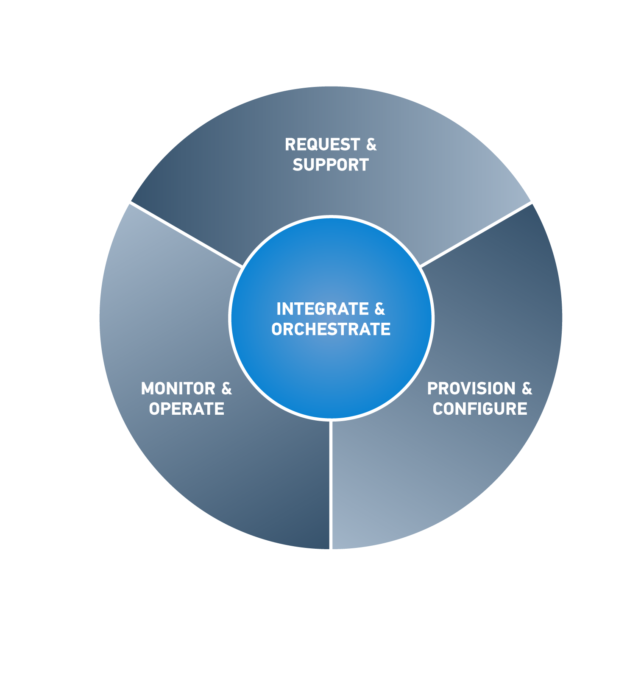
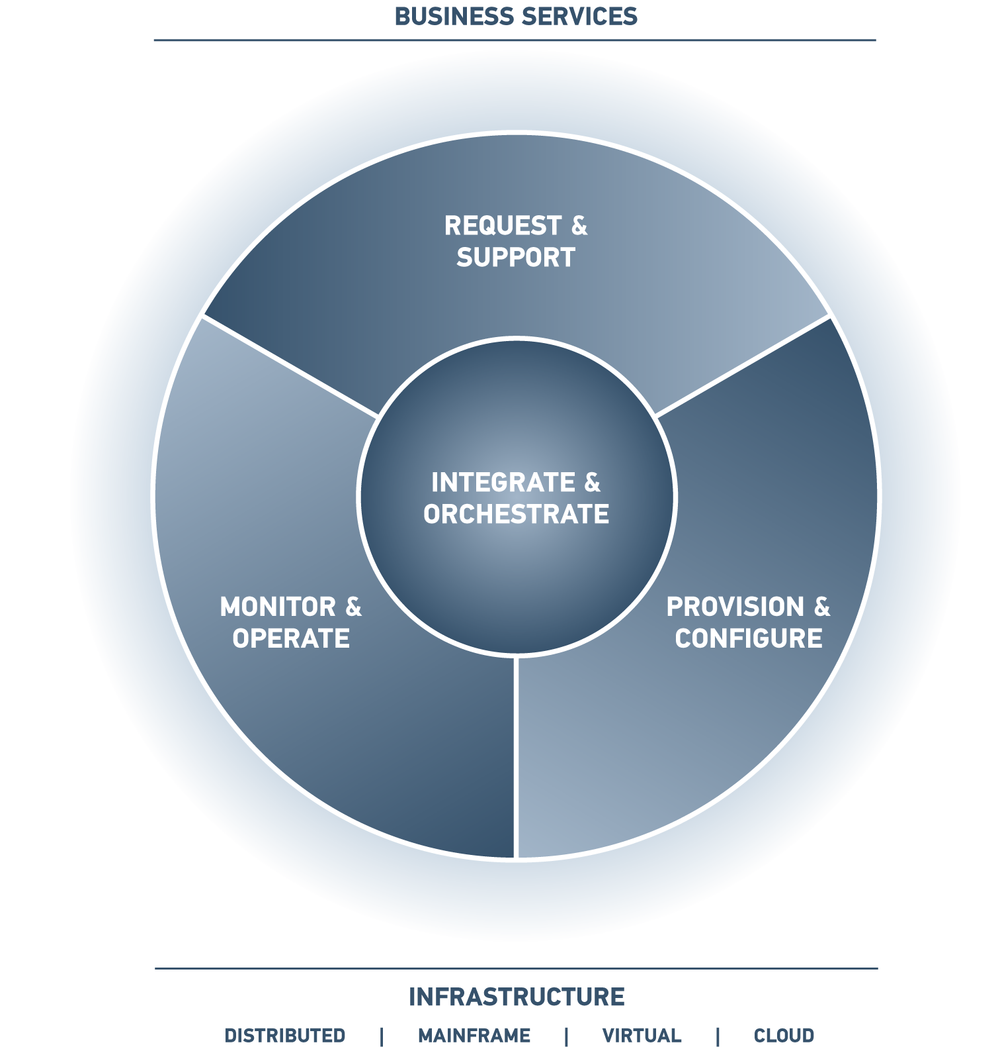

BSM simplifies and automates service management
Request, change, and support business services
Consistently deploy services across applications, servers, networks, and clients
CHANGE
NEW
FIX
Discover, model, and prioritize services to improve decisions
Federate and orchestrate data and workflow to improve efficiency
Proactively identify and resolve IT issues

Slide 9
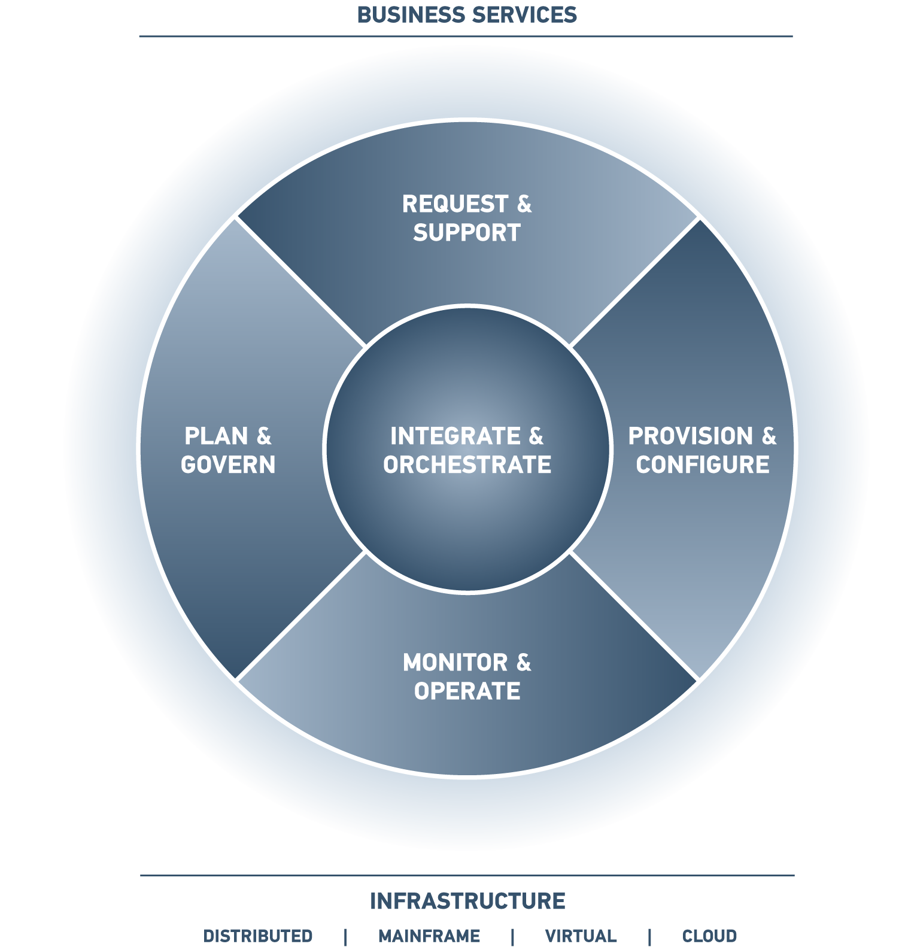
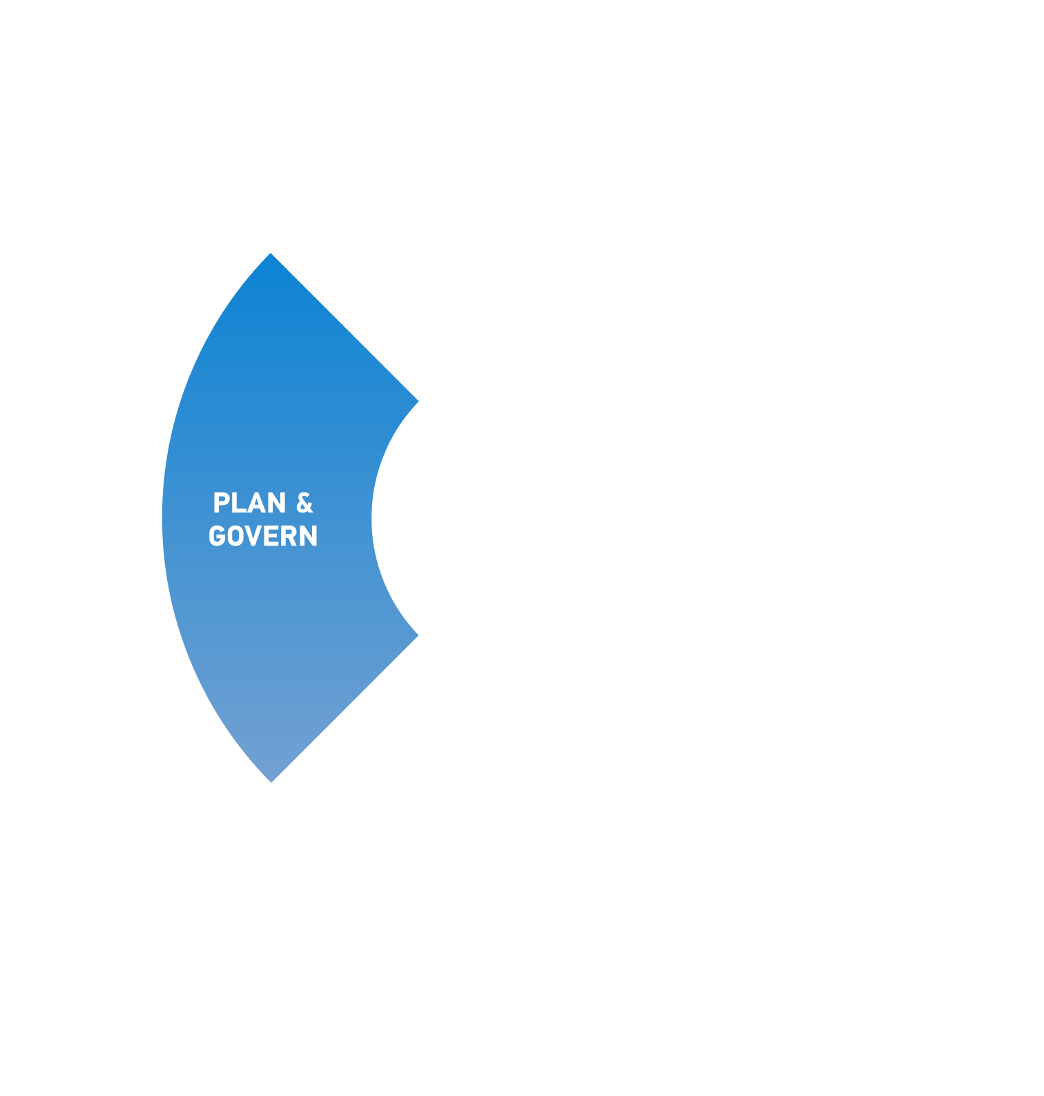
BSM unifies service management with IT planning and governance
Request, change, and support business services
Consistently deploy services across applications, servers, networks, and clients
Manage your IT supply, demand, and budget
Ensure compliance with policies and regulations
Discover, model, and prioritize services to improve decisions
Federate and orchestrate data and workflow to improve efficiency
Proactively identify and resolve IT issues

Slide 10
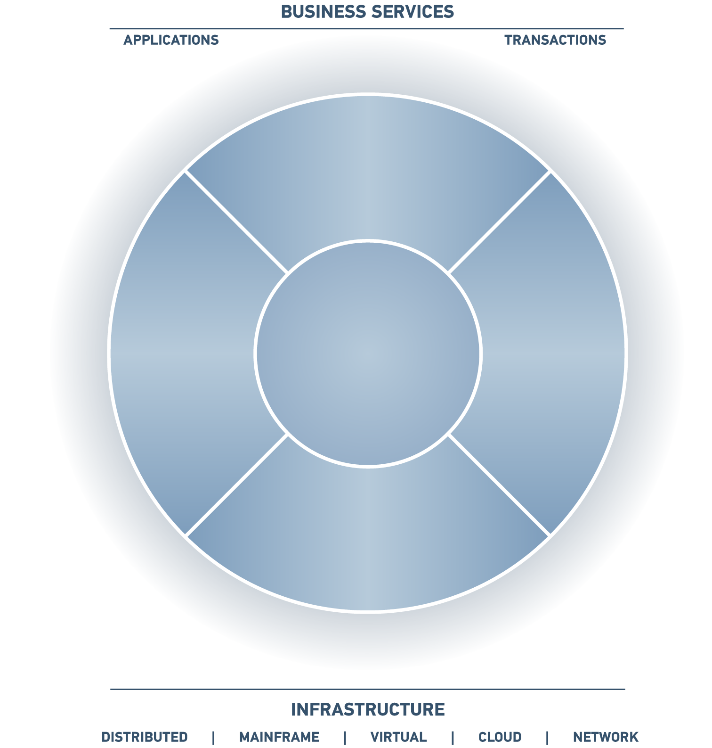





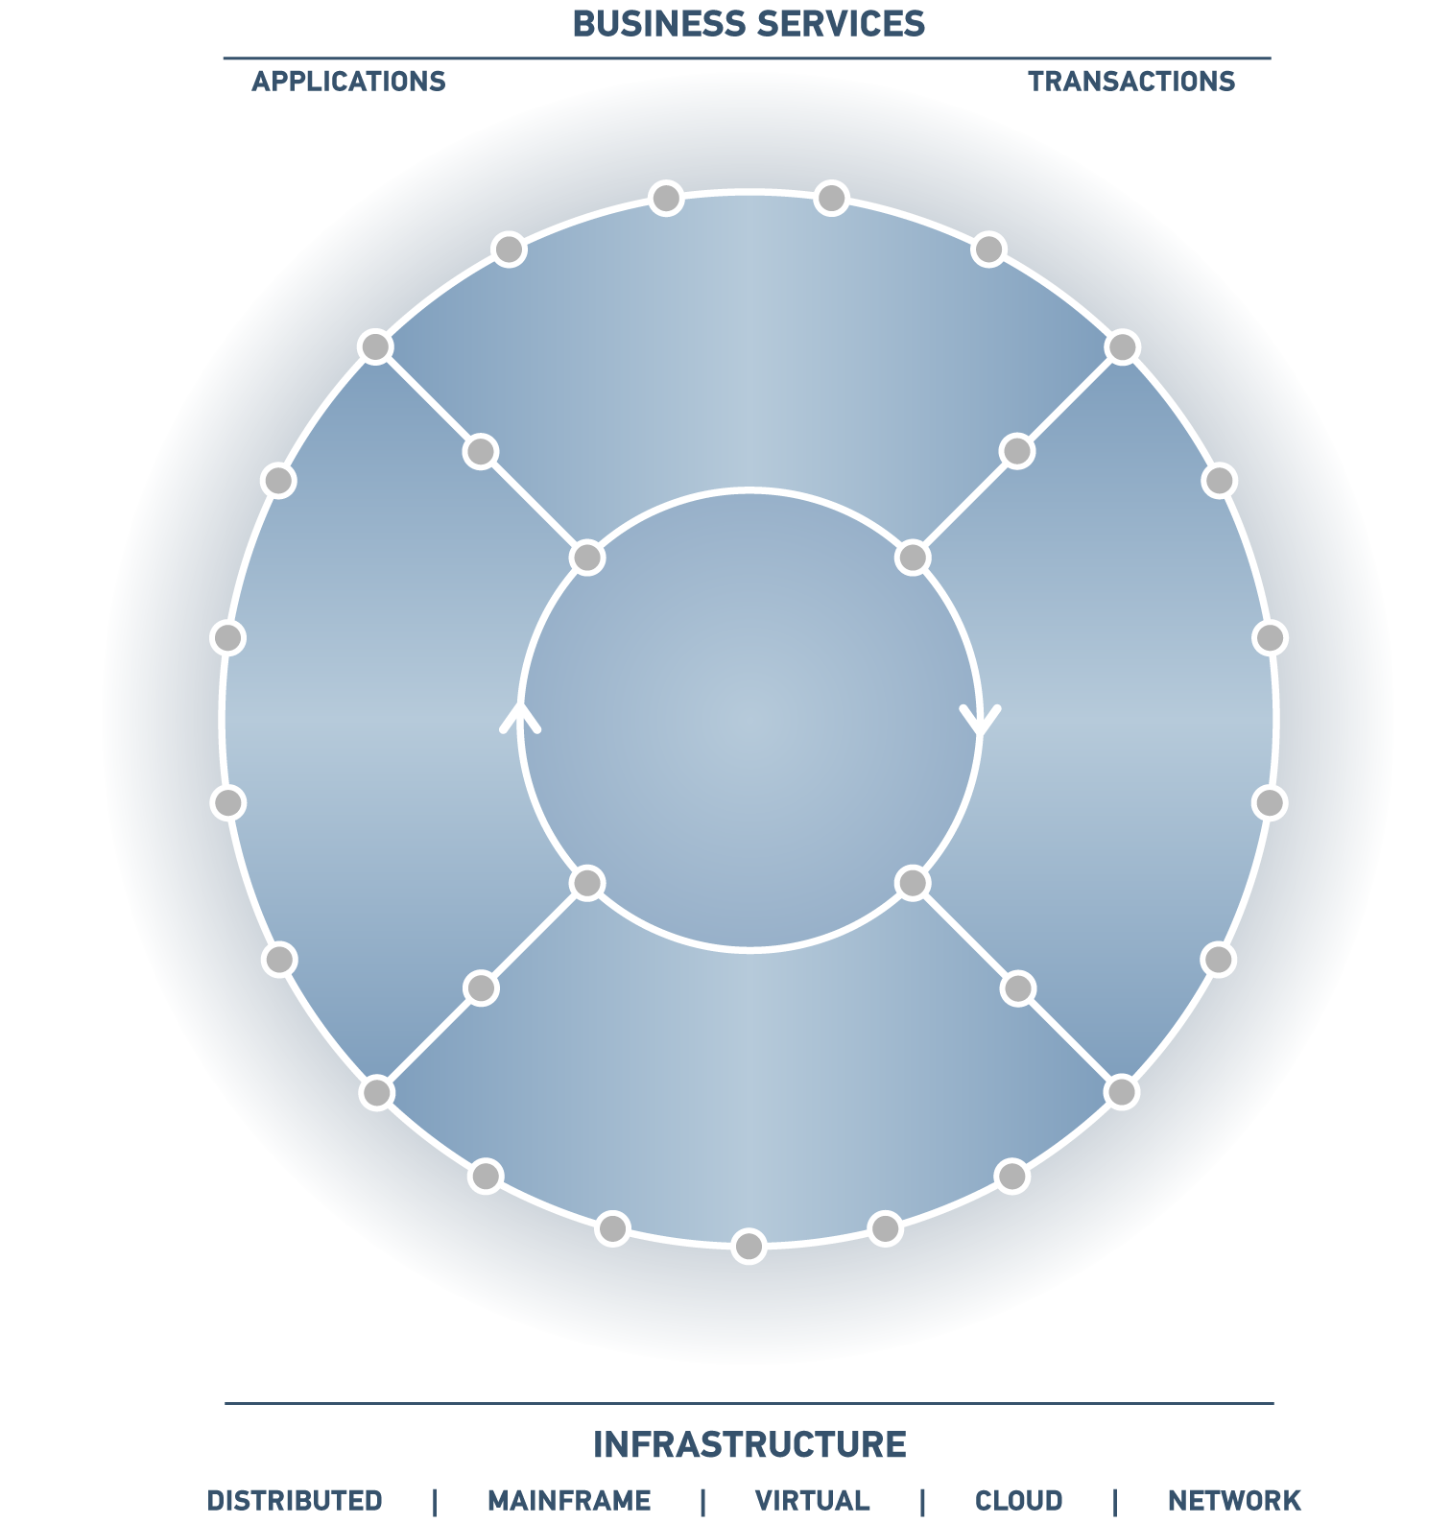

BSM is a unified platform for running IT
Incident
Management
Knowledge
Management
Service Request
Management
Problem
Management
Project &
Portfolio Management
REQUEST &
SUPPORT
Identity
Management
Vendor
Management
Asset
Management
Change & Release Management
Application
Automation
Service
Catalog
INTEGRATE & ORCHESTRATE
Discovery &
Dependency
Financial
Management
Server
Automation
PLAN &
GOVERN
PROVISION &
CONFIGURE
Human Capital
Management
CMDB / CMS
Network
Automation
Service Level
Management
Dashboards &
Analytics
Compliance &
Policy Management
Event & Impact
Management
Mainframe
Automation
Client
Automation
Capacity
Management
MONITOR &
OPERATE
Enterprise Scheduling &
Workload Automation
Storage
Management
Application Problem
Resolution
Data
Management
Performance &
Availability
Management
Middleware
Management

Slide 11
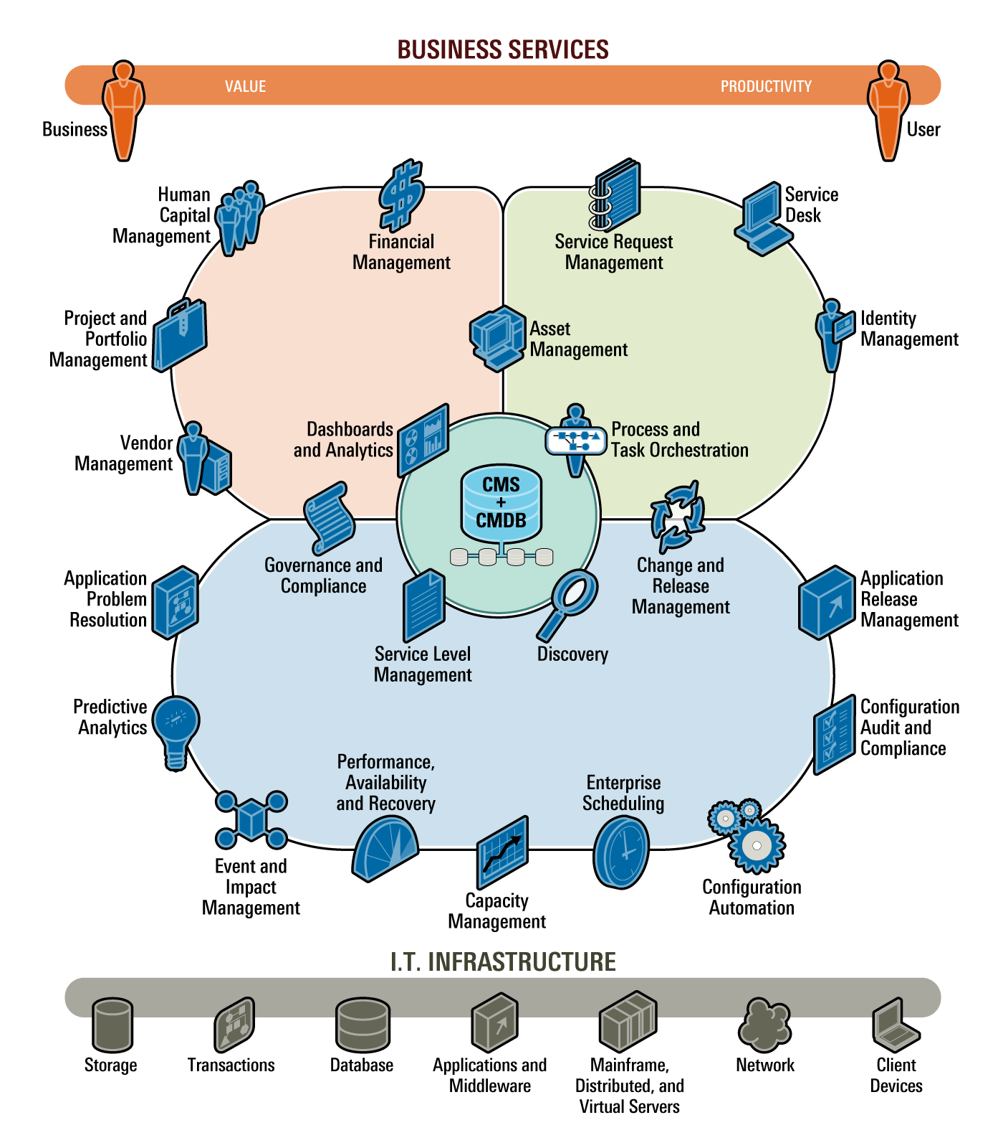
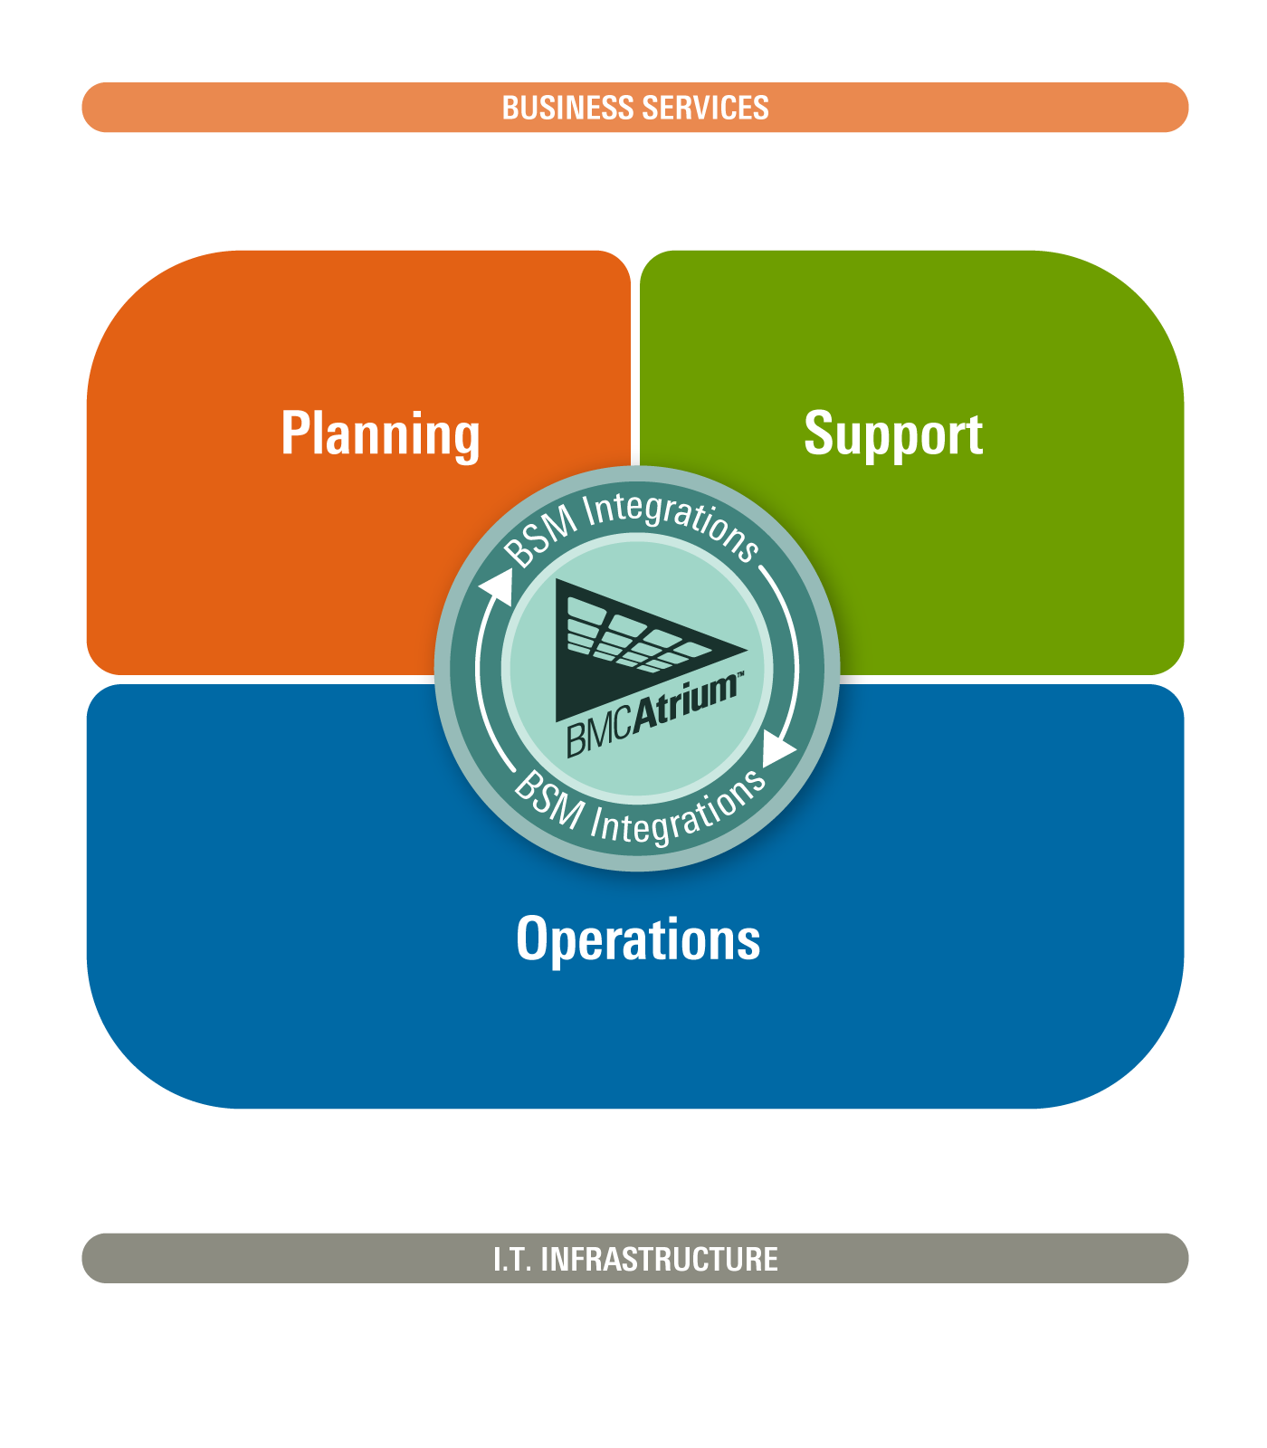
A unique offering to achieve BSM
BSM from BMC is a comprehensive approach and unified platform for running IT
Better Decisions
  Unique capability to predict IT issues and identify probable cause
  Cross-platform capacity management to minimize CapEx and plan for the future
  Complete visibility across IT activities and spend
Unique Architecture and Workflow
  The most pervasive IT management workflow platform in the industry
  Proven scalability and global language support
  Unified architecture for provisioning and compliance
Superior Coverage
  Always on, mainframe computing
  Physical and virtual environments
11
© Copyright 12/29/2014 BMC Software, Inc.

Slide 12
BSM Architectural Principles
12/29/2014
Top Down Design
  Driven by scenarios/use cases – consuming applications, processes set the required functions
Time to Value
  Installation, configuration, avoid duplication, etc.
Flexibility and Maintainability
  Backwards compatibility
Standard Solution Experience
  Consistency across BMC products/solutions
  Platform support, look-n-feel, terminology, etc.
  Multi-tenancy, security
Decoupling of Functions
  SOA approach; Decomposition / abstraction
  Support for 3rd party / competitive products
Reusability
  Technology shared across BMC products/solutions
12
Notes:
12

Slide 13
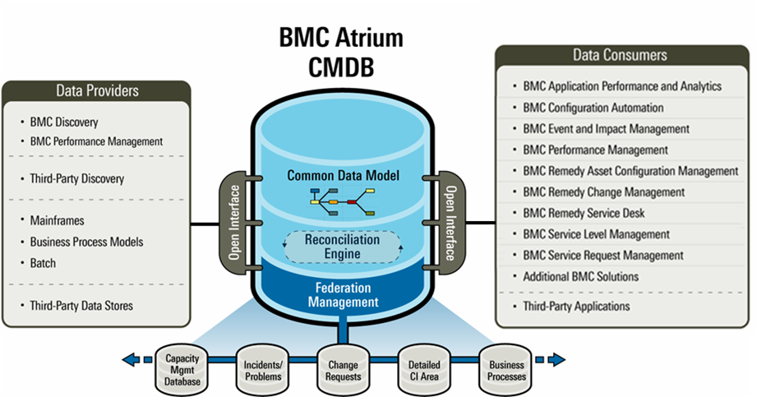
BMC Atrium CMDB
Single Source of Truth

Slide 14












Service Assurance: Scope of Automation and Compliance for Virtual Environments
Service Provisioning, Bi-directional Integrations with Change Mgmt, Asset Mgmt, Service Request Mgmt
Application Modeling and Discovery, Application Packaging, Secure Environment Promotion and Deployment
Provisioning, Patching, Software Distribution, Configuration Compliance and Remediation, Remote Administration
Configuration Compliance and Remediation, Virtualized Adhoc Administration (Start, Stop, Pause, Delete, Move etc.)
AIX LPAR
Solaris LPAR
Linux VM
Win 2008
Solaris 10, IBM Aix, HP-UX
VMWare ESX, MS Hyper-V, Xen, KVM
Bare Metal Provisioning, Patching, Configuration Compliance and Remediation

Slide 15
Service Assurance: Scope of Performance and Availability for Virtual Environments
Real-Time Analytics, Service Level Mgmt, Event and Impact Management
End User Response Monitoring, Comprehensive Application Monitoring for packaged and custom applications
Infrastructure Monitoring (Disk, Services, OS Parameters)
Monitor Workloads, Resource Pools, Clusters
AIX LPAR
Solaris LPAR
Linux VM
Win 2008
Solaris 10, IBM Aix, HP-UX
VMWare ESX, MS Hyper-V, Xen, KVM
Monitoring the physical servers as well as the virtualization infrastructure

Slide 16
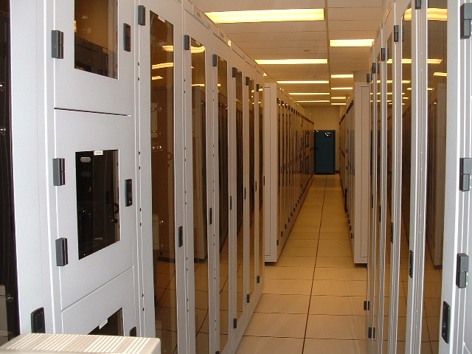
Virtualization
Management
Notes:
16

Slide 17
BMC Virtualization management strategy tenets
Address Customer needs at all levels of virtualization adoption from consolidation to cloud
Unified heterogeneous physical and virtual Mgmt
“Full Stack Mgmt” (Business Services, Apps, VM, HW)
Deep Integration with Infrastructure Vendors
Comprehensive, Integrated, Modular Solutions

Slide 18
Virtualization customer maturity profile
Maturity
Key Attributes
Key Challenges
Level 3
Shared Virtual Computing
(Cloud / Utility)
60 – 100% Virtual
Standardized Virtual Machines and apps with embedded mgmt
Enforce service levels by allocating resources based on QoS
Dynamic workloads based on seasonality, business needs
Service Catalog based automated provisioning
Applications run on shared, not dedicated, infrastructure
Defining IT Offerings and CoS
Identifying appropriate workloads for the cloud
Policy Governance
Internal and External clouds
Level 2
“Virtual First” policy – new hardware on exception basis
Processes and tools optimized for virtual environment
Establish Standard Configs for Applications and VM’s
Automated Service Provisioning
Manage Performance Service Levels
VM Sprawl
Enterprise scale
App + VM + Com + Net + Storage
V-Motion sickness
Physical and Virtual Mgmt
Migration to Virtual Datacenter
30 - 60% Virtual
Managing Mixed Environments
0 - 30% Virtual
Level 1
Focus on consolidation of physical servers
Unified management solution for virtual and physical environment
Apply existing processes to virtual computing
Performance Management
Capacity Management
Processes do not support agility, shared infrastructure model well
OPEX associated with admin
Physical and Virtual Mgmt
Notes:
80% are in level 1 and 2-% are in level 2 -3
In3 years it would

Slide 19


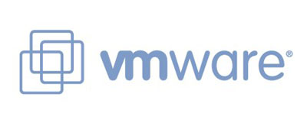


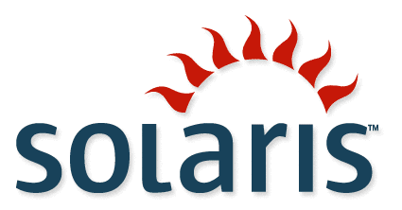
BSM for Virtualization
Unify management of physical and virtual environments to gain control of your infrastructure
Virtual Lifecycle Management
Virtual Performance Management
Virtual Compliance Management
Private Cloud Computing
BUSINESS SERVICES
APPLICATIONS TRANSACTIONS
Incident
Management
Service Request
Management
REQUEST & SUPPORT
PLAN &
GOVERN
INTEGRATE & ORCHESTRATE
PROVISION &
CONFIGURE
Service
Catalog
Application
Automation
Change & Release Management
Financial
Management
Server
Automation
Service Level
Management
CMDB / CMS
Discovery &
Dependency
Network
Automation
Compliance &
Policy Management
MONITOR & OPERATE
Client
Automation
Event & Impact
Management
Capacity
Management
Enterprise Scheduling &
Workload Automation
Performance &
Availability
Management
INFRASTRUCTURE
DISTRIBUTED MAINFRAME VIRTUAL CLOUD NETWORK
Notes:
19
Slide objective: Highlight Value Paths for Data Center Automation
Key points:
-- data center automation is designed to provide policy driven and operator assisted automation of processes and technologies
-- the value of doing this is to reduce the manual tasks and effort required to deploy and update services, as well as reducing errors associated with change
-- our customers seem to have five consistent paths for achieving data center automation, which are present on the left-hand part of the slide
-- customers like Carfax have been able to reduce job scheduling effort by up to half, and companies like Virgin media have been able to reduce their server build time by 96%
Sample Delivery:
Data center automation is one of the most frequent initiatives we see our customers going through, and we've seen both innovative and effective efforts, as well as automation efforts that have not delivered on requirements. Most of our customers are pursuing these automation initiatives for economic reasons -- reducing the cost of IT by reducing the amount of manual effort required to perform repetitive tasks. At the same time, we see IT organizations pursuing data center automation to remove the errors associated with introducing change into IT.
We seen five clusters of activity taking shape around data center automation initiatives:
-- configuration automation: providing and executing policies that propagate application and system configurations to target systems and applications
-- compliance automation: automating the process of understanding the current state of IT. What's out there, and what is it running?
-- event automation: automating the handling of a wide range of events
-- job scheduling and workload automation: automating the process performing job scheduling in managing workloads, primarily on mainframe environments
-- mainframe automation: automating a complex series of mainframe tasks
We've had proven success with our customers that have taken all of these paths. For example, CARFAX has reduce their ever required to manage job schedules by nearly 50%. Virgin media has been able to reduce the time and effort required to build and provisioning server by 96%.

Slide 20






Virtual Lifecycle Management: Defined
Full visibility and control of VM creation, operation, and retirement
Avoid VM sprawl, Control changes, Enforce VM decommissioning
X
Creation
Operation
Retirement
Notes:
Definition:
Creation: VM creation is typically done by “cloning” a VM template (this is what’s represented by the diagram). This cloning can be performed in literally 60 seconds, leading to rapid and uncontrolled proliferation of VMs
Operation: Standard management tasks for a server. VMs have some special things about them – for example they can move from one host to another (for VMware, this is called “VMotion”). BMC uniquely has the ability to detect these Vmotion events, and automatically (in near-real-time) update the CMDB.
Retirement – IT needs a structured process to ensure that VMs are retired and their resources reclaimed.
Messaging for this value path:
Situation — One of the most common challenges that organizations see as they begin using virtualization is a lack of control over how virtual machines are created and deployed.
Complication — This lack of control — coupled with the business need for IT agility — often leads to a rapid proliferation of deployed virtual machines with a very poor level of visibility into the inventory of what’s out there.
Implication — Without controlling the process of deploying, changing, and retiring virtual machines, IT organizations will be unable to manage an exponentially increasing number of virtual machines.
20

Slide 21


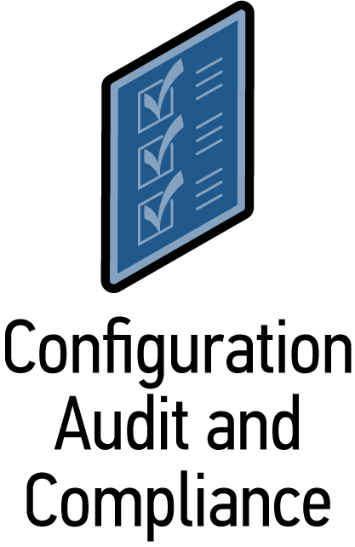
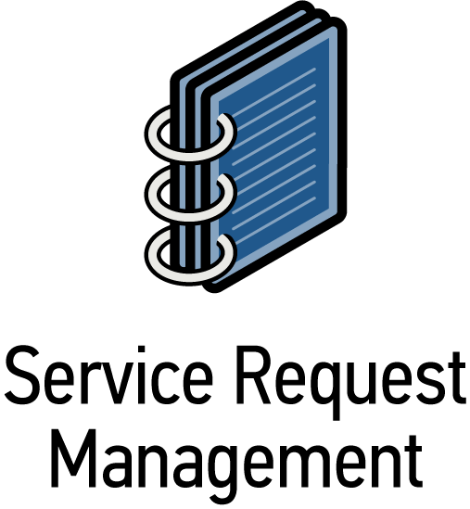



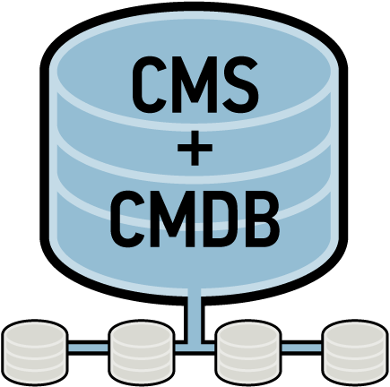





Service Lifecycle View
Requester
Customer
Portal
Service Request Portal
Atrium
Orchestrator
User role and policies determine services available for requesting
Physical
Unified Service Definition:
Offerings
Cost
Tiers
Service Catalog
BMC Bladelogic for Apps, Servers and Networks
Remedy
Change
Release
Mgmt
Virtual
3rd Party
Systems
Virtual Center,
VMware Lifecycle Manager
BMC Bladelogic Application Release Mgmt
Development
QA
Cloud
Application Parameterization and Release
Cloud API

Slide 22


BSM enables cross-IT workflow
BUSINESS SERVICES
Service-Driven Provisioning
Service Request
Management
Rapid provisioning of services
Simplified and standardized interface for common requests
Automated configuration
Repeatable, auditable process
REQUEST & SUPPORT
PLAN &
GOVERN
INTEGRATE & ORCHESTRATE
PROVISION &
CONFIGURE
Application
Automation
Change & Release Management
Server
Automation
CMDB / CMS
Network
Automation
Time to deploy new services improved by more than 50%
MONITOR & OPERATE
INFRASTRUCTURE
DISTRIBUTED MAINFRAME VIRTUAL CLOUD NETWORK
Notes:
22
Describe how BSM operates as an integrated system when enabling self-service driven provisioning. Give the examples of simple IT services (such as requesting a web server or database server) or more complex services (such as on-boarding a new client)

Slide 23

BSM for Virtualization Management Today
Unified service level mgmt
Shared Service Catalog
Auto discovery of heterogeneous virtual environments and application dependencies
Link business services, apps to dynamic virtual infrastructure
Orchestration / Automation of virtualization administration tasks
Service Request Management for Self-Service
Change Release Mgmt optimized for Virtual environments
Expanded Asset Mgmt capabilities for Virtual Assets, new licensing models
REQUEST & SUPPORT
BUILD &
CONFIGURE
PLAN &
GOVERN
UNIFY & ORCHESTRATE
CMDB / CMS
Predictive intelligence across virtual and physical environments
Manage service levels across physical and virtual
“Full stack” performance and availability monitoring
Heterogeneous Capacity Mgmt (P2V, V2V)
MANAGE & OPERATE
Service Provisioning / De-provisioning
“Full stack” configuration automation
“Full stack” compliance enforcement
“Full stack” administration with RBAC
23

Slide 24

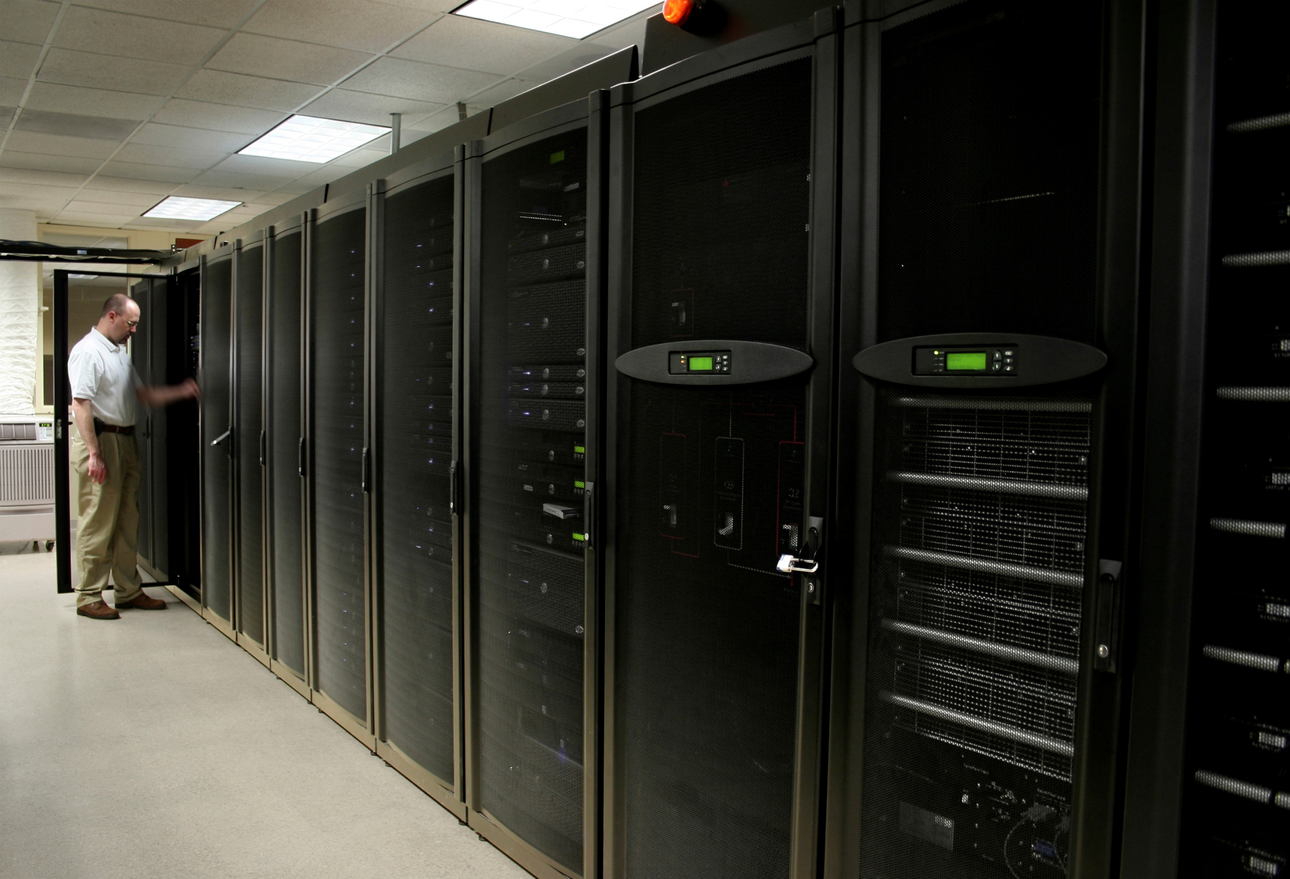
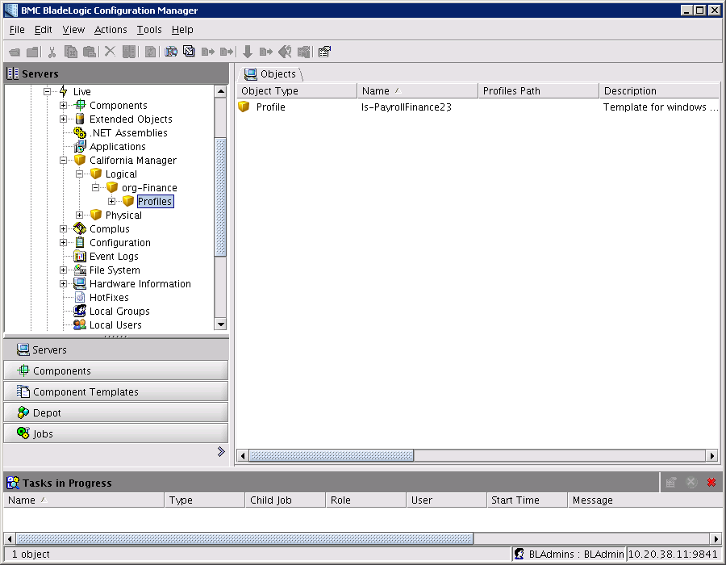

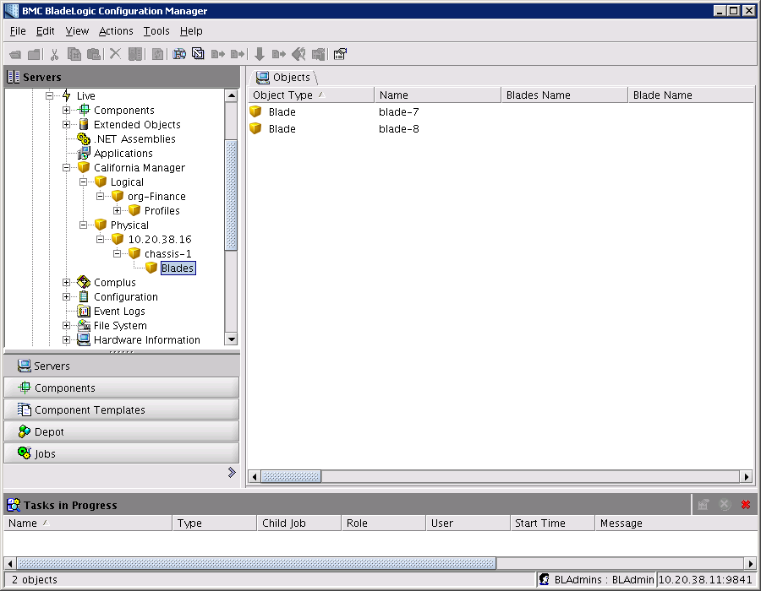


BMC BladeLogic for Cisco Unified Computing System
35% Reduction in Opex through IT Process Automation
Virtualization
Platform
Hypervisor
Optimization
with VN-Link
Resource Scaling
With Intel Nehalem
Dynamic
Provisioning
Compute
Platform
Network
Platform
BMC BladeLogic for UCS delivers
Operational Savings:
Fewer FTE/Service
Faster Provisioning
Seamless Repurposing
Better Coordination
Fewer IT Failures
Unified Fabric
with Nexus Series
Notes:
24
24
24
24
24
Turnkey solution that is pre-built, tested, and serviced as an integrated product for the virtualized Data Center
Unified Computing is the intersection of the platforms
Executed within open standards and a robust partner ecosystem, Unified Computing:
Scales service delivery - accelerating the delivery of new virtualized services simply, reliably and securely
Radically reduces the number of devices requiring setup, management, power/cooling and cabling
The Unified Computing architecture enables software provisioning and automation of the deployment of new workloads, workload portability across the system, and consistent systems management and accounting.
The IT department will still own and control the assets; but their role will evolve from the physical deployment of new assets to the logical configuration and provisioning of software defined virtual assets while deploying capacity not per application, but for the aggregate needs of the business.
By establishing an open architecture that understands the intersections and interdependencies, significant TCO improvements can be realized in:
Data center facilities
Platform integration issues
Organizational process refinements
The result: Unified Computing dramatically reduces data center total cost of ownership while simultaneously increasing IT agility and responsiveness

Slide 25
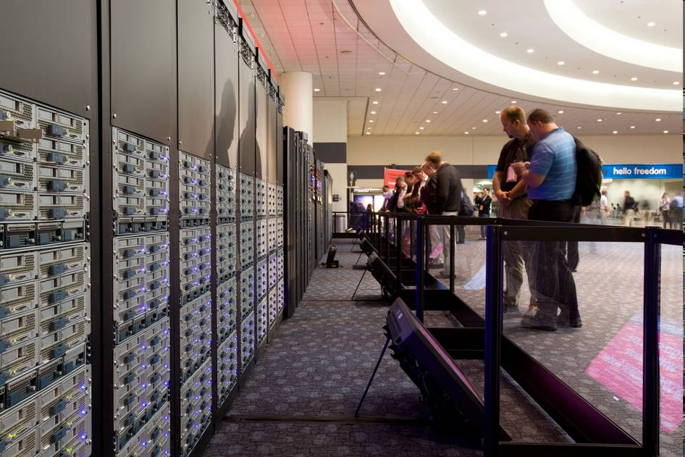
VMWorld 2009 Datacenter – San Francisco
512 Cisco UCS Blades
Other HW from EMC, NetApp, HP
28 racks, 6,208 processor cores
37 TB RAM
776 ESX Servers
348 TB disk storage
37,248 Virtual Machines
Provisioned, Configured and Managed by BMC

Slide 26

Forecast is:
Sunny
with Clouds
Notes:
26

Slide 27

Clouds – The Real Transformation
Drastically reduce “time to change” infrastructure and services in response to demand
Increase visibility of IT infrastructure and how it ties to business results
Reset IT cost structures
  Move ongoing IT demand and consumption to a variable cost structure
  Free IT from viewing everything as massive fixed cost
Enable a more precise, commoditized approach to service sourcing

Slide 28

Enterprise Clouds – Next-eneration Datacenters
A tool for agility, productivity and cost effectiveness
Leading IT organizations are looking to optimize the benefits of
public and private clouds through hybrid cloud strategies
Organizations are looking for many of the benefits of public cloud services, but with the control and compliance they require
Private Cloud = Service Enabled, Highly Virtualized, Highly Automated
Self-Service – empower users
Agility – fast provisioning
Elastic – resources as needed
Utilization – high resource use
Shared – multi-tenancy
Granular usage metering

Slide 29
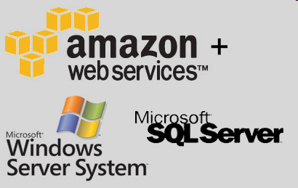






Benefits of Public Cloud Infrastructure Services
...and Challenges
On-Demand provisioning
“Pay as you go”
Self-service portals
Perception of unlimited resources
Avoidance of Capital Expense
Less Operational Expense
Challenges
  Compliance, Security, Privacy concerns
  Not suitable for all applications and workloads
  Economics and QOS requirements have to be evaluated for each use case
  Often consumed outside of normal IT process and governance requirements

Slide 30

BMC’s role in Private Clouds
BUSINESS SERVICES
Enable and Manage Private Cloud Environments:
  Request / Support: Establish Service Catalog with tiered classes of service and offerings
  Build: Change, Release, Provisioning, De-provisioning, Configuration, Automation
  Management: Capacity, Performance, Incident, Problem Management
  Govern: Discovery and Asset, Audit and Compliance Management
  Integrated: Solution extends to the rest of your virtual, physical environment
REQUEST & SUPPORT
INTEGRATE & ORCHESTRATE
PLAN &
GOVERN
PROVISION &
CONFIGURE
MONITOR & OPERATE
INFRASTRUCTURE
DISTRIBUTED MAINFRAME VIRTUAL CLOUD NETWORK

Slide 31


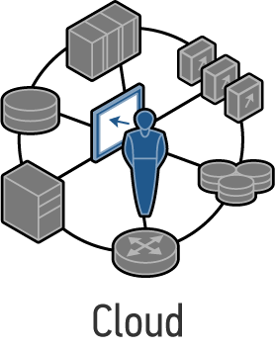
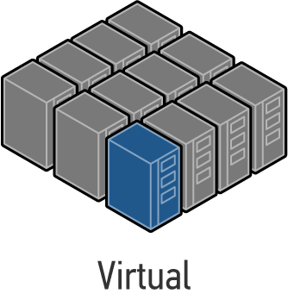
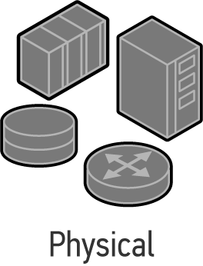
BMC’s Role in Clouds
REQUEST & SUPPORT
Enable Service Providers to deliver new Cloud Offerings:
Key features for reliability, scale, security demanded for service providers:
  Request / Support: Establish multi-tentant Service Catalog with tiered classes of service and offerings
  Provision and Configure: Multi-tenant change and Release Management, Multi-tenant CMDB, Application Release Mgmt, Provisioning, De-provisioning, Configuration, Automation
  Monitor and Operate: Capacity Management, Application Performance Management, Proactive analytics
  Govern: Discovery and Asset, Audit and Compliance Management, Service Level Management
  Integration and orchestration: Ability to integrate with 3rd party systems mgmt, billing systems and customer portals
INTEGRATE & ORCHESTRATE
PLAN &
GOVERN
PROVISION &
CONFIGURE
MONITOR & OPERATE

Slide 32
BMC’s Role in Hybrid Clouds
REQUEST & SUPPORT
Enable and Manage Hybrid Cloud Environments:
  Infrastructure as a Service:
    Extend enterprise processes to enable safe and efficient use of external Cloud Services
    Provision / De-provision / Secure / Administer off premise resources from a central location
    Monitor external cloud services:
      Application Performance Management
      End User Experience
  Software as a Service:
    Monitor external cloud services:
      Application Performance Management
      End User Experience
INTEGRATE & ORCHESTRATE
PLAN &
GOVERN
PROVISION &
CONFIGURE
MONITOR & OPERATE
SaaS, IAS, PAS Provider
Internal Cloud

Slide 33
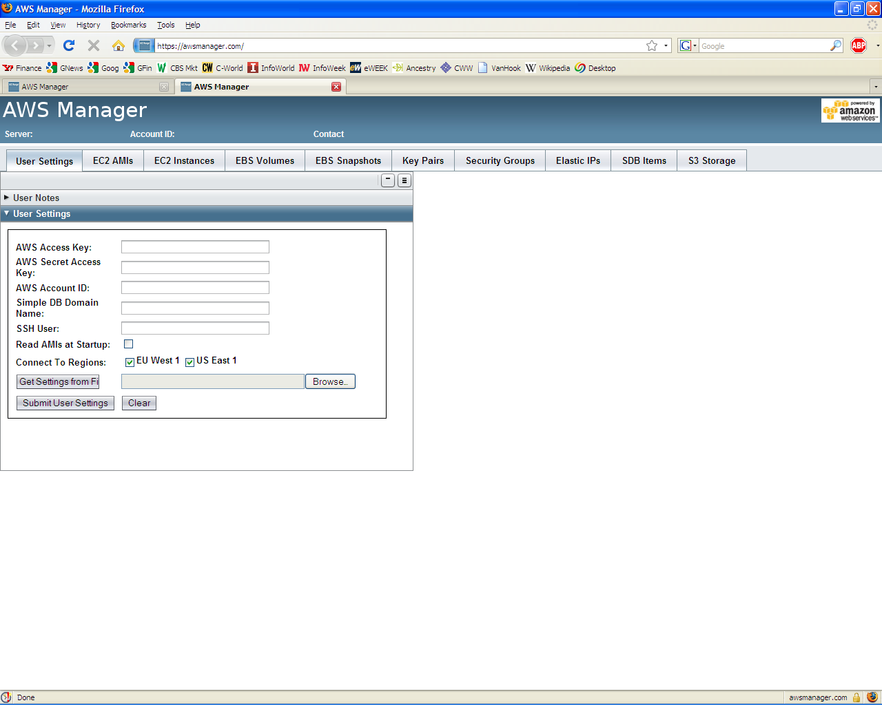
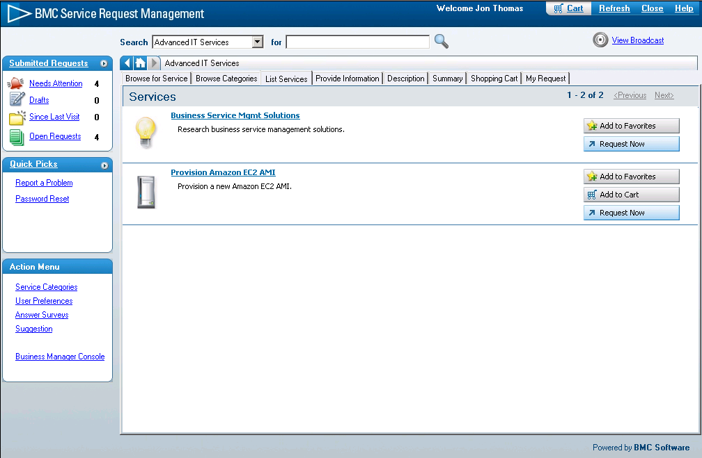
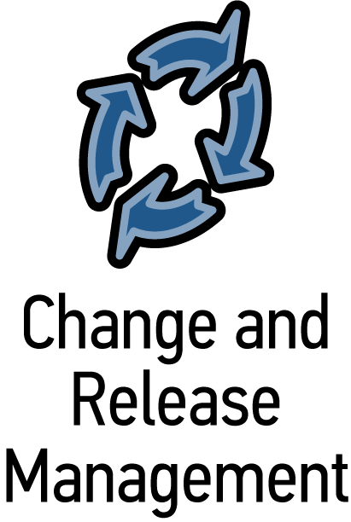
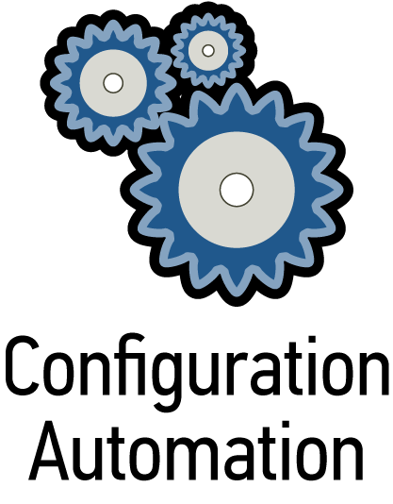
Public Cloud services: Without & with BMC
Service Request
Management
No change management
No configuration management
No compliance
No process control
No governance
Change
Management
Integrated ITIL processes
Managed configuration
Fully compliant
Full control
Single Interface
Automation
Service Provider
Service Provider
Configuration
Management &
Compliance

Slide 34
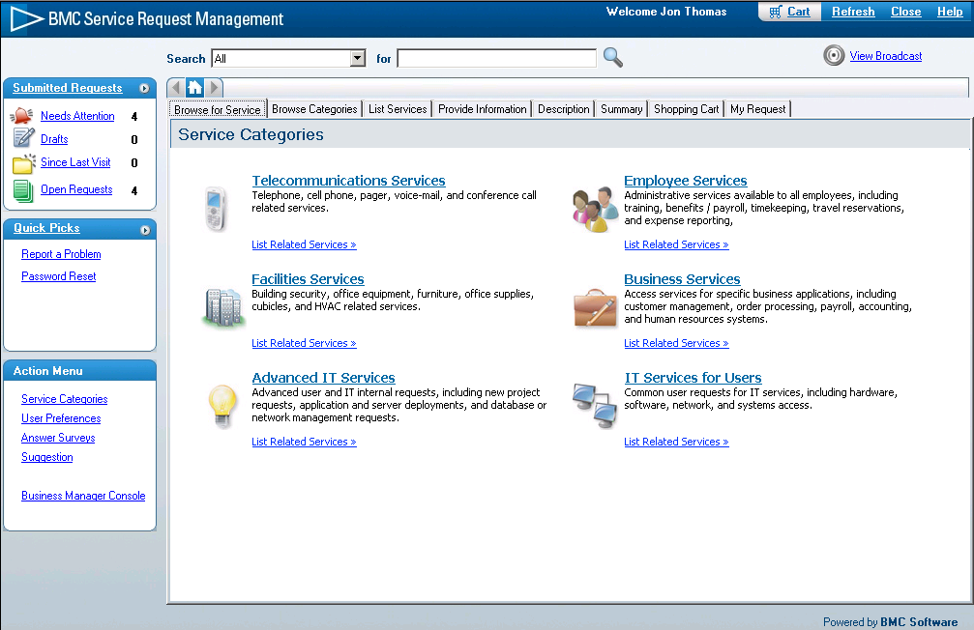
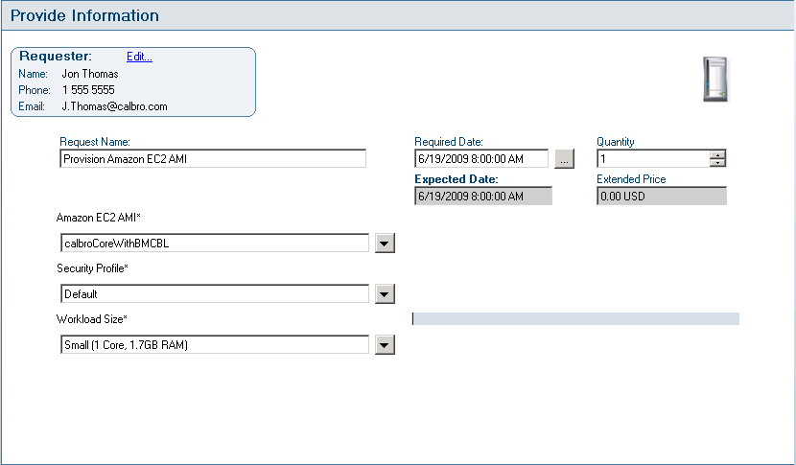



External Cloud Provisioning Use Case
Service Request Manager

Slide 35
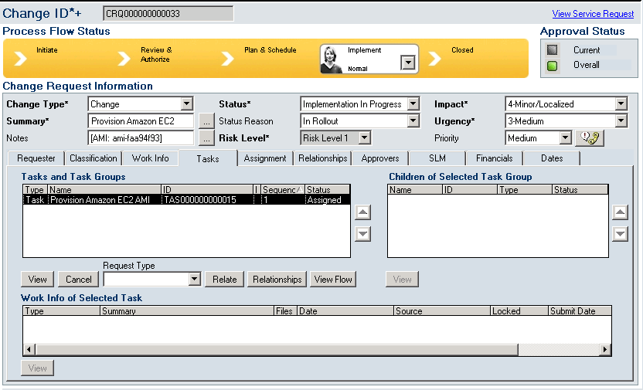
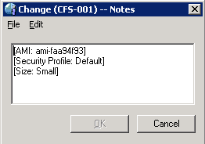

Change is automatically created

Slide 36
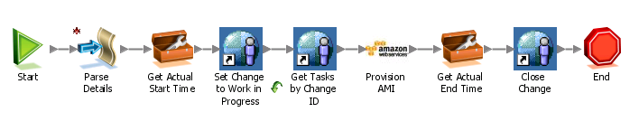
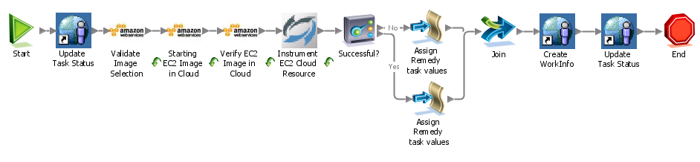
Orchestrator is automatically triggered

Slide 37
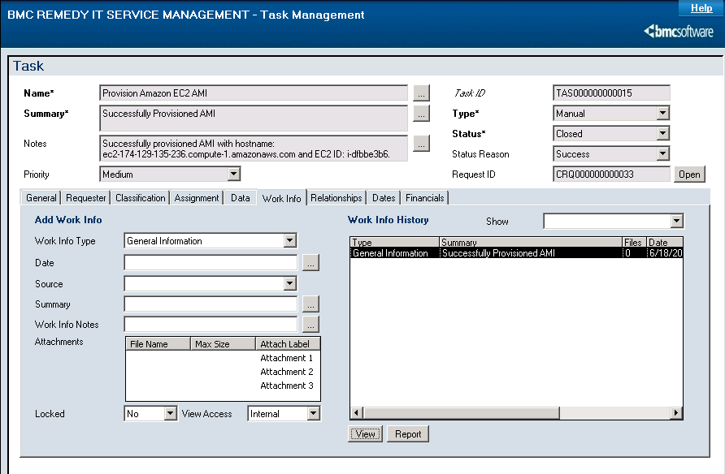
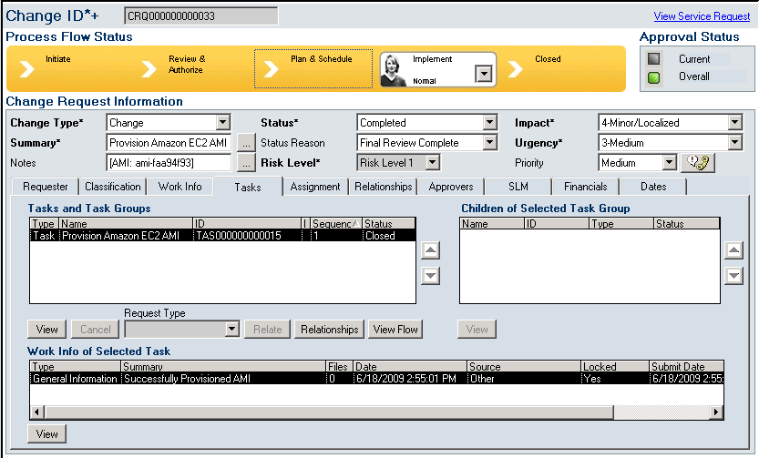
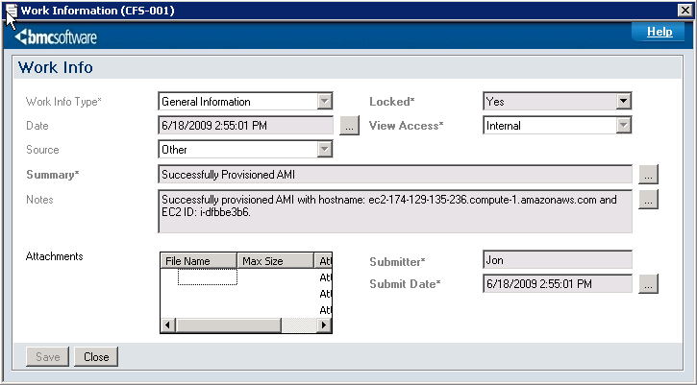
Change and Task are updated

Slide 38
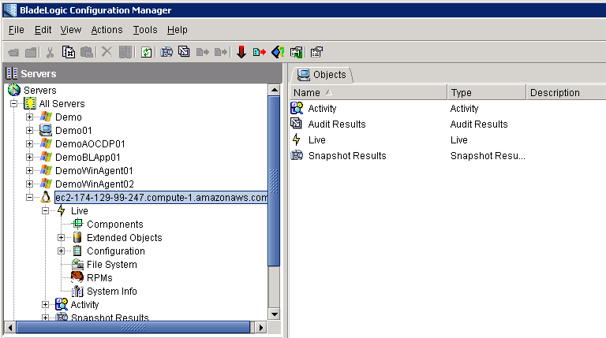
Instance is available for management in BladeLogic

Slide 39
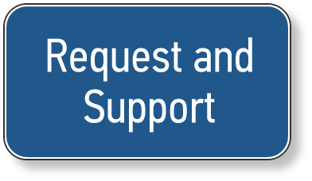

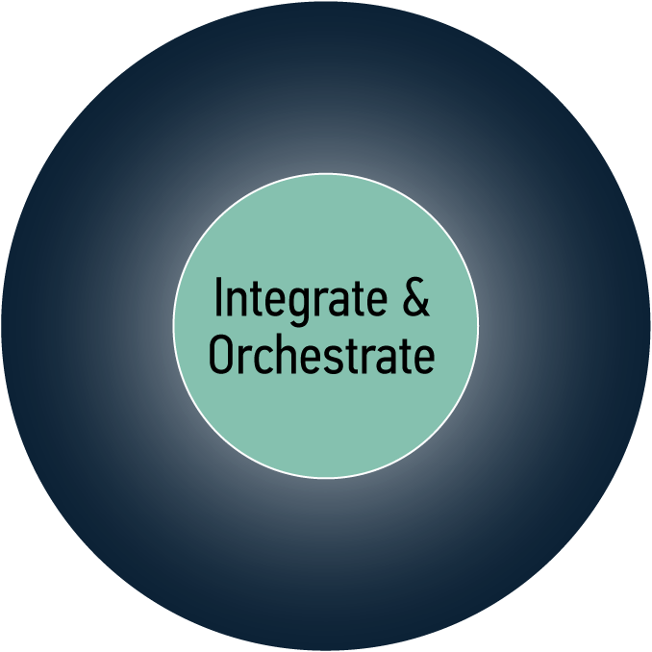

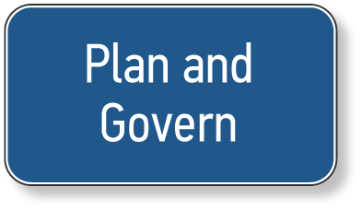
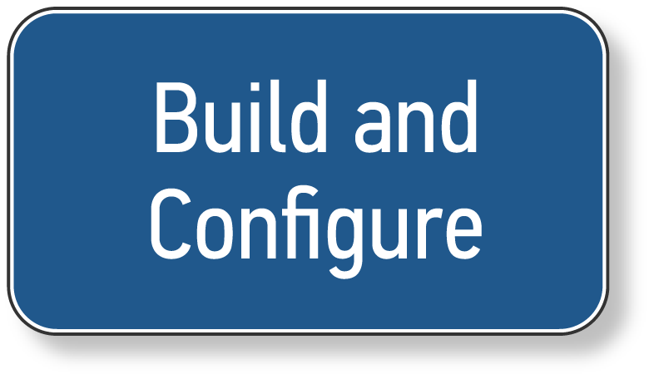


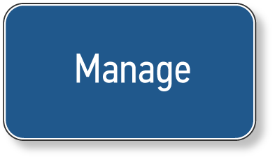
Dynamic BSM Enables Organizations to adapt to seamlessly manage their entire environment
Adaptive and Dynamic BSM:
Services and applications delivered on demand
Dynamic allocation of shared resources based on policy
Continuously monitor and optimize resource utilization
Support Multi-Sourcing for infrastructure, software, and IT services

Slide 40








BMC’s vision for dynamic BSM
BEFORE
AFTER
GO
Services delivered by poorly utilized, static resources
Unpredictable costs
70%+ of issues reported by users
Highly manual processes, dependent on tribal knowledge
Services delivered by “shared resource pools”
Tiered classes of service with predictable costs
70%+ of issues resolved proactively
Policy-based and assisted automation
Notes:
40
Imagine if you could automatically detect that you were going to have an issue and have trust in your automation system to be able to reconfigure resources to ensure the issue was avoided. And imagine if you could do this based on standardized and tiered service levels to ensure cost objectives were met.
Real-time infrastructure and continuous resource optimization
Predictive, proactive, and preventative
Cost of service delivery based on business value
Highest level of service for every business request and unpredictable costs
Standard classes of service with well-defined costs (e.g. platinum, gold, silver, bronze)
Internal and external best practices converted into policy-based and assisted automation
3X-10X staff productivity

Slide 41

Where to Get Started?
Align with the business needs
Have a phased strategy
Define Key IT and Business Services
Design your infrastructure with operations in mind
Establish policies for internal vs. external
Evaluate and Optimize Processes
Simplify, Integrate, and Automate your processes
Continuous Improvement
Notes:
Accelerate time to value
Process visualization and management
Installation and configuration automation
Unified discovery
Make business value demonstrable
BSM (cross-functional) analytics
Enhanced SLM business KPIs and dashboards
Datacenter deployment analytics
Further unify…
Integrate Service Catalog, SLAs across solutions
Expanded SOA integration for 3rd party tools
Third party discovery integration
Datacenter automation
Virtual environment management
Drift tracking
Ad hoc scripting partner integration
Broader/deeper automation
Software license management
Change risk analysis
Enhancements for ITIL version 3
Compliance, security and governance
Compliance reporting for Change, Configuration
Vulnerability management partner integration
Project portfolio management partner integration

Slide 42
Service Resource Planning
Incident
Management
Knowledge
Management
Service Request
Management
Problem
Management
Project &
Portfolio Management
REQUEST &
SUPPORT
Identity
Management
Vendor
Management
Asset
Management
Change & Release Management
Application
Automation
Service
Catalog
INTEGRATE & ORCHESTRATE
Discovery &
Dependency
Financial
Management
Server
Automation
PLAN &
GOVERN
PROVISION &
CONFIGURE
Human Capital
Management
CMDB / CMS
Network
Automation
Service Level
Management
Dashboards &
Analytics
Compliance &
Policy Management
Event & Impact
Management
Mainframe
Automation
Client
Automation
Capacity
Management
MONITOR &
OPERATE
Enterprise Scheduling &
Workload Automation
Storage
Management
Application Problem
Resolution
Data
Management
Performance &
Availability
Management
Middleware
Management

Slide 43
Confidence in answering the tough questions…
What are all of our active projects and their status by budget, time and risk? Are these projects prioritized and aligned with the business?
Who are our top vendors by annual spend and importance to the business? How are they performing? How can I consolidate vendors or reduce annual support costs without impacting service levels?
Am I 100% certain of IT’s compliance with SOX, GLBA, State regulations, etc.
How are our contractors performing against SLAs and vs. each other?
Are our vendor invoices 100% accurate?
Am I paying maintenance on an asset no longer in use?
What is the business impact of a 10% decrease in IT budget?
What is the mix of IT spend on projects vs. sustaining spend? How can I optimize?
What is the TCO for each service by LOB/Business Unit (by VP level)?
Do I have the optimal mix of people and skills for the business?
When do I “pull the plug” on a current project and defend the decision ?

Slide 44
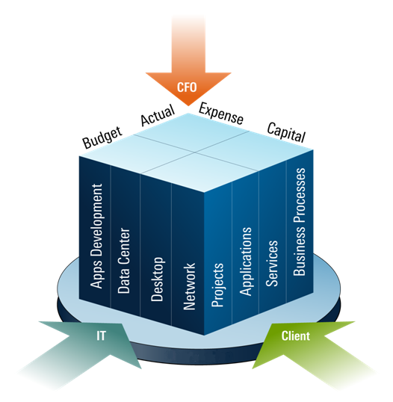
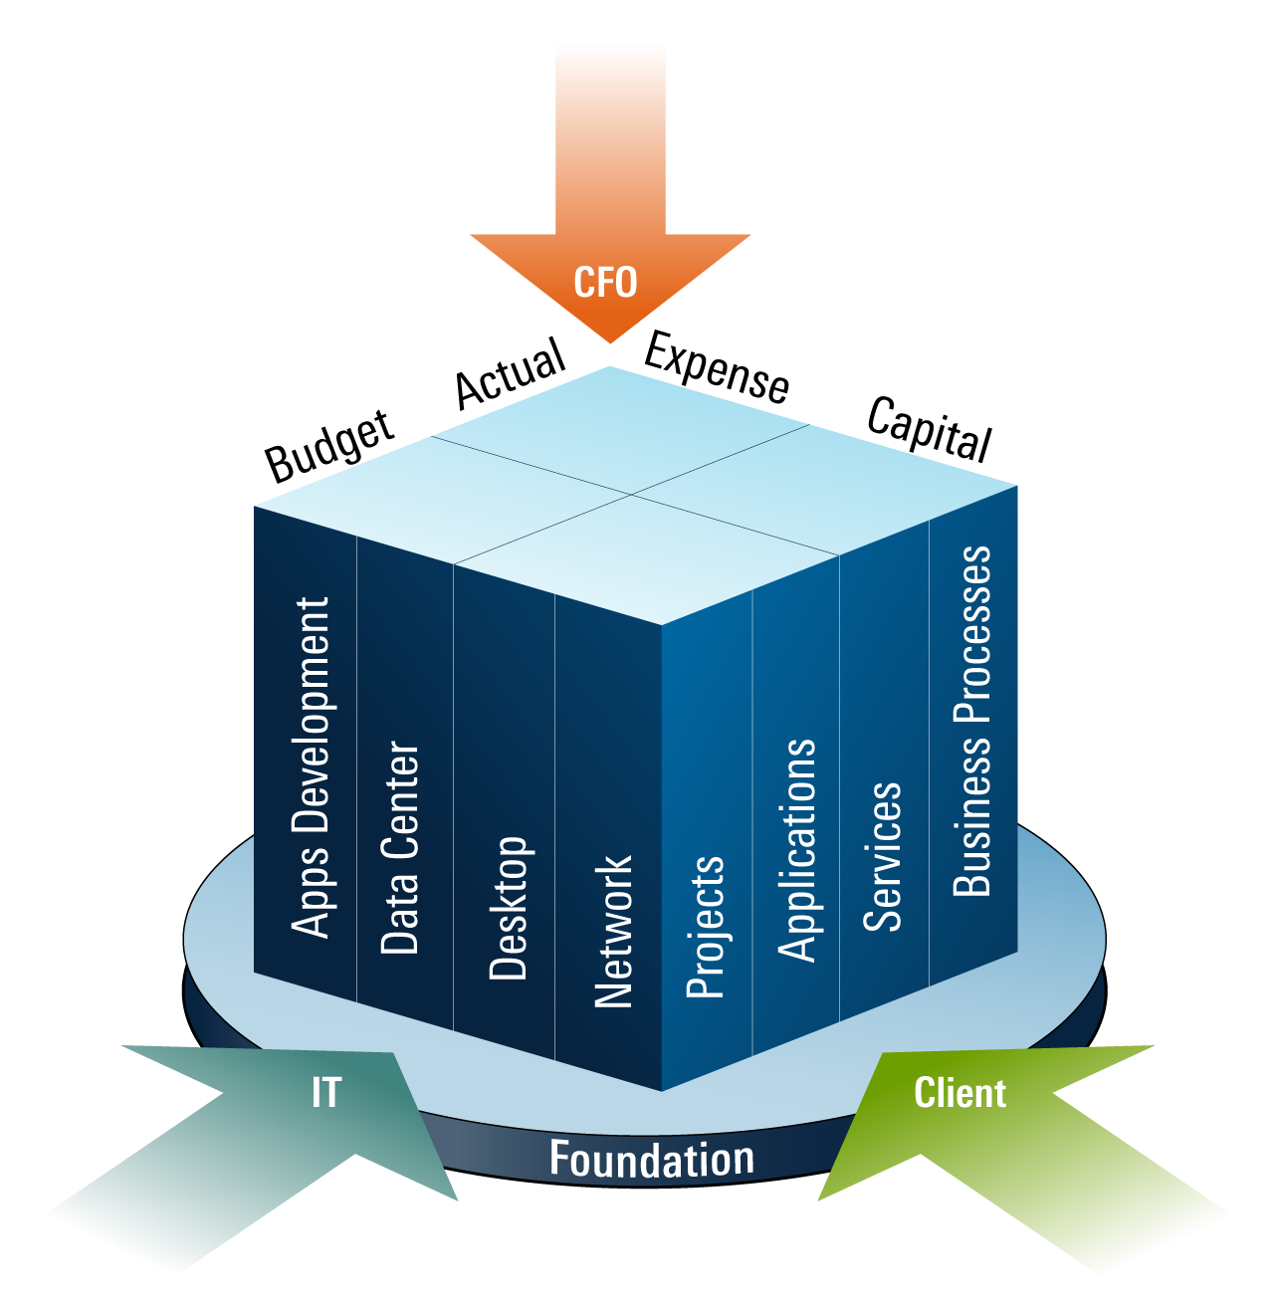
What is Required?
A Single Source of Truth – ERP for IT
Atrium
Speed, Fidelity, and Transparency to Respond to Business
Notes:
44
44
44
The cypher / rosetta stone ☺
The reference architecture
Plan and track 100% of IT Spending
Explain IT costs in the language of the stakeholder
Align IT portfolios & investment to the business
Manage resources needed to deliver IT, including People, Money, Assets, and Suppliers
Reduce risk through sustained governance, risk and compliance management
Manage interdependencies between project, applications, services and supporting assets, labor, vendor services and overhead.

Slide 45
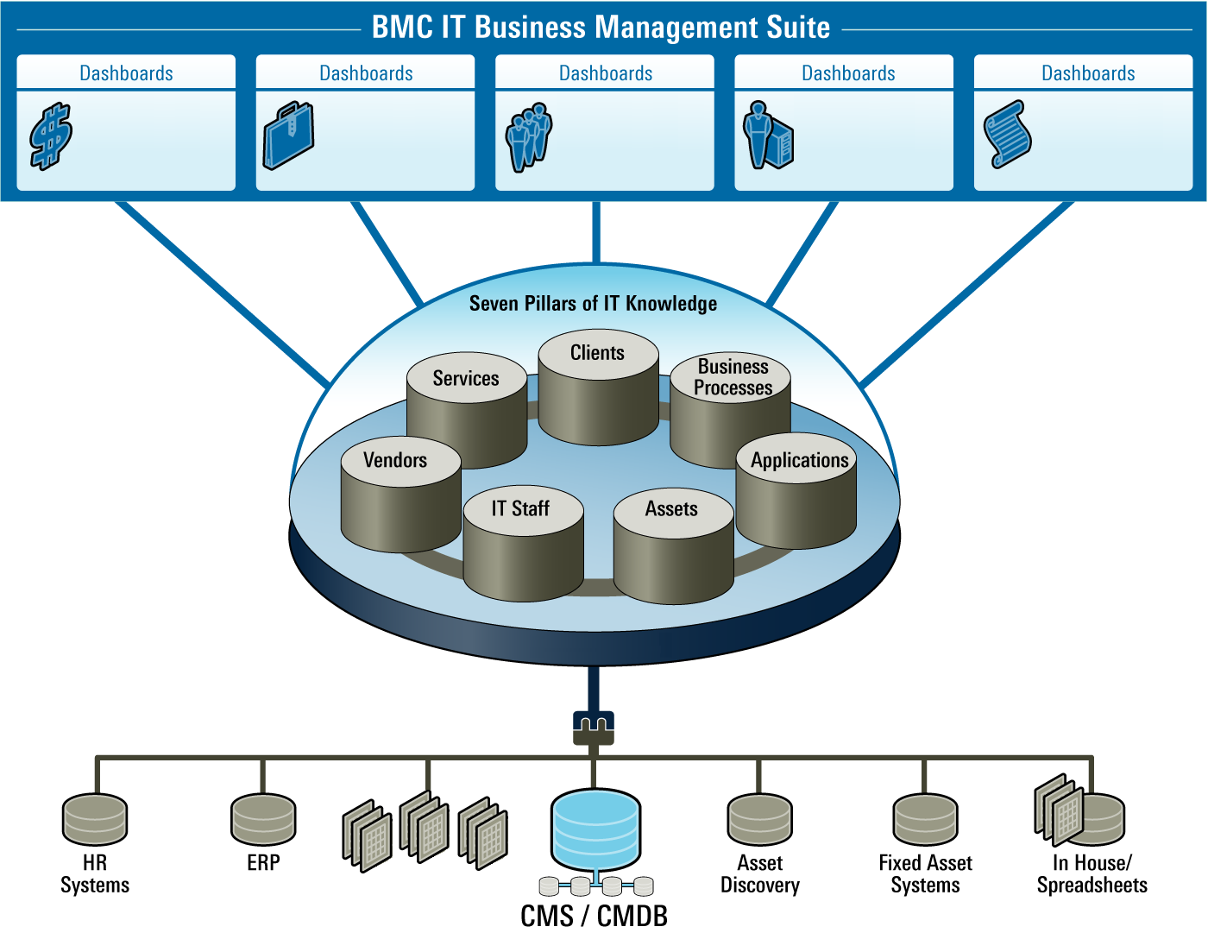




The SRP Business Suite
Integrated IT Business Application Suite
Financial
Planning & Budgeting
Strategic Planning &
Portfolio Mgt
Demand & Resource Management
Supplier Lifecycle
Management
Governance,
Risk & Compliance
CMDB
/ CMS
Unstructured
Data
Notes:
Its more than just the data
Complexity of people & organizations, processes and data…….
Spend $35M to bring this together – one integrated view, integrated set of proceess,

Slide 46
The SRP Business Suite
Integrated IT Business Application Suite
Financial
Planning & Budgeting
Strategic Planning &
Portfolio Mgt
Demand & Resource Management
Supplier Lifecycle
Management
Governance,
Risk & Compliance
CMDB
/ CMS
Unstructured
Data
Notes:
Its more than just the data
Complexity of people & organizations, processes and data…….
Spend $35M to bring this together – one integrated view, integrated set of proceess,

Slide 47
The SRP Business Suite
Integrated IT Business Application Suite
Financial
Planning & Budgeting
Strategic Planning &
Portfolio Mgt
Demand & Resource Management
Supplier Lifecycle
Management
Governance,
Risk & Compliance
CMDB
/ CMS
Unstructured
Data
Notes:
Its more than just the data
Complexity of people & organizations, processes and data…….
Spend $35M to bring this together – one integrated view, integrated set of proceess,

Slide 48

End State – ERP for IT

Slide 49




BMC Solution: Financial Planning and Budgeting
Comprehensive Financial Planning For IT
What we deliver:
IT Budgeting – Bottom-up, hierarchical IT budgeting
Cost Management – Monitor, track, trend & drill-down
Cost Modeling and Analysis – Metrics, TCO of services, apps, projects, forecasting
Capital and Expense Planning – Evaluate, prioritize and fund capital requests
Chargeback and Billing – Charge the business for IT services and activities
Benefits:
Accelerate planning from months to weeks
Shift staff to higher value analysis work
Establish baseline, implement measurable cost reduction programs
Spread budget accountability
1% reduction in IT spend through increased efficiencies and reallocated labor
Notes:
49
49
Imagine that every month you received a cable bill, and it had a list of 75 numbers: 121.31 MHz, 127.31MHz, 133.31MHz, etc. with charges next to each, and perhaps a list of equipment including an R1U-RX100BX4 Optical Return Path Receiver, and maybe a labor allocation charge, licensing fee allocations from a bunch of media companies, etc…
It may sound crazy, but this is exactly how we often communicate the costs of IT to the business.
This is in spite of the fact that larger IT organizations can have literally 100 or more resources dedicated to IT finance. We’ve seen this at Kaiser Permanente and Dresdner Kleinwort. In each case, these organizations have been challenged to take these valuable resources and shift them from manual, labor intensive work of manually assembling budgets and assembling one-off analyses in excel in response to fire-drills, to focusing on higher value analysis that allow IT to become more efficient and effective.
The Dresdner CIO’s stated goal was to flip things around – instead of 90% of effort on manual budgeting and 10% on analysis, to 90% on analysis and only 10% of time on budget preparation and routine reporting. As a result they redirected 20 FTEs with this effort.
BMC Financial Resource Management is focused on two simple things:
1) helping to translate IT costs into the language of business stakeholders – in the case of the business – translating costs to correlate to the value – like the costs of applications and projects that are delivered on behalf of the business.
2) Speeding and automating the process of IT planning and budgeting eliminating costly and time consuming manual spreadsheet consolidations, rollups and ad-hoc analyses and enabling IT to answer financial questions quickly so they can adjust to changing business demands – like how to cut costs intelligently when faced with budget pressure.

Slide 50




BMC Solution: Strategic Planning & Portfolio Management Top-Down, IT Portfolio Focused Approach
What we deliver:
Collaboration – Collaborate and capture biz objectives with IT, finance, and the business
Portfolio Analysis – Compare value, cost & risk of value drivers (services, apps, projects)
Alignment – Evaluate benefits, align value drivers to biz objectives & strategy
Prioritize & Rationalize – Prioritize value drivers against available resources and funding
Scenario Planning – What-if comparison of different investment options & impact
Benefits:
Invest in services aligned to business objectives
Reduce execution risk
Achieve better visibility into ongoing efforts
Save 10% or more by eliminating low value services, applications and projects
Notes:
50
50
We’ve talked to a lot of IT organizations that have attempted to deploy PPM once or maybe several times over many years. We see the same issues over and over – attempts to deploy deep, bottoms-up, comprehensive integrated project and resource management solutions that are designed to keep track of every task and person-hour on every project, have complex resource loading and dependency mapping features. The result is often the same – either the customer uses about 5% of the solution or they stop using the tool all together.
We think that these bottoms-up approaches to portfolio management miss the biggest benefit – getting control over the demand funnel and establishing a lean, but effective process for driving fact-based decisions on where to invest. And once you pick what to do, providing a minimum necessary and sufficient project lifecycle governance to make sure projects are monitored and evaluated across key phases to ensure issues are flagged early and the necessary steps are taken to ensure successful completion.
The BMC PPM solution focuses on just these capabilities, with the benefit of integration with solutions like financial planning and budgeting, vendor management (many projects require new vendor capabilities – how do you govern the vendor selection process?), asset management, compliance and resource management.
This approach can deliver value in 90 days or less. One client, a new CIO uncovered 400 active projects discovered and reduced that number to just 7 strategically aligned while another organization achieved a more modest 10% reduction in their portfolio. The potential for savings is going to depend heavily on your current process maturity and the degree to which you have all your demand centralized and going through a single evaluation process.
Most importantly, you are investing in a solution that integrates into IT financial planning, vendor and asset management, resource management and compliance for full visibility and control across IT

Slide 51


BMC Solution: Demand & Resource Management
Manage supply and demand to support the highest value work
What we deliver:
Demand Governance – Comprehensively capture, evaluate, prioritize all demand
Capacity Management – Characterize capacity of labor resources, fixed and variable
Organizational Planning – Optimize skills, costs and efficiency of resources
Resource Allocation – Allocate and analyze staff assignments
Execution Governance – Manage & govern execution of activities in the portfolio
Benefits:
Achieve the right staffing profile to meet the needs of the business
Avoid over-commitment of resources
Reduce project delays due to resourcing conflicts
Assign staff to the highest value and most critical efforts
>20% reduction in the effort to plan and staff work
DBA Staff Capacity
Notes:
51

Slide 52

BMC Solution: IT Sourcing and Supplier Management
Managing the Full Vendor Lifecycle
What we deliver:
Supplier Portfolio – Rationalize & optimize vendor portfolio across cost, performance & risk
Supplier Governance – Govern evaluation, selection, acquisition & other critical processes
Performance Management –Track commitments & deliverables, measure 360 deg. quality
Supplier Risk Management – Evaluate and managing supplier risk profile
Contract & Cost management – Track contracts, committed vs. actual vendor spend
Benefits:
Improve vendor performance
Consolidate the vendor portfolio, putting focus on the vendors that matter the most
Save 5% to 10% of total vendor spend in 90 days
Save 5% to 10% of Total Vendor Spend in as little as 90 Days
Notes:
52
52
When people first hear vendor management, functions like asset management or procurement often come to mind.
Vendor management is something different and complimentary to these processes – it is concerned with the function of strategic, full lifecycle management of vendors. We are finding IT organizations are realizing the huge cost savings and performance opportunity of better managing their vendors – which by the way typically represent upwards of 40 or 50% of overall IT spend – by implementing Vendor Management Offices, or VMOs as part of the office of the CIO.
Why?
Procurement is typically focused tactically on the transaction, and asset management is typically focused on inventory or maybe capital costs and depreciation, depending on where it sits in the organization. But who is:
Managing the process for selecting strategic vendors?
Measuring vendor performance?
Tracking commitments and ensuring the parties deliver over the long term?
Tracking maintenance and leases, ensuring renewal when appropriate, but discontinuing when not (why pay maintenance on something not being used anymore?)
Tracking service providers and outsourcers and ensuring they are delivering? Not overbilling?
Identifying and managing vendor risk (who is qualified from a security standpoint? Who has impact on mission critical processes?)
Vendor Management:
[review bullets]
Example Benefits:
A regional specialty bank saved $350,000 (10% of vendor spend) in first 3 months
Dresdner Kleinwort saved $25M (5% of vendor spend) in year one
We see vendor management is low hanging fruit – it does not require a lot of staff or process impact to get a better handle on vendors and vendor spending – we’ve had customers who pay back the cost of the entire initiative during the process of inventorying vendors in a 90 day VRM project.

Slide 53

BMC Solution: IT Regulatory Compliance
Accelerating Compliance in IT
What we deliver:
IT Business Governance – Includes portfolio, financial, resource ,supplier and compliance
Risk Mitigation – Inventory and prioritize risk, assess impact, develop mitigation plans & test
Compliance Mgt – Multiple initiatives; self-assessment of control testing and remediation
Content Management – Central repository for all compliance artifacts
Compliance Metrics – Metrics and drilldown by initiative; compliance maturity by initiative
Benefits:
Shorten the time to assess compliance
Reduce the cost of 3rd party audit
Gain confidence in regulatory compliance
Reduce compliance labor by up to 50%
IT Compliance Program
(BMC Governance and Compliance Management)
Datacenter
Operations
Network
Operations
Desktop
Apps Development
IT Business Management
Process
Process
Process
Process
Example Compliance Risk:
Server Configuration, Change Control
Network Security
Desktop Security
Change and Release Control
Project, Financial, Vendor Governance
Notes:
53
53
To this end, the BMC Governance and Compliance Management application is designed to
Centralize and automate testing and tracking of compliance across different IT functions and across different regulations.
Drive down the labor and time required to assess compliance on an ongoing basis
Drives down the cost of 3rd party audit by getting your house in order, with testing and documentation well ordered and easy to access.
Examples:
A regional specialty bank cut labor to manage compliance by 50%
A medical devices manufacturer used the solution to manage compliance:
Documentation, automation, and management of 4000+ controls and testing activities
Management reporting across 5 decentralized operating units
This organization went from 5 months behind on compliance to on-time.

Slide 54


Customer Snapshot: Dresdner Kleinwort
Challenge | Solution | Value
Improve efficiency, reduce costs, while improving overall business alignment Lack of transparency regarding cost allocations to the lines of business Redundant or unnecessary vendor spend Costly regulatory compliance | BMC BSM Solutions, featuring BMC Service Resource Planning Deployed all 5 applications in the IT Business Management Suite Deployed Service Support and BMC Atrium solutions | Streamlined planning and budgeting 1,500 cost centers reduced to 150 Reduced planning cycle from 13 months to 6 weeks Eliminated 20 FTEs First year savings: $3M Euro Saved $25M € on IT Supplier Costs Saved $3M € in 90 days by consolidating vendor contracts Central data repository for all vendor and contract information Increased transparency resulted in improved governance, more strategically aligned IT decisions and increased credibility
“By extending our BMC implementation with the complete view of demand, resources, and financials available within IT Management’s Business Suite, our IT organization now has the information and tools necessary to make informed and aligned business decisions.” – Keith O’Kelly, Director, IT Business Management, Dresdner Kleinwort
Industry
Financial Services
Background
Dresdner Kleinwort Investment Bank is a global operation with offices in 16 countries
A €6B business with international reach
Business Drivers
Drive IT efficiency
Insure IT investments are aligned to the most profitable areas of the business.
Solutions Areas
BSM
Notes:
Here is an example of a customer that has embraced BSM, including Service Resource Planning…
The completed integrations with SAP AP and Coda in 90 days using one consultant
Their initial vendor inventory revealed multiple contracts in place with Reuters and were able to leverage this information to save $3M Euro –this single act gave a return on investment, more than paying for the entire project in 90 days. Note, this is the type of savings that would have never been uncovered by traditional IT asset management program.

Slide 55










World Class Customer Base
From Regional to Global
IT Financial Planning & Budgeting
Service Portfolio
Management
Demand Mgt & Resource Planning
Strategic Sourcing
IT Compliance
Notes:
France Telecom -- 9,000 servers (of 12,000 total) cross-Platform -- reduced time to upgrade infrastructure application on 5 thousand servers from 4 weeks to 3 days
Expedia 5,000 servers Cross-Platform -- Reduced the effort and time for a typical application release from 15 people over 12 hours to 2 people over 3 hours - 95% reduction in man-hours - Saved $3.6M in reduced planned downtime every 10 weeks
Vanguard -- 400 servers UNIX -- Increased success rate of application deployments from 40% to 95%
Cap Gemini -- 5,000 servers (of 10,000 total) Cross-Platform -- Increased server to admin ratio from 22:1 to 166:1 - 8X increase in productivity
E*Trade 3,400 servers (of 4,500 total) Cross-Platform -- Reduced time to audit all servers for compliance from 12 weeks to 4 hours. Savings of over $100K per audit cycle.
Priceline 1,100 servers Cross-Platform -- estimated annual savings with automation is over $2.5M
Virgin Mobile 150 servers (of 500 total) UNIX -- Deployed Tibco application in 5 days versus 2 months.
ADP -- 2,400 servers (of 10,000+ total) US 1,200 servers in Europe Cross-Platform -- reduced cycle time of app changes by 70%
Time Warner -- 600 servers UNIX -- Reduced time to remediate critical security vulnerability from 4 hours to 2 minutes.

Slide 56
Significantly Lower IT Costs
While Increasing Business Impact
1+%
Save 1% or more of total IT spend through increased financial planning efficiencies and financial transparency
>10%
Save >10% of IT portfolio spend by eliminating redundant and mis-aligned projects, applications and services
Credibility
5%
Eliminate 5% of overall IT spend by rationalizing the supplier portfolio and managing supplier performance
>20%
Eliminate >20% of resource management effort and prioritize the highest value work by automating and centralizing resource planning efforts
50+%
Reduce by 50% annual IT compliance audit costs associated with SOX-404, HIPAA, etc.
Notes:
56
56
The solution provides many point benefits, but overall the power is in the integrated suite.
This does not mean you have to do it all at once. You can start with a single problem area, maybe vendor management and get a quick win, and then move on to a second problem area.

Slide 57
BMC Service Resource Planning Solutions
Project & Portfolio
Human Capital
Governance & Compliance
Service Request & Portfolio
Helpdesk &
Change
Vendor
Financial
Asset
Financial Planning & Budgeting
Portfolio Management
Demand & Resource Mgt.
Supplier Lifecycle Management
Governance, Risk and Compliance
It’s all about LEVERAGE…
Notes:
57

Slide 58






BMC Service Resource Planning Solutions
Project & Portfolio
Human Capital
Governance & Compliance
Service Request
Helpdesk &
Change
Vendor
Financial
Asset
Financial Planning & Budgeting
Pillars
Projects
Resources
Vendor Services
Assets
Services
Apps
Incidents
Change
Requests
Service
Requests
IT Budget
Spreadsheet
Oracle
(General
Ledger)
Oracle
(Fixed
Asset)
Planview
Project
Accounting
Apps
Budget
Desktop
Budget
Datactr
Budget
Network
Budget
Apps
Dept A
Apps
Dept A
PeopleSoft
(HR)
Home-grown
(Time Tracking)
MS Project
(Project
Mgt.)
Apps
Dept B
Apps
Dept A
Apps
Dept A
Apps
Dept B
Apps
Dept C
Apps
Dept B
Apps
Dept B
Apps
Dept C
Atrium
(CMDB)
MKS
(ALM)
Home-grown
Self-Service
Portal
Apps
Dept C
Apps
Dept C
Unstructured
Structured
Notes:
58
Sources of data, getting these together; several lines of people behind each effort to pull this together.
Why it takes 13 months (this is for Financial Planning and Budgeting); as opposed to 3 weeks

Slide 59

Notes:
This slide is designed to be an opening or closing slide. This will allow the presenter to have a presentation cued up in slideshow mode without being on the title slide. The audience can take their seats, leave, or have open discussion with this slide up.

