Slide 1
Citrix Access Gateway
Advanced Edition
Technical Overview
Seceidos GmbH&Co. KG
Robert Hochrein
robert.hochrein@seceidos.de

Slide 2
Agenda
Overview
Citrix Access Gateway Advanced Edition
Feature & Benefits
Architecture

Slide 3



The Customer Problems
Consistent user experience
Cannot access from behind firewalls
Access from widely varying devices
Corporate Laptop
Local Users
CPS Applications
Access
Gateway
appliance
Advanced
Access
Control
server
Need access to all internal IT resources
Email Servers
Mobile PDA
Firewall
Firewall
Web or App Servers
Minimize re-authentication on re-connect
Internet
Home Computer
Bandwidth
Latency
Device
idiosyncrasies
File Servers
Partners
Desktops & Phones
Endpoint security, identification, and integrity validation
Consistent user experience
Secure and Hardened
Centralized access control to all IT resources
Control over how information and applications can
be used
Notes:
This slide details various access problems from customers.
Customers wants:
Their connecting endpoints are trusted and secure
End users have a consistent access experience, regardless of if they are inside or outside the network.
Leverage a secure, hardened appliance in the DMZ
Provide a centralized management point for all of their resources
Lastly, control how information can be used or accessed.
Challenges customers face with solutions in the market today:
Limited access from behind the firewall (e.g. IPSec VPNs)
Increasing number of mobile users are leveraging small form factor devices
Require access to information from anywhere, anytime to stay competitive (kiosk, home, etc.)
Combination of slow bandwidth & limited usability often lead to frustrated users

Slide 4
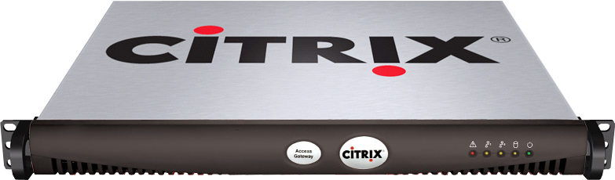
Citrix Access Gateway
Universal SSL VPNs providing access to all internal IT resources, including IP telephony
Hardened, scalable appliances
Easy-to-use, automatically downloaded and updated client
Controlled access with administrator-defined policies
Tight integration with Citrix Presentation Server
Notes:
Key features and messages for the Access gateway.

Slide 5
Citrix Access Gateway
SSL VPN Remote Access
Simple and Cost Effective Secure Remote Access
Advanced Access Control and Device Flexibility
Complex and Demanding Environments
Access Gateway
Standard Edition
Access Gateway
Advanced Edition
Access Gateway
Enterprise Edition
best for
Small-to-Midsized Customers
best for
Presentation Server Environments
best for
Enterprise
Deployments
Notes:
The Citrix Access Gateway is a comprehensive product line of SSL VPN solutions, each one tailored to best fit any customer need.
Note: The Citrix Access Gateway, Advanced Edition is the one which is provided in the Citrix Access Suite bundled offering with Citrix Presentation Server and Citrix Password Manager.
Note: The Citrix Access Gateway, Enterprise Edition is coming soon, targeting Q3 2006.

Slide 6
Agenda
Overview
Citrix Access Gateway Advanced Edition
Feature & Benefits
Architecture

Slide 7

Access Gateway Advanced Edition
Tight information control:
  Granular policy based Access (SmartAccess)
  Granular control of CPS apps (action rights)
  Customizable End Point Analysis
Browser-Only Access (e.g. no clients)
PDA and Mobile Device Support
Access Gateway
Advanced Edition
Access Gateway
Standard Edition
Model 2000
Notes:
Sell Whats Best for the Customer

Slide 8
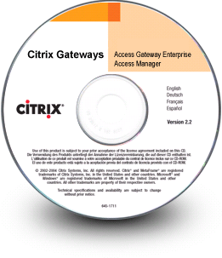

Product Components
+
Access Gateway 2000
Advanced Access Control server
Access Gateway hardened appliance in DMZ
Enables end-to-end secure communication via SSL
Authentication point
Enforces policies generated by Advanced Access Control
Deployed in a secured network
Deployed on Windows Server platform
Centralizes administration, management & policy based access control
Centralized reporting and auditing
Manages endpoint analysis and client delivery
Extends access to more devices and scenarios
Advanced policy engine with action rights control
Notes:
In September, the customers will be able to replace their Secure Gateway in the DMZ with the Access Gateway. The Advanced Access Control will continue to be deployed inside the secure LAN on a server running Windows 2000 Server or Windows Server 2003.
What is the advantage of deploying AAC inside the network?
The main reason Advanced Access Control is deployed in the secure network, as oppose to the DMZ, is because we believe sensitive information (user information, management configuration, access policies) should reside inside the secure network.

Slide 9
Agenda
Overview
Citrix Access Gateway Advanced Edition
Feature & Benefits
Architecture

Slide 10
Access Gateway Advanced Edition
Features & Benefits
Feature | Function | Benefit
Policy-based Access and Action Rights Control | Detect and adapt policies based on access scenario to control the flow of the organization’s sensitive data | Granular access controls Intellectual property protection Extend user’s access to more situations Enhances security without effecting the user experience
Endpoint Analysis | Determines client device status for access policies and provides device remediation. | Enables corporate and regulatory compliance Extensible with industry standard development tools to meet customer needs
Browser-only Access | Access with any web browser on any device to web sites, files, and email | No additional client components Ubiquitous access
Mobile Device Awareness | Re-factored email and file interface for PDAs and small-form factor devices | Seamless device transition User productivity
Extended Access Control for Presentation Server | Policy-based control of Presentation Server using end-point analysis and network location awareness | Address regulatory and security concerns Enhances Web Interface
Centralized Logging and Trend Reporting | Provide sophisticated usage data for troubleshooting and planning | Improved management Easy integration with 3rd party tools

Slide 11
Finding the Right Balance
Access
Anywhere, Anytime
  After work hours
  During office closures
  On the road
Access to all applications
Access is transparent
Access from any device
Information Security
Protection of critical systems
  Denial of service
  Exposure to malware
Intellectual property control
Address regulatory compliance
Risk mitigation
Practical and cost-effective

Slide 12
SmartAccess Technology
Extensive policy-based sense and response
  Automatically reconfigures the appropriate level of access as users roam between devices, locations and connections
  Advanced, extensible end-point security policies and analysis
  Action Rights Control defines what the user can access, and what actions they can take

Slide 13

Granular Controls
E-mail Sync
Web E-mail
Full Presentation Server Access
Full Presentation Server App Set
File Download
Local Edit and Save
File Upload
Corporate Desktop
Edit in Memory
Limited Presentation Server access (read-only local drive mapping)
Limited Presentation Server application set
File Preview
File Upload
E-mail Sync
Web E-mail
Remote Corporate Device
File Preview
Web E-mail
Controlled Presentation Server Access
Public Kiosk
Notes:
This is the action slide (the do), looking from the perspective of three different access perspectives.

Slide 14
Elements of SmartAccess
SSL-VPNs
Analyze Endpoint & Connection
Apply Access Control
Apply Action Rights Control
Machine Identity:
  NetBIOS name
  Domain Membership
  MAC address
Machine Configuration
  Operating System
  Anti-Virus System
  Personal Firewall
Network Zone
Authentication Method
CPS applications
File & network shares
Web based email
Web sites (URLs)
Web applications
Email synchronization
Client/Server applications
VoIP
Full download of documents
Preview documents with HTML
  Access from PDAs
  No viewer app on client
Attach to email
  Avoid transmission to client
Virtualized Applications
  Control applications
  Limit local mapped drives

Slide 15



Access Scenario:
Corporate Users from a Hotel
 OK
Corporate Laptop
CPS Applications
Access
Gateway
appliance
Advanced Access
Control server
Email Servers
Mobile PDA
Firewall
Firewall
Web or App Servers
Internet
Download and Access Information:
  Full download
  Download to memory only
  Access via CPS only
  Preview in HTML only
Edit and Save Changes:
  Save locally
  Save only to network
  Save disabled
Print
  Print locally
  Print to selected printers only
  Printing disabled
CPS Applications
Home Computer
File Servers
Partner Machine
Desktops & Phones

Slide 16
Access Scenario:
Corporate Users from Home
Corporate Laptop
CPS Applications
Access
Gateway
appliance
Advanced Access
Control server
Email Servers
Mobile PDA
Firewall
Firewall
Web or App Servers
 OK
Internet
Download and Access Information:
  Full download
  Download to memory only
  Access via CPS only
  Preview in HTML only
Edit and Save Changes:
  Save locally
  Save only to network
  Save disabled
Print
  Print locally
  Print to selected printers only
  Printing disabled
CPS Applications
Home Computer
File Servers
Partner Machine
Desktops & Phones
Notes:
Use case scenario:
User accessing from a home PC. We want to point out the device may be infected with malware, Trojans, worms, etc.
In most solutions in the market today, the user may simply be denied access.
With Access Gateway and Advanced Access Control, administrator can grant user access with action rights– he/she can view the document, but not save it, or the user can launch the document in Presentation Server mode.

Slide 17
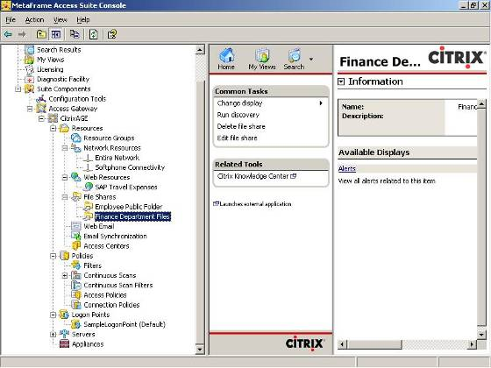
Policy Configuration
Define resources which can be accessed and viewed by users
Supported resource types:
  File shares
  Web sites
  VPN network access
  Email sync
  Web-based email

Slide 18
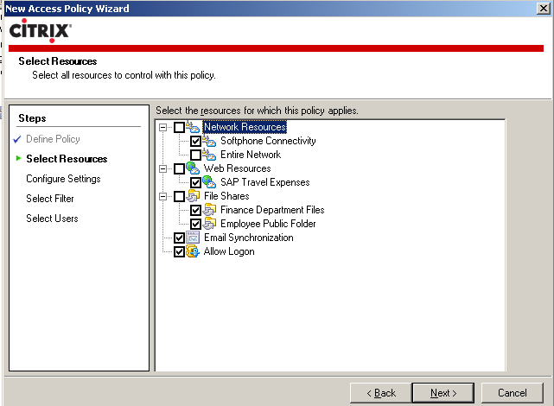
Policy Configuration
Policies are first defined by the resources which they effect
Administrators may multi-select resources

Slide 19
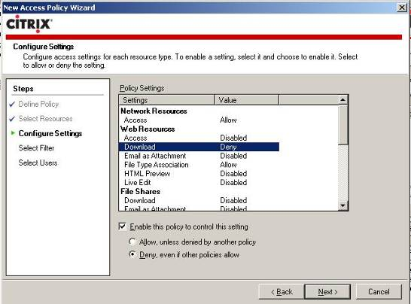
Policy Configuration
Policies define the permissions which apply to the selected resources
Administrators set permissions based on resource type
Policies can:
  Grant Access
  Deny
  Specify how a user
  can access a resource

Slide 20
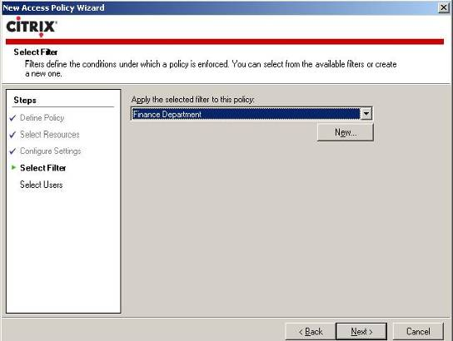
Policy Configuration
Policies can be defined to only apply under certain scenarios
Filters define scenarios

Slide 21
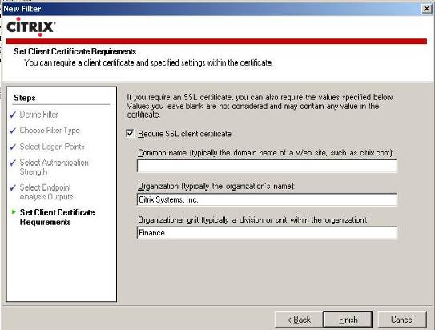
Policy Configuration
Filters can use a number of criteria including:
  How the user authenticated
  User’s network location
  Results of endpoint analysis
  Client certificate queries

Slide 22
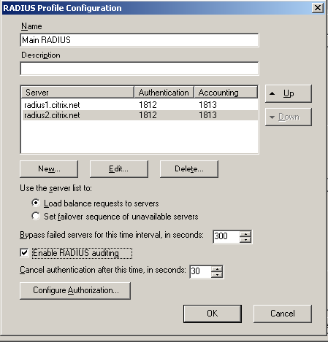
Policy Configuration
Policies can be applied to specific users
Users can be authenticated from:
  RADIUS
  LDAP
  Secure LDAP
  Active Directory
  RSA SecurID
  SecureComputing SafeWord

Slide 23
“Entire Network” Access
Pre-defined “Entire Network” resource can be used in policies to give users access to all servers in the network

Slide 24
Phased Policy Rollout
Define a group of trust remote users
Grant full network access by giving access to the “Entire Network”
Restrict full access with end-point scans (if desired)
Prepare granular policies and roll-out to select users as desired
CPS Applications
Email Servers
Web or App Servers
File Servers
Desktops & Phones
Notes:
This technique can be used by administrators to quickly give users access to the protected network using the Access Gateway client. Policies can be created using the “Entire Network” resource which will grant access to all routable servers and ports.
Then, administrators can gradually create more detailed policies that tightly define access to corporate resources. Using a combination of these techniques, administrators can comfortably roll out a sophisticated policy system.

Slide 25
Methodology for Defining Access Policies
Inventory all IT resources
Group resources into levels of sensitivity
Define end user access scenarios
Associate end user access scenarios with levels of sensitivity
Validate the policies with a select group using event logging
Roll policies into full production
CPS Applications
Email Servers
Web or App Servers
File Servers
Desktops & Phones
Corporate Laptop
Mobile PDA
Home Computer
Home Computer
Partner Machine
Notes:
A well thought out access strategy will let any organization effectively connect users to information from anywhere, at anytime. This process is required to have confidence in the flow of information in and out of our organization. Fortunately, this methodology can be evolved over time and doesn’t need to be rolled out day 1. The product provides powerful mechanisms to achieve immediate usability of the system.

Slide 26
Action Rights Control: Overview
Designed to prevent inadvertent leakage of information normally associated with user error.
Example: Users forget it is against company policy to access sensitive information from home or a kiosk.
Notes:
HTML Preview and LiveEdit are features to address inadvertent leakage of information, and are not necessarily there to prevent someone from intentionally “stealing” of information.

Slide 27





Action Right: HTML Preview
Server-side rendering into HTML of:
    Microsoft Excel spreadsheets
    Microsoft PowerPoint presentations
    Microsoft Word documents
    Microsoft Visio diagrams
    Adobe PDF documents
Provide access to documents when client doesn’t have a viewer application available, such viewing from a kiosk.
Extends access to small-form factor devices, such as PDA
HTML Preview can be resource-intensive, but can be configured as a separate server.
Microsoft Office must be installed on the server(s) generating the HTML Preview
Requires 3rd party PDF to HTML converter
Notes:
HTML Preview requires Microsoft Office installed on the server vs. LiveEdit requires Microsoft Office installed on the client.

Slide 28
Action Right:
File Type Association
Secures important documents by preventing them from leaving the protected network
Users don’t have to trade usability for security
Extends access to a wide range of devices and platforms
Uses Presentation Server to provide access to a document requested from:
  A protected web server
  An email attachment
  A file share
Compatible with the ICA Java client

Slide 29
Action Right:
File Type Association
Internet
DMZ
Protected Network
Interactions
User selects a link in the browser window and the browser generates a request to the Access Gateway appliance
Appliance forwards the request to the web proxy component of AAC
Web Proxy decodes the URL of the request and determines the true destination of the request
Retrieve the session ticket from the cookie in the request header and perform access control against the Policy Engine
Policy Engine determines that user has permission to access the requested
Forward the request to the destination
Presentation
Server
Connector
SSL
HTTP/S
3
Web Proxy
HTTP/S
MetaFrame Presentation Server
1
2
4
Endpoint Device
Access Gateway appliance
Policy
Engine
6
5
Advanced Access Control server
Enterprise Web Server

Slide 30
Action Right:
File Type Association
Internet
DMZ
Protected Network
Interactions
Web proxy receives response
Web proxy queries policy engine to determine access method. Document must be launched via Presentation Server
AAC generates an ICA file to invoke the ICA client on the endpoint
ICA client starts and generates a request to Presentation Server
Published app requests document from web server and displays it within the ICA session
CGP/ICA
4
Presentation
Server
Connector
3
HTTP/S
Citrix Presentation Server
Web Proxy
SSL
2
HTTPS
1
5
Endpoint Device
Access Gateway appliance
Policy
Engine
HTTP/S
Advanced Access Control server
Protected Web Server

Slide 31
Endpoint Analysis:
Overview
Analyze the client machine to identify the device and determine if it is secured.
Endpoint Analysis Clients:
  ActiveX client for IE browsers (requires Admin or Power user privileges)
  Win32 install (via MSI)
  Netscape plug-in for Netscape and Mozilla browsers
3rd party product integration (AV, Personal Firewall):
  Symantec/Norton, McAfee, TrendMicro, Microsoft, WholeSecurity, Check Point ICS, etc.
Fully customizable via Citrix’s EPA SDK:
  SDK available on Citrix Developers Network
  SDK is well-integrated with Visual Studio.NET
Notes:
Endpoint analysis is available for IE, Netscape and Mozilla browser. For browsers not supported by endpoint analysis, such as Safari, the administrator has the option to setup access policies to either only allow CPS or read only access.
Endpoint Analysis not only integrates with leading AV/Endpoint scan products, but it’s fully extensible to enable customized endpoint scans.

Slide 32
Endpoint Analysis:
User Interaction
Internet
DMZ
Protected Network (LAN)
Interactions
User opens browser and points to appliance
Appliance detects a new session and deploys the endpoint scan client
Scan client is activated. It calls to dispatchers to retrieve scan parameters
Dispatchers retrieve scan scripts and parameters via Endpoint Analysis Web Service.
Browser downloads necessary endpoint analysis modules if not cached on endpoint. Modules are stored in the database and deployed from EAS and scan operations execute
EPA client posts results to Endpoint Analysis Web Service via appliance and EAS executes transformation modules on results. May repeat from step 4 until all needed data is collected
Appliance posts transformed results to Authentication Service. EAS queries Policy Engine to determine if authentication is allowed
If yes, display the authentication page
Otherwise, provide feedback to instruct on steps for remediation.
At authentication, results are stored with session data
1
2
4
8
3
5
6
7
9
Endpoint Device
Access Gateway
appliance
Advanced Access Control server
Notes:
Step by step interaction flow diagram of Citrix’s endpoint analysis.

Slide 33
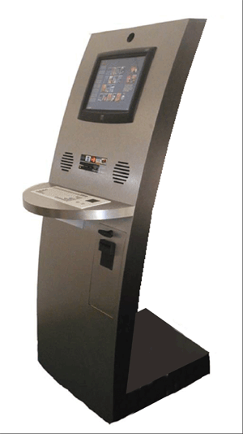
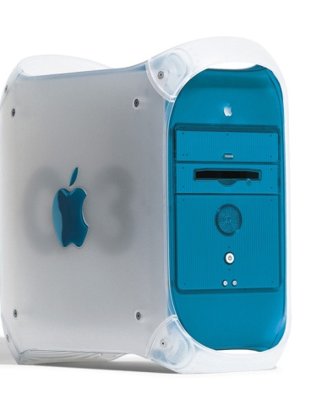
Browser-only Access
Extend access to any device with a browser
Absolutely no client required
Deliver e-mail, file shares, web sites/applications to any device with a browser
Automatically render Microsoft Office documents to HTML preview

Slide 34

Browser-only Access: Overview
For use when an Access Gateway
client is not deployed
Obfuscates internal URLs
Controls client-side caching
Enforces access control
Provides access to:
  Protected Web Sites Web Proxy
  File Shares Nav UI
  Web email Outlook Web Access,
  iNotes, or Nav UI
Notes:
In addition to fulfilling the best access experience through full and partial Secure Access Client for managed devices access, Advanced Access Control also offers client-less access to information from anywhere, anytime by providing access to protected web sites, email, and file shares.

Slide 35
Browser-only Access: Web Proxy
Request received from browser
Request is validated by verifying a valid session cookie and is forwarded to the AAC server. URL decoding occurs.
Proxy operations:
  Validate requested URL against allowed destinations in access control list
  Strip cookies from request (unless explicitly allowed).
  The request is forwarded to the destination web server.
  If HTTP Auth required, respond with primary session credentials or web form (if permitted by AAC administrator).
Response is received from the web server
Response processed and rewritten
  HTML content has links rewritten
  GIF/JPEG and other supporting content is returned unaltered
  If request is to known document type, an action right is applied. User may be prompted with an action choice
Response proxied back to client
Protected
Web Server
4
Access Gateway appliance
AAC Server
3
6
6
5
Access
Gateway
Connection
Manager
Web Proxy
1
2
2
Processes Web pages and rewrites URLs to:
  Provide clientless access to internal web sites
  Proxy authentication request/response
  Render links so they route through the web proxy
Notes:
This slide build-out illustrates how Web Proxy works from when a regular Web page request comes in from a client browser, to when AAC sends a respond back.
The URL Decoding Filter monitors incoming requests for specific URL paths.

Slide 36

Browser-only Access:
Web Proxy URL Rewriting
http://fltrdover.pss.citrite.net/CitrixWebProxy/aHR0cDovL2Z0bHJwYXVsd3Nwcy5jaXRyaXguY29t/sites/age/
AAC server
Proxified
Base 64 encoded internal server name
Resource
http://ftlrpaulwsps.citrix.com/sites/age/
Notes:
What the user sees vs. the actual URL.
The URL rewriting obfuscates the internal server name, thus minimizes the risk of server name exposure and eliminates the need to clean up URL history bar.

Slide 37
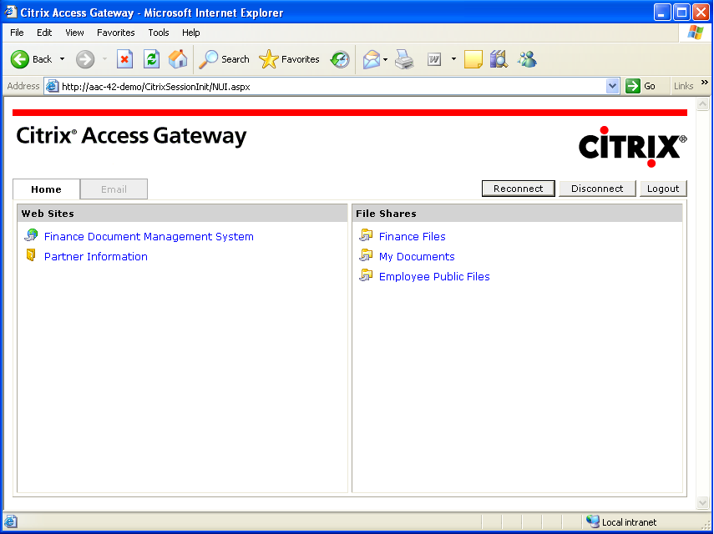
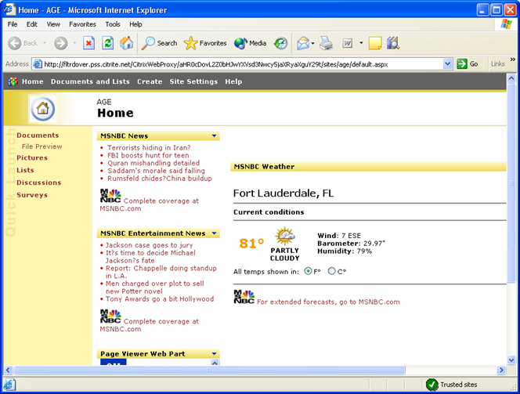
Browser-only Access:
Nav UI – Applications
Connection routed through the Web Proxy
Notes:
This slides shows the re-written URL for the web based application access, including Sharepoint and Websphere.

Slide 38

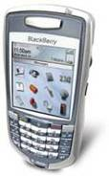
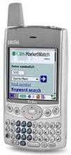
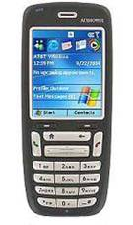
Mobile Device Awareness
Support for small form-factor devices:
  Nav UI
  Web Email
  File Browser
  HTML Preview
  Email as attachment
Supported platforms:
  Palm
  RIM Blackberry
  PocketPC 2000/2003
  Microsoft Smartphones
Notes:
This slides summarizes the various AAC components available on SFF devices.

Slide 39
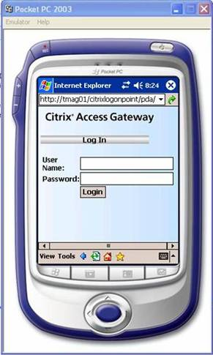
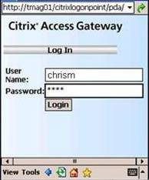
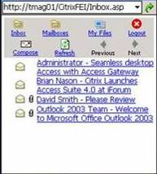
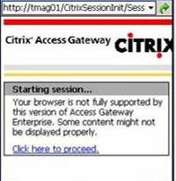
Mobile Device Awareness:
User Experience
User types in the logon point URL into the PDA browser
User enters login credentials, including two-factor as necessary
After successful authentication, user is informed of session start
User is presented with the file and email interface
Notes:
Illustrates what our email interface looks like from a Pocket PC. One of the advantages of using this interface is that it will allow users to preview, send documents as attachments without downloading them to the device.

Slide 40
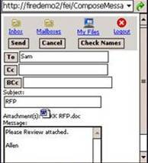
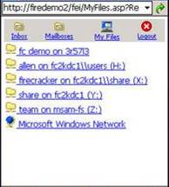
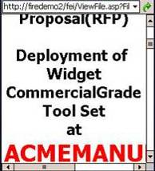
Mobile Device Awareness:
User Experience
Create/view email
Access shared or mapped drives
Access, view and email Microsoft Office files without download
Email documents from file shares

Slide 41
Extended Control for
Citrix Presentation Server
Set policies to securely launch documents using applications hosted on Presentation Server
Set policy-based access to Presentation Server
published applications
Set policy-based access to Presentation Server virtual channels (e.g., local printing, local drive mapping)
Reconnect to disconnected applications automatically at login (with policy-based access)
Notes:
Published Applications: Based on end-point analysis and other session evidence, the Advanced Access Control option determines which Citrix Presentation Server applications are available within a session. For example, accessing from an untrusted end-point device, the user may not get access to sensitive business-critical applications.
Control of ICA session channels: The Advanced Access Control option uses policies to control which ICA channels are available. For example, local printing and drive mapping cannot be used when connecting from untrusted devices, but will be available when connecting to a corporately managed desktop.
When a user moves to a different end-point device, the Advanced Access Control option can reconnect the user to only the subset of Citrix Presentation Server applications to which they have access given the new evidence. For example, a sensitive financial application may be locked down to only permit access from within the financial network. As a user moves to a terminal outside of the financial network, they can be prevented from reconnecting to their disconnected session.
Leverage Presentation Server applications to securely view documents requested from file shares, web sites, and email servers (attachments).

Slide 42
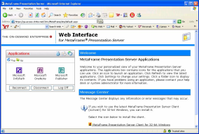
Extending Web Interface
Local Users
Access Gateway
appliance
Advanced Access
Control server
Web Interface
Firewall
Firewall
Corporate Laptop
Internet
Citrix Presentation Server Farm
Provide users with the best possible Presentation Server experience
Provide administrators with the strongest level of control
Notes:
Access Gateway works in conjunction with Citrix’s Web Interface to add functionality to Presentation Server farms. When first launching presentation server sessions, AG+AAC is involved to ensure the proper level of rights on published applications, virtual channels, and reconnection operations for disconnection session is applied correctly.
Once the ICA or CGP connection is established, AG is the only component involved in securely tunneling the traffic. Other products are available which actively modify the ICA traffic as it passes through the proxy. This mechanism introduces unnecessary latency into the connection. AG+AAC can provide the same functionality due to our propriety, patent-pending integration with CPS. However, our solution results in the best possible user experience since we are not actively modifying the connection with CPS.

Slide 43
Upgrade from Standard Edition to Advanced Edition
Local Users
Corporate Laptop
CPS Applications
Access
Gateway
appliance
Advanced Access
Control server
Email Servers
Mobile PDA
Firewall
Firewall
Web or App Servers
Internet
Home Computer
Management
Console
File Servers
Partner Machine
Desktops & Phones
Notes:
This slide demonstrates the upgrade scenario for an AG 4.x customer. This scenario applies to customers who are currently using AG for simple network access and/or SG replacement with Citrix Presentation Server.
The customer will need to purchase AAC licenses (upgrade) and deploy a server to run AAC inside the LAN.
Once deployed, the AAC server will assume all management and configuration operations. AAC will provide all appliance management via the Access Suite Console.

Slide 44
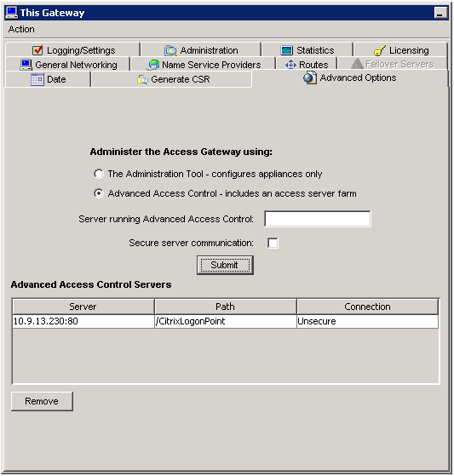
Configuring the appliance for Advanced Edition
Access Gateway appliances can be easily configured to work with Advanced Access Control servers
Enable the checkbox and specify the location of the Advanced Access Control server

Slide 45
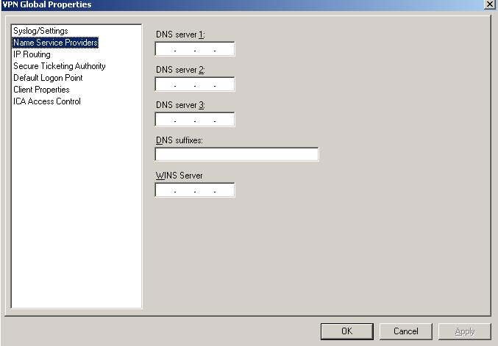
Appliance Management
Access Gateway cluster is configured in the Access Suite Console

Slide 46
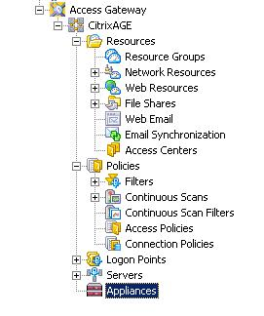
Configuring Access Gateway with Advanced Access Control
AAC provides rich, policy-based control of VPN connection:
  Specify which access scenarios to use VPN access.
  Control Split Tunneling
  Configure Continuous Endpoint scans

Slide 47
Agenda
Overview
Citrix Access Gateway Advanced Edition
Feature & Benefits
Architecture

Slide 48
Standard Deployment
Responsibilities:
Fetch configuration from Advanced Access Control servers (at start-up)
Authentication page delivery and validation
End Point Analysis proxy
Connection policy enforcement
Session verification
Presentation Server
Advanced Access
Control server
Access Gateway
appliance
E-mail Servers
HTML Authentication
Firewall
Firewall
Client Device
Secure Control Channel
(SOAP)
Web/App Servers
Responsibilities:
Authentication
End Point Analysis service
Configuration Management
Policy decisions
Licensing
Session Management
File Servers
IP PBX

Slide 49
Traffic Flow - VPN
Presentation Server
Presentation
Server Client
Access Gateway
appliance
E-mail Servers
VPN Client Traffic
Firewall
Firewall
AG Client
Web/App Servers
Secure Control Channel
Web Browser
File Servers
Advanced Access
Control server
IP PBX

Slide 50
AG Traffic – ICA/CGP
Presentation Server
Presentation
Server Client
Access Gateway
appliance
E-mail Servers
ICA/CGP Traffic
Firewall
Firewall
AG Client
Web/App Servers
Secure Control Channel
Web Browser
File Servers
Advanced Access
Control server
IP PBX

Slide 51

AG+AAC Traffic – Browser-based
AG responsibilities are:
Validate Session with AAC
Enforce Level 3-4 policies
Proxy HTTP traffic to AAC
Presentation Server
Presentation
Server Client
Access Gateway
appliance
E-mail Servers
HTML/HTTP Traffic
Firewall
Firewall
AG Client
Web/App Servers
AAC responsibilities are:
Policy Decisions
Render Navigation Pages
Enforce Granular Access
Action Rights
Advanced Access
Control server
Web Browser
File Servers
IP PBX

Slide 52
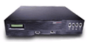

Fully Redundant Deployment
Internet
DMZ
Protected Network
Enterprise Resource Servers
Exchange/ Notes
Database Cluster
File
Shares
Endpoint Device
NetScaler
Load-Balancer
Access Gateway appliances
Web
Servers
Advanced Access Control Servers
Optional - Access Center Agent Services
MPS
Optional - Indexing Services
Notes:
It is possible to use an external load balancer, like the NetScaler 9000 series Load Balancer, to support a full redundant deployments.

Slide 53
Components and Traffic Flow
Advanced Access Control Server
Logon Agent
Page Execution
Logon
Appliance
Service
Validate Rule Set
Agent
HTML Rendering/
Pages
Validation Rules
Connection
Ticket Validation
Authentication
Manager
Service
EPA Client
Endpoint
Analysis
EPA Proxy
Requests
Service
State Change
Notifications
Gateway
Notify Request
Session
Config
Notification
Manager
Service
Service
Cluster + Session
Config Request
Notify Request
Gateway
Config
Configuration
Cluster Config
Business
Service
Objects
Session Config
Policy
Engine
Outbound traffic: port 9005
Inbound traffic: port 80 or 443

Slide 54
Access Gateway Advanced Edition
+
Access Gateway appliance
Advanced Access Control server
Defining a new level of control and access!
Notes:
In September, the customers will be able to replace their Secure Gateway in the DMZ with the Access Gateway. The Advanced Access Control will continue to be deployed inside the secure LAN on a server running Windows 2000 Server or Windows Server 2003.
What is the advantage of deploying AAC inside the network?
The main reason Advanced Access Control is deployed in the secure network, as oppose to the DMZ, is because we believe sensitive information (user information, management configuration, access policies) should reside inside the secure network.

Slide 55
Additional Resources:
Access Gateway Technical Presentation & FAQ:
  http://sharepoint.citrite.net/sites/gateways/
Endpoint Analysis SDK:
  http://apps.citrix.com/cdn

Slide 56


