Slide 1
Software Defined Networks (SDN)
Deepak Munjal
Technologist, HP Networking

Slide 2
The Problem with Networks Today
The industry hasn’t been able to keep up with ever-growing requirements
    Routers, switches and other devices have become complex because they implement an increasing number of distributed protocols and use closed and proprietary interfaces
    It is difficult to innovate in the network
Networks continue to have problems with security, robustness, manageability, mobility, as well as their ability to rapidly evolve
CAPEX has not been reduced and OPEX grows due to the complexity of the implementations
Network operators find it difficult to introduce new revenue generating services on their infrastructures

Slide 3
Open Networking Foundation on SDN
… In the SDN architecture, the control and data planes are decoupled, network intelligence and state are logically centralized and the underlying network infrastructure is abstracted or virtualized from the applications …
Source: opennetworking.org

Slide 4
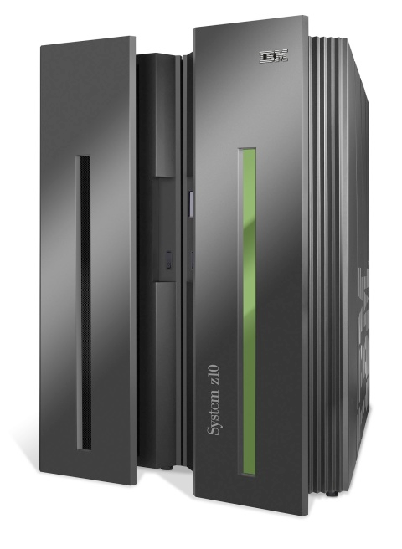
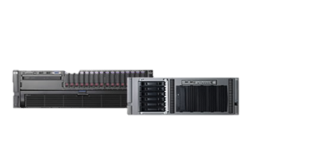
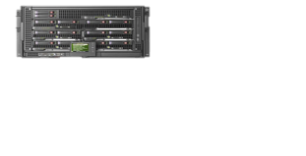

Evolution of Server Architectures
Innovation!
App
App
App
…
Proprietary Applications
Standard interfaces and programming languages
Standard Operating Systems
(Linux, Windows, etc)
Proprietary
Operating Systems
Standard interfaces
Standard Intel x86-based systems
Proprietary Hardware

Slide 5
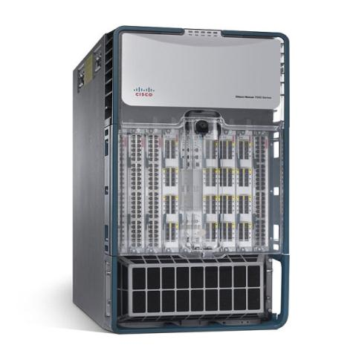
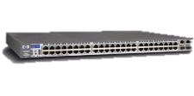
Evolution of Network Architectures
Innovation!
Network features (applications)
MCast
Routing
QoS
…
OS-Integrated Features
Open interfaces and programming languages
Centralized Control Plane
Proprietary OS
Standard interfaces and control protocols
Standard “programmable” systems
Proprietary Hardware

Slide 6

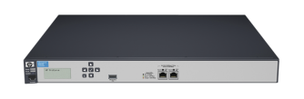




What Is OpenFlow?
  Protocol for direct access to switch forwarding plane
    Controller or control software uses OpenFlow protocol to provide programmable interface to switches & routers
    Open standard defined by the Open Networking Foundation (ONF)
Controller
Core
Switch
Core
Switches
Firewall
Net Apps
IPS
Agg
Switches
Edge
Switches
Edge
Switches
Wireless
APs
Notes:
Abstraction of control and management plane:
Today, control plane is on the physical switch hardware
Network control plane
Fragmented across many devices
Centralized intelligence
Attempts with management tools

Slide 7
HP Delivers SDN to Achieve Agility
Ability to Apply Business Logic to Network Behavior in Dynamic Fashion
Application
Layer
Business Applications
Business Applications
Business Applications
Deliver open programmable interfaces to automate orchestration of network services
Deliver open programmable interfaces to automate orchestration of network services
Deliver open programmable interfaces to automate orchestration of network services
(e.g., OpenStack, CloudStack)
Network Applications
Cloud Orchestration
Network Applications
SDN Applications
Control
Layer
Programmable Open APIs
Separate control and data plane; abstract control plane of many devices to one
Separate control and data plane; abstract control plane of many devices to one
SDN Architecture
SDN Controller
Infrastructure Layer
Control & Data Plane Programmable
Interface (e.g., OpenFlow)
Open standard-based programmatic access to infrastructure
Open standard-based programmatic access to infrastructure
Network Device
Network Device
Network Device
Notes:
Define SDNs as requiring the following three elements:
A method for modifying packet forwarding rules and/or applying policy to packets
A method for doing element 1 across multiple devices, i.e. applying packet forwarding rules and polices across multiple devices (not just one device) in a dynamic and coordinated fashion
The ability to perform elements 1 and 2 in a programmable fashion
Multiple layers of API possible
Access to services that ‘compile’ the complexity of the actual network into usable components; e.g. topology; these are the ‘libraries’ for the programmability

Slide 8


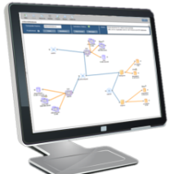


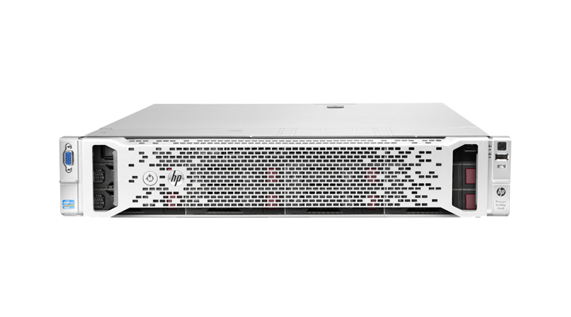


Introducing HP Virtual Cloud Network Application
Enables Scalable, Programmable Clouds, Eliminates Human Middleware
Automates Network Provisioning Enabling Self-service Cloud
Limits Provisioning Actions to Low Risk Infrastructure Elements
Enables Scaling Beyond Traditional Hardware Limits
Delivers Virtual Networking for Openstack Public & Private Clouds
Runs on HP Virtual Application Networks SDN Controller
Zero
Network Admin
One
Minute
1,000s
Cloud Users
Virtual Application Networks
SDN Controller
Notes:
We’ve talked earlier about how unfeasible attempting to run a cloud-scale network with people is. Well, we have a pretty close partner who needs to run a cloud-scale network and they presented us with three challenges in constructing a network virtualization solution for them:
1) Scalable Automation – reduce the number of points in the network which must be automated each time a new provisioning request comes in
2) Low Risk Automation – limit the points of the network which are automated to low risk areas. In other words, don’t make a change in the core of the network, that’s dangerous
3) Scalable Multi-Tenancy – come up with a straightforward way to scale beyond traditional network hardware limits
HP’s Virtual Cloud Network application, built on top of the HP VAN SDN Controller, does just this. Automation is limited to only the edge devices supporting that tenant rather than requiring network changes to occur throughout the entire networking stack. This significantly simplifies the automation task but also drastically reduces the number of commands to be implemented and the scope of configuration changes, reducing the risk of error and avoiding change to critical elements of the network.
Additionally, HP’s virtualization approach allows the cloud provider to scale beyond hardware limits in today’s switches, while allowing HP to take advantage of it’s hardware innovation in the future.
Finally, continuing HP’s commitment to Openstack, HP’s VCN application includes the plug-ins necessary for seamless integration to Openstack based clouds.
In short, HP’s Virtual Cloud Networking fills the critical gaps cloud service providers (public and private) are facing in their networks today, allowing them to move forward and focus on meeting the needs of their businesses.

Slide 9


Sentinel Security Application
Delivering Real-time Network Threat Protection
Delivers Real-time Threat Characterization with HP TippingPoint DVLabs Database
Protects from over 700,000+ Botnet, Malware & Spyware Malicious Sites
Improved Visibility & Accuracy with ArcSight Integration
Leverages OpenFlow on Switches
Runs on HP Virtual Application Networks SDN Controller
Networking
TippingPoint
Virtual Application Networks
SDN Controller
Notes:
It goes without saying that security is a top concern for all organizations. Our customers are telling us that one of their top concerns are botnets, spyware and malware. Whether it's the resulting denial of service issues or stolen data, it's just a bad day for IT administrators all around. Now let me ask, when was the last time your network solution was an integral part of the solution and not part of the problem? Never…but today we are announcing a new SDN-based security application that changes everything.
As you know, HP doesn't just do networking, but has an enormous amount of security solution capability. Two of our crown jewels are our TippingPoint and ArcSight group. TippingPoint is a Gartner MQ leader for Intrusion Prevention Service solutions and ArcSight is a Gartner MQ leader for Security Information/Event Management. We decided to partner with the folks at TippingPoint and ArcSight to bring a converged solution that addresses security pain in a completely new way within the network solution…all enabled through the power of SDN/OpenFlow.
What we did was take the power of SDN/OpenFlow to granularly control networks and married it to TippingPoint's DVLabs reputation intelligence. DVLabs reputation intelligence, called RepDV for those familiar with today's TippingPoint solutions, is an enormous database consisting of over 600k malicious websites associated with botnets, spyware and malware control servers. Anytime traffic heads to these websites, you know it's a bad day. So what we do is use SDN/OpenFlow to pick specific traffic streams that are of interest to us and compare them to the RepDV database. If we notice the traffic is heading to a malicious site we block it and flag it within ArcSight. No questions asked.
The bottom line is that Sentinel shows how SDN/OpenFlow as a technology base can transform the network from being part of the problem to being part of the solution."

Slide 10

CERN: Distributed Load Balancing Application
Delivering Advanced Traffic Characterization & Orchestration
Characterizes & load balances for increased scalability
Optimized traffic distribution with synchronization across load balancers
Adaptive load balancing based on application feedback
Leverages OpenFlow-enabled HP Switches; eliminate the need for dedicated hardware
Runs on Virtual Application Networks SDN Controller with Open APIs
Virtual Application Networks
SDN Controller

Slide 11

HP Delivers Complete Single-Touch SDN Solution Today
 | Cisco | Overlay Only | HP
Third-party applications enabled by open APIs
Campus & Branch SDN applications
Data Center SDN applications
Separate control and data plane
Open programmable access to infrastructure
Single pane-of-glass & config automation
Hardware performance
Virtual Cloud Network
Sentinel Security
Load Balancing
Application Layer
Control Layer
Infrastructure Layer
Notes:
Access/Exposure to Control Plane : dynamic state
“You can never eliminate the human middleware unless your SDN solution includes an ability to automate the configuration of the network” – this is the failure of the s/w-only SDN approaches

Slide 12


SDN Services – Strategize & Assess
Achieve Enterprise/IT Alignment, Save Hundreds of Hours of Meetings & Research Time
Define the Delta Between Compute & Storage vs. Network Provisioning Timelines
Prove SDN Value Proposition (Months to Minutes) against Baseline Assessment
Transformation Experience Workshop
Network Provisioning Baseline Assessment
Virtual App Network
Proof of Concept
Notes:
Today’s HP is announcing Industry first SDN product and services innovations.
HP’s SDN services work in concert with HP product innovations NOW to help customers realize the benefits of Software Defined Networking.
The Transformation Experience workshop is a proven approach to achieve the crucial business/IT alignment necessary for any transformational initiative, especially where there are clear people and process implications with regards to the future operating model. The output of a TEW is a set of recommendations that can then be further built out with respect to go forward plans.
The second service, Network Provisioning baseline assessment focuses on the second key premise of a transformational initiative. Understanding what current state is.
The third service, the VAN proof of concept aims to make improvements to current network provisioning cycles while building the pragmatic plan to achieve full SDN vision.

Slide 13
Starting the SDN Conversation
How do you handle network administration today?
How has network administration and operations increased the burden on your staff?
How are you managing the increasing number of network devices?
How are you taking advantage of server and storage virtualization today?
How do you provision network services like firewalls, load balancing and WAN optimization?
How do you provision network policy like QoS, ACLs, and VLANs?
What benefits do you see to a more open-standards network infrastructure?
Would virtualizing the network with SDN offer you benefits in creating a SDDC?
Are you deploying OpenStack as a part of your cloud infrastructure?

Slide 14
Key Messages and Value to your customer
Key messages to deliver to your customer | Value to your customer
We provide a complete SDN solution – Our SDN solution provides a scalable and open architecture - a solution that leverages software control with hardware acceleration to simplify your network infrastructure | A more open solution that is truly multi-vendor and not limited by proprietary implementations. Takes advantage of hardware acceleration offering higher performance compared to overlay solutions.
Our solution enables third party applications – The solution allows for the development of third party applications via the HP SDN API. Applications can be developed by HPN partners or customers can develop their own with the SDK. | Enables customers to virtualize their network applications like load balancing and firewalls into a software application. Automates network configuration and provisioning with zero config network administration resulting in lower TCO.
Industry-leading innovation – Unified network service applications reduce complexity by providing a single display and reduce costs associated with redundant solutions | Allows you to respond to customer and/or market demands faster. SIMPLIFY, SCALE AND AUTOMATE - Demonstrates our leadership in this area vs. Cisco, Brocade and Juniper.
Tools to support you:
SDN Bethany’s video:
http://youtu.be/hGXbss1BDSU
SDN Overview video:
  http://www.youtube.com/watch?v=3oAbPXODtrU&feature=youtu.be
  SDN Technical Whitepaper:
  http://h20195.www2.hp.com/V2/GetPDF.aspx%2F4AA4-3871ENW.pdf
  SDN Business Whitepaper:
  http://h20195.www2.hp.com/V2/GetPDF.aspx%2F4AA4-0790ENW.pdf
  SDN webpage:
  http://intranet.hp.com/tsg/WW3/networking/Pages/index.aspx
  Resources to support you:
  HPN Sales Specialist or DM – see account list in email
  If account is not listed, please contact
      Rick Reddell for West
      Jerry Khoury or Josh Nowak for Central
      James Gonsalves/Steve Gordon for East
    Additional RBU support: Robert Ruiz and Deepak Munjal
Notes:
We don’t want to cover this in too much detail given time constraints. Pick the top 2 messages we want them to deliver to their customer and what the value is to their customer

