Slide 1
Fortinet Product Quick Guide
2020

Slide 2







Fortinet Security Fabric
Fabric Management Center
  BROAD
  visibility of the entire digital attack surface to better manage risk
  INTEGRATED
  solution that reduces the complexity of supporting multiple point products
  AUTOMATED
  workflows to increase speed
  of operations and response
Network
Access
Open Fabric Ecosystem
Secure
WLAN/LAN
Cloud
Infrastructure
NGFW
SD-WAN
Endpoint
Applications
Security Operations

Slide 3










Broadest End-to-End Cybersecurity Platform
FortiNAC
FortiAP
FortiGate
FortiGate VM
FortiWeb
FortiClient
FortiAnalyzer
FortiManager
FortiClient
Fabric Agent
FortiSwitch
FortiCWP
FortiMail
FortiEDR
FortiSIEM
FortiGate Cloud
FortiAuthenticator
FortiCASB
FortiSandbox
FortiCloud
Appliance
Virtual Machine
Cloud
Security-as- a-Service
Software
FortiADC
FortiSOAR
FortiGuard Services
Notes:
Unlike other platforms built from acquired products that offer lose integration Fortinet’s security fabric offers the broadest portfolio of products mostly organically built from the ground up, offering the best integration available, enabling communication between and across, devices, networks and applications across a single management console.
All of the products are available in multiple form factors including cloud, VM and others.
Every product can be standalone but is more powerful as part of the Fabric Platform.

Slide 4





Fortinet Security Fabric
Zero-trust Network Access
Security-driven Networking
Dynamic Cloud Security
FortiGate
Public Cloud & Data Center
FortiGate
Secures against malicious websites, undesirable applications, attacks and malware. Enables secure SD-WAN
Cloud On-ramp
Secures your cloud infrastructure from attacks
FortiCWP
FortiNAC
Manage risk and compliance through multi-cloud infrastructures
Enforce dynamic network access control and enable network segmentation
FortiExtender
Secure 3G/4G Wireless WAN Extender
Applications
FortiMail
FortiClient
Fabric Agent
Visibility across endpoints in your network, and secure remote access
Secures against email threats and prevents SPAM and virus attacks from reaching users
FortiAuthenticator
FortiToken
FortiSwitch
Provides secure, scalable wired access to users
Identifies users wherever they are and enforces strong authentication
FortiWeb
FortiAP
FortiADC
Prevents web application attacks against your critical web assets
Provides secure, scalable wireless access to users
Application-aware intelligence for smart distribution of application traffic
FortiCASB
Prevent misconfigurations of SaaS applications and meet compliance
FortiClient (EPP)
Advanced security delivers highly effective, comprehensive protection for end-users
FortiEDR
FortiSOAR
FortiAnalyzer
FortiSIEM
Detect and prevent advanced threats along with cloud-monitored incident response
Automated security operations, analytics, and response
Analyzes network threats, inefficiencies, and usage analysis with reporting across Security Fabric
Extend integrated security, performance, and availability monitoring beyond Security Fabric
Respond
FortiInsight
FortiSandbox
FortiDeceptor
Detect
Detect and prevent insider threat with user and entity behavior analytics (UEBA)
Secure virtual runtime environment exposes unknown threats
Discover active attackers inside with decoys assets
AI-powered Security Operations
FortiGuard Subscriptions
Protect
Protection and intelligence delivered by FortiGuard Labs, providing around the clock coverage to keep your network safe—backed by more than 300+ researchers, and industry-leading AI\ML and analytics
Fabric-management Center
FortiManager
Fortinet Fabric Ecosystem
Control your network better with centralized management of your Fortinet security infrastructure
Extend your Security Fabric to other solutions and platforms through connectors and APIs

Slide 5
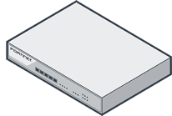

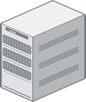
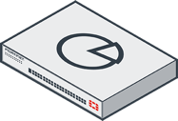
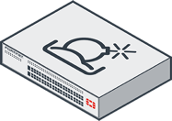

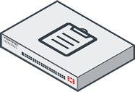
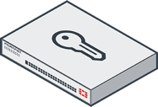
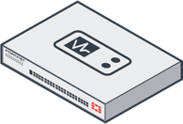
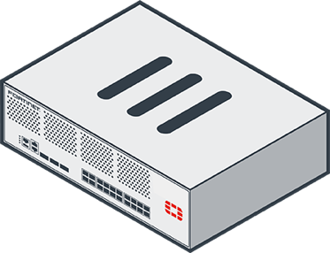

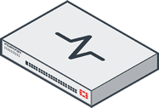
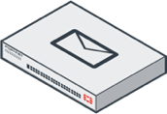
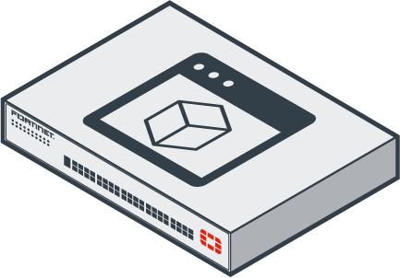
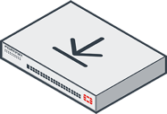




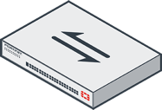

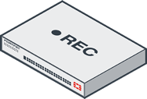
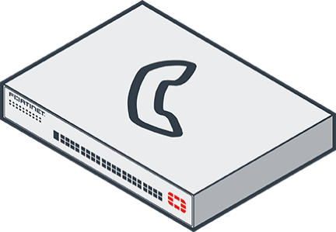


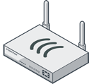





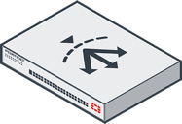

FortiGate Cloud
SECURITY/NETWORK OPERATING CENTER
FortiGate Mgmt., Log Analysis and Retention
Bulk Provisioning
IoC Service
FortiSandbox Cloud
FortiMail Cloud
FortiWeb Cloud
FortiAP Cloud
FortiSwitch Cloud
FortiToken Cloud
FortiVoice Cloud
FortiPresence
FortiCASB
FortiCWP
FortiDeceptor
FortiSOAR
FortiAnalyzer
FortiNAC
FortiSandBox
FortiWLC
Honeypot
SOAR
Central Log & report
IoT Access Control
File Analysis
Wireless Controller
Central Device Mgmt.
User Access Mgmt.
Network Tester
Wireless Manager
SIEM
Client Mgmt. System
Public Cloud
Instances
FortiManager
FortiAuthenticator
FortiTester
FortiWLM
FortiSIEM
FortiClient EMS
FTNT Hosted Services
L7 D/DOS Mitigator
Mail Sec. Gateway
Mail Servers
Remote VPN
Security Gateway
2 Factor OTP Token
Endpoint Security
FortiIsolator
FortiProxy
FortiDDoS
FortiMail
FortiGate
FortiToken
Browser Isolation
Secure Web Gateway
MOBILE USERS
FortiClient
FortiEDR
LAN
DATA CENTER
Switch
Access
Point
Surveillance
IP PBX
VMWare
Citrix Xen
MS Hyper-V
KVM
Nutanix AHV
3G/4G WAN
FortiExtender
Site-to-site VPN
Virtual Appliances
Secure WiFi Access
FortiSwitch
FortiAP
FortiRecorder
FortiVoice
Web App. Firewall
Load Balancer
FortiWiFi
REMOTE OFFICE
Web Servers
FortiCamera
FortiFone
FortiWeb
FortiADC

Slide 6
Content
FortiGate/FortiWiFi
FortiAnalyzer
FortiManager
FortiSIEM
FortiAuthenticator
FortiAP
FortiSwitch
FortiNAC
FortiSandbox
FortiClient
FortiMail
FortiWeb
FortiADC
FortiCASB
FortiDDoS
FortiDeceptor
FortiEDR
FortiIsolator
FortiProxy
FortiRecorder & FortiCamera
FortiSOAR (coming soon)
FortiTester
FortiToken
FortiVoice & FortiFone
FortiWLC
FortiWLM

Slide 7

FortiGate/FortiWiFi

Slide 8
Fortinet Security Processor Evolution
2006 | 2007 | 2008 | 2009 | 2010 | 2011 | 2012 | 2013 | 2014 | 2015 | 2016.. | 2019 | 2020
6
7
9
2
4
7
1
4

Slide 9



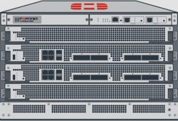

FortiGate Product Range
Personality, Threat Protection Performance and Scalability
 |  |  |  |  | Mobile Security
 |  |  |  |  | Segmentation |  |  |  | CFW/ VMFW
 |  |  |  | IPS
 |  |  |  | SWG
 | NGFW
 | Secure SD-WAN
Software & Services
Product Range | Entry-Level |  | Mid-Range |  | High-End |  | Ultra High-End | Chassis-Based | Virtual Appliances
CPU
Multi
Core
CPU
Multi
Core
CPU
Multi
Core
CPU
Processor Card System
Multi
Core
CPU
SoC
NP
CP
NP
CP
NP
CP
150 Mbps
250 Mbps
1 Gbps - 20 Gbps
35 Gbps - 100 Gbps
H/W Dependent
600-900 Series
6000 Series
5000 & 7000
Series
VM Series
30-90 Series
100-500 Series
3000 Series
1000-2000 Series
FortiGuard
Security Services
FortiOS
Operating System
FortiCare
Support Services

Slide 10
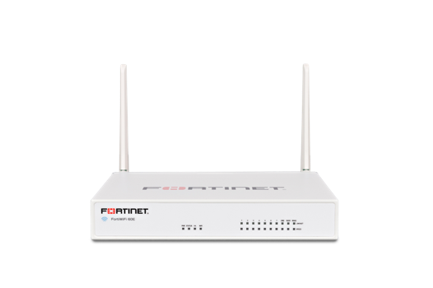

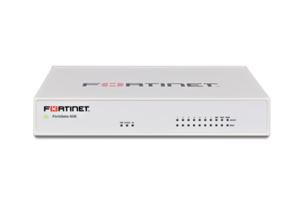




FortiGate Entry Level Series - Overview
        Feature-rich Security Appliances For Small/Home Offices & Small Branch Offices
FG- 80E Series
FG/FWF- 60E/60F Series
FG/FWF- 40F Series
FG/FWF- 30E/50E Series
NGFW
Secure SD-WAN
950 Mbps – 10 Gbps
Firewall throughput
300 Mbps – 1.4 Gbps
IPS Throughput
200 Mbps - 1 Gbps
NGFW Throughput
150 Mbps - 700 Mbps
Threat Protection Throughput
GE RJ45 | GE RJ45 PoE/+ | GE SFP
Variants: WiFi | In-built 3G4G | In-built DSL | Ruggedized

Slide 11
FortiGate Entry Level Series: Comparison
 | FG-30E | FG-40F | FG-50E | FG-60E | FG-60F | FG-80E
Firewall (1518/512/64 byte UDP) | 950 Mbps | 5 / 5 / 5 Gbps | 2.5 Gbps | 3 / 3 / 3 Gbps | 10 / 10 / 6 Gbps | 4 /4 /4 Gbps
Concurrent Sessions | 900,000 | 700,000 | 1.8 Mil | 1.3 Mil | 700,000 | 1.3 Mil
New Sessions/Sec | 15,000 | 35,000 | 21,000 | 30,000 | 35,000 | 30,000
IPSec VPN | 75 Mbps | 4.4 Gbps | 90 Mbps | 2 Gbps | 6.5 Gbps | 2.5 Gbps
IPS (Ent. Mix) | 300 Mbps | 1 Gbps | 350 Mbps | 400 Mbps | 1.4 Gbps | 450 Mbps
NGFW (Ent. Mix) | 200 Mbps | 800 Mbps | 220 Mbps | 250 Mbps | 1 Gbps | 360 Mbps
Threat Protection (Ent. Mix) | 150Mbps | 600 Mbps | 160 Mbps | 180 Mbps | 700 Mbps | 250 Mbps
Interfaces | 5 x GE RJ45 | 5 x GE RJ45 | 7 x GE RJ45 | 10 x GE RJ45 | 10 x GE RJ45 | 14 x GE RJ45 2x Shared Media Pairs
Storage | - | - | 32 GB (51E) | 128 GB (61E) | 128 GB (61F) | 128 GB (81E)
Variants | WiFi | WiFi, 3G4G | WiFi | WiFi, PoE | WiFi | PoE

Slide 12
FortiGate Entry Level Series: Comparison
 | FWF30E | FWF40F | FWF50E | FWF60/61E | FWF60/61F
Thick AP | ● | ● | ● | ● | ●
Wireless Controller | ● | ● | ● | ● | ●
# of WiFi radios | 1 | 1 | 1 | 1 | 1
Supported Std | a/b/g/n | a/b/g/n/ac W2 | a/b/g/n | a/b/g/n/ac | a/b/g/n/ac W2
802.11n | 2x2 MIMO | 3x3 MIMO | 2x2 MIMO | 2x2 MIMO | 3x3 MIMO
Max wireless association rate total | 300 Mbps | 1,300 Mbps | 300 Mbps | 867 Mbps | 1,300 Mbps
SSID’s (incl. reserved) | 8 | 8 | 8 | 8 | 8
Max AP (Total/ Tunnel) | 2 / 2 | 16 / 8 | 10 / 5 | 30 / 10 | 64 / 32

Slide 13
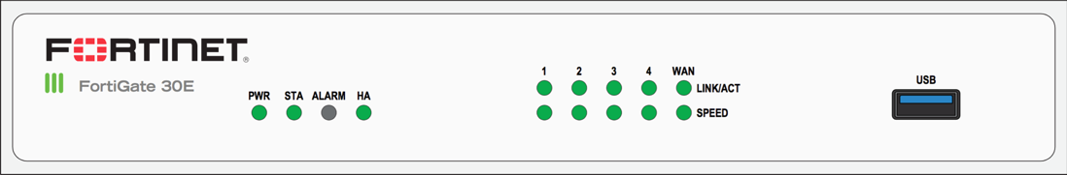
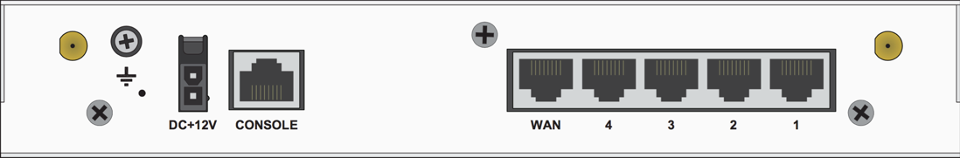


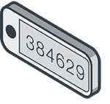
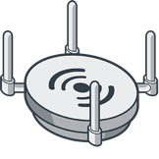
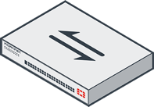


FortiGate/FortiWiFi 30E
1 x GE RJ45 WAN Port
4 x GE RJ45 Ports
WiFi Variant: 802.11a/b/g/n
3
1
2
950 Mbps
Firewall throughput
0.9 Million
Concurrent Sessions
125 Mbps
SSL Inspection Throughput
300 Mbps
IPS Throughput
200 Mbps
NGFW Throughput
150 Mbps
Threat Protection Throughput
Small Business / Remote Office
NGFW / Secure SD-WAN
15,000
New Sessions/Sec
500
2
8

Slide 14

FortiGate 30E-3G4G
1 x GE RJ45 WAN Port
4 x GE RJ45 Ports
1
2
950 Mbps
Firewall throughput
0.9 Million
Concurrent Sessions
125 Mbps
SSL Inspection Throughput
300 Mbps
IPS Throughput
200 Mbps
NGFW Throughput
150 Mbps
Threat Protection Throughput
Small Business / Remote Office
NGFW / Secure SD-WAN
15,000
New Sessions/Sec
500
2
8

Slide 15


FortiGate/FortiWiFi 40F
1 x GE RJ45 WAN Port
1 x GE RJ45 FortiLink Port
3 x GE RJ45 Ports
WiFi Variant: 802.11a/b/g/n/ac W2
4
1
2
3
5 Gbps
Firewall throughput
700,000
Concurrent Sessions
310 Mbps
SSL Inspection Throughput
1 Gbps
IPS Throughput
800 Mbps
NGFW Throughput
600 Mbps
Threat Protection Throughput
Small Business / Remote Office
NGFW / Secure SD-WAN
35,000
New Sessions/Sec
500
16
8

Slide 16
FortiGate/FortiWiFi 40F-3G4G
1 x GE RJ45 WAN Port
1 x GE RJ45 FortiLink Port
3 x GE RJ45 Ports
WiFi Variant: 802.11a/b/g/n/ac W2
4
1
2
3
5 Gbps
Firewall throughput
700,000
Concurrent Sessions
310 Mbps
SSL Inspection Throughput
1 Gbps
IPS Throughput
800 Mbps
NGFW Throughput
600 Mbps
Threat Protection Throughput
Small Business / Remote Office
NGFW / Secure SD-WAN
35,000
New Sessions/Sec
500
16
8

Slide 17
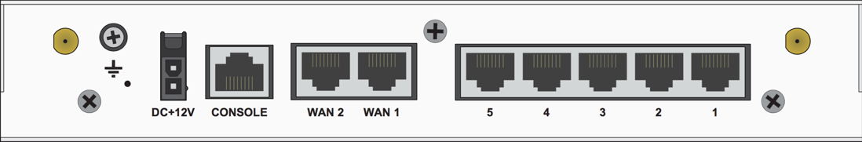
FortiGate/FortiWiFi 50E
2 x GE RJ45 WAN Ports
5 x GE RJ45 Ports
WiFi Variant: 802.11a/b/g/n
3
1
2
2.5 Gbps
Firewall throughput
1.8 Million
Concurrent Sessions
150 Mbps
SSL Inspection Throughput
350 Mbps
IPS Throughput
220 Mbps
NGFW Throughput
160 Mbps
Threat Protection Throughput
Small Business / Remote Office
NGFW / Secure SD-WAN
21,000
New Sessions/Sec
500
10
8

Slide 18

FortiGate/FortiWiFi 51E
2 x GE RJ45 WAN Ports
5 x GE RJ45 Ports
WiFi Variant: 802.11a/b/g/n
3
1
2
2.5 Gbps
Firewall throughput
1.8 Million
Concurrent Sessions
150 Mbps
SSL Inspection Throughput
350 Mbps
IPS Throughput
220 Mbps
NGFW Throughput
160 Mbps
Threat Protection Throughput
Small Business / Remote Office
NGFW / Secure SD-WAN
21,000
New Sessions/Sec
500
10
8

Slide 19

FortiGate/FortiWiFi 60E
2 x GE RJ45 WAN Ports
1 x GE RJ45 DMZ Port
7 x GE RJ45 Ports
WiFi Variant: 802.11a/b/g/n/ac
3
1
2
3
3 Gbps
Firewall throughput
1.3 Million
Concurrent Sessions
135 Mbps
SSL Inspection Throughput
400 Mbps
IPS Throughput
250 Mbps
NGFW Throughput
200 Mbps
Threat Protection Throughput
Small Business / Remote Office
NGFW / Secure SD-WAN
30,000
New Sessions/Sec
500
30
16

Slide 20
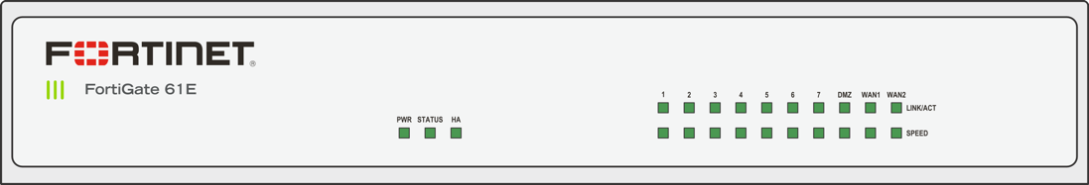

FortiGate/FortiWiFi 61E
2 x GE RJ45 WAN Ports
1 x GE RJ45 DMZ Port
7 x GE RJ45 Ports
WiFi Variant: 802.11a/b/g/n/ac
3
1
2
3
3 Gbps
Firewall throughput
1.3 Million
Concurrent Sessions
135 Mbps
SSL Inspection Throughput
400 Mbps
IPS Throughput
250 Mbps
NGFW Throughput
200 Mbps
Threat Protection Throughput
Small Business / Remote Office
NGFW / Secure SD-WAN
30,000
New Sessions/Sec
500
30
16

Slide 21
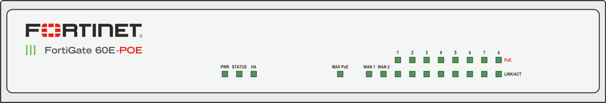
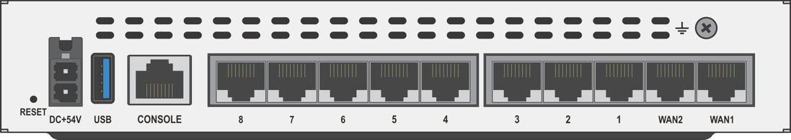

FortiGate 60E-POE
8 x GE RJ45 PoE/+ Ports
2 x GE RJ45 WAN Ports
1
2
3 Gbps
Firewall throughput
1.3 Million
Concurrent Sessions
135 Mbps
SSL Inspection Throughput
400 Mbps
IPS Throughput
250 Mbps
NGFW Throughput
200 Mbps
Threat Protection Throughput
Small Business / Remote Office
NGFW / Secure SD-WAN
30,000
New Sessions/Sec
500
30
16

Slide 22
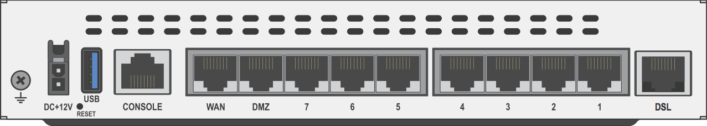
FortiGate/FortiWiFi 60E-DSL/J
2 x GE RJ45 WAN/DMZ Ports
7 x GE RJ45 Ports
1 x GE RJ11 DSL Ports
1
2
3
3 Gbps
Firewall throughput
1.3 Million
Concurrent Sessions
135 Mbps
SSL Inspection Throughput
400 Mbps
IPS Throughput
250 Mbps
NGFW Throughput
200 Mbps
Threat Protection Throughput
Small Business / Remote Office
NGFW / Secure SD-WAN
30,000
New Sessions/Sec
500
30
16

Slide 23
FortiGate/FortiWiFi 60/61F
2 x GE RJ45 WAN Ports
1 x GE RJ45 DMZ Port
7 x GE RJ45 Ports
3
1
2
3
10 Gbps
Firewall throughput
700,000
Concurrent Sessions
750 Mbps
SSL Inspection Throughput
1.4 Gbps
IPS Throughput
1. Gbps
NGFW Throughput
700 Mbps
Threat Protection Throughput
Small Business / Remote Office
NGFW / Secure SD-WAN
35,000
New Sessions/Sec
500
64
16

Slide 24
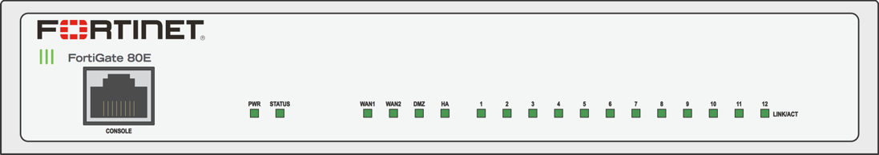
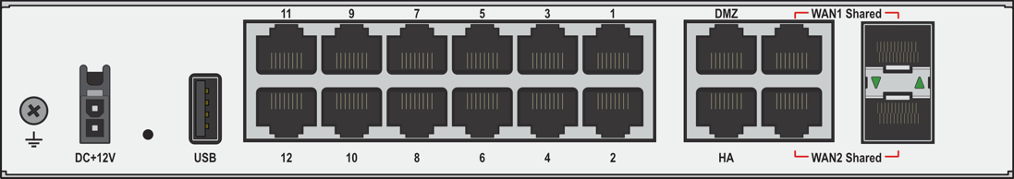
FortiGate 80E/81E
2 x GE RJ45 DMZ/HA Port
12 x GE RJ45 Ports
2x Shared Media interface Pairs
2
1
3
4 Gbps
Firewall throughput
1.3 Million
Concurrent Sessions
135 Mbps
SSL Inspection Throughput
450 Mbps
IPS Throughput
360 Mbps
NGFW Throughput
250 Mbps
Threat Protection Throughput
Small Business / Remote Office
NGFW / Secure SD-WAN
30,000
New Sessions/Sec
500
32
16

Slide 25
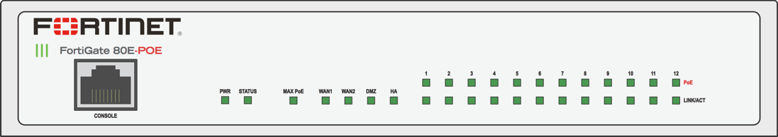
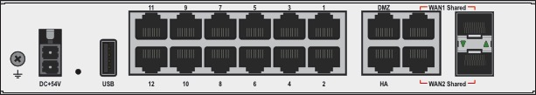
FortiGate 80E/81E-POE
2 x GE RJ45 DMZ/HA Port
12 x GE RJ45 PoE/+ Ports
2x Shared Media interface Pairs
2
1
3
4 Gbps
Firewall throughput
1.3 Million
Concurrent Sessions
135 Mbps
SSL Inspection Throughput
450 Mbps
IPS Throughput
360 Mbps
NGFW Throughput
250 Mbps
Threat Protection Throughput
Small Business / Remote Office
NGFW / Secure SD-WAN
30,000
New Sessions/Sec
500
32
16

Slide 26
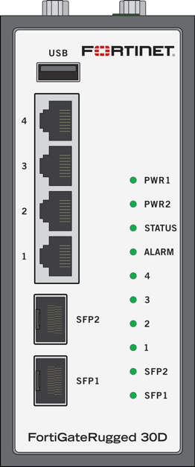
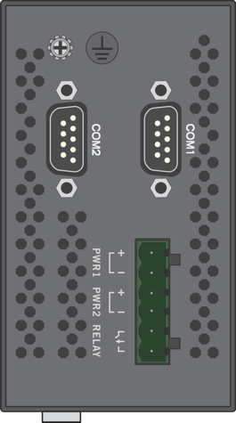


FortiGate Rugged-30D
4x GE RJ45 Ports
2x GE SFP Slots
2x DB9 Serial Port
1
3
2
900 Mbps
Firewall throughput
750,000
Concurrent Sessions
5,000
New Sessions/Sec
180 Mbps
IPS Throughput
45 Mbps
NGFW Throughput
16 Mbps
Threat Protection Throughput
Small Business / Remote Office
NGFW / Secure SD-WAN
500
32
8

Slide 27
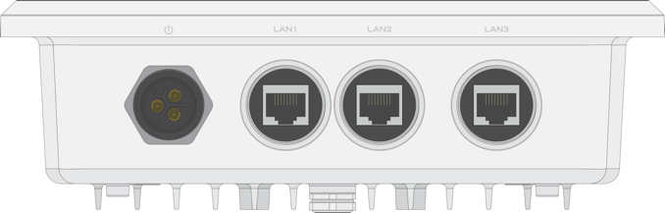
FortiGate Rugged-35D
3x GE RJ45 Ports
1
550 Mbps
Firewall throughput
750,000
Concurrent Sessions
5,000
New Sessions/Sec
210 Mbps
IPS Throughput
65 Mbps
NGFW Throughput
16 Mbps
Threat Protection Throughput
Small Business / Remote Office
NGFW / Secure SD-WAN
500
32
8

Slide 28
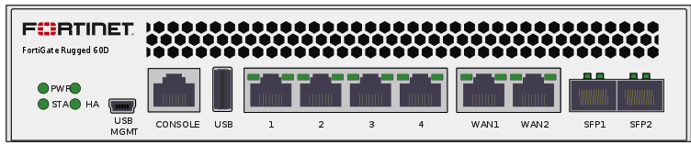
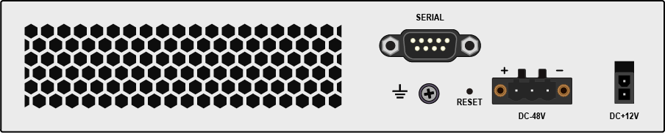

FortiGate Rugged-60D
4x GE RJ45 Ports
2x Shared Media Pairs
1x DB9 Serial Port
1
2
3
1.5 Gbps
Firewall throughput
500,000
Concurrent Sessions
4,000
New Sessions/Sec
95 Mbps
IPS Throughput
40 Mbps
NGFW Throughput
23 Mbps
Threat Protection Throughput
Small Business / Remote Office
NGFW / Secure SD-WAN
500
32
8

Slide 29
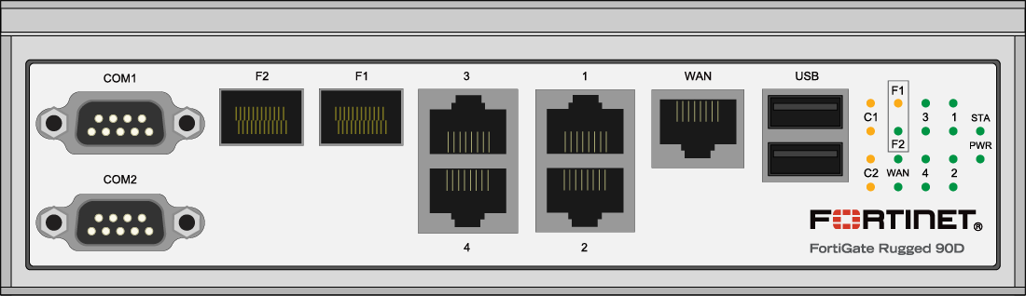
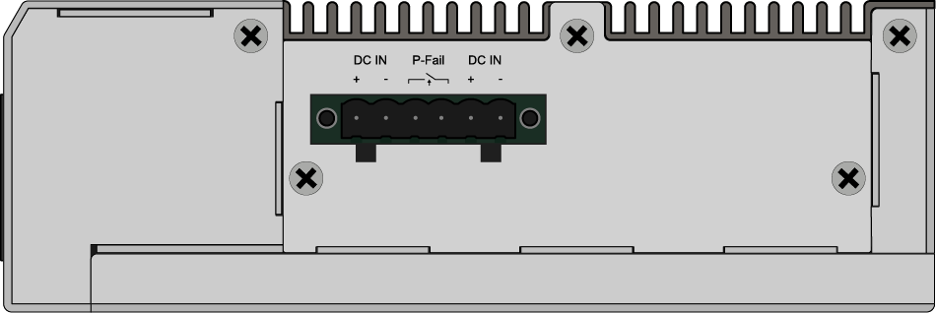
FortiGate Rugged-90D
2x DB9 Serial Interface/Console
2x GE SFP Slots
1x GE RJ45 Bypass Pair
3x GE RJ45 ports
1
2
4
3
4
2 Gbps
Firewall throughput
2.5 Million
Concurrent Sessions
20,000
New Sessions/Sec
350 Mbps
IPS Throughput
370 Mbps
NGFW Throughput
280 Mbps
Threat Protection Throughput
Small Business / Remote Office
NGFW / Secure SD-WAN
500
32
8

Slide 30
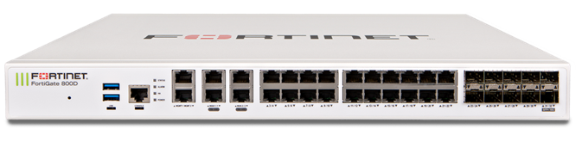
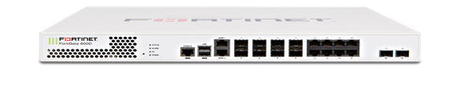
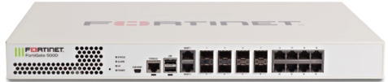



FortiGate Mid-Range Series - Overview
        High Performance, Top Rated Network Security for Mid-Sized Enterprises
NGFW
FG-900D
FG-800D
FG-600E
FG-500E
FG-400E
FG-300E
FG-200E Series
FG-100F Series
Secure SD-WAN
SWG (600 series+)
IPS (600 series+)
7.4 Gbps – 50 Gbps
Firewall throughput
500 Mbps – 10 Gbps
IPS Throughput
360 Mbps – 9.5 Gbps
NGFW Throughput
250 Mbps – 7 Gbps
Threat Protection Throughput
GE RJ45 | GE SFP | 10GE SFP+

Slide 31
FortiGate Mid Range Devices: Comparison
 | FGT-100E Series | FGT-140E-POE | FGT-100F Series | FGT-200E Series
Firewall (1518/512/64 byte UDP) | 7.4 / 7.4 / 4.4 Gbps | 7.4 / 7.4 / 4.4 Gbps | 20 / 18 / 10 Gbps | 20 / 20 / 9 Gbps
Concurrent Sessions | 2 Mil | 2 Mil | 1.5 Mil | 2 Mil
New Sessions/Sec | 30,000 | 30,000 | 56,000 | 135,000
IPSec VPN | 4 Gbps | 4 Gbps | 11.5 Gbps | 9 Gbps
IPS (Ent. Mix) | 500 Mbps | 500 Mbps | 2.6 Gbps | 2.2 Gbps
NGFW (Ent. Mix) | 360 Mbps | 360 Mbps | 1.6 Gbps | 1.8 Gbps
Threat Protection (Ent. Mix) | 250 Mbps | 250 Mbps | 1 Gbps | 1.2 Gbps
Interfaces | 20 x GE RJ45, 2x Shared Media Pairs | 18 x GE RJ45, 24 x GE RJ45 POE, 2 x GE SFP | 2 x 10GE SFP+, 18 x GE RJ45, 8x GE SFP, 4x Shared Media Pairs | 18x GE RJ45, 4x GE SFP
Storage | 480 GB (101E) | - | 480 GB (101F) | 480 GB (201E)
Variants | Fiber | - | - | -

Slide 32
FortiGate Mid Range Devices: Comparison
 | FGT-300E Series | FGT-400E Series | FGT-500E Series | FGT-600E Series | FG-800D | FG-900D
Firewall (1518/512/64 byte UDP) | 32 / 32 / 20 Gbps | 32 / 32 / 24 Gbps | 36 / 36 / 22 Gbps | 32 / 32 / 27 Gbps | 36 / 36 / 22 Gbps | 52 / 52 / 33 Gbps
Concurrent Sessions | 4 Mil | 4 Mil | 8 Mil | 8 Mil | 5 Mil | 11 Mil
New Sessions/Sec | 300,000 | 450,000 | 300,000 | 450,000 | 280,000 | 280,000
IPSec VPN | 20 Gbps | 20 Gbps | 20 Gbps | 20 Gbps | 20 Gbps | 25 Gbps
IPS (Ent. Mix) | 5 Gbps | 7.8 Gbps | 5.2 Gbps | 10 Gbps | 4.2 Gbps | 4.2 Gbps
NGFW (Ent. Mix) | 3.5 Gbps | 6 Gbps | 5 Gbps | 9.5 Gbps | 4 Gbps | 4 Gbps
Threat Protection (Ent. Mix) | 3 Gbps | 5 Gbps | 4.7 Gbps | 7 Gbps | 3 Gbps | 3 Gbps
Interfaces | 18 x GE RJ45, 16 x GE SFP | 18 x GE RJ45, 16 x GE SFP | 2x 10 GE SFP+, 10x GE RJ45, 8x GE SFP | 2x 10 GE SFP+, 10x GE RJ45, 8x GE SFP | 2x 10 GE SFP+, 8x GE SFP, 4x GE RJ45 Bypass, 22x GE RJ45 | 2x 10GE SPF+ , 16x GE SFP, 18x GE RJ45
Storage | 480 GB (301E) | 480 GB (401E) | 480 GB (501E) | 480 GB (601E) | 240 GB | 256 GB
Variants | - | - | - | - | - | -

Slide 33
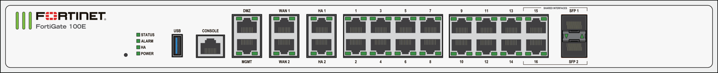
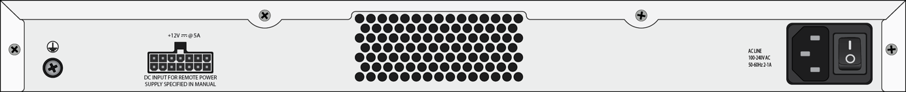



FortiGate 100/101E
2 x GE RJ45 MGMT/DMZ Ports
2 x GE RJ45 HA Ports
2 x GE RJ45 WAN Port
14 x GE RJ45 Ports
2 x GE RJ45/SFP Shared Media Pairs
1
2
3
4
5
7.4 Gbps
Firewall throughput
2 Million
Concurrent Sessions
130 Mbps
SSL Inspection Throughput
500 Mbps
IPS Throughput
360 Mbps
NGFW Throughput
250 Mbps
Threat Protection Throughput
Enterprise Branch / Mid Enterprise
NGFW / Secure SD-WAN
30,000
New Sessions/Sec
5,000
64
24

Slide 34
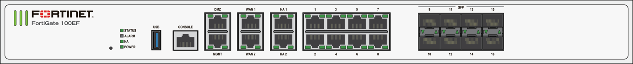
FortiGate 100EF
2 x GE RJ45 MGMT/DMZ Ports
2 x GE RJ45 WAN Ports
2 x GE RJ45 HA Port
8 x GE RJ45 Ports
8 x GE SFP Slots
1
2
3
4
5
7.4 Gbps
Firewall throughput
2 Million
Concurrent Sessions
130 Mbps
SSL Inspection Throughput
500 Mbps
IPS Throughput
360 Mbps
NGFW Throughput
250 Mbps
Threat Protection Throughput
Enterprise Branch / Mid Enterprise
NGFW / Secure SD-WAN
30,000
New Sessions/Sec
5,000
64
24

Slide 35
FortiGate 140E-POE
2 x GE RJ45 MGMT/HA Ports
2 x GE RJ45 WAN Ports
14x GE RJ45 Ports
24x GE PoE/+ Ports
2 x GE SFP DMZ Slots
1
2
3
4
5
7.4 Gbps
Firewall throughput
2 Million
Concurrent Sessions
130 Mbps
SSL Inspection Throughput
500 Mbps
IPS Throughput
360 Mbps
NGFW Throughput
250 Mbps
Threat Protection Throughput
Enterprise Branch / Mid Enterprise
NGFW / Secure SD-WAN
30,000
New Sessions/Sec
5,000
64
24

Slide 36
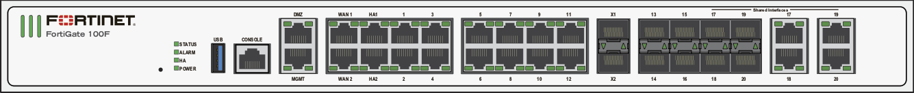


FortiGate 100/101F
2 x GE RJ45 MGMT/DMZ Ports
2 x GE RJ45 HA Ports
2 x GE RJ45 WAN Ports
12 x GE RJ45 Ports
2 x 10GE SFP+ FortiLink Slots
8 x GE SFP Slots
4 x GE RJ45/SFP Shared Media Pairs
1
2
3
4
5
6
7
20 Gbps
Firewall throughput
1.5 Million
Concurrent Sessions
1 Gbps
SSL Inspection Throughput
2.6 Gbps
IPS Throughput
1.6 Gbps
NGFW Throughput
1 Gbps
Threat Protection Throughput
Enterprise Branch / Mid Enterprise
NGFW / Secure SD-WAN
56,000
New Sessions/Sec
5,000
128
24

Slide 37
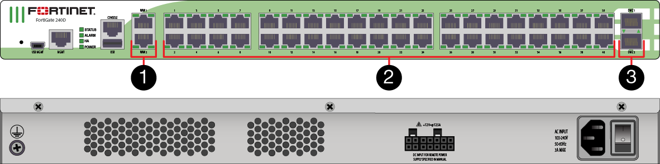




FortiGate 240D
2x GE RJ45 WAN Ports
40x GE RJ45 Switch Ports
2x GE SFP Slots
4 Gbps
Firewall throughput
2 Million
Concurrent Sessions
77,000
New Sessions/Sec
420 Mbps
IPS Throughput
330 Mbps
NGFW Throughput
310 Mbps
Threat Protection Throughput
Enterprise Branch / Mid Enterprise
NGFW / Secure SD-WAN
5,000
128
24

Slide 38
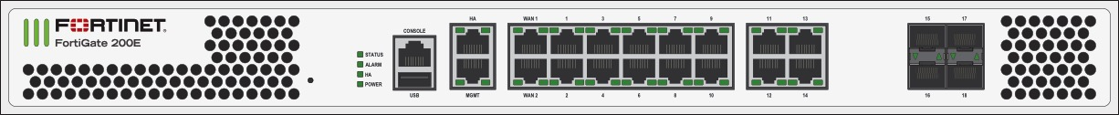


FortiGate 200/201E
2 x GE RJ45 MGMT/HA Ports
2 x GE RJ45 WAN Ports
14 x GE RJ45 DMZ Port
4 x GE SFP Slots
1
2
3
4
20 Gbps
Firewall throughput
2 Million
Concurrent Sessions
820 Mbps
SSL Inspection Throughput
2.2 Gbps
IPS Throughput
1.8 Gbps
NGFW Throughput
1.2 Gbps
Threat Protection Throughput
Enterprise Branch / Mid Enterprise
NGFW / Secure SD-WAN
135,000
New Sessions/Sec
5,000
256
64

Slide 39





FortiGate 300/301E
2 x GE RJ45 MGMT/HA Ports
16 x GE RJ45 Ports
16 x GE SFP Slots
1
2
3
32 Gbps
Firewall throughput
4 Million
Concurrent Sessions
3.9 Gbps
SSL Inspection Throughput
5 Gbps
IPS Throughput
3.5 Gbps
NGFW Throughput
3 Gbps
Threat Protection Throughput
Enterprise Branch / Mid Enterprise
NGFW / Secure SD-WAN
300,000
New Sessions/Sec
5,000
512
72

Slide 40


FortiGate 400E and 401E/-DC
2 x GE RJ45 MGMT/HA Ports
16 x GE RJ45 Ports
16 x GE SFP Slots
1
2
3
32 Gbps
Firewall throughput
4 Million
Concurrent Sessions
4.8 Gbps
SSL Inspection Throughput
7.8 Gbps
IPS Throughput
6 Gbps
NGFW Throughput
5 Gbps
Threat Protection Throughput
Enterprise Branch / Mid Enterprise
NGFW / Secure SD-WAN
450,000
New Sessions/Sec
5,000
512
72

Slide 41


FortiGate 500/501E
2 x GE RJ45 MGMT/HA Ports
8 x GE RJ45 Ports
8 x GE SFP Slots
2x 10GE SFP+ Slots
1
2
3
4
36 Gbps
Firewall throughput
8 Million
Concurrent Sessions
5.7 Gbps
SSL Inspection Throughput
5.2 Gbps
IPS Throughput
5 Gbps
NGFW Throughput
4.7 Gbps
Threat Protection Throughput
Enterprise Branch / Mid Enterprise
NGFW / Secure SD-WAN
300,000
New Sessions/Sec
5,000
512
72

Slide 42

FortiGate 600/601E
2 x GE RJ45 MGMT/HA Ports
8 x GE RJ45 Ports
8 x GE SFP Slots
2x 10GE SFP+ Slots
1
2
3
4
36 Gbps
Firewall throughput
8 Million
Concurrent Sessions
8.0 Gbps
SSL Inspection Throughput
10 Gbps
IPS Throughput
9.5 Gbps
NGFW Throughput
7 Gbps
Threat Protection Throughput
Enterprise Branch / Mid Enterprise
NGFW / Secure SD-WAN / IPS / SWG
450,000
New Sessions/Sec
5,000
1,024
96

Slide 43




FortiGate 800D
2x GE RJ45 Management Ports
2x Bypass GE RJ45 Pairs
20x GE RJ45 Ports
8x GE SPF Slots
2x 10GE SPF+ Slots
1
2
3
4
5
36 Gbps
Firewall throughput
5 Million
Concurrent Sessions
3.9 Gbps
SSL Inspection Throughput
4.2 Gbps
IPS Throughput
4 Gbps
NGFW Throughput
3 Gbps
Threat Protection Throughput
Enterprise Branch / Mid Enterprise
NGFW / Secure SD-WAN / IPS / SWG
280,000
New Sessions/Sec
5,000
1,024
64

Slide 44



FortiGate 900D
2
2x GE RJ45 Management Ports
16x GE SFP Slots
16x GE RJ45 Ports
2x 10GE SPF+ Slots
4
1
1
2
3
52 Gbps
Firewall throughput
11 Million
Concurrent Sessions
3.9 Gbps
SSL Inspection Throughput
4.2 Gbps
IPS Throughput
4 Gbps
NGFW Throughput
3 Gbps
Threat Protection Throughput
Enterprise Branch / Mid Enterprise
NGFW / Secure SD-WAN / IPS / SWG
280,000
New Sessions/Sec
5,000
1,024
64

Slide 45




FortiGate High End Series - Overview
        Data Center Firewall / Large Enterprise NGFW with High Speed Interfaces
NGFW, IPS
FG-3000D/E Series
FG-2000E Series
FG-1000D/E/F Series
Segmentation
SWG
Mobile
Security
52 Gbps – 320 Gbps
Firewall throughput
6 Gbps – 55 Gbps
IPS Throughput
5 Gbps – 40 Gbps
NGFW Throughput
3 Gbps – 30 Gbps
Threat Protection Throughput
GE RJ45 | GE SFP 10GE SFP+
25GE SFP28
40GE QSFP+
100GE QSFP28

Slide 46
FortiGate High End Series: Comparison
 | FG-1000D | FG-1100E | FG-1200D | FG-1500D | FG-1800F | FG-2000E
Firewall (1518/512/64 byte UDP) | 52 / 52 / 33 Gbps | 80 / 80 / 45 Gbps | 72 / 72 / 55 Gbps | 80 / 80 / 55 Gbps | 198 / 197 / 140Gbps | 90 / 90 / 60 Gbps
Concurrent Sessions | 11 Mil | 8 Mil | 11 Mil | 12 Mil | 12 Mil | 20 Mil
New Sessions/Sec | 280,000 | 500,000 | 290,000 | 300,000 | 750,000 | 500,000
IPSec VPN | 25 Gbps | 48 Gbps | 48 Gbps | 50 Gbps | 65 Gbps | 65 Gbps
IPS (Ent. Mix) | 6 Gbps | 12.5 Gbps | 6.8 Gbps | 13 Gbps | 13 Gbps | 11.5 Gbps
NGFW (Ent. Mix) | 5 Gbps | 9.8 Gbps | 6 Gbps | 7 Gbps | 11 Gbps | 9 Gbps
Threat Protection (Ent. Mix) | 3 Gbps | 7.1 Gbps | 4 Gbps | 5 Gbps | 9.1 Gbps | 5.4 Gbps
Interfaces | 2x 10GE SPF+ , 16x GE SFP, 18x GE RJ45, | 2x 40GE QSFP+, 4x 25 GE SFP28, 4x 10 GE SFP+, 8x GE SFP, 18x GE RJ45 | 4x 10GE SPF/+, 16x GE SFP, 18x GE RJ45 | 8x 10GE SPF/+, 16x GE SFP, 18x GE RJ45 | 4x 40GE QSFP+, 12x 25 GE SFP28, 2x 10GE SFP+, 8x GE SFP, 18x GE RJ45 | 6x 10GE SPF+, 34x GE RJ45
Storage | 256 GB | 2x 480 GB (1101E) | 240 GB | 480 GB |  | 480 GB
Variants | - | - | - | 10 GE RJ45 |  | -

Slide 47
FortiGate High End Series II: Comparison
 | FG-2200E | FG-2500E | FG-3000D | FG-3100D | FG-3200D | FG-3300E
Firewall (1518/512/64 byte UDP) | 158 / 155 / 100 Gbps | 150 / 150 / 95 Gbps | 80 / 80 / 50 Gbps | 80 / 80 / 50 Gbps | 80 / 80 / 50 Gbps | 160 / 158 / 100 Gbps
Concurrent Sessions | 24 Mil | 20 Mil | 50 Mil | 50 Mil | 50 Mil | 50 Million
New Sessions/Sec | 500,000 | 500,000 | 400,000 | 400,000 | 400,000 | 460,000
IPSec VPN | 98 Gbps | 65 Gbps | 50 Gbps | 50 Gbps | 50 Gbps | 98 Gbps
IPS (Ent. Mix) | 16.5 Gbps | 11.5 Gbps | 23 Gbps | 22 Gbps | 26 Gbps | 27 Gbps
NGFW (Ent. Mix) | 13.5 Gbps | 9 Gbps | 22 Gbps | 18 Gbps | 24 Gbps | 23 Gbps
Threat Protection (Ent. Mix) | 11 Gbps | 5.4 Gbps | 13 Gbps | 13 Gbps | 15 Gbps | 17 Gbps
Interfaces | 4x 40GE QSFP+, 20x 25 GE SFP28, 14x GE RJ45 | 2x 10GE Bypass SFP+,10x 10GE SPF+, 34x GE RJ45 | 16x 10GE SFP+ 2 x GE RJ45 | 32x 10GE SFP+ 2 x GE RJ45 | 48x 10GE SFP+ 2 x GE RJ45 | 4x 40GE QSFP+, 16x 25 GE SFP28, 4x 10GE RJ45, 14x GE RJ45
Storage | 2x 1TB (2201E) | 480 GB | 480 GB | 480 GB | 960 GB | 2x 1TB (3301E)
Variants | - | - | - | - | - | -

Slide 48
FortiGate High End Series III: Comparison
 | FG-3400E | FG-3600E | FG-3700D | FG-3800D | FG-3960E | FG-3980E
Firewall (1518/512/64 byte UDP) | 240 / 238 /150 Gbps | 240 / 240 /150 Gbps | 160 / 160 / 110 Gbps | 320 / 300 / 150 Gbps | 620 / 610 / 370 Gbps | 1.05 Tbps / 1.05 Tbps / 680 Gbps
Concurrent Sessions | 50 Mil | 50 Mil | 50 Mil | 95 Mil | 160 Million | 160 Million
New Sessions/Sec | 460,000 | 460,000 | 400,000 | 480,000 | 550,000 | 550,000
IPSec VPN | 140 Gbps | 145 Gbps | 100 Gbps | 135 Gbps | 280 Gbps | 400 Gbps
IPS (Ent. Mix) | 44 Gbps | 55 Gbps | 28 Gbps | 30 Gbps | 30 Gbps | 32 Gbps
NGFW (Ent. Mix) | 34 Gbps | 40 Gbps | 20 Gbps | 20 Gbps | 22 Gbps | 28 Gbps
Threat Protection (Ent. Mix) | 23 Gbps | 30 Gbps | 13 Gbps | 13 Gbps | 13.5 Gbps | 20 Gbps
Interfaces | 4x 100GE QSFP28 , 24x 10GE SFP+, 2x GE RJ45 | 6x 100GE QSFP28 , 32x 10GE SFP+, 2x GE RJ45 | 4 x 40GE QSFP+, 20 x 10-GE SFP+ /GE SFP Slots, 8 x ultra-low latency 2 x GE RJ45 | 4 x 100GE CFP2, 4 x 40GE QSFP+, 8x 10GE SFP+, 2 x GE RJ45 | 6x 100GE QSFP28, 16x 10GE SFP+, 2x GE RJ45 | 10x 100GE QSFP28, 16x 10GE SFP+, 2x GE RJ45
Storage | 2x 2TB (3401E) | 2x 2TB (3601E) | 2x 1TB | 960 GB | - | -
Variants | DC | - | DC | DC | DC | DC

Slide 49


FortiGate 1000D
2
2x GE RJ45 Management Ports
16x GE SFP Slots
16x GE RJ45 Ports
2x 10GE SPF+ Slots
4
1
3
55 Gbps
Firewall throughput
11 Million
Concurrent Sessions
5.0 Gbps
SSL Inspection Throughput
6 Gbps
IPS Throughput
5 Gbps
NGFW Throughput
3 Gbps
Threat Protection Throughput
Large Enterprise / Data Center / SP
NGFW / ISFW / IPS / SWG / Mobile Security
280,000
New Sessions/Sec
20,000
4,096
128

Slide 50




FortiGate 1100E/-DC and 1101E
2 x GE RJ45 MGMT/HA Ports
16 x GE RJ45 Ports
8 x GE SFP Slots
4 x 10GE SFP+ Slots
4 x 25GE SFP28/10GE SFP+ Slots
2 x 40GE QSFP+ Slots
1
2
3
4
5
6
80 Gbps
Firewall throughput
8 Million
Concurrent Sessions
10 Gbps
SSL Inspection Throughput
12.5 Gbps
IPS Throughput
9.8 Gbps
NGFW Throughput
7.1 Gbps
Threat Protection Throughput
Large Enterprise / Data Center / SP
NGFW / ISFW / IPS / SWG / Mobile Security
500,000
New Sessions/Sec
20,000
4,096
196

Slide 51


FortiGate 1200D
2x GE RJ45 Management Ports
16x GE SFP Slots
16x GE RJ45 Ports
4x 10GE SPF/+ Slots
1
2
3
4
72 Gbps
Firewall throughput
11 Million
Concurrent Sessions
5.0 Gbps
SSL Inspection Throughput
6.8 Gbps
IPS Throughput
6 Gbps
NGFW Throughput
4 Gbps
Threat Protection Throughput
Large Enterprise / Data Center / SP
NGFW / ISFW / IPS / SWG / Mobile Security
290,000
New Sessions/Sec
20,000
4,096
128

Slide 52

FortiGate 1500D
2x GE RJ45 Management Ports
16x GE SFP Slots
16x GE RJ45 Ports
8x 10GE SPF/+ Slots
1
2
3
4
80 Gbps
Firewall throughput
12 Million
Concurrent Sessions
5.7 Gbps
SSL Inspection Throughput
13 Gbps
IPS Throughput
7 Gbps
NGFW Throughput
5 Gbps
Threat Protection Throughput
Large Enterprise / Data Center / SP
NGFW / ISFW / IPS / SWG / Mobile Security
300,000
New Sessions/Sec
20,000
4,096
128

Slide 53

FortiGate 1500DT
2x GE RJ45 Management Ports
16x GE SFP Slots
16x GE RJ45 Ports
4x 10GE RJ45 Ports
4x 10GE SPF/+ Slots
1
2
3
4
5
80 Gbps
Firewall throughput
12 Million
Concurrent Sessions
5.7 Gbps
SSL Inspection Throughput
13 Gbps
IPS Throughput
7 Gbps
NGFW Throughput
5 Gbps
Threat Protection Throughput
Large Enterprise / Data Center / SP
NGFW / ISFW / IPS / SWG / Mobile Security
300,000
New Sessions/Sec
20,000
4,096
128

Slide 54



FortiGate 1800/1801F
2 x GE RJ45 MGMT Ports
2 x 10GE RJ45 HA SFP+ Slots
16 x GE RJ45 Ports
8 x GE SFP Slots
12 x 25GE SFP28/10GE SFP+ Slots
4 x 40GE QSFP+ Slots
1
2
3
4
5
6
198 Gbps
Firewall throughput
12 Million
Concurrent Sessions
17 Gbps
SSL Inspection Throughput
13 Gbps
IPS Throughput
11 Gbps
NGFW Throughput
9.1 Gbps
Threat Protection Throughput
Large Enterprise / Data Center / SP
NGFW / ISFW / IPS / SWG / Mobile Security
750,000
New Sessions/Sec
20,000
4,096
128

Slide 55


FortiGate 2000E
2x GE RJ45 Management Ports
32x GE RJ45 Ports
6x 10GE SFP+ Slots
1
2
3
90 Gbps
Firewall throughput
20 Million
Concurrent Sessions
9.4 Gbps
SSL Inspection Throughput
11.5 Gbps
IPS Throughput
9 Gbps
NGFW Throughput
5.4 Gbps
Threat Protection Throughput
Large Enterprise / Data Center / SP
NGFW / ISFW / IPS / SWG / Mobile Security
500,000
New Sessions/Sec
20,000
4,096
196

Slide 56


FortiGate 2200/2201E
2 x GE RJ45 MGMT Ports
12 x GE RJ45 Ports
18 x 25GE SFP28/10GE SFP+ Slots
2 x 25GE SFP28/10GE SFP+ HA Slots
4 x 40GE QSFP+ Slots
1
2
3
4
5
158 Gbps
Firewall throughput
24 Million
Concurrent Sessions
17 Gbps
SSL Inspection Throughput
16.5 Gbps
IPS Throughput
13.5 Gbps
NGFW Throughput
11 Gbps
Threat Protection Throughput
Large Enterprise / Data Center / SP
NGFW / ISFW / IPS / SWG / Mobile Security
500,000
New Sessions/Sec
20,000
4,096
128

Slide 57

FortiGate 2500E
2x GE RJ45 Management Ports
32x GE RJ45 Ports
10x 10GE SFP+ Slots
2x 10GE SFP+ SR Bypass (LC Connector)
1
2
3
4
150 Gbps
Firewall throughput
20 Million
Concurrent Sessions
9.4 Gbps
SSL Inspection Throughput
11.5 Gbps
IPS Throughput
9 Gbps
NGFW Throughput
5.4 Gbps
Threat Protection Throughput
Large Enterprise / Data Center / SP
NGFW / ISFW / IPS / SWG / Mobile Security
500,000
New Sessions/Sec
20,000
4,096
196

Slide 58



FortiGate 3000D
2x GE RJ45 Management Ports
16x 10G SFP+/GE SFP Slots
1
2
80 Gbps
Firewall throughput
50 Million
Concurrent Sessions
15 Gbps
SSL Inspection Throughput
23 Gbps
IPS Throughput
22 Gbps
NGFW Throughput
13 Gbps
Threat Protection Throughput
Large Enterprise / Data Center / SP
NGFW / ISFW / IPS / SWG / Mobile Security
400,000
New Sessions/Sec
20,000
4,096
256

Slide 59

FortiGate 3100D
2x GE RJ45 Management Ports
32x 10G SFP+/GE SFP Slots
1
2
80 Gbps
Firewall throughput
50 Million
Concurrent Sessions
16 Gbps
SSL Inspection Throughput
22 Gbps
IPS Throughput
18 Gbps
NGFW Throughput
13 Gbps
Threat Protection Throughput
Large Enterprise / Data Center / SP
NGFW / ISFW / IPS / SWG / Mobile Security
400,000
New Sessions/Sec
20,000
4,096
256

Slide 60

FortiGate 3200D
2x GE RJ45 Management Ports
48x 10G SFP+/GE SFP Slots
1
2
80 Gbps
Firewall throughput
50 Million
Concurrent Sessions
17 Gbps
SSL Inspection Throughput
26 Gbps
IPS Throughput
24 Gbps
NGFW Throughput
15 Gbps
Threat Protection Throughput
Large Enterprise / Data Center / SP
NGFW / ISFW / IPS / SWG / Mobile Security
400,000
New Sessions/Sec
20,000
4,096
256

Slide 61


FortiGate 3300/3301E
2 x GE RJ45 MGMT/HA Ports
12 x GE RJ45 Ports
4 x 10GE RJ45 Ports
14 x 25GE SFP28/10GE SFP+ Slots
2 x 25GE SFP28/10GE SFP+ HA Slots
4x 40GE QSFP+ Slots
1
2
3
4
5
6
160 Gbps
Firewall throughput
50 Million
Concurrent Sessions
21 Gbps
SSL Inspection Throughput
27 Gbps
IPS Throughput
23 Gbps
NGFW Throughput
17 Gbps
Threat Protection Throughput
Large Enterprise / Data Center / SP
NGFW / ISFW / IPS / SWG / Mobile Security
460,000 New Sessions/Sec
20,000
4,096
128

Slide 62



FortiGate 3400/3401E/-DC
2x GE RJ45 Management Ports
2x 10EG SFP+/GE HA SFP Slots
22x 25EG SFP28/10GE SFP+/GE SFP Slots
4x 100GE QSFP28 / 40GE QSFP+ Slots
1
2
3
4
240 Gbps
Firewall throughput
50 Million
Concurrent Sessions
30 Gbps
SSL Inspection Throughput
44 Gbps
IPS Throughput
34 Gbps
NGFW Throughput
23 Gbps
Threat Protection Throughput
Large Enterprise / Data Center / SP
NGFW / ISFW / IPS / SWG / Mobile Security
460,000
New Sessions/Sec
20,000
4,096
256

Slide 63


FortiGate 3600E/-DC and 3601E
2x GE RJ45 Management Ports
2x 10GE SFP+/GE HA SFP Slots
30x 25GE SFP28/10GE SFP+/GE SFP Slots
6x 100GE QSFP28 / 40GE QSFP+ Slots
1
2
3
4
240 Gbps
Firewall throughput
50 Million
Concurrent Sessions
34 Gbps
SSL Inspection Throughput
55 Gbps
IPS Throughput
40 Gbps
NGFW Throughput
30 Gbps
Threat Protection Throughput
Large Enterprise / Data Center / SP
NGFW / ISFW / IPS / SWG / Mobile Security
460,000
New Sessions/Sec
20,000
4,096
256

Slide 64





FortiGate 3700D/-DC
2 x GE RJ45 Management Ports
4 x 40GE QSFP Slots
20 x 10GE SFP/+ Slots
8 ultra-low latency 10GE SFP+ Slots
1
2
3
4
160 Gbps
Firewall throughput
50 Million
Concurrent Sessions
15.5 Gbps
SSL Inspection Throughput
28 Gbps
IPS Throughput
20 Gbps
NGFW Throughput
13 Gbps
Threat Protection Throughput
Large Enterprise / Data Center / SP
NGFW / ISFW / IPS / SWG / Mobile Security
480,000
New Sessions/Sec
20,000
4,096
256

Slide 65


FortiGate 3800D/-DC
2 x GE RJ45 Management Ports
4 x 100GE CFP2 Slots
4 x 40GE QSFP+ Slots
8 x 10GE SFP+ Slots
1
2
3
4
320 Gbps
Firewall throughput
95 Million
Concurrent Sessions
14.4 Gbps
SSL Inspection Throughput
30 Gbps
IPS Throughput
20 Gbps
NGFW Throughput
13 Gbps
Threat Protection Throughput
Large Enterprise / Data Center / SP
NGFW / ISFW / IPS / SWG / Mobile Security
480,000
New Sessions/Sec
20,000
4,096
256

Slide 66


FortiGate 3960E/-DC
2 x GE RJ45 Management Ports
16 x GE/10GE SFP/SFP+ Slots
6x 100GE QSFP28 Slots
3
1
2
620 Gbps
Firewall throughput
160 Million
Concurrent Sessions
23 Gbps
SSL Inspection Throughput
30 Gbps
IPS Throughput
22 Gbps
NGFW Throughput
13.5 Gbps
Threat Protection Throughput
Large Enterprise / Data Center / SP
NGFW / ISFW / IPS / SWG / Mobile Security
550,000
New Sessions/Sec
20,000
8,192
256

Slide 67

FortiGate 3980E/-DC
2 x GE RJ45 Management Ports
16 x GE/10GE SFP/SFP+ Slots
10x 100GE QSFP28 Slots
1
2
3
1.06 Tbps
Firewall throughput
160 Million
Concurrent Sessions
26 Gbps
SSL Inspection Throughput
32 Gbps
IPS Throughput
28 Gbps
NGFW Throughput
20 Gbps
Threat Protection Throughput
Large Enterprise / Data Center / SP
NGFW / ISFW / IPS / SWG / Mobile Security
550,000
New Sessions/Sec
20,000
8,192
256

Slide 68

FortiGate 5000 Series
        Security Appliances For Very Large Enterprises & Service Providers
Chassis-based platforms offer maximum performance, reliability, and scalability for high-speed service provider, large enterprise or telecommunications carrier networks.
Flexibility enables protection of complex, multi-tenant cloud-based security-as-a-service and infrastructure-as-a-service environments.
Primary Benefits:
✔ | Native 10GE support for high speed requirements
✔ | ATCA-compliant architecture delivers carrier-grade performance, reliability, availability and serviceability
✔ | Chassis support two, six, or fourteen FortiGate-5000 series blades, allowing customization and scaling
FG-5144C with FG-5001D & FCTL-5903C

Slide 69

Load Distribution & Virtualization
Most flexible chassis based solution in the market
Ease of Maintenance – hot swappable components
Supports full hardware redundancy
Supports various Inter and Intra HA configurations
…
Security Blades
Chassis
Networking Blades
VDOMs
Clustering | Virtualization
Scales Traffic processing capacity linearly. Interoperates with external devices | Facilitates virtualized security components on FortiGate blades

Slide 70
FortiGate 5000 Series: Comparison
 | FG-5001D | FG-5001E
Firewall (1518/512/64 byte UDP) | 80 / 80 /455 Gbps | 80 / 80 / 50 Gbps
Concurrent Sessions | 23 Mil | 40 Mil
New Sessions/Sec | 565,000 | 640,000
IPSec VPN | 25 Gbps | 45 Gbps
IPS (HTTP) | 18 Gbps | 25 Gbps
Interfaces | 2x 40GE QSFP+, 2x 10GE SFP+, 2x GE RJ45 | 2x 40GE QSFP+, 2x 10GE SFP+, 2x GE RJ45
Storage | 200 GB | -
Variants | - | -

Slide 71



FortiGate 5001D
2x 40GE slots
2x 10GE slots
2x GE RJ45 MGMT ports
Back plane connectivity : 2x base backplane 1Gbps, 4x fabric backplane 10/40Gbps
80 Gbps
Firewall throughput
23 Million
Concurrent Sessions
565,000
New Sessions/Sec
13 Gbps
IPS Throughput
10 Gbps
NGFW Throughput
7.7 Gbps
Threat Protection Throughput
Data Center / Service Provider
NGFW / ISFW / IPS / Mobile Security
20,000
4,096
Yes

Slide 72
FortiGate 5001E/5001E1
2x 40GE slots
2x 10GE slots
2x GE RJ45 MGMT ports
Back plane connectivity : 2x base backplane 1Gbps, 4x fabric backplane 10/40Gbps
80 Gbps
Firewall throughput
40 Million
Concurrent Sessions
640,000
New Sessions/Sec
18 Gbps
IPS Throughput
15 Gbps
NGFW Throughput
13.5 Gbps
Threat Protection Throughput
Data Center / Service Provider
NGFW / ISFW / IPS / Mobile Security
20,000
4,096
Yes

Slide 73

FortiController 5902D
4 x 40 GE QSFP+
2 x 10GE SFP+
1 x GE RJ45 Ports
80 Gbps
Firewall throughput
50 Million
Concurrent Sessions
155,000
New Sessions/Sec
11 Gbps
IPS Throughput
10 Gbps
NGFW Throughput
6.1 Gbps
Threat Protection Throughput
Data Center / Service Provider
NGFW / ISFW / IPS / Mobile Security
20,000
4,096
N/A

Slide 74


FortiController 5903C/5913C
 | FCTRL-5903C | FCTRL-5913C
Maximum Traffic Throughput | 120 Gbps | 200 Gbps
Concurrent Sessions | 135 Million | 135 Million
New Sessions/Second (TCP) | 3.2 Million | 3.6 Million
4x 40 GE QSFP+
2x 10 GE SFP+
1x GE RJ45
2x 100 GE CFP2
2x 10 GE SFP+
1x GE RJ45

Slide 75


FortiGate 6300/6301F
2 x GE RJ45, 1x 10 GE SFP+
Management Ports
2 x 10 GE SFP+ HA Slots
24x 1/10/25 GE SFP/SFP+/SFP28 Slots
4x 40/100 GE QSFP+/QSFP28 Slots
1
2
3
4
239 Gbps
Firewall throughput
120 Million
Concurrent Sessions
66 Gbps
SSL Inspection Throughput
110 Gbps
IPS Throughput
90 Gbps
NGFW Throughput
60 Gbps
Threat Protection Throughput
Data Center / Service Provider
NGFW / ISFW / IPS / Mobile Security
2 Million
New Sessions/Sec
20,000
N.A
N.A

Slide 76
FortiGate 6500/6501F
2 x GE RJ45, 1x 10 GE SFP+
Management Ports
2 x 10 GE SFP+ HA Slots
24x 1/10/25 GE SFP/SFP+/SFP28 Slots
4x 40/100 GE QSFP+/QSFP28 Slots
1
2
3
4
239 Gbps
Firewall throughput
200 Million
Concurrent Sessions
110 Gbps
SSL Inspection Throughput
170 Gbps
IPS Throughput
150 Gbps
NGFW Throughput
100 Gbps
Threat Protection Throughput
Data Center / Service Provider
NGFW / ISFW / IPS / Mobile Security
3 Million
New Sessions/Sec
20,000
N.A
N.A

Slide 77





FortiGate 7030E
1 x FIM
2 x Processing Module Slots
3 (+1 optional) Hot Swappable Redundant PS
1
2
3
115 Gbps
Firewall throughput
160 Million
Concurrent Sessions
39.9 Gbps
SSL Inspection Throughput
60 Gbps
IPS Throughput
50 Gbps
NGFW Throughput
35 Gbps
Threat Protection Throughput
Data Center / Service Provider
NGFW / ISFW / IPS / Mobile Security
900,000
New Sessions/Sec
20,000
N.A
N.A

Slide 78
FortiGate 7040E
2 x I/O Module Slots
2 x Processing Module Slots
3 (+1 optional) Hot Swappable Redundant PS
1
2
3
315 Gbps
Firewall throughput
160 Million
Concurrent Sessions
39.9 Gbps
SSL Inspection Throughput
60 Gbps
IPS Throughput
50 Gbps
NGFW Throughput
40 Gbps
Threat Protection Throughput
Data Center / Service Provider
NGFW / ISFW / IPS / Mobile Security
950,000 New Sessions/Sec
20,000
N.A
N.A

Slide 79



FortiGate 7060E*
2
2 x I/O Module Slots
2 +2 optional Processing Module Slots
4 +2 optional) Hot Swappable Redundant PS
1
3
630 Gbps
Firewall throughput
320 Million
Concurrent Sessions
79.9 Gbps
SSL Inspection Throughput
120 Gbps
IPS Throughput
100 Gbps
NGFW Throughput
80 Gbps
Threat Protection Throughput
Data Center / Service Provider
NGFW / ISFW / IPS / Mobile Security
1.8 Million New Sessions/Sec
20,000
N.A
N.A
* Specs with fully populated FPMs

Slide 80
FortiGate 7040E & 7060E Bundle
FG-7040E | FPM-7620E | FIM-7901E | FIM-7904E | FIM-7910E | FIM-7920E
Network Interfaces | - | 32x GE/10 GE SFP/+ | 8x 40 GE QSFP+ | 4x 100 GE CFP2 | 4x 100 GE QSFP28
Base Channel Interfaces | - | 2x 10 GE SFP+ | 2x 10 GE SFP+ | 2x 10 GE SFP+ | 2x 10 GE SFP+
Management Interfaces | - | 4x GE RJ45 | 4x GE RJ45 | 4x GE RJ45 | 4x GE RJ45
FG-7040E-8 | 2 | Any 2 FIMs
FG-7060E-8 | 2 (+2)* | Any 2 FIMs
* Optional 2 more FPMs, order separately.

Slide 81
FortiGate Virtual Appliance Series
        Agile Security for Virtual Environments
Primary Benefits:
✔ | Increased visibility and security within virtualized infrastructure better protect critical resources
✔ | Ability to manage virtual appliances and physical appliances from a single pane of glass management platform reduces TCO
✔ | Comprehensive Hypervisor support
✔ | Feature-rich security and virtual networking support facilitate wide deployment and requirement options
AmazonAWS
MS Azure
GCP
OCI
Aliyun
FG-VM for Public Cloud
VMware
ESXi
Citrix
Xen
Xen
KVM
MS Hyper-V
Nutanix AHV
FG-VM for Private Cloud

Slide 82
FortiGate-VM
 | FG-VM00 | FG-VM01 | FG-VM02 | FG-VM04 | FG-VM08 | FG-VM16 | FG-VM32 | FG-VMUL
Private Cloud Platforms
VMware | ✓ | ✓ | ✓ | ✓ | ✓ | ✓ | ✓ | ✓
Citrix | ✓ | ✓ | ✓ | ✓ | ✓ | ✓ | ✓ | ✓
Microsoft Hyper-V | ✓ | ✓ | ✓ | ✓ | ✓ | ✓ | ✓ | ✓
KVM | ✓ | ✓ | ✓ | ✓ | ✓ | ✓ | ✓ | ✓
Open Source Xen | ✓ | ✓ | ✓ | ✓ | ✓ | ✓ | ✓ | ✓
Nutanix AHV | ✓ | ✓ | ✓ | ✓ | ✓ | ✓ | ✓ | ✓
Public Cloud Platforms (BYOL)
Amazon AWS | ✓ | ✓ | ✓ | ✓ | ✓ | ✓ | ✓ | ✓
Microsoft Azure | ✓ | ✓ | ✓ | ✓ | ✓ | ✓ | ✓
Google Cloud Platform | ✓ | ✓ | ✓ | ✓ | ✓ | ✓ | ✓ | ✓
Oracle Cloud Infrastructure |  |  | ✓ | ✓ | ✓ | ✓ | ✓ | ✓
AliCloud | ✓ | ✓ | ✓ | ✓ | ✓ | ✓ | ✓ | ✓

Slide 83
Transceivers & Breakout Cables
Max Dist. | SFP (GE) | XFP (10GE) | SFP+ (10GE) | QSFP+ (40GE) | CFP2 (100GE) | QSFP28 (100GE)
10 M |  |  | SP-CABLE-ADASFP+
100 M | FN-TRAN-GC |  | FN-TRAN-SFP+GC | FN-TRAN-QSFP+SR FG-TRAN-QSFP+SR-BIDI (on OM3 MMF) | FG-TRAN-CFP2-SR10 | FN-TRAN-QSFP28-SR4
150 M |  |  |  | FN-TRAN-QSFP+SR FG-TRAN-QSFP+SR-BIDI (on OM4 MMF)
220 M | FN-TRAN-SX FR-TRAN-SX (62.5/125 micron MMF) |  | ]
300 M |  | FG-TRAN-XFPSR (OM3MMF) | FN-TRAN-SFP+SR
500 M | FN-TRAN-SX FR-TRAN-SX (50/125 micron MMF)
10 KM | FN-TRAN-LX FR-TRAN-LX | FG-TRAN-XFPLR | FN-TRAN-SFP+LR |  | FG-TRAN-CFP2-LR4 | FN-TRAN-QSFP28-LR4
40 KM |  |  | FN-TRAN-SFP+ER
90 KM | FR-TRAN-ZX

Slide 84
Transceivers & Breakout Cables
Max Dist. | SFP (GE) | XFP (10GE) | SFP+ (10GE) | QSFP+ (40GE) | CFP2 (100GE)
1 Meter Length |  |  |  | FG-TRAN-QSFP-4XSFP | FG-CABLE-SR10-SFP+
5 meter Length |  |  |  | FG-TRAN-QSFP-4SFP-5 | FG-CABLE-SR10-SFP+5

Slide 85
Transceivers
Models | Slot Type(s) | Transceivers Shipped
FG-80E Series | SFP | NIL
FG-100EF | SFP | NIL
FG-140E/140E-POE | SFP | NIL
FG-200E/201E | SFP | NIL
FG-300E/301E, 400E/401E | SFP | 2x Fiber SX SFP modules (1000BaseSX)
FG-500E/501E, FG-600E/601E | SFP/+ SFP | 2x Fiber SX SFP modules (1000BaseSX)
FG-600D | SFP/+ SFP | 2x Fiber SX SFP modules (1000BaseSX)
FG-800D | SFP/+ SFP | 2x Fiber SX SFP modules (1000BaseSX)
Models | Slot Type(s) | Transceivers Shipped
FG-900D/1000D | SFP/+ SFP | NIL
FG-1100E | QSFP+ SFP28 SFP/+ SFP | 2x Fiber SX SFP modules (1000BaseSX)
FG-1200D | SFP/+ SFP | NIL
FG1500D | SFP/+ SFP | 2x SFP+ (SR 10GE)
FG-2000E | SFP/+ | 2x SFP+ (SR 10GE)
FG-2200E | QSFP+ SFP28 SFP/+
FG-2500E | SFP/+ SFP+ bypass | 2x SFP+ (SR 10GE)

Slide 86
Transceivers
Models | Slot Type(s) | Transceivers Shipped
FG-3000D | SFP/+ | 2x SFP+ (SR 10GE)
FG-3100D | SFP/+ | 2x SFP+ (SR 10GE)
FG-3200D | SFP/+ | 2x SFP+ (SR 10GE)
FG-3300E | QSFP+ SFP28 SFP/+ | 2x SFP+ (SR 10GE)
FG-3400E | QSFP28 SFP/+ | 2x SFP+ (SR 10GE)
FG-3600E | QSFP28 SFP/+ | 2x SFP+ (SR 10GE)
FG-3700D/DX | QSFP+ SFP/+ SFP+ | 2x SFP+ (SR 10GE)
FG-3800D | CFP2 QSFP+ SFP+ | 2x SFP+ (SR 10GE) FG-CABLE-SR10-SFP+
Models | Slot Type(s) | Transceivers Shipped
FG-3960E | QSFP28 SFP/+ | 2x SFP+ (SR 10GE)
FG-3980E | QSFP28 SFP/+ | 2x SFP+ (SR 10GE)
FG-5001D/5001E | QSFP+ SFP/+ | 2x SFP+ (SR 10GE)
FCTL-5903C | QSFP+ SFP/+ | 2x SFP+ (SR 10GE)

Slide 87
Power Adapters & Redundant Power Supplies
Models | Spare/Redundant Power Supplies Option
FG/FWF-20C, 30D | SP-FG20C-PA-XX
FG/FWF-30D-POE | SP-FG30D-POE-PDC
FG/FWF-30E, FG/FWF-50E, FG/FWF-51E | SP-FG30E-PA-XX
FG-52E, FG-50E-2R, FG-30E-3G4G | SP-FG52E-PA-XX
FG/FWF-40C, 60C, 60D,60D-3G4G, 60E, 61E, 90D, FG-70D | SP-FG60C-PDC
FG/FWF-60D-POE | SP-FG60D-POE-PDC
FG-80D | SP-FG80D-PDC
FG-60E-POE, FG-80-POE, 81E-POE | SP-FG80E-POE-PDC
FG/FWF-90D-POE, FG-70D-POE | SP-FG90D-POE-PDC
FG/FWF-92D, FG-90/91E | SP-FG92D-PDC
Models | Spare/Redundant Power Supplies Option
FG-100E, 100EF, 140E | FRPS-100 (max 2 units)
FG-140E-POE | FRPS-740-FG (max 2 units)
FG-200D, 240D, 200E | FRPS-100 (max 2 units)
FG-200D/240D/280-POE | FRPS-740-FG (max 2 units)
FG-300C | SP-FG310B-RPS FRPS-100 (max 4 units)
FG-300D | FRPS-100 (max 2 units)
FG-300/301E, FG-400/401E, FG500/501E & FG-600/601E | SP-FG300E-PS (additional as option)
FG-400D, 500D | FRPS-100 (max 2 units)
FG-600C, 800C | SP-FG600C-PS (additional as option)
FG-600C-DC, FG-800C-DC | SP-FG600C-DC-PS (additional as option)

Slide 88
Power Adapters & Redundant Power Supplies
Models | Spare/Redundant Power Supplies Option
FG600D | FRPS-100 (max 2 units)
FG-620B, 621B | SP-FG620B-RPS
FG-800D | SP-FG600C-PS (additional as option)
FG-1000C, FG-1000C-DC | SP-FG600C-PS, SP-FG600C-DC-PS (spare)
FG-900D/1000D | SP-FXX1000D
FG-1200D, FG-1500D, FG-1500DT | SP-FG1200D-PS
FG-1240B, FG-3040B, FG-3140B | SP-FG1240B-PS (spare)
FG-3000D, FG-3100D, FG-3240C, 3200D | SP-FG3000D-PS
FG-3600C | SP-FG3600C-PS (spare)
Models | Spare/Redundant Power Supplies Option
FG-3400/3401E, FG-3600/3601E | SP-FG3800D-PS (Spare)
FG-3700D, FG-3700D-DC | SP-FG3800D-PS, SP-FG3800D-DC-PS (spare)
FG-3800D,3810D,3815D | SP-FG3800D-PS (spare)
FG-3810A, FG-3810A-DC | SP-FG3810A-PS, SP-FG3810A-DC-PS (spare)
FG-3950B, FG-3951B | SP-FG3950B-PS (spare)
FG-3960E FG-3980E | FG-7040E-PS-AC (spare) FG-7040E-PS-DC (spare)
FG-7030E FG-7040E | FG-7040E-PS-AC FG-7040E-PS-DC
FG-7060E | FG-7060E-PS-AC

Slide 89







Power Cords
C14 Inlet | SP-FGPCOR-US | SP-FGPCOR-UK | SP-FGPCOR-EU | SP-FGPCOR-AU
C15 Inlet | SP-FGPCORC15-US SP-FGPCORC15-JP | SP-FGPCORC15-UK | SP-FGPCORC15-EU | SP-FGPCORC15-AU
*C6 Inlet | SP-FG60CPCOR-US | SP-FG60CPCOR-UK | SP-FG60CPCOR-EU | SP-FG60CPCOR-AU
 | NEMA 5-15 | BS 1363 | CEE7 VII | AS/NZS 3112
 | Type B | Type G | Type C, E, F, K | Type I
http://en.wikipedia.org/wiki/AC_power_plugs_and_sockets
http://www.worldstandards.eu/electricity/plug-voltage-by-country/
* For FG-60C and FG/FWF-40C, FG/FWF-60D, 60E & FG/FWF-90D

Slide 90
Hard Disks
 | SP- D1000 | SP- D1TB | SP- D1TC | SP- D2TC | SP- D2TE | SP- D3TC | SP- D2000 | SP- D2000A | SP- DFWB2T | SP- D960
FortiManager |  |  | 1000C, 3000C | 3000C gen2, 4000D |  | 300E, 400E, 2000E, 3000F | 1000D |  |  | 3900E
FortiAnalyzer |  | 4000B | 1000C, 2000B | 1000C Gen2 2000B Gen2, 3000D |  | 400E, 1000E, 2000E, 3000E, 3500F | 1000D | 3500D |  | 3900E
FortiMail |  |  | 2000B. 3000C | 2000B Gen2, 3000D | 2000E, 3000E, 3200E |  | 1000D
FortiWeb | 1000D |  | 1000C, 3000C | 3000D, 4000C, 4000D |  |  | 1000D |  | 3000E 4000E
FortiDB |  |  | 1000C, 2000B | 3000D |  |  | 1000D
FortiAuthenticator |  |  | 1000C, 3000B | 3000D | 2000E, 3000E |  | 1000D
FortiCache |  |  | 1000C, 3000C | 1000C Gen2, 3000D | 3000E |  | 1000D
FortiSandbox |  |  |  | 3000D | 3000E |  | 1000D

Slide 91
FortiOS 6.4

Slide 92
FortiOS Software Evolution
2005
2007
2009/Q1
2009/Q3
2010/Q1
2011/Q3
2012/Q4
 | V 2.8 | V 3.0 | V 4.0 | V4.1 | V 4.2 | V 4.3 | V 5.0
New Key functionalities | Antispam | SSL VPN IM/P2P mgmt | DLP WAN Opt. SSL Proxy App Control | Wireless ctrl IPv6 UTM SQL Logging | New GUI Network VM | Token Server ICAP | Client reputation Sandbox integration Endpoint control Device based policy
2014/Q2
2016/Q3
2017/Q1
2018/Q1
2019/Q2
2020/Q1
 | V 5.2 | V 5.4 | V 5.6 | V 6.0 | V 6.2 | V 6.4
New Key functionalities | FortiView Deep Flow AV Software performance optimization | ATP Integration SDN support | Security Fabric Integration and Features | Security Fabric Enhancements Automation | Fabric Connectors Enhancements Additional Trigger and Actions for Automation | SD-WAN Enhancements Additional Fabric Integration IoT and IPAM Services

Slide 93
FortiOS V6.4
Configuration | Log & Report | Diagnostics | Monitoring | Operation | Systems Integration | Central Mgmt. and Provisioning |  | Cloud & SDN Integration
 |  |  |  |  | Visibility |  | Automation
Policy Modes | Device Identification |  | SSL inspection | Policy and Control | NAC |  | Compliance & Security Rating
Firewall | Application Control |  | Anti-Malware | Security | Advanced Threat Protection (ATP)
VPN | IPS & DoS | Web Filtering | Email Filtering
SD WAN | Explicit Proxy | IPv6 | High Availability | Networking | Wireless Controller | Switch Controller |  | WAN Interface Manager
Routing/NAT | L2/Switching | Offline Inspection | Essential Network Services
Physical Appliance (+SPU) | Virtual System | Hypervisor | Cloud | Platform Support | Security Fabric
* Features availability may varied by models
* Features availability may varied by models

Slide 94

1. 24x7 plus Advanced Services Ticket Handling 2. Available when running FortiOS 6.4
FortiManager Cloud |  |  |  | ●
FortiAnalyzer Cloud |  |  |  | ●
SD-WAN Overlay Controller VPN Service |  |  |  | ●
SD-WAN Cloud Assisted Monitoring |  |  |  | ●
SD-WAN Orchestrator Entitlement ² |  |  |  | ●
IPAM Cloud ² |  |  |  | ●
FortiConverter Service |  |  | ● | ●
FortiGuard IoT Detection Service ² |  |  | ● | ●
FortiGuard Industrial Service |  |  | ● | ●
FortiGuard Security Rating Service |  |  | ● | ●
FortiGuard Anti-Spam Service |  | ● | ● | ●
FortiGuard Web Filtering Service |  | ● | ● | ●
FortiGuard Advanced Malware Protection (AMP) - Antivirus, Mobile Malware, Botnet, CDR, Virus Outbreak Protection and FortiSandbox Cloud Service | ● | ● | ● | ●
FortiGuard IPS Service | ● | ● | ● | ●
FortiGuard App Control Service | ● | ● | ● | ●
FortiCare (incl. Internet Service DB, Client ID DB, IP Geography DB, Malicious URL DB, URL Whitelist DB) | 24x7 | 24x7 | 24x7 | ASE ¹
6.4 Bundles | Threat Protection | UTM | Enterprise Protection | 360

Slide 95

FortiAnalyzer

Slide 96






Introducing FortiAnalyzer
Appliance
Virtual Machine
Hosted
Cloud
        Logging, reporting and analysis from multiple Fortinet devices
 | Centralized Search and Reports
 | Real-time and Historical Views into Network Activity
 | Scans security logs using FortiGuard IOC Intelligence for APT detection
 | Light-weight Event Management
 | Seamless Integration with the Fortinet Security Fabric

Slide 97
FortiAnalyzer Series
 | FAZ-200F | FAZ-300F | FAZ-400E | FAZ-800F
GB/Day | 100 | 150 | 200 | 300
Analytic Sustained Rate (logs/sec) | 3,000 | 4,500 | 6,000 | 8,250
Collector Sustained Rate (logs/sec) | 4,500 | 6,750 | 9,000 | 12,000
Max. Devices/ADOMs | 150 | 180 | 200 | 800
Max Number of Days Analytics | 40 | 28 | 30 | 30
Total Interfaces | 2x GE RJ45 | 2x GE RJ45, 2x GE SFP | 4x GE RJ45 | 4x GE RJ45, 2x GE SFP
Storage capacity | 1x 4 TB | 2x 4 TB | 4x 3 TB | 4x 4 TB
RAID support | N/A | Yes (0,1) | Yes (0,1,5,10) | Yes (0,1,5,10)

Slide 98
FortiAnalyzer Series
 | FAZ-1000F | FAZ-2000E | FAZ-3000F | FAZ-3500G | FAZ-3700F
GB/Day | 660 | 1,000 | 3,000 | 5,000 | 8,300
Analytic Sustained Rate (logs/sec) | 20,000 | 30,000 | 42,000 | 60,000 | 100,000
Collector Sustained Rate (logs/sec) | 30,000 | 45,000 | 60,000 | 90,000 | 150,000
Max. Devices/ADOMs | 2,000 | 2,000 | 4,000 | 10,000 | 10,000
Max Number of Days Analytics | 34 | 30 | 21 | 38 | 60
Total Interfaces | 2x GE RJ45, 2x 10GE SFP+ | 4x GE RJ45, 2x GE SFP | 4x GE RJ45, 2x GE SFP | 2x GE RJ45, 2x 25GE SFP28 | 2x GE RJ45, 2x 10GE SFP+
Storage capacity | 8x 4TB | 12x 3TB | 16x 3TB | 24x 4TB | 60x 4TB
RAID support | Yes, (RAID 0, 1, 5, 6, 10, 50, 60) | Yes, (RAID 0, 1, 5, 6, 10, 50, 60) | Yes, (RAID 0, 1, 5, 6, 10, 50, 60) | Yes, (RAID 0, 1, 5, 6, 10, 50, 60) | Yes, (RAID 0, 1, 5, 6, 10, 50, 60)

Slide 99
FortiAnalyzer VM-Series
 | FAZ-VM-BASE | FAZ-VM-GB1 | FAZ-VM-GB5 | FAZ-VM-GB25 | FAZ-VM-GB100 | FAZ-VM-GB500 | FAZ-VM-GB2000
GB/Day | 1 | +1 | +5 | +25 | +100 | +500 | +2,000
Max. Devices/ADOMs | 10,000 | 10,000 | 10,000 | 10,000 | 10,000 | 10,000 | 10,000
Storage Capacity | 200 GB | +500 GB | +3 TB | +10 TB | +24 TB | +48 TB | +100 TB
RAID Support | - | - | - | - | - | - | -

Slide 100

FortiManager

Slide 101



Introducing FortiManager
Appliance
Virtual Machine
Hosted
Cloud
        Tools that effectively manage any size Fortinet security infrastructure, from a few to thousands of appliances
 | Easy centralized configuration, policy-based provisioning, update management, and end to-end network monitoring
 | Segregate management of large deployments with ADOMs
 | Single-pane-of-glass manages more than firewalls
 | Script and automation support with JSON/XML APIs with external systems

Slide 102
FortiManager Series
 | FMG-200D | FMG-300F | FMG-1000F | FMG-2000E | FMG-3000F | FMG-3700F
Max. Devices/VDOMs¹ | 30 | 100 | 1,000 | 1,200 | 4,000+ | 10,000+
Sustained Log Rates | 50 | 50 | 50 | 50 | 150 | 150
GB/Day | 2 | 2 | 2 | 2 | 10 | 10
Interfaces | 4x GE RJ45 | 4x GE RJ45, 2x GE SFP | 4x GE RJ45, 2x SFP+ | 4x GE RJ45, 2x SFP+ | 4x GE RJ45, 2x 10GE SFP+ | 2x GE RJ45, 2x 10 GE SFP+
Storage capacity | 1x 1TB | 4x 4TB | 8x 4TB | 12x 3TB | 16x 3TB | 60x 4TB
1 Each Virtual Domain (VDOM) operating on a physical or virtual device counts as one (1) licensed network device

Slide 103
FortiManager-VM Series
 | FMG-VM-BASE | FMG-VM-10-UG | FMG-VM-100-UG | FMG-VM-1000-UG | FMG-VM-5000-UG
Max. Devices/VDOMs¹ | 10 | +10 | +100 | +1,000 | +5,000
Storage Capacity | 100 GB | 200 GB | 1 TB | 4 TB | 8 TB
GB Logs/day | 1 | 2 | 5 | 10 | 25
Max. Virtual NICs (Min/Max) | 1 / 4
Storage capacity (Min/Max) | 100 GB / 16 TB
1 Each Virtual Domain (VDOM) operating on a physical or virtual device counts as one (1) licensed network device

Slide 104
FortiSIEM

Slide 105




Introducing FortiSIEM
Appliance
Virtual Machine
Cloud
        Unified event correlation and risk management for modern networks
 | Asset Self-Discovery
 | Rapid Integrations and Scalability
 | Automated Workflow with Remediation Library
 | Single Pane of Glass to quickly remediate service issues
 | Multi-tenancy for role-based access to a unified platform

Slide 106

FortiAuthenticator

Slide 107

















Introducing FortiAuthenticator
Appliance
Virtual Machine
Cloud
        Identity Management, User Access Control and multi-factor identification
 | Transparently identify network users and enforce identity-driven policy on a Fortinet-enabled enterprise network
 | Seamless secure two-factor/OTP authentication across the organization in conjunction with FortiToken
 | Certificate management for enterprise wireless and VPN deployment
 | Guest management for wired and wireless network security
 | Single Sign On capabilities for both internal and cloud networks
FortiToken
Issuing CA
LDAP
User Database
FortiAuthenticator

Slide 108
FortiAuthenticator Series
 | FAC-200E | FAC-400E | FAC-1000D | FAC-2000E | FAC-3000E
Max. Local + Remote Users | 500 | 2,000 | 10,000 | 20,000 | 40,000
Max. FortiTokens | 1,000 | 4,000 | 20,000 | 40,000 | 80,000
Max. NAS Devices | 166 | 666 | 3,333 | 6,666 | 26,666
Max. User Groups | 25 | 50 | 2,000 | 2,000 | 4,000
Max. CA Certificates | 10 | 10 | 50 | 50 | 50
Max. User Certificates | 2,500 | 10,000 | 50,000 | 50,000 | 50,000
Interfaces | 4x GE RJ45 Gbps | 4x GE RJ45 | 4x GE RJ45 Gbps | 4x GE RJ45 Gbps 2x GE SFP | 4x GE RJ45 Gbps 2x GE SFP
Storage Capacity | 1 x 1 TB | 2 x 1 TB | 2 x 2 TB | 2 x 2 TB | 2 x 2 TB

Slide 109
FortiAuthenticator-VM Series
 | FAC-VM Base | FAC-VM-100-UG | FAC-VM-1000-UG | FAC-VM-10000-UG | FAC-VM-100000-UG
Max. Local Users | 100 | +100 | +1,000 | +10,000 | +100,000
Max. Remote Users | 100 | +100 | +1,000 | +10,000 | +100,000
Max. FortiTokens | 200 | +200 | +2,000 | +20,000 | +200,000
Max. NAS Devices | 33 | +33 | +333 | +3,333 | +33,333
Max. User Groups | 10 | +10 | +100 | +1,000 | 10,000
Max. CA Certificates | 5 | +5 | +50 | +500 | +500
Max. User Certificates | 100 | +100 | +1,000 | +10,000 | +100,000
Interfaces (Min/Max) | 1 / 4
Virtual CPUs (Max) | 64
Storage Capacity (Min Max) | 60 GB / 16 TB

Slide 110

FortiAP

Slide 111
FortiAP Family Positioning
FAP-U
Universal
FAP
FAP-S
Smart
Controller
Controller
Controller
Integrated
Integrated
Integrated
Cloud
Cloud
Cloud

Slide 112
FortiAP Family
4x4:4 | Dual Radio
3x3:3
2x2:2 | Triple Radio
 | Dual Radio
 |  | Wall Plate | Outdoor | Indoor
802.11ac W2
FAP-421/423E
802.11ac W2
FAP-321E
802.11ac
FAP-320/321C
802.11ac W2
FAP-231E
802.11ac W2
FAP-224E
802.11ac W2
FAP-C24JE
802.11ac W2
FAP-221/223E
802.11ac W2
FAP-222E

Slide 113



FortiAP 320/321C
Indoor | 802.11ac | Dual Radio | 3x3
 |  | FAP-320C | FAP-321C
 | Target Environment | High density, streaming app, resilience | Medium density without resilience
 | Number of Antenna | 6 internal | 6 internal
 | Rx / Tx | 3x3 | 3x3
 | Radio 1 | 2.4 GHz b/g/n (450 Mbps) | 2.4 GHz b/g/n (450 Mbps)
 | Radio 2 | 5GHz a/n/ac (1300 Mbps) | 5GHz a/n/ac (1300 Mbps)
 | PoE | 802.3af | 802.3af
2 x GE RJ45 Interface
2 x GE RJ45 Interface

Slide 114

FortiAP 221/223E
Indoor | 802.11ac W2 | Dual Radio | 2x2
 |  | FAP-221E | FAP-223E
 | Target Environment | Medium density indoor | Medium density indoor
 | Number of Antenna | 4 internal | 4 External
 | Rx / Tx | 2x2 | 2x2
 | Radio 1 | 2.4 GHz b/g/n (300 Mbps) | 2.4 GHz b/g/n (300 Mbps)
 | Radio 2 | 5GHz a/b/g/n/ac (867 Mbps) | 5GHz a/b/g/n/ac (867 Mbps)
 | PoE | 802.3af | 802.3af
1 x GE RJ45 Interface
1 x GE RJ45 Interface

Slide 115

FortiAP 321E
Indoor | 802.11ac W2 | Dual Radio | 3x3
 | Target Environment | Medium density indoor
 | Number of Antenna | 6 Internal (RP-SMA) + 1 BLE internal
 | Rx / Tx | 3 x 3 (Radio 1), 2 x 2 (Radio 2)
 | Radio 1 | 2.4 GHz b/g/n (450 Mbps)
 | Radio 2 | 5GHz a/n/ac (1,300 Mbps)
 | PoE | 802.3af/at
1x GE RJ45
1x RS-232 RJ45 Serial Port

Slide 116

FortiAP 231E
Indoor | 802.11ac W2 | Triple Radio | 2x2
 | Target Environment | Medium density indoor
 | Number of Antenna | 6 Internal + 1 BLE internal
 | Rx / Tx | 2 x 2
 | Radio 1 | 2.4/5.0 GHz (high band) a/b/g/n/ac (867 Mbps)
 | Radio 2 | 5GHz a/n/ac (867 Mbps)
 | Radio 3 | 2.4/5.0 GHz b/g/n (400 Mbps)
 | PoE | 802.3af/at
2x GE RJ45
1x RS-232 RJ45 Serial Port

Slide 117


FortiAP 421/423E
Indoor | 802.11ac W2 | Dual Radio | 4x4
 |  | FAP-421E | FAP-423E
 | Target Environment | High density, high performance indoor | High density, high performance indoor
 | Number of Antenna | 8 internal | 8 External
 | Rx / Tx | 4x4 | 4x4
 | Radio 1 | 2.4 GHz b/g/n (600 Mbps) | 2.4 GHz b/g/n (600 Mbps)
 | Radio 2 | 5GHz a/b/g/n/ac (1733 Mbps) | 5GHz a/b/g/n/ac (1733 Mbps)
 | PoE | 802.3at | 802.3at
2 x GE RJ45 Interface
1x RS-232 RJ45 Serial Port
2 x GE RJ45 Interface
1x RS-232 RJ45 Serial Port

Slide 118


FortiAP 222/224E
Outdoor | 802.11ac W2 | Dual Radio | 2x2
 |  | FAP-222E | FAP-224E
 | Target Environment | High density Outdoor, IP67 rated | High density Outdoor, IP67 rated
 | Number of Antenna | 4 External (N-Type) + 1 BT/BLE External | 4 Internal+ 1 BT/BLE Internal
 | Rx / Tx | 2 x 2 | 2 x 2
 | Radio 1 | 2.4 GHz b/g/n (400 Mbps) | 2.4 GHz b/g/n (400 Mbps)
 | Radio 2 | 5GHz a/n/ac (867 Mbps) | 5GHz a/n/ac (867 Mbps)
 | PoE | 802.3af/at | 802.3af/at
1 x GE RJ45 Interface
1 x GE RJ45 Interface

Slide 119

FortiAP C24JE
Wall Plate | 802.11n/ac W2 | 2x2
 | Target Environment | Indoor Wall Plate AP for hotel and dorm rooms
 | Number of Antenna | 4 Internal
 | Rx / Tx | 2 x 2
 | Radio 1 | 2.4 GHz b/g/n (300 Mbps)
 | Radio 2 | 5GHz a/n/ac (867 Mbps)
 | PoE | 802.3af
1x GE WAN/POE Uplink
2x RJ45 GE, 1x RJ45 GE POE-PS
1x RJ45 pass-thru

Slide 120
FortiAP 321E
Indoor | 802.11n/ac W2 | 3x3
 | Target Environment | Medium density indoor
 | Number of Antenna | 6 Internal (RP-SMA) + 1 BLE internal
 | Rx / Tx | 3 x 3 (Radio 1), 2 x 2 (Radio 2)
 | Radio 1 | 2.4 GHz b/g/n (450 Mbps)
 | Radio 2 | 5GHz a/n/ac (1,300 Mbps)
 | PoE | 802.3af/at
1x GE RJ45
1x RS-232 RJ45 Serial Port

Slide 121
FortiAP Family Overview
S-Series
4x4:4
3x3:3
2x2:2 | Dual Radio
 |  | Wall Plate | Outdoor | Indoor
802.11ac W2
FAP-S221/223E

Slide 122


FortiAP S221/223E
Indoor | 802.11ac W2 | Dual Radio | 2x2
 |  | FAP-S221E | FAP-S223E
 | Target Environment | Medium density indoor with Security | Medium density indoor with Security
 | Number of Antenna | 4 Internal + Bluetooth | 4 External + Bluetooth
 | Rx / Tx | 2x2 | 2x2
 | Radio 1 | 2.4 GHz b/g/n (300 Mbps) | 2.4 GHz b/g/n (300 Mbps)
 | Radio 2 | 5 GHz a/n/ac (867 Mbps) | 5 GHz a/n/ac (867 Mbps)
 | PoE | 802.3af | 802.3af
2 x GE RJ45 Interface
2 x GE RJ45 Interface

Slide 123
FortiAP Family Overview
U-Series
4x4:4 | Triple Radio | Resiliency
 | Dual Radio
3x3:3
2x2:2
 |  |  | Wall Plate | Outdoor | Indoor
802.11ax
FAP-U431/433F
802.11ac W2
802.11ac W2
FAP-U422EV
FAP-U421/423EV
802.11ac W2
FAP-U321/323EV
802.11ac
802.11ac W2
FAP-U24JEV
FAP-U221/223EV

Slide 124
FortiAP U221/223EV
Indoor | 802.11ac W2 | Dual Radio | 2x2
 |  | FAP-U221E | FAP-U223E
 | Target Environment | Medium density indoor with Security | Medium density indoor with Security
 | Number of Antenna | 4 Internal + Bluetooth | 4 External + Bluetooth
 | Rx / Tx | 2x2 | 2x2
 | Radio 1 | 2.4 GHz b/g/n (300 Mbps) | 2.4 GHz b/g/n (300 Mbps)
 | Radio 2 | 5 GHz a/n/ac (867 Mbps) | 5 GHz a/n/ac (867 Mbps)
 | PoE | 802.3af/at | 802.3af/at
1 x GE RJ45 Interface
1 x GE RJ45 Interface

Slide 125


FortiAP U321/323EV
Indoor | 802.11ac W2 | Dual Radio | 3x3
 |  | FAP-U321EV | FAP-U323EV
 | Target Environment | High density and performance Indoor AP | High density and performance Indoor AP
 | Number of Antenna | 6 Internal + 1 Bluetooth | 6 External+ 1 Bluetooth
 | Rx / Tx | 3x3 | 3x3
 | Radio 1 | 2.4 GHz b/g/n (450 Mbps) | 2.4 GHz b/g/n (450 Mbps)
 | Radio 2 | 5GHz a/n/ac (2340 Mbps) | 5GHz a/n/ac (2340 Mbps)
 | PoE | 802.3at/af | 802.3at/af
2 x GE RJ45 Interface
2 x GE RJ45 Interface

Slide 126
FortiAP U421/423EV
Indoor | 802.11ac W2 | Dual Radio | 4x4
 |  | FAP-U321EV | FAP-U323EV
 | Target Environment | High density, high performance indoor | High density, high performance indoor
 | Number of Antenna | 8 internal + 1 Bluetooth | 8 External + 1 Bluetooth
 | Rx / Tx | 4x4 | 4x4
 | Radio 1 | 2.4 GHz b/g/n (800 Mbps) | 2.4 GHz b/g/n (800 Mbps)
 | Radio 2 | 5GHz a/b/g/n/ac (3460 Mbps) | 5GHz a/b/g/n/ac (3460 Mbps)
 | PoE | 802.3at | 802.3at
2 x GE RJ45 Interface
2 x GE RJ45 Interface

Slide 127


FortiAP U431/433F
Indoor | 802.11ax | Triple Radio | 4x4
 |  | FAP-U431F | FAP-U433F
 | Target Environment | High density, high performance indoor | High density, high performance indoor
 | Number of Antenna | 10 internal + 1 BT/BLE Internal | 10 External (RP-SMA) + 1 BT/BLE Internal
 | Rx / Tx | 4x4 | 4x4
 | Radio 1 | 5 GHz a/n/ac/ax (4,804 Mbps) | 5 GHz a/n/ac/ax (4,804 Mbps)
 | Radio 2 | 2.4/5 GHz a/b/g/n/ac/ax (4,804 Mbps) | 2.4/5 GHz a/b/g/n/ac/ax (4,804 Mbps)
 | Radio 3 | 2.4/5 GHz b/g/n/ac (300 Mbps) | 2.4/5 GHz b/g/n/ac (300 Mbps)
 | PoE | 802.3af/at | 802.3af/at
1 x 2.5GE RJ45 Interface
1 x GE RJ45 Interface
1 x 2.5GE RJ45 Interface
1 x GE RJ45 Interface

Slide 128

FortiAP U422EV
Outdoor | 802.11n/ac W2 | 4x4
 | Target Environment | High Performance Outdoor
 | Number of Antenna | 8 External (Type N) + 1 BT/BLE Internal
 | Rx / Tx | 4 x 4
 | Radio 1 | 2.4 GHz b/g/n (600 Mbps)
 | Radio 2 | 5GHz a/n/ac (3,466 Mbps)
 | PoE | 802.3at/Proprietary
2x GE RJ45
1x RS-232 RJ45 Serial Port

Slide 129

FortiAP U24JEV
Wall Plate | 802.11n/ac | 2x2
 | Target Environment | Indoor Wall Plate AP for hotel and dorm rooms
 | Number of Antenna | 2 Internal + 1 BLE Internal
 | Rx / Tx | 2 x 2
 | Radio 1 | 2.4/5 GHz a/b/g/n/ac (867 Mbps)
 | Radio 2 | -
 | PoE | 802.3af/at
4x GE RJ45 (inc. (1x 802.3at PoE PD)
1x RJ45 GE 802.3af PoE PSE
1x RJ45 pass-thru

Slide 130
Hardware Overview – FortiAP U-Series
Indoor
 | FAP-U321/323EV | FAP-U321/323EV | FAP-U421/423EV
Form Factor | Indoor, rectangular | Indoor, rectangular | Indoor, rectangular
Rx / Tx | 2x2 | 3x3 | 4x4
Radio 1 | 5GHz a/n/ac (867 Mbps) | 5GHz a/n/ac (2340Mbps) | 5GHz a/n/ac (3460 Mbps)
Radio 2 | 2.4 GHz b/g/n (300 Mbps) | 2.4 GHz b/g/n (450 Mbps) | 2.4 GHz b/g/n (800 Mbps)
PoE | 802.3af/at | 802.3af/at | 802.3af/at
Antennas | 4 internal / external + BT | 6 internal / external + BT | 8 internal / external + BT
Ethernet Interfaces | 1 x GE RJ45 | 2 x GE RJ45 | 2 x GE RJ45

Slide 131
FortiAP Power Adaptors
 | Power Supply Type | Power supply shipped with unit | (Spare) Power supply order SKU | GPI-115 Support | GPI-130 Support
FAP-11C | AC | ✔ (Integrated power supply) | N/A | - | -
FAP-14C | AC | ✔ | SP-FAP14C-PA-XX | - | -
FAP-21D | AC | ✔ (USB powered) | N/A | - | -
FAP-24D | PoE 802.3af | - | SP-FG20C-PA-XX | ✔ | -
FAP-25D | AC | ✔ (Integrated power supply) | N/A | - | -
FAP-28C | AC | ✔ | SP-FG20C-PA-XX | - | -
FAP-112B | PoE Proprietary | ✔ | SP-FAP112B-PA (includes PoE injector) + SP-ADAPTORPLUG-01-XX | - | -
FAP-112D | PoE Proprietary | ✔ | SP-FAP222B-PA (includes PoE injector) + SP-ADAPTORPLUG-01-XX | - | -
FAP-210B | PoE 802.3af | ✔ | SP-FAP220B-PA-XX | ✔ | -
FAP-220B | PoE 802.3af | ✔ | SP-FAP220B-PA-XX | ✔ | -

Slide 132
FortiAP Power Adaptors
 | Power Supply Type | Power supply shipped with unit | (Spare) Power supply order SKU | GPI-115 Support | GPI-130 Support
FAP-221B/223B | PoE 802.3af | - | SP-FAP221B-PA + SP-ADAPTORPLUG-01-XX | ✔ | -
FAP-221C/223C | PoE 802.3af | - | SP-FG20C-PA-XX | ✔ | -
FAP-221E/223E | PoE 802.3af | - | SP-FAP200-PA-XX | ✔ | -
FAP-222B/222C | PoE 802.3at/POE Proprietary | ✔ | SP-FAP222B-PA (includes PoE injector) + SP-ADAPTORPLUG-01-XX | - | -
FAP-222E | PoE 802.3at | ✔ | TBC | - | ✔
FAP-224D | PoE 802.3af | ✔ | SP-FAP221B-PA + SP-ADAPTORPLUG-01-XX | ✔ | -
FAP-224E | PoE 802.3at | - | N/A | - | ✔
FAP-320B | PoE 802.3af | - | SP-FG20C-PA-XX | ✔ | -
FAP-320C | PoE 802.3af | - | SP-FG20C-PA-XX | ✔ | -
FAP-321C | PoE 802.3af | - | SP-FG20C-PA-XX | ✔ | -
FAP-421E/423E | PoE 802.3at | - | SP-FAP400-PA-XX | - | ✔

Slide 133
FortiAP Power Adaptors
 | Power Supply Type | Power supply shipped with unit | (Spare) Power supply order SKU | GPI-115 Support | GPI-130 Support
FAP-231E | 802.3.af 802.3.at | - | SP-FAP200-PA-XX | - | ✔
FAP-321E | 802.3.af 802.3.at | - | SP-FAP200-PA-XX | - | ✔

Slide 134
FortiAP S-Series Power Adaptors
 | Power Supply Type | Power supply shipped with unit | (Spare) Power supply order SKU | GPI-115 Support | GPI-130 Support
FAP-S221E/223E | PoE 802.3af | - | SP-FAP200-PA-XX | ✔ | -
FAP-S311C/313C | PoE 802.3at | - | SP-FG20C-PA-XX | ✔ | ✔ (to use USB port)
FAP-S321C/323C FAP-S321CR/323C | PoE 802.3at | - | SP-FG20C-PA-XX | - | ✔
FAP-S322C/S322CR | PoE 802.3at | ✔ (PoE injector + Power Adapter) | TBC | - | ✔
FAP-S421E/423E | PoE 802.3at | - | SP-FAP400-PA-XX | - | ✔
FAP-S422E | PoE 802.3at | ✔ (PoE injector + Power Adapter) | TBC | - | ✔

Slide 135
FortiAP U-Series Power Adaptors
 | Power Supply Type | Power supply shipped with unit | (Spare) Power supply order SKU | GPI-115 Support | GPI-130 Support
FAP-U221EV/223EV | PoE 802.3af | - | SP-FAP200-PA-XX | ✔ | -
FAP-U321EV/323EV | PoE 802.3af PoE 802.3at | - | SP-FAP200-PA-XX | - | ✔
FAP -U431F/433F | PoE 802.3at | - | SP-FAP400-PA-XX | - | ✔
FAP-U421EV/423EV | PoE 802.3af PoE 802.3at | - | SP-FAP400-PA-XX | - | ✔
FAP- U422EV | Proprietary 802.3at | ✔ (Proprietary PoE injector) | - | - | ✔

Slide 136
FortiAP C-Series Power Adaptors
 | Power Supply Type | Power supply shipped with unit | (Spare) Power supply order SKU | GPI-115 Support | GPI-130 Support
FAP-C220C/225C | PoE 802.3af | - | - | ✔ | -
FAP-C23JD | PoE 802.3af (wall Plate) | - | - | - | -
FAP-C24JE | PoE 802.3af (wall Plate) | - | - | - | -

Slide 137
FortiSwitch

Slide 138




Introducing FortiSwitch
Appliance
        Access level Gigabit Switches with ease of use and low cost of ownership
FSW-1xxD/E Series
FSW-2xxD/E Series
FSW-4xxD Series
FSW-5xxD Series
Outstanding price, performance, and scalability to organizations with diverse operational needs.
Primary Benefits:
High Port Density
Integrated Power Over Ethernet
Connect Access Points, Peripherals, Cameras, Phones
Create an integrated, secure network

Slide 139

FortiSwitch Family
48 ports
32 ports
24 ports
8 ports
 |  | 100 Series | 200 Series | 400 Series | 500 Series | 1000/3000 Series
 |  | + 2x GE SFP uplink (except FS-124E/-POE/-FPOE) | + 4x GE SFP uplink | + 2x10 GE SFP+ uplink | + 4x 10 GE SFP+ and 2x 40 GE stacking | Data Center Switches
FSW-248E-FPOE
FSW-448D/E-FPOE
FSW-548D-FPOE
FSW-248D/E-POE
FSW-448D/E-POE
FSW-248D
FSW-448D/E
FSW-548D
FSW-1048E
FSW-3032E
FSW-3032D
FSW-124E-FPOE
FSW-224D-FPOE
FSW-424D-FPOE
FSW-524D-FPOE
FSW-124E-POE
FSW-224E-POE
FSW-424D-POE
FSW-124E
FSW-224E
FSW-424D
FSW-524D
FSW-108E-FPOE
FSW-108E-POE
FSW-108E

Slide 140




FortiSwitch 108E Series
 |  | FS-108E | FS-108E-POE | FS-108E-FPOE
 | Switch Capacity | 20 Gbps | 20 Gbps | 20 Gbps
 | MAC Address Storage | 8K | 8K | 8K
 | Network Latency (64b) | 4 ms | 4 ms | 4 ms
 | VLANs Supported | 4K | 4K | 4K
 | Max LAG Size | up to 8 ports | up to 8 ports | up to 8 ports
 | PoE Power Budget | - | 65 W | 130 W
 | Power Supply | Single PS/PoE-PD | Single PS | Single PS
7x GE RJ45 Ports
1x GE POE-PD RJ45 Ports
2x GE SFP slots
4x GE RJ45 Ports
4x GE RJ45 POE+ Ports
2x GE SFP slots
8x GE RJ45 POE+ Ports
2x GE SFP slots

Slide 141

FortiSwitch 124E Series
 |  | FS-124E | FS-124E-POE | FS-124E-FPOE
 | Switch Capacity | 56 Gbps | 56 Gbps | 56 Gbps
 | MAC Address Storage | 8K | 8K | 8K
 | Network Latency (64b) | 4 ms | 4 ms | 4 ms
 | VLANs Supported | 4K | 4K | 4K
 | Max LAG Size | up to 8 ports | up to 8 ports | up to 8 ports
 | PoE Power Budget | - | 185 W | 370 W
 | Power Supply | Single PS | Single PS | Single PS
24 x GE RJ45 Ports
4x GE SFP slots
12x GE RJ45 Ports
12x GE RJ45 POE+ Ports
4x GE SFP slots
24x GE RJ45 POE+ Ports
4x GE SFP slots

Slide 142



FortiSwitch 224D/E Series
 |  | FS-224E | FS-224E-POE | FS-224D-FPOE
 | Switch Capacity | 56 Gbps | 56 Gbps | 56 Gbps
 | MAC Address Storage | 16K | 16K | 16K
 | Network Latency (64b) | <1 μs | <1 μs | <1 μs
 | VLANs Supported | 4K | 4K | 4K
 | Max LAG Size | up to 8 ports | up to 8 ports | up to 8 ports
 | PoE Power Budget | N/A | 180 W | 370 W
 | Power Supply | Dual Redundant PS | Single PS, Optional FRPS-740 | Single PS, Optional FRPS-740
24x GE RJ45 Ports
4x GE SFP Slots
12 x GE RJ45 Ports
12 x GE RJ45 POE+ Ports
4x GE SFP slots
24 x GE RJ45 POE/POE+ Ports
4x GE SFP slots

Slide 143


FortiSwitch 248D Series
 |  | FS-248D | FS-248D-POE
 | Switch Capacity | 104 Gbps | 104 Gbps
 | MAC Address Storage | 16K | 16K
 | Network Latency (64b) | <1 μs | <1 μs
 | VLANs Supported | 4K | 4K
 | Max LAG Size | up to 8 ports | up to 8 ports
 | PoE Power Budget | - | 370 W
 | Power Supply | Single PS | Single PS
48 x GE RJ45 Ports
4x GE SFP slots
24 x GE RJ45 Ports
24 x GE RJ45 POE Ports
2x GE SFP slots

Slide 144


FortiSwitch 248E Series
 |  | FS-248E-POE | FS-248E-FPOE
 | Switch Capacity | 104 Gbps | 104 Gbps
 | MAC Address Storage | 16K | 16K
 | Network Latency (64b) | <1 μs | <1 μs
 | VLANs Supported | 4K | 4K
 | Max LAG Size | up to 8 ports | up to 8 ports
 | PoE Power Budget | 370 W | 740 W
 | Power Supply | Single PS, Optional FRPS-740 | Single PS, Optional FRPS-740
24x GE RJ45 Ports
24x GE PoE/PoE+ Ports
4x GE SFP Slots
48 x GE PoE/PoE+ RJ45 Ports
4x GE SFP slots

Slide 145



FortiSwitch 424D Series
 |  | FS-424D | FS-424D-POE | FS-424D-FPOE
 | Switch Capacity | 88 Gbps | 88 Gbps | 88 Gbps
 | MAC Address Storage | 16K | 16K | 16K
 | Network Latency (64b) | <1 μs | <1 μs | <1 μs
 | VLANs Supported | 4K | 4K | 4K
 | Max LAG Size | up to 8 ports | up to 8 ports | up to 8 ports
 | PoE Power Budget | - | 185 W | 370 W
 | Power Supply | Dual Redundant PS | Single PS, Optional FRPS-740 | Single PS, Optional FRPS-740
24x GE RJ45 Ports
2x 10GE SFP+ slots
24x GE RJ45 POE/POE+ Ports
2x 10GE SFP slots
24x GE RJ45 POE/POE+ Ports
2x 10GE SFP slots

Slide 146



FortiSwitch 448D Series
 |  | FS-448D | FS-448D-POE | FS-448D-FPOE
 | Switch Capacity | 176 Gbps | 176 Gbps | 176 Gbps
 | MAC Address Storage | 16K | 16K | 16K
 | Network Latency (64b) | <1 μs | <1 μs | <1 μs
 | VLANs Supported | 4K | 4K | 4K
 | Max LAG Size | up to 8 ports | up to 8 ports | up to 8 ports
 | PoE Power Budget | - | 185 W | 370 W
 | Power Supply | Dual Redundant PS | Single PS, Optional FRPS-740 | Dual Redundant PS
48x GE RJ45 Ports
4x 10GE SFP+ slots
48x GE RJ45 POE/POE+ Ports
4x 10GE SFP slots
48x GE RJ45 POE/POE+ Ports
4x 10GE SFP slots

Slide 147
FortiSwitch 448E Series
 |  | FS-448E | FS-448E-POE | FS-448E-FPOE
 | Switch Capacity | 128 Gbps | 128 Gbps | 128 Gbps
 | MAC Address Storage | 16K | 16K | 16K
 | Network Latency (64b) | <1 μs | <1 μs | <1 μs
 | VLANs Supported | 4K | 4K | 4K
 | Max LAG Size | up to 8 ports | up to 8 ports | up to 8 ports
 | PoE Power Budget | - | 421 W | 772 W
 | Power Supply | Dual Redundant PS | Dual Redundant PS | Dual Redundant PS
48x GE RJ45 Ports
4x 10GE SFP+ slots
48x GE RJ45 POE/POE+ Ports
4x 10GE SFP slots
48x GE RJ45 POE/POE+ Ports
4x 10GE SFP slots

Slide 148


FortiSwitch 524D Series
 |  | FS-524D | FS-524D-FPOE
 | Switch Capacity | 288 Gbps | 288 Gbps
 | MAC Address Storage | 96K | 96K
 | Network Latency (64b) | <2 μs | <2 μs
 | VLANs Supported | 4K | 4K
 | Max LAG Size | up to 24 ports | up to 24 ports
 | PoE Power Budget | - | 400 W
 | Power Supply | Single PS, Optional FS-PSU-150 | Single PS, Optional FS-PSU-600
24x GE RJ45 Ports
4x 10GE SFP+ slots
2x 40GE stacking interface
24x GE RJ45 POE/POE+ Ports
4x 10GE SFP+ slots
2x 40GE stacking interface

Slide 149

FortiSwitch 548D Series
 |  | FS-548D | FS-548D-FPOE
 | Switch Capacity | 336 Gbps | 336 Gbps
 | MAC Address Storage | 96K | 96K
 | Network Latency (64b) | <2 μs | <2 μs
 | VLANs Supported | 4K | 4K
 | Max LAG Size | up to 24 ports | up to 24 ports
 | PoE Power Budget | - | 750 W
 | Power Supply | Single PS, Optional FS-PSU-150 | Single PS, Optional FS-PSU-900
48x GE RJ45 Ports
4x 10GE SFP+ slots
2x 40GE stacking interface
48x GE RJ45 POE/POE+ Ports
4x 10GE SFP+ slots
2x 40GE stacking interface

Slide 150

FortiSwitch 1048E
 | Switch Capacity (Duplex) | 1760 Gbps
 | MAC Address Storage | 144,000
 | Network Latency (64b) | <800 ns
 | VLANs Supported | 4096
 | Max LAG Size | up to 48 ports
 | PoE Power Budget | -
 | Power Supply | Dual Redundant PS
4x 40/100GE QSFP28 slots
6x 40GE QSFP+ slots
48x GE/10GE SFP/SFP+ slots
1x GE RJ45 Mgmt port

Slide 151

FortiSwitch 3032D
 | Switch Capacity (Duplex) | 2560 Gbps
 | MAC Address Storage | 128,000
 | Network Latency (64b) | <1 μs
 | VLANs Supported | 4096
 | Max LAG Size | up to 24 ports
 | PoE Power Budget | -
 | Power Supply | Dual Redundant PS
32x 40GE QSFP+ slots
1x GE RJ45 Mgmt port

Slide 152

FortiSwitch 3032E
 | Switch Capacity (Duplex) | 6400 Gbps
 | MAC Address Storage | 40,000
 | Network Latency (64b) | <1 μs
 | VLANs Supported | 4096
 | Max LAG Size | up to 48 ports
 | PoE Power Budget | -
 | Power Supply | Dual Redundant PS
32x 40/100GE QSFP28 slots
1x GE RJ45 Mgmt port

Slide 153
FortiSwitch Series – Secure Access Switches (I)
 | FS-108E | FS-108E-POE | FS-108E-FPOE
GE Ports | 7x RJ45, 1x RJ45 PoE-PD 2x SFP | 4x RJ45 2x SFP | 2x SFP
PoE GE Ports | - | - | -
PoE/+ GE Ports | - | 4 | 8
10GE SFP+ slots | - | - | -
Shared Ports (pair) | - | - | -
Power Budget | - | 65 W | 130 W
Power Supply | Single AC/PoE-PD | Single AC | Single AC

Slide 154
FortiSwitch Series – Secure Access Switches (II)
 | FS-124E | FS-124E-POE | FS-124E-FPOE
GE Ports | 24x RJ45, 4 x SFP | 12x RJ45, 4 x SFP | 4 x SFP
PoE GE Ports | - | - | -
PoE/+ GE Ports | - | 12 | 24
Power Budget | - | 185 W | 370 W
Power Supply | Single AC | Single AC | Single AC

Slide 155
FortiSwitch Series – Secure Access Switches (III)
 | FS-224E | FS-224E-POE | FS-224D-FPOE
GE Ports | 24x RJ45, 4x SFP | 12x RJ45, 4x SFP | 4x SFP
PoE GE Ports | - | - | -
PoE/+ GE Ports* | - | 12 | 24
Shared Ports (pair) | - | - | -
Power Budget | - | 180 W | 370 W
Power Supply | Dual Redundant PS | Single AC, Optional FRPS-740 | Single AC, Optional FRPS-740

Slide 156
FortiSwitch Series – Secure Access Switches (IV)
 | FS-248D | FS-248D-POE | FS-248E-POE | FS-248E-FPOE
GE Ports | 48x RJ45 4x SFP | 24x RJ45 2x SFP | 24x RJ45 4x SFP | 4x SFP
PoE GE Ports | - | 24 | - | -
PoE/+ GE Ports | - | - | 24 | 48
Power Budget | - | 370 W | 370 W | 740 W
Power Supply | Single PS | Single PS | Single AC, Optional FRPS-740 | Single AC, Optional FRPS-740

Slide 157
FortiSwitch Series – Secure Access Switches (V)
 | FS-424D | FS-424D-POE | FS-424D-FPOE | FS-448D | FS-448D-POE | FS-448D-FPOE
GE Ports | 24 | - | - | 48 | - | -
PoE/+ GE Ports | - | 24 | 24 | - | 48 | 48
10GE SFP+ slots | 2 | 2 | 2 | 4 | 4
Power Budget | - | 185 W | 370 W | - | 370 W | 740 W
Power Supply | Dual Redundant AC | Single AC, Optional FRPS-740 | Single AC, Optional FRPS-740 | Dual Redundant AC | Single AC, Optional FRPS-740 | Dual Redundant AC

Slide 158
FortiSwitch Series – Secure Access Switches (VI)
 | FS-524D | FS-524D-FPOE | FS-548D | FS-548D-FPOE
GE Ports | 24 | - | 48 | -
PoE/+ GE Ports | - | 24 | - | 48
10GE SFP+ slots | 4 | 4 | 4 | 4
40GE QSFP+ slots | 2 | 2 | 2 | 2
Power Budget | - | 500 W | - | 750 W
Power Supply | Single PS, Optional FS-PSU-150 | Single PS, Optional FS-PSU-600 | Single PS, Optional FS-PSU-150 | Single PS, Optional FS-PSU-900

Slide 159
FortiSwitch Series – Data Center Switches
 | FSW-1024D | FSW-1048D | FSW-1048E | FSW-3032D | FSW-3032E
GE Ports | 1x mgmt | 1x mgmt | 1x mgmt | 1x mgmt | 1x mgmt
PoE GE Ports | - | - | - | - | -
10GE Ports | 24 (1G/10G) | 48 (1G/10G) | 48 (1G/10G) | - | -
40GE Ports | - | 4 | 2 | 32 | -
100GE Ports | - | - | 4 (40G/100G) | - | 32 (40G/100G)
Power Budget | - | - | - | - | -

Slide 160
FortiNAC

Slide 161








Introducing FortiNAC
Appliance
Virtual Machine
        Provides Visibility of Users and End points for Enterprise Networks and Automates Threat Response
 | Device identification and profiling
 | Simplified guest access with self-registration
 | Continuous risk assessment
 | Micro-segmentation of endpoints
 | Automated response to identified risks
 | Orchestration of 3rd party devices
Continuous device profiling
Network
Sentry
1. Printer connected
to network
2. MAC notification trap triggers FortiNAC
3. FortiNAC
Profiles device as
printer
4. FortiNAC
Informs Fabric to allow
Printer-type access to network
Containment of lateral threats at Edge
Network
Sentry
1. User brings
infected laptop to
work
2. FGT sends event
to FortiNAC
3. FortiNAC
quarantines the laptop
at access layer
4. Virus contained
at switch node

Slide 162
FortiNAC Series
 | FNC-CA-500C | FNC-CA-600C | FNC-CA-700C | FNC-R-650C | FNC-M-550C
Type | Mid-range Control and Application Server | High Performance Control and Application Server | Ultra High Performance Control and Application Server | Reporting and Analytics Server | Centralized Management Appliance
Target Environment | Small Environments | Medium Environments | Large Environments with few Persistent Agents | Multi-site environments with multiple appliances | Multi-site environments with multiple appliances
Capacity | Manages up to 1,000 ports in the network* | Manages up to 7,500 ports in the network* | Manages up to 15,000 ports in the network* | Unlimited | Unlimited
Virtual appliances are also available, please refer to www.fortinet.com for more information

Slide 163

FortiSandbox

Slide 164







Introducing FortiSandbox
Appliance
Virtual Machine
Hosted
Cloud
        Advanced Threat Protection solution designed to identify and thwart the highly targeted and tailored attacks
 | Independently top-rated
 | Broad integration
 | Intelligent automation
 | All-in-one
 | Flexible deployment
 | Open extensibility

Slide 165
FortiSandbox Series
FortiSandbox | FSA-500F | FSA-1000F/-DC | FSA-2000E | FSA-3000E | FSA-VM
VM Sandboxing (Files/Hour) | 120 | 280 | 480 | 1,120 | Hardware Dependent
Sandbox Pre-Filter (Files/Hour) | 4,500 | 7,500 | 12,000 | 15,000 | Hardware Dependent
Number of VMs | 2+4 optional | 2+12 optional | 4+20 optional | 8 + 48 optional | Total: 1 to 54
Interfaces | 4x GE RJ45 ports | 4x GE RJ45 ports, 4x 10GE SFP+ slots | 4x GE RJ45 ports, 2x 10GE SFP+ slots | 4x GE RJ45 ports, 2x 10GE SFP+ slots | Hardware Dependent

Slide 166

FortiClient

Slide 167







Introducing FortiClient
        Comprehensive end-point protection & security enforcement
 | Broad endpoint visibility
 | Endpoint compliance and vulnerability management
 | Proactive endpoint defense
 | Automated threat containment
 | Secure remote access
 | Easy to deploy and manage

Slide 168
FortiClient V6.2
1 Requires FortiClient to be managed by EMS
New in 4.0 MR3
 | Windows | Mac OSX | Android | iOS | Chromebook | Linux
Security Fabric Components
Endpoint Telemetry¹ | ✓ | ✓ | ✓ | ✓ | ✓ | ✓
Compliance Enforcement using Dynamic Access Control¹ | ✓ | ✓ | ✓ | ✓ |  | ✓
Endpoint Audit and Remediation with Vulnerability Scanning¹ | ✓ | ✓ |  |  |  | ✓
Automated Endpoint Quarantine | ✓ | ✓

Slide 169
FortiClient V6.2
New in 4.0 MR3
 | Windows | Mac OSX | Android | iOS | Chromebook | Linux
Host Security and VPN Components
Antivirus | ✓ | ✓ |  |  |  | ✓
Cloud-based Threat Detection | ✓
Anti-Exploit | ✓
Sandbox Detection (On-prem) | ✓ | ✓ |  |  |  | ✓ (limited)
Sandbox Detection (Cloud) | ✓
Web Filtering | ✓ | ✓ | ✓ | ✓ | ✓
Application Firewall | ✓ | ✓
IPSec VPN | ✓ | ✓ | ✓
SSL VPN | ✓ | ✓ | ✓ | ✓ |  | ✓

Slide 170
FortiClient V6.2
 | Windows | Mac OSX | Android | iOS | Chromebook | Linux
Others
Remote Logging & Reporting | ✓ | ✓ |  | ✓ | ✓ | ✓
Windows AD SSO Agent | ✓ | ✓
USB Device Control | ✓ | ✓ |  |  |  | ✓

Slide 171

FortiMail

Slide 172

















Introducing FortiMail
Appliance
Virtual Machine
Hosted
Cloud
        Advanced anti-spam and antivirus filtering solution, with extensive quarantine and archiving capabilities.
 | Top-rated Antispam and Antiphishing
 | Independently certified advanced threat defense
 | Integrated data protection
 | Enterprise-class management
 | High-performance mail handling
Mail
Servers
FortiMail

Slide 173
FortiMail Series
FortiMail | FML-60D | FML-200F | FML-400F | FML-900F | FML-2000E | FML-3000E | FML-3200E
Email Domains | 2 | 20 | 100 | 800 | 800 | 2,000 | 2,000
Server Mode Mailboxes | 50 | 150 | 400 | 1,500 | 1,500 | 3,000 | 3,000
Email Routing* (Msg/hr) | 3.6 K | 50 K | 250 K | 800 K | 1.5 Mil | 2.5 Million | 3.4 Million
FortiGuard Enterprise ATP* (Msg/hr) | 2.7 K | 30 K | 150 K | 400 K | 700 K | 1.5 Million | 2.0 Million
GE RJ45 ports | 4 | 4 | 4 | 4 | 4 | 4 | 4
GE SFP Slots | - | - | - | 2 | 2 | 2 | 2
10 GE SFP+ Slots | - | - | - | - | - | - | 2
Storage capacity | 1x 500GB | 1x 1TB | 2x 1TB | 2x 2 TB (2x 2 TB Optional) | 2x 2 TB (6x 2 TB Optional) | 2x 2TB (10 x 2 TB Optional) | 2x 2 TB (10x 2 TB Optional)
Form Factor | Desktop | Rack Mount, 1RU | Rack Mount, 1RU | Rack Mount, 2RU | Rack Mount, 2RU | Rack Mount, 2RU | Rack Mount, 2RU
* Based on 100KB message size, no queuing

Slide 174
FortiMail-VM Series
FortiMail | FML-VM00 | FML-VM01 | FML-VM02 | FML-VM04 | FMG-VM08 | FMG-VM016 | FMG-VM32
Email Domains | 2 | 20 | 100 | 800 | 2,000 | 2,000 | 2,000
Server Mode Mailboxes | 50 | 150 | 400 | 1,500 | 3,000 | 3,000 | 3,000
Email Routing* (Msg/hr) | 3,600 | 34,000 | 67,000 | 306,000 | 675,000 | 875,000 | 1,200,000
FortiGuard Antispam+AV* (Msg/hr) | 2,700 | 30,000 | 52,000 | 225,000 | 585,000 | 817,000 | 1,100,000
Max vCPU supported | 1 | 1 | 2 | 4 | 8 | 16 | 32
Max vNICs | 4 | 4 | 4 | 4 | 4 | 6 | 6
Storage capacity (Min/Max) | 50 GB / 1 TB | 50 GB / 1 TB | 50 GB / 2 TB | 50 GB / 4 TB | 50 GB / 8 TB | 50 GB / 12 TB | 50 GB / 24 TB
Memory required (Min/Max) | 1 GB / 2 GB | 1 GB / 2 GB | 1 GB / 4 GB | 1 GB / 8 GB | 1 GB / 16 GB | 1 GB / 128 GB | 1 GB / 128 GB
* Based on 100KB message size, no queuing

Slide 175

FortiWeb

Slide 176



Introducing FortiWeb
Appliance
Virtual Machine
Hosted
Cloud
Container
        Web application firewall to protect, balance, and accelerate web applications
 | Feature-rich product that consolidates NGFW and SWG services
 | Powerful hardware that can perform SSL deep inspection
 | Anti-malware techniques updated with the latest threat intelligence
 | single pane of glass management
 | Effectively remove blind spots in encrypted traffic
 | Stay protected against the latest known and unknown attacks

Slide 177
FortiWeb Series
FortiWeb | FWB-100D | FWB-400E | FWB-600E | FWB-1000D | FWB-1000E
Throughput | 25 Mbps | 250 Mbps | 750 Mbps | 1 Gbps | 1.3 Gbps
GE RJ45 ports | 4 | 4 | 2 + 2 Bypass | 2 + 4 Bypass | 2 + 4 Bypass
GE SFP slots | - | 4 | 4 | 2 | 4
10GE SFP+ | - | - | - | - | 2
Storage capacity | 16 GB | 480 GB | 480 GB | 2x 2 TB | 2x 1 TB
Form Factor | Desktop | 1RU | 1RU | 2RU | 2RU
FortiWeb | FWB-2000E | FWB-3000E | FWB-3010E | FWB-4000E
Throughput | 2.5 Gbps | 5 Gbps | 5 Gbps | 20 Gbps
GE RJ45 ports | 4 Bypass | 4 + 4 Bypass | 4+ 4 Bypass | 4+ 4 Bypass
GE SFP slots | 4 | 4 | 4 | 4
10GE SFP+ | 2 | 4 | 2+ 2 Bypass | 2+ 2 Bypass
Storage capacity | 2x 1 TB | 2x 2 TB | 2x 2 TB | 2x 2 TB
Form Factor | 2RU | 2RU | 2RU | 2RU

Slide 178
FortiWeb-VM and Container Series
FortiWeb-VM | FWB-VM01 | FWB-VM02 | FWB-VM04 | FWB-VM08
HTTP Throughput | 25 Mbps | 100 Mbps | 500 Mbps | 2 Gbps
Max vCPU Supported | 1 | 2 | 4 | 8
Memory required (Min/Max) | 1 GB / Unlimited
Storage capacity (Min/Max) | 40 GB / 2 TB
FortiWeb Container | FWB-VMC01 | FWB-VMC02 | FWB-VMC04 | FWB-VMC08
HTTP Throughput | 25 Mbps | 100 Mbps | 500 Mbps | 2 Gbps
Memory required (Min) | 4 GB
Storage capacity (Min/Max) | 30 GB / 500 GB

Slide 179

FortiADC

Slide 180















Introducing FortiADC
Appliance
Virtual Machine
Cloud
        Optimize the availability, performance and scalability of mobile, cloud and enterprise application delivery
 | Layer 7 Load Balancing
 | Secure Traffic Management
 | Application Optimization
 | Security Fabric Integration
 | Global Server Load Balancing
 | Value-added Security Features
Web Application
Servers

Slide 181
FortiADC Series
FortiADC | FAD 60F | FAD 100F | FAD 200F | FAD 300F | FAD 400F | FAD 1000F | FAD 2000F | FAD 4000F | FAD 5000F
L4 Throughput | 400 Mbps | 1.5 Gbps | 3 Gbps | 8 Gbps | 15 Gbps | 20 Gbps | 40 Gbps | 60 Gbps | 200 Gbps
L7 Throughput | 200 Mbps | 1.3 Gbps | 2.2 Gbps | ? Gbps | 12 Gbps | 15 Gbps | 25 Gbps | 35 Gbps | 12\50 Gbps
L4 CPS | 15,000 | 50,000 | 100,000 | 300,000 | 400,000 | 425,000 | 750,000 | 800.000 | 2.5 Million
L4 HTTP RPS | 45,000 | 150,000 | 300,000 | 1 Million | 1.5 Million | 1.5 Million | 2.6 Million | 3.8 Million | 7.5 Million
L4 Concurrent Connection | 1 Million | 3 Million | 5 Million | 12 Million | 12 Million | 18 Million | 36 Million | 72 Million | 160 Million
SSL Bulk Encryption Throughput | 240 Mbps | 400 Mbps | 1 Gbps | 3 Gbps | 6 Gbps | 7.5 Gbps | 11 Gbps | 14 Gbps | 50 Gbps
Total Interfaces | 5x GE RJ45 | 6x GE RJ45 | 4x GE RJ45 2x GE SFP | 4x GE RJ45 4x GE SFP | 2x 10 GE SFP+, 4x GE SFP, 4x GE RJ45 | 4x 10 GE SFP+, 8x GE SFP, 8x GE RJ45 | 8x 10 GE SFP+, 8x GE SFP, 8x GE RJ45 | 4x 10 GbE SFP+, 16x GE RJ45 | 4x 100 GE QSFP28, 8x 40 GE QSFP
Power Supply | Single | Single | Single | Single | Single (optional Dual) | Dual | Dual | Dual | Dual

Slide 182
FortiADC-VM Series
FortiADC | FAD-VM01 | FAD-VM02 | FAD-VM04 | FAD-VM08 | FAD-VM16 | FAD-VM32
L4 Throughput | 1 Gbps | 2 Gbps | 4 Gbps | 10 Gbps | 16 Gbps | 24 Gbps
VDOM | 0 | 0 | 5 | 10 | 15 | 20
vCPU support (Max) | 1 | 2 | 4 | 8 | 16 | 32
Memory support (Max) | 4 GB | 4 GB | 8 GB | 16 GB | 32 GB | 64 GB

Slide 183
FortiCASB

Slide 184

Introducing FortiCASB
Hosted
        Hosted Service Designed to Provide Visibility, Insight, and Control for SaaS Applications
 | API-Based
 | Compliance and DLP
 | User Insights and Policies
 | Security Fabric Integration
 | Shadow IT Discovery
 | Advanced Analytics

Slide 185
FortiCWP

Slide 186


Introducing FortiCWP
Hosted
        Cloud Security Analytics and Posture Management
 | API-Based
 | DevOps Integration
 | Customizable Threat Discovery
 | Comprehensive Analytics
 | Compliance Reporting and Policies
 | Cloud Blind Spot Elimination

Slide 187

FortiDDoS

Slide 188






Introducing FortiDDoS
Appliance
        Hardware Accelerated DDoS Intent Based Defense
 | (SPU)-based layer 3, 4, and 7 DDoS protection
 | Behavior-based DDoS protection to eliminate need for signature files
 | Minimal false-positive detections through continuous threat evaluation
 | Ability to monitor enormous parameters simultaneously
 | Advanced defense against bulk volumetric, layer 7 applications
 | Attack protection for DNS services via specialized tools
ISP 1
Web Hosting Center
FortiDDoS
Firewall
ISP 2
Legitimate Traffic
Malicious Traffic

Slide 189
FortiDDoS Series
 | FDD-400B | FDD-600B | FDD-800B
Throughput (Full Duplex) | 6 Gbps | 12 Gbps | 12 Gbps
Simultaneous Connections | 1 Mil | 2 Mil | 2 Mil
Session Setup/ Teardown | 100,000 / Second | 200,000 / Second | 200,000 / Second
Latency | < 50 μs | < 50 μs | < 50 μs
Interfaces | 8 LAN Interfaces (Copper/SFP), 8 WAN Interfaces (Copper/SFP) | 8 LAN Interfaces (Copper/SFP), 8 WAN Interfaces (Copper/SFP) | 8 LAN Interfaces (Copper/SFP), 8 WAN Interfaces (Copper/SFP)
Advanced DNS Mitigation | Yes | No | Yes

Slide 190
FortiDDoS Series
 | FDD-1000B/-DC | FDD-1200B | FDD-1500E | FDD-2000E
Throughput (Full Duplex) | 18 Gbps | 36 Gbps | 35 Gbps | 70 Gbps
Simultaneous Connections | 3 Mil | 6 Mil | 12 Mil | 25 Mil
Session Setup/ Teardown | 300,000 / Second | 600,000 / Second | >1.5M /Second | >3M /Second
Latency | < 50 μs | < 50 μs | < 50 μs | < 50 μs
Interfaces | 16x LAN & WAN 10GE SFP/+ | 16x LAN & WAN 10GE SFP/+, 4 LAN & WAN bypass 10GE SFP/+ | 16x LAN & WAN 10GE SFP/+, 4 LAN & WAN bypass 100GE QSFP28 | 16x LAN & WAN 10GE SFP/+, 4 LAN & WAN bypass 100GE QSFP28
Advanced DNS Mitigation | Yes | Yes | Yes | Yes

Slide 191
FortiDeceptor

Slide 192

Introducing FortiDeceptor
Appliance
Virtual Machine
        Automated Detection and Response to External and Internal Threats
 | GUI driven threat map quickly uncovers threat campaigns targeting your organization
 | Security infrastructure integration provides real-time blocking of attackers before real damage occurs
 | Centrally manage and automate the deployment of deception VMs and decoys

Slide 193
FortiDeceptor Series
 | FDC-1000F | FDC-VM
VM Instance support (Maximum) * | 16 Win / 16 Linux / Mix | 16 Win / 16 Linux / Mix
VLANs support (Maximum) | 32 | 32
Deception VMs Shipped * | 2 Win (1 x Win7 & 1 x Win10) and 8 Linux | 0
Interfaces | 4 x GE RJ45, 4 x GE SFP | 6 Virtual
Storage Capacity | 2TB (2 x 1TB HDD) | 200GB to 16TB

Slide 194
FortiEDR

Slide 195



Introducing FortiEDR
        Advanced, automated endpoint protection, detection, and response
 | Discover, Predict, Prevent
 | Detect and Defuse in Real Time
 | Playbook-based Incident Response
 | Real Time and Automatic
 | Efficient Security Operations
 | Minimize Business Impact

Slide 196
FortiIsolator

Slide 197

Introducing FortiIsolator
Appliance
Virtual Machine
        Secure Web Access by Browser Isolation
 | Safely access internet content
 | Clientless browser access, removing dependencies on specific devices or applications
 | Security Fabric integration with FortiGate and FortiMail
 | Boost Productivity by quickly renders safe web content for the end users
 | Secure Valuable Data by adding layer of advanced protection

Slide 198
FortiIsolator Series
 | FIS-1000F | FIS-VM
Concurrent Browser Sessions | 250* | Base VM license includes 2 concurrent sessions annual subscription basis in blocks of 50 sessions
Supported Browsers | Chrome, Firefox, Microsoft Edge, Microsoft Internet Explorer, Safari, Opera
Integration Methods | Proxy, URL Rewrite, Transparent Inline
* 20% of the sessions are video sessions

Slide 199
FortiProxy

Slide 200









Introducing FortiProxy
Appliance
Virtual Machine
Cloud
        Reduce the cost and impact of downloaded content, while increasing performance by improving the speed of access
 | Accelerated SSL deep inspection
 | Protection against sophisticated web attacks
 | Authenticated web application control
 | WAN Optimization and Advanced Caching
Web Application
Servers
Internal User
FortiWeb
FortiGate
FORTIPROXY
External User

Slide 201
FortiProxy Series
 | FPX-400E | FPX-2000E | FPX-4000E
User License | 500 – 4,000 | 2,500 – 15,000 | 10,000 - 50,000
Total Interfaces | 4x GE RJ45 | 2 x GE RJ45 2 x GE RJ45 bypass 2 x GE SFP 2 x 10GE SFP+ | 4 x GE RJ45 2 x GE RJ45 bypass 2 x GE SFP 4 x 10GE SFP+
Storage Capacity | 2x 2 TB | 4x 2 TB (16 TB Max) | 4x 2 TB (24 TB Max)
 | FPX-VM01 | FPX-VM02 | FPX-VM04 | FPX-VM08 | FPX-VM16 | FPX-UL
License Capacity | 100 users | 100 – 500 users | 100 – 2,500 users | 100 – 10,000 users | 100 – 25,000 users | 100 – 50,000 users
Total Interfaces (Max) | 10 | 10 | 10 | 10 | 10 | 10
CPU, memory, storage | 2 CPU, 2 GB RAM, 1 Disk | 4 CPU, 4 GB RAM, 2 Disk | 8 CPU, 8 GB RAM, 2 Disk | 16 CPU, 32 GB RAM, 4 Disk | 32 CPU, 64 GB RAM, 8 Disk | Unlimited CPU, Unlimited GB RAM, 16 Disk

Slide 202

FortiRecorder & FortiCamera

Slide 203

Introducing FortiRecorder and
FortiCamera
Appliance
Virtual Machine
Cloud
        AI-enabled video surveillance for secure and safer workplaces
 | Multiple recording options: continuous, event-based, scheduled, manual
 | Access to live and recorded video from mobile apps and browsers
 | Recorder available as hardware or VM deployment
 | Large range of cameras to fit any environment, all powered with PoE
 | Free professional-grade video management system (VMS)
 | RADIUS, LDAP, SNMP, and remote data storage support

Slide 204




FortiRecorder Series
 | FRC-100D | FRC-200D | FRC-400F | FRC-VM
Camera Capacity | 16 | 64 | 64 | 1024
Form Factor | Desktop | 1 RU | 1 RU | VM
Total Interface | 3x GE RJ45 | 4x GE RJ45 | 3x GE RJ45 | 1 to 4 network cards supported
Storage | 1 TB | 3 TB | 1x 4 TB (4x 8 TB max.) | Unrestricted
Features | Web-based interface simplifies configuration and management Comprehensive video management system Intelligent video analysis with AI-enabled detection Camera live view and video playback Event monitor with timeline Email notifications with snapshot preview Integrated with Fortinet Security Fabric products Secure proxy for 3rd party cameras
Management Tools | FortiCentral (Windows) FortiRecorder Mobile Apps (iOS, Android)

Slide 205




FortiCamera Series
 | FCM-MB40 | FCM-MD50B | FCM-FD40 | FCM-FD50
Description | Day/Night Mini Box IP Camera for Indoor | Day/Night Mini Dome IP Camera for Indoor/Outdoor | Ultra-WDR Day/Night Fixed Dome IP Camera for Indoor/Outdoor | Ultra-WDR Day/Night Fixed Dome IP Camera for Indoor/Outdoor
Encoder | 4 megapixel; H.264 | 5 megapixel; H.265 | 4 megapixel; H.264 | 5 megapixel; H.265
Additional Features | Compact & lightweight Shutter ultra-WDR Wide angle 100° lens Two-way audio, built-in mic and speaker IR capture 15 ft / 5 m 3D noise reduction | Low-light sensor with wide 101° viewing range IR capture 60 ft / 20 m 3D noise reduction | Motorized 3x autofocus zoom lens Shutter ultra-WDR Low-light progressive sensor IR capture 130 ft / 40 m Line in/out audio 3D noise reduction | Motorized 4x autofocus zoom lens Shutter ultra-WDR Low-light progressive sensor IR capture 100 ft / 30 m Two-way audio with built-in mic 3D noise reduction
Total Interface | 1x FE RJ45, 802.3af PoE | 1x FE RJ45, 802.3af PoE | 1x FE RJ45, 802.3af PoE | 1x FE RJ45, 802.3af PoE

Slide 206



FortiCamera Series
 | FCM-SD20B | FCM-CB50 | FCM-FB50
Description | Ultra-WDR PTZ Speed Dome IP Camera for Indoor/Outdoor | Day/Night Compact Bullet IP Camera for Indoor/Outdoor | Ultra-WDR Day/Night Full Bullet IP Camera for Indoor/Outdoor
Encoder | 2 megapixel; H.265 | 5 megapixel; H.265 | 5 megapixel; H.265
Additional Features | 360° continuous pan/tilt operation Superior optical 30x zoom range Electronic image stabilization Shutter ultra-WDR with 0.005 Lux night sensitivity Line in/out audio 3D noise reduction | Wide angle 4x varifocal lens Low-light sensor with advanced infrared LED technology IR capture 100 ft / 30 m One-way audio with built-in mic 3D noise reduction | Motorized 4x autofocus zoom lens Shutter ultra-WDR Low-light progressive sensor IR capture 100 ft / 30 m Two-way audio; line in/out 3D noise reduction
Total Interface | 1x FE RJ45, 802.3at PoE+ (class 4) | 1x FE RJ45, 802.3af PoE | 1x FE RJ45, 802.3af PoE

Slide 207
FortiTester

Slide 208





Introducing FortiTester
Appliance
Virtual Machine
        Network performance tester that aids in infrastructure optimization and configuration validation
 | Attack replay test
 | HTTP/HTTPS connections per second test
 | HTTP/HTTPS requests per second test
 | TCP throughput test
 | TCP concurrent connections test
 | Mixed traffic test

Slide 209
FortiTester Series
 | FTS-2000D | FTS-2000E | FTS-2500E | FTS-3000E | FTS-4000E (2 devices mode) | FTS-VM04 (vSwitch)
HTTP Throughput | 19.9 Gbps | 20 Gbps | 20 Gbps | 38.9 Gbps | 94 Gbps | 14 Gbps
HTTP CPS | 819,000 | 975,000 | 979,000 | 1,570,000 | 1,500,000 | 353,000
HTTP Connection | 9,000,000 | 9,000,000 | 9,000,000 | 18,000,000 | 76,000,000 | 2,000,000
SSL Throughput | 8 Gbps | 11.8 Gbps | 10 Gbps | 18 Gbps | 28.8 Gbps | 1.1 Gbps
SSL CPS | 1,700 | 3,000 | 17,400 | 25,000 | 32,000 | 2,600
SSL Connection | 15,000 | 60,000 | 15,000 | 20,000 | 30,000 | 15,000
Total Interfaces | 4x 10GE SFP+, 1x MGMT GE RJ45 | 4x 10GE SFP+, 1x MGMT GE RJ45 | 4x 10GE SFP+, 1x MGMT GE RJ45 | 2x 40GE QSFP+, 1x MGMT GE RJ45 | 1x 100GE QSFP28, 1x MGMT GE RJ45 | -
Form Factor | 1U | 1U | 1U | 1U | 1U | -
Storage | 120 GB SSD | 1 TB HDD | 120 GB SSD | 2 TB HDD | 2 TB HDD | -

Slide 210

FortiToken

Slide 211

Introducing FortiToken
        Oath Compliant Time Based Hardware One Time Password Token
 | Scalable strong authentication solution for low entry cost and low total cost of ownership (TCO)
 | Unique online activation option reducing complexity
 | Reduced operations costs through leveraging existing FortiGate as the authentication server
 | Large, easy-to-read LCD display

Slide 212
Introducing FortiToken Mobile
        Oath Compliant Time Based One Time Password Soft Token
 | Reduced costs by leveraging existing FortiGate as the authentication server
 | Minimized overhead with unique online activation option
 | A scalable solution for low entry cost and low total cost of ownership

Slide 213
FortiVoice & FortiFone

Slide 214


Introducing FortiVoice & FortiFone
Appliance
Virtual Machine
Hosted
        Secure, all-inclusive business communications solution enables organizations to collaborate efficiently across offices
 | Secure communications safeguard conversations
 | Centralized management across locations
 | Rich features with integrated voice, conferencing and fax
 | Comprehensive system monitoring and reporting
 | Local survivability support for business continuity
 | Versatile IP phone selection with HD audio clarity

Slide 215





FortiVoice Series
 | FVE-20E2/4 | FVE-50E6 | FVE-100E | FVE-200F8
Form Factor | Desktop | Desktop | Desktop | Rack Mount (1U)
VoIP trunks | 4 | 8 | 16 | 24
Extensions | 20 | 50 | 100 | 200
Concurrent calls | 8 | 15 | 30 | 32
Auto attendants | 5 | 5 | 10 | 15
Conference bridges | 2 | 2 | 8 | 10
PRI (T1/E1) | 0 | 0 | 0 | 0
Traditional telephone lines (FXO) | 2 / 4 | 2 | 4 | 2
Analog extensions (FXS) | 2 / 0 | 2 | 4 | 2
Network interfaces (RJ45) | 2 | 2 | 4 | 2
Add-ons | Call Center | Hotel Management | FortiFone Softclient (iOS, Android, Mac, Windows)

Slide 216



FortiVoice Series
 | FVE-300E-T | FVE-500F | FVE-2000F | FVE-5000F
Form Factor | Rack Mount (1U) | Rack Mount (1U) | Rack Mount (1U) | Rack Mount (1U)
VoIP trunks | 30 | 50 | 200 | 500
Extensions | 300 | 500 | 2,000 | 5,000
Concurrent calls | 60 | 75 | 300 | 800
Auto attendants | 20 | 20 | 100 | 100
Conference bridges | 12 | 12 | 50 | 50
PRI (T1/E1) | 1 | 0 | 0 | 0
Traditional telephone lines (FXO) | 0 | 0 | 0 | 0
Analog extensions (FXS) | 0 | 0 | 0 | 0
Network interfaces (RJ45) | 5 | 4 | 4 | 4 + 2x SFP
Add-ons | Call Center | Hotel Management | FortiFone Softclient (iOS, Android, Mac, Windows)

Slide 217
FortiVoice: VM Series
 | FVE-VM-50 | FVE-VM-100 | FVE-VM-200 | FVE-VM-500
Form Factor | VM | VM | VM | VM
VoIP trunks | 8 | 16 | 24 | 50
Extensions | 50 | 100 | 200 | 500
Concurrent calls | 15 | 30 | 32 | 75
Auto attendants | 5 | 10 | 15 | 20
Conference bridges | 2 | 8 | 10 | 12
Add-ons | Call Center | Hotel Management | FortiFone Softclient (iOS, Android, Mac, Windows)
 | FVE-VM-2000 | FVE-VM-5000 | FVE-VM-10000 | FVE-VM-50000
Form Factor | VM | VM | VM | VM
VoIP trunks | 200 | 500 | 1,000 | 3,000
Extensions | 2,000 | 5,000 | 10,000 | 50,000
Concurrent calls | 300 | 800 | 1,500 | 2.000
Auto attendants | 100 | 100 | 100 | 200
Conference bridges | 50 | 50 | 50 | 100
Add-ons | Call Center | Hotel Management | FortiFone Softclient (iOS, Android, Mac, Windows)

Slide 218



FortiFone Desk Phone Series
FON-175 | FON-375 | FON-475
A no fuss IP telephone with HD quality audio, 11 feature keys and color screen | A phone that adds easy-to-use second screen that can be programmed to show you who is on a call, which lines are in use and more. | Comes with a vivid color display, premium audio quality in both the handset and speaker
2.4" color screen 5 dedicated feature keys Full duplex speakerphone 2 x 10/100 Ethernet ports Integrated Power over Ethernet (PoE) support | Dual color screens: 2.8" + 2.4” 8 dedicated feature keys 30 programable phone keys Full duplex speakerphone 2 x 10/100/1000 Ethernet ports Integrated Power over Ethernet (PoE) support | 4.3" color screen 11 dedicated feature keys 45 programable phone keys Full duplex speakerphone 2 x 10/100/1000 Ethernet ports Integrated Power over Ethernet (PoE) support

Slide 219



FortiFone Desk Phone Series
FON-570 | FON-575 | FON-675i
Equip with a touchscreen with dedicated feature keys and programmable appearance keys | A phone that provides dedicated feature keys and up to 106 programmable keys | An executive phone with vivid touchscreen and programmable appearance keys
7" color screen 7 dedicated feature keys 109 programable phone keys Full duplex speakerphone 2 x 10/100/1000 Ethernet ports Integrated Power over Ethernet (PoE) support | Color screens: 4.3" + 2 built-in 3.5” side displays 11 dedicated feature keys 106 programable phone keys Full duplex speakerphone 2 x 10/100/1000 Ethernet ports Integrated Power over Ethernet (PoE) support | 7" TFT color screen 5 dedicated feature keys 112 programable phone keys Camera with adjustable position Full duplex speakerphone 2 x 10/100/1000 Ethernet ports Integrated Power over Ethernet (PoE) support

Slide 220


FortiFone Conference/Cordless Phone Series
FON-C71
A conference phone that offers premium HD audio, full-duplex technology and acoustic echo cancelling on the three microphone array
3.1" pixel graphic display Full duplex speakerphone Three microphone array 10/100 Ethernet port Integrated Power over Ethernet (PoE) support Wi-Fi/Bluetooth support to connect your mobile and PCs
FON-D71
A phone that delivers complete cordless convenience with uncompromising quality, with an impressive 30 hours of talk time on a single charge, and a range of 150 feet indoors
2.4” pixel graphic display Full duplex speakerphone Up to 30 hours of talk time on a single charge Range: 150 feet indoors Supports up to 8 handsets 10/100 Ethernet port

Slide 221


FortiFone Hotel Phone Series
FON-H25
A customizable IP phone with high quality audio and dedicated feature keys
6 dedicated feature keys Full duplex speakerphone 2 x 10/100 Ethernet ports Integrated Power over Ethernet (PoE) support
FON-H35
A customizable IP phone with high quality audio, dedicated feature keys and color screen
3.5” color display Dedicated feature keys 6 programable keys Full duplex speakerphone 2 x 10/100 Ethernet ports Integrated Power over Ethernet (PoE) support

Slide 222
FortiWLC

Slide 223

Introducing FortiWLC
Appliance
Virtual Machine
        Wi-Fi Controller that manages authentication, encryption and virtual private network connections for the wireless network.
 | Superior density, scalability, and mobility
 | Protection for sensitive data and help to meet compliance
 | Option for Single Channel or Multi-Channel deployment
 | Simplified deployment and capacity expansion
 | Scalability from 1 to 10,000 APs
 | Wireless device location tools included with no additional license

Slide 224
FortiWLC Series
 | FWC-50D | FWC-200D | FWC-500D | FWD-1000D | FWD-3000D
Max. Access Points | 50 | 200 | 500 | 1,000 | 3,000
Max Clients | 1,500 | 2,500 | 7,500 | 20,000 | 45,000
Total Interface | 4x GE RJ45 | 4x GE RJ45 | 4x GE RJ45 4x GE SFP 2x 10GE SFP+ | 2x GE RJ45 4x 10GE SFP+ | 2x GE RJ45 8x 10GE SFP+
Form Factor | 1 RU | 1 RU | 1 RU | 2 RU | 2 RU
 | FWC-50D-VM | FWC-200D-VM | FWC-500D-VM | FWD-1000D-VM | FWD-3000D-VM
Max. Access Points | 50 | 200 | 500 | 1,000 | 3,000
Max Clients | 1,500 | 2,500 | 7,500 | 20,000 | 45,000
Max vCPU | 4 | 4 | 8 | 24 | 48
Max RAM | 4 GB | 8 GB | 16 GB | 32 GB | 64 GB

Slide 225
FortiWLM

Slide 226
Introducing FortiWLM
Appliance
Virtual Machine
        Platform for secure access applications focused on WLAN management, interference detection and security.
 | Network management that supports monitoring, configuring and reporting of wireless network health
 | RF interference detection and mitigation
 | A choice of appliances sized to fit your business scale

Slide 227
FortiWLM Series
 | FWM-100D | FWM-1000D | FWM-VM
Number of Infrastructure APs | 1,000 | 15,000 | 15,000
Number of Stations | 5,000 | 75,000 | 75,000
Total Interface | 4x GE RJ45 | 4x GE RJ45 4x GE SFP | -
Form Factor | 1 RU | 1 RU | -

Slide 228
Other Information

Slide 229
Virtual Appliance Platforms
B
BYOL
P
PAYG
 | VMWare vSphere | Citrix Xen Server | Xen | KVM | Microsoft Hyper-V | Nutanix AHV | Amazon AWS | Microsoft Azure | Oracle OPC | Google GCP | AliCloud
FortiGate-VM* | ✓ | ✓ | ✓ | ✓ | ✓ | ✓
FortiManager-VM | ✓ | ✓ | ✓ | ✓ | ✓ | ✓
FortiAnalyzer-VM | ✓ | ✓ | ✓ | ✓ | ✓ | ✓
FortiWeb-VM | ✓ | ✓ | ✓ | ✓ | ✓ | ✓
FortiWeb Manager-VM | ✓
FortiMail-VM | ✓ | ✓ |  | ✓ | ✓ | ✓
FortiAuthenticator-VM | ✓ |  | ✓ | ✓ | ✓
FortiADC-VM | ✓ | ✓ | ✓ | ✓ | ✓ | ✓
FortiVoice-VM | ✓ | ✓ |  | ✓ | ✓
FortiRecorder-VM | ✓ | ✓ |  | ✓ | ✓
FortiSandbox-VM | ✓ |  |  | ✓ | ✓ | ✓
FortiSIEM | ✓ |  |  | ✓ | ✓ | ✓
FortiProxy-VM | ✓ |  |  | ✓
B
P
B
P
B
P
B
P
B
P
B
P
B
B
B
B
B
P
B
B
B
B
B
P
B
P
B
B
B
B
B
P
B
P
B
B
B
B
B
P
B
P
B
P
B
P
B
B
P
B
P
P
B
B
B
B
B
* Also support AzureStack and RackSpace (PAYG)

