Slide 1
Active Directory® Certificate Services
Infrastructure Planning and Design
Published: June 2010
Updated: November 2011
Notes:
Copyright © 2011 Microsoft Corporation. This documentation is licensed to you under the Creative Commons Attribution License. To view a copy of this license, visit http://creativecommons.org/licenses/by/3.0/us/ or send a letter to Creative Commons, 543 Howard Street, 5th Floor, San Francisco, California, 94105, USA. When using this documentation, provide the following attribution: Infrastructure Planning and Design is provided with permission from Microsoft Corporation.
This documentation is provided to you for informational purposes only, and is provided to you entirely "AS IS". Your use of the documentation cannot be understood as substituting for customized service and information that might be developed by Microsoft Corporation for a particular user based upon that user’s particular environment. To the extent permitted by law, MICROSOFT MAKES NO WARRANTY OF ANY KIND, DISCLAIMS ALL EXPRESS, IMPLIED AND STATUTORY WARRANTIES, AND ASSUMES NO LIABILITY TO YOU FOR ANY DAMAGES OF ANY TYPE IN CONNECTION WITH THESE MATERIALS OR ANY INTELLECTUAL PROPERTY IN THEM.
Microsoft may have patents, patent applications, trademarks, or other intellectual property rights covering subject matter within this documentation. Except as provided in a separate agreement from Microsoft, your use of this document does not give you any license to these patents, trademarks or other intellectual property.
Information in this document, including URL and other Internet Web site references, is subject to change without notice. Unless otherwise noted, the example companies, organizations, products, domain names, e-mail addresses, logos, people, places and events depicted herein are fictitious.
Microsoft, Active Directory, Windows, and Windows Server are either registered trademarks or trademarks of Microsoft Corporation in the United States and/or other countries and regions.
The names of actual companies and products mentioned herein may be the trademarks of their respective owners.
You have no obligation to give Microsoft any suggestions, comments or other feedback (“Feedback”) relating to the documentation. However, if you do provide any Feedback to Microsoft then you provide to Microsoft, without charge, the right to use share and commercialize your Feedback in any way and for any purpose. You also give to third parties, without charge, any patent rights needed for their products, technologies and services to use or interface with any specific parts of a Microsoft software or service that includes the Feedback. You will not give Feedback that is subject to a license that requires Microsoft to license its software or documentation to third parties because we include your Feedback in them.

Slide 2
What Is IPD? Guidance that clarifies and streamlines the planning and design process for Microsoft® infrastructure technologies
IPD:
Defines decision flow
Describes decisions to be made
Relates decisions and options for the business
Frames additional questions for business understanding
IPD guides are available at www.microsoft.com/ipd
Notes:
Infrastructure Planning and Design (IPD) is a series of planning and design guides created to clarify and streamline the planning and design process for Microsoft® infrastructure technologies.
Each guide in the series addresses a unique infrastructure technology or scenario.
These guides include the following topics:
Defining the technical decision flow (flow chart) through the planning process.
Describing the decisions to be made and the commonly available options to consider in making the decisions.
Relating the decisions and options for the business in terms of cost, complexity, and other characteristics.
Framing the decisions in terms of additional questions for the business to ensure a comprehensive understanding of the appropriate business landscape.
The guides in this series are intended to complement and augment Microsoft product documentation.

Slide 3
Getting Started
Active Directory Certificate Services
Notes:
The guide was created to enable infrastructure planners to design an Active Directory Certificate Services infrastructure. The guide includes specific design information and activities that encourage sound planning.
Each activity includes:
Prerequisites and background on the activity.
Tasks that will be performed to complete the activity.
Reference information regarding the activity’s impact on characteristics such as the cost, complexity, and capacity of the solution.
Questions to ensure that business needs are captured and reflected in the solution.
The guide is written for information technology (IT) infrastructure specialists who are responsible for planning and designing the infrastructure for Active Directory Certificate Services.

Slide 4
Purpose and Overview
Purpose
To provide design guidance for an Active Directory Certificate Services infrastructure
Overview
Active Directory Certificate Services architecture
Active Directory Certificate Services infrastructure design process
Notes:
The guide focuses on the elements that organizations must consider when designing an Active Directory Certificate Services infrastructure.

Slide 5
What Is Active Directory Certificate Services?
Active Directory Certificate Services (AD CS) provides a public key infrastructure (PKI) that can be used to distribute certificates from a trusted source to enable:
Secure data transmission to a known recipient through encryption
Signing of code and documents that confirms who the sender is and that the data has not been tampered with in any way
Notes:
Active Directory Certificate Services (AD CS) provides a public key infrastructure (PKI) that can be used to distribute certificates from a trusted source to enable:
Secure data transmission to a known recipient through encryption.
Signing of code and documents that confirms who the sender is and that the data has not been tampered with in any way.
This guide, when used in conjunction with product documentation, will help companies confidently design an AD CS infrastructure.
Using the guide, IT professionals can plan and design an AD CS infrastructure that ensures that critical phases are not left out of the plan and that a good foundation is established for future expansion.

Slide 6
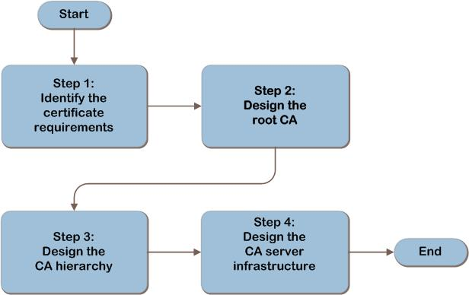
Active Directory Certificate Services Decision Flow
MAP w/ CAL Tracker
SCM
ITA
Notes:
The AD CS design flow provides a graphical overview of the steps in designing an AD CS infrastructure.
These steps are:
Identify the certificate requirements
Design the root CA
Design the CA hierarchy
Design the CA server infrastructure
Each of these steps will be discussed in greater detail in the following slides.
The primary parts of an AD CS infrastructure are shown in the diagram on the next slide.

Slide 7
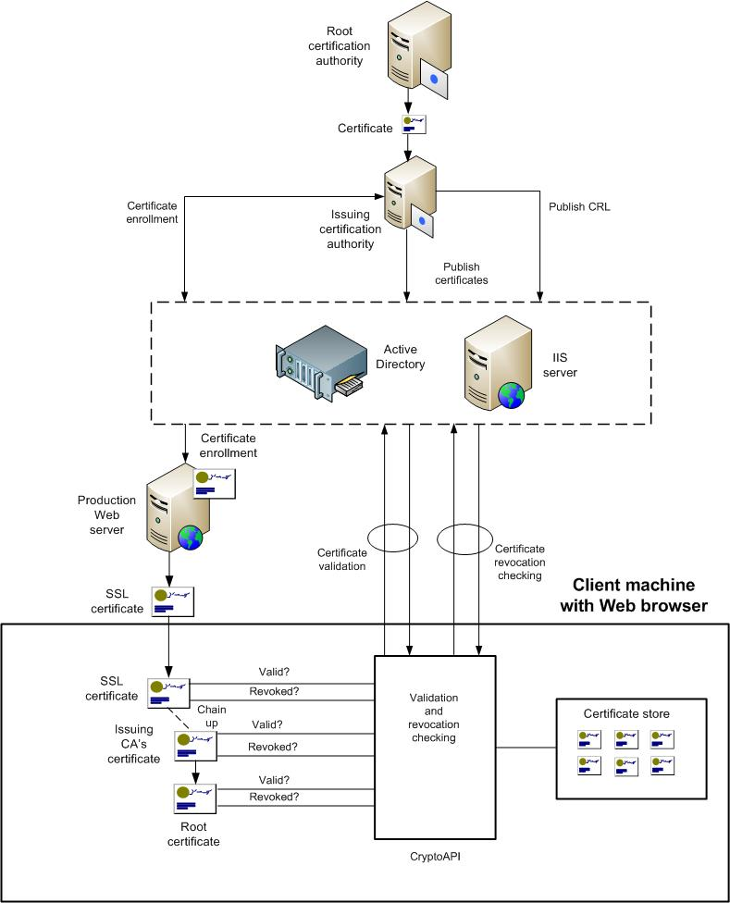
Active Directory Certificate Services Architecture
SCM
ITA
Notes:
This diagram illustrates the relationship between the components that work together to provide an architecture for AD CS. They are shown together in one possible implementation for illustration purposes, but other configurations are possible.

Slide 8
Step 1: Identify the Certificate Requirements
Task 1: Identify Where Certificates Will Be Used
Record:
Locations where certificates will be deployed
Locations where certificates will be validated, which includes chaining-up and revocation checking
Notes:
Step 1: Identify the Certificate Requirements
Task 1: Identify Where Certificates Will Be Used
Start by defining which parts of the organization will be included in the project. For example, the project scope might include all enterprise servers and workstations, laptops used by mobile employees, workstations on a partner extranet that access corporate data for order fulfillment, or any client on the Internet, if information or services will be provided beyond the corporate firewall.
Once the project scope has been defined, determine where certificates will be used. For reference, a table listing examples of applications and services that require certificates is provided in Table B-1 “Applications and Services That Use Certificates” in Appendix B in the guide. That table provides a brief description of how the application or device uses certificates as well as the certificate requirements. In Table A-1 in Appendix A, record the following:
Locations where certificates will be deployed and locations where certificates will be validated.
The deployment location may be different from the location where the certificate is inspected. For example, an SSL certificate is deployed to a web server, but is validated from the browser client machine.
If certificate enrollment services are not available, this will affect the deployment of new application services or users. It will also prevent certificate renewals to existing services and the validation of certificates that are not already present in the CryptoAPI cache.
If certificate revocation services are not available, there is a risk that a compromised certificate will be used, which could create a security exposure.
For each application or service, review the impact of a potential failure in certificate services, and record in Table A-1 in Appendix A in the guide the fault-tolerance requirements for each application or service that will use certificate services. This will be used as input to the fault-tolerance design of the certificate services infrastructure in Step 4.

Slide 9
Validating with the Business (Step 1)
Work with the business decision makers to ensure agreement and understanding of the certificate requirements. Ensure that the following questions are asked:
Are there any additional legal, government, or regulatory requirements that may affect certificate usage?
Are the implications of using certificates for encryption fully understood? These might include:
Encrypted traffic cannot be inspected for malicious content
Encryption and decryption will place an additional processing load on corporate servers
The use of certificates and encryption increases complexity in the environment
Notes:
Validating with the Business
Work with the business decision makers to ensure agreement and understanding of the certificate requirements. Ensure that the following questions are asked:
Are there any additional legal, government, or regulatory requirements that may affect certificate usage? Local laws or industry regulations may impose limitations or controls on the certificate services design.
Are the implications of using certificates for encryption fully understood? These implications might include:
Encrypted traffic cannot be inspected for malicious content.
Encryption and decryption will place an additional processing load on corporate servers.
The use of certificates and encryption increases complexity in the environment.

Slide 10
Step 2: Design the Root Certification Authority
Task 1: Determine the Number of Root CAs
Start by planning for a single root CA
Task 2: Determine the Root CA Type and Location
The root CA can be deployed in one of the following ways:
Stand-alone root CA
Enterprise root CA
External root CA
Notes:
Step 2: Design the Root Certification Authority
The root CA is the highest level in the certificate hierarchy in an organization. Start by planning for a single root CA, then add root CAs for any of the reasons listed in Task 1 below.
Task 1: Determine the Number of Root CAs
There is no technical reason to design more than one root CA, so plan for a single root CA. However, all applications and services that will use certificates must trust the root CA, so it may be necessary to design additional root CAs, for the following reasons:
Business unit, division, or location that must be isolated and self-administering. This need may be based on:
Laws, regulations, or other compliance standards.
Restrictions that are part of the organization’s policy.
For example, a multinational organization may be required by law to have a separate root CA for each country or region where they have a location or business presence.
Application or service that is required to administer certificates separately. The owner of an application or service may require full control over all aspects of the application or service, including certificate security.
A single root CA can manage more than one Domain Name System (DNS) domain namespace. Namespaces are based on the DNS domain namespaces, so a single root CA can issue certificates for multiple DNS domain namespaces.
Although a DNS domain namespace typically has only one CA hierarchy, it is possible to have more than one.
Task 2: Determine the Root CA Type and Location
Perform this task for each root CA that was specified in the previous task.
The root CA can be deployed in one of the following ways:
Stand-alone root CA. The CA is not integrated with AD DS. It operates in a workgroup and may be taken offline in order to maintain physical security.
Enterprise root CA. Integrated with AD DS.
External root CA. Operated by a third party beyond the organization’s firewall, it issues public root certificates. This is outside the scope of this guide but some information on it is provided in Appendix C.
If an offline stand-alone root CA will be used, at least one online subordinate CA must be designed in Step 3.

Slide 11
Step 3: Design the Certification Authority Hierarchy
Task 1: Determine the Number of Issuing CAs
Add CAs as necessary for the following reasons:
Regulatory requirements
Political and organizational reasons
Low bandwidth locations
Fault tolerance; can be achieved by the following techniques:
Design additional CAs
Make each CA highly available
Task 2: Determine the Number of Intermediate CAs
Intermediate CAs can optionally be added to the hierarchy design
Notes:
Step 3: Design the Certification Authority Hierarchy
The following roles can exist in a CA hierarchy:
Root CA. This is the highest level in the CA, and signs its own certificates.
Intermediate CA. Subordinate to another CA in the hierarchy, it enables centralized policy administration across its subordinate CAs.
Issuing CA. Subordinate to at least one other CA, it is the lowest level in the hierarchy.
All of these roles can perform the three certificate functions: certificate enrollment, validation, and revocation checking. And all of these functions can be combined on a single CA.
Task 1: Determine the Number of Issuing CAs
Add CAs as necessary for the following reasons:
Regulatory requirements. Regulations may require that a separate CA provide certificate services to a particular location or, for example, that web server certificates be validated by a separate issuing CA.
Political and organizational reasons. A business unit within the organization may require its own issuing CA.
Low bandwidth locations. If there are locations that are connected by low bandwidth links and if the load on the certificate service is expected to be high, design an issuing CA in each remote location.
Fault tolerance. Fault tolerance for certificate services can be achieved by any, or all, of the following techniques:
Design additional CAs. If this approach will be used, add CAs to the design to duplicate the function of the CAs that require fault tolerance. This technique cannot be used for a root CA because there can only be one active instance of a root CA in the PKI.
Make each CA highly available. This approach will be covered in the next step.
Task 2: Determine the Number of Intermediate CAs
Intermediate CAs can optionally be added to the hierarchy design as additional layers that centralize policy administration across multiple subordinate CAs. Designing a three-tier hierarchy with intermediate CAs increases the complexity of the environment. If intermediate CAs will be used, determine the number that will be required in order to meet the organization’s needs.

Slide 12
Step 4: Design the Certification Authority Server Infrastructure
Task 1: Design the Certificate Services Roles
Decide which protocol will be used for each service
Design and place the certificate services roles to meet the needs of all locations
Task 2: Design the CA Servers
Product group recommends each CA runs on a dedicated server
Task 3: Design the IIS Servers
IIS servers may be used to perform four different certificate services functions:
Certificate enrollment
Certificate validation
CRL publication
Online responder for OCSP
Notes:
Step 4: Design the Certification Authority Server Infrastructure
Task 1: Design the Certificate Services Roles
Decide which protocol will be used for each of the services, and record that in Table A-2 in the guide. Then use this information to design and place the certificate services roles to meet the needs of all locations, using as few servers as possible.
For the first location, refer to services required in that location, map those to the protocols that will be used to deliver the services, and then decide where the servers will be placed. Repeat this process for each location, adjusting as necessary the placement of the servers so that they can best meet the needs of the locations, again using as few servers as possible.
Task 2: Design the CA Servers
Use benchmark information at http://blogs.technet.com/wincat/archive/2009/08/10/scale-testing-the-world-s-largest-pki-all-running-on-ws08r2-and-hyper-v.aspx and guidance from the product group for Windows Server® 2003 at http://technet.microsoft.com/en-us/library/cc778985(WS.10).aspx. The AD CS product group states that this guidance is applicable to Windows Server 2008 R2.
If fault tolerance is required, this can be achieved in two ways:
Additional issuing CAs can be added to the design and placed behind a load balancer. In the event that one of the servers fails, requests can be redirected to the other servers. Note that this approach cannot be used for the root CA since there can only be one instance of the root CA.
The CA server can be run in a failover cluster.
Task 3: Design the IIS Servers
IIS servers may be used to perform four different certificate services functions, and all of these can be implemented on the same server. They can be run on the CA server, or on a separate server. If the IIS server will be placed in a perimeter network, also known as DMZ, to provide services on the Internet, this will normally require role separation from the CA server, which is inside the corporate firewall.
Design the minimum number of IIS servers that will perform the required roles.

Slide 13
Summary and Conclusion
The guide has addressed the technical aspects, service characteristics, and business requirements needed to complete a comprehensive review of the decision-making process. When used in conjunction with product documentation, this guide can help organizations confidently plan implementation of public key infrastructures using Active Directory Certificate Services
Provide feedback to ipdfdbk@microsoft.com
Notes:
Summary and Conclusion
This guide has focused on summarizing the critical design decisions, activities, and tasks required to successfully design a public key infrastructure using Active Directory Certificate Services in Windows Server 2008 R2.
Once the certificate requirements were identified, they were used to design the root CAs. Then for each root CA, the CA hierarchy was determined, and finally the CA servers, IIS servers, and file servers were designed.
The guide has addressed the technical aspects, service characteristics, and business requirements needed to complete a comprehensive review of the decision-making process. When used in conjunction with product documentation, this guide can help organizations confidently plan implementation of public key infrastructures using Active Directory Certificate Services.

Slide 14
Find More Information
Download the full document and other IPD guides:
www.microsoft.com/ipd
Contact the IPD team:
ipdfdbk@microsoft.com
Access the Microsoft Solution Accelerators website:
http://www.microsoft.com/technet/SolutionAccelerators

Slide 15
Questions?

Slide 16
Addenda
Benefits of Using the Active Directory Certificate Services Guide
IPD in Microsoft Operations Framework 4.0
Active Directory Certificate Services in Microsoft Infrastructure Optimization

Slide 17
Benefits of Using the Active Directory Certificate Services Guide
Benefits for Business Stakeholders/Decision Makers
Most cost-effective design solution for implementation
Alignment between the business and IT from the beginning of the design process to the end
Benefits for Infrastructure Stakeholders/Decision Makers
Authoritative guidance
Business validation questions ensuring solution meets requirements of business and infrastructure stakeholders
High integrity design criteria that includes product limitations
Fault-tolerant infrastructure
Infrastructure that’s sized appropriately for business requirements
Notes:
Benefits of Using the Active Directory Certificate Services Guide
Benefits for Business Stakeholders/Decision Makers:
Most cost-effective design solution for an implementation. IPD eliminates over-architecting and over-spending by precisely matching the technology solution to the business needs.
Alignment between the business and IT from the beginning of the design process to the end.
Benefits for Infrastructure Stakeholders/Decision Makers:
Authoritative guidance. Microsoft is the best source for guidance about the design of Microsoft products.
Business validation questions to ensure the solution meets the requirements of both business and infrastructure stakeholders.
High integrity design criteria that includes product limitations.
Fault-tolerant infrastructure, where necessary.
Proportionate system and network availability to meet business requirements. Infrastructure that is sized appropriately to meet business requirements.

Slide 18
Benefits of Using the Active Directory Certificate Services Guide (Continued)
Benefits for Consultants or Partners
Rapid readiness for consulting engagements
Planning and design template to standardize design and peer reviews
A “leave-behind” for pre- and post-sales visits to customer sites
General classroom instruction/preparation
Benefits for the Entire Organization
Using the guide should result in a design that will be sized, configured, and appropriately placed to deliver a solution for achieving stated business requirements
Notes:
Benefits of Using the Active Directory Certificate Services (Continued)
Benefits for Consultants or Partners:
Rapid readiness for consulting engagements.
Planning and design template to standardize design and peer reviews.
A “leave-behind” for pre- and post-sales visits to customer sites.
General classroom instruction/preparation.
Benefits for the Entire Organization:
Using the guide should result in a design that will be sized, configured, and appropriately placed to deliver a solution for stated business requirements, while considering the performance, capacity, manageability, and fault tolerance of the system.

Slide 19
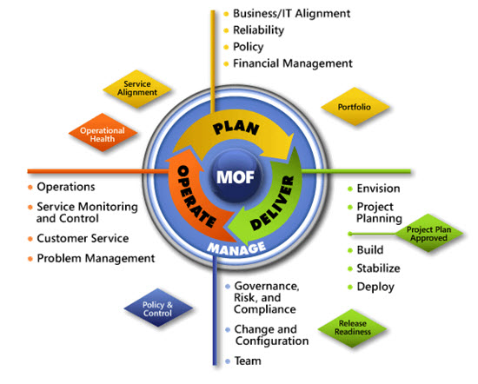
IPD in Microsoft Operations Framework 4.0
Use MOF with IPD guides to ensure that people and process considerations are addressed when changes to an organization’s IT services are being planned.
Notes:
For more information about Microsoft Operations Framework 4.0, go to www.microsoft.com/mof.

Slide 20
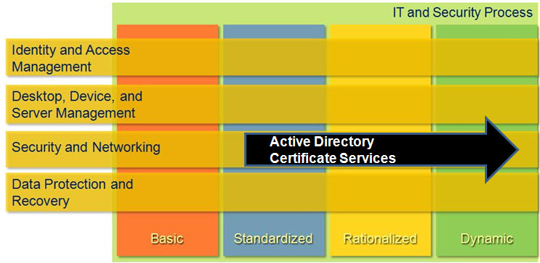
Active Directory Certificate Services in Microsoft Infrastructure Optimization
Notes:
<This slide shows the effect that Active Directory Certificate Services has on infrastructure maturity as reflected in the Core Infrastructure Optimization Model.>
The Infrastructure Optimization (IO) Model at Microsoft groups IT processes and technologies across a continuum of organizational maturity. (For more information, see www.microsoft.com/infrastructure.) The model was developed by industry analysts, the Massachusetts Institute of Technology (MIT) Center for Information Systems Research (CISR), and Microsoft's own experiences with its enterprise customers. A key goal for Microsoft in creating the Infrastructure Optimization Model was to develop a simple way to use a maturity framework that is flexible and can easily be applied as the benchmark for technical capability and business value.
IO is structured around three information technology models: Core Infrastructure Optimization, Application Platform Optimization, and Business Productivity Infrastructure Optimization. According to the Core Infrastructure Optimization Model, having a well-planned Active Directory Certificate Services infrastructure will help move an organization to the Dynamic level. Active Directory Certificate Services gives the administrator control over certificate enrollment, certificate revocation, and other public key infrastructure services needed by the applications and services running in their organization. On the path to the Dynamic level, organizations can use Active Directory Certificate Services to automatically enroll and renew certificates required for applications and services, such as System Center Configuration Manager or DirectAccess in Windows® 7.

