Slide 1
Microsoft® SharePoint® Online— Evaluating Software-plus-Services
Infrastructure Planning and Design
Published: June 2009
Updated: December 2010
This guide was last updated in December 2010 but the basic principles still apply when planning your SharePoint Online infrastructure. This guide will not continue to be updated. For the latest information, please visit the SharePoint Online product group page.
Notes:
Copyright © 2010 Microsoft Corporation. This documentation is licensed to you under the Creative Commons Attribution License. To view a copy of this license, visit http://creativecommons.org/licenses/by/3.0/us/ or send a letter to Creative Commons, 543 Howard Street, 5th Floor, San Francisco, California, 94105, USA. When using this documentation, provide the following attribution: Infrastructure Planning and Design is provided with permission from Microsoft Corporation.
This documentation is provided to you for informational purposes only, and is provided to you entirely "AS IS". Your use of the documentation cannot be understood as substituting for customized service and information that might be developed by Microsoft Corporation for a particular user based upon that user’s particular environment. To the extent permitted by law, MICROSOFT MAKES NO WARRANTY OF ANY KIND, DISCLAIMS ALL EXPRESS, IMPLIED AND STATUTORY WARRANTIES, AND ASSUMES NO LIABILITY TO YOU FOR ANY DAMAGES OF ANY TYPE IN CONNECTION WITH THESE MATERIALS OR ANY INTELLECTUAL PROPERTY IN THEM.
Microsoft may have patents, patent applications, trademarks, or other intellectual property rights covering subject matter within this documentation. Except as provided in a separate agreement from Microsoft, your use of this document does not give you any license to these patents, trademarks or other intellectual property.
Information in this document, including URL and other Internet Web site references, is subject to change without notice. Unless otherwise noted, the example companies, organizations, products, domain names, email addresses, logos, people, places and events depicted herein are fictitious.
Microsoft, Active Directory, Excel, Forefront, InfoPath, SharePoint, Visual Studio, and Windows Live are either registered trademarks or trademarks of Microsoft Corporation in the United States and/or other countries.
The names of actual companies and products mentioned herein may be the trademarks of their respective owners.
You have no obligation to give Microsoft any suggestions, comments or other feedback (“Feedback”) relating to the documentation. However, if you do provide any Feedback to Microsoft then you provide to Microsoft, without charge, the right to use, share and commercialize your Feedback in any way and for any purpose. You also give to third parties, without charge, any patent rights needed for their products, technologies and services to use or interface with any specific parts of a Microsoft software or service that includes the Feedback. You will not give Feedback that is subject to a license that requires Microsoft to license its software or documentation to third parties because we include your Feedback in them.

Slide 2
What Is IPD? Guidance that clarifies and streamlines the planning and design process for Microsoft infrastructure technologies
IPD:
Defines decision flow
Describes decisions to be made
Relates decisions and options for the business
Frames additional questions for business understanding
IPD guides are available at www.microsoft.com/ipd
Notes:
Infrastructure Planning and Design (IPD) is a series of planning and design guides created to clarify and streamline the planning and design process for Microsoft® infrastructure technologies.
Each guide in the series addresses a unique infrastructure technology or scenario.
These guides include the following topics:
Defining the technical decision flow (flow chart) through the planning process.
Describing the decisions to be made and the commonly available options to consider in making the decisions.
Relating the decisions and options for the business in terms of cost, complexity, and other characteristics.
Framing the decisions in terms of additional questions for the business to ensure a comprehensive understanding of the appropriate business landscape.
The guides in this series are intended to complement and augment Microsoft product documentation.

Slide 3
Getting Started
Microsoft SharePoint Online—Evaluating Software-plus-Services
Notes:
The Microsoft SharePoint Online—Evaluating Software-plus-Services guide evaluates the Microsoft SharePoint Online Standard and Dedicated and on-premises solution offerings in many areas of interest to technical decision makers, including client options, the “six workloads of SharePoint,” operational impacts, and security concerns. This evaluation is made only for topics where the capabilities of the offerings differ. If the capabilities are the same across all three offerings, the topic is not presented. The organization’s needs will be rated in terms of importance, and the advantages and disadvantages of each offering will be evaluated against business requirements to provide a quantitative view of which offering will be best suited to serve the business’s collaboration needs.

Slide 4
Purpose and Agenda
Purpose
The guide will provide a technical decision maker with information about topics to consider when deciding whether to use an on-premises collaboration service or the Microsoft SharePoint Online Standard or Dedicated offering.
Agenda
Software-plus-Services
Overview of Steps – Categories/Topics
Sample Topic for Rating/Scoring
Sample Tally Sheet
Evaluate Results
Conclusion
Notes:
Purpose
The purpose of this presentation is to guide the reader through the decision-making process about whether to use an on-premises collaboration service or the Microsoft SharePoint Online Standard or Dedicated offering.
Agenda
The guide contains 10 steps; the first nine steps contain sections grouped into similar areas of functionality. The 10th step contains instructions relative to evaluating the results from rating/scoring the categories and topics in the first nine steps.
The following slides will introduce software-plus-services and then will present the various topics that are covered in detail in the guide. Instructions will be given for how each topic should be rated and how to tally all of the scores at the end. A sample topic will be presented.

Slide 5
What Is Software-plus-Services?
Software-plus-services is a model of software development where an application is hosted as a service and combined with locally installed, client-based software for rich interactivity and higher performance
The software-plus-services strategy is about choice, creating freedom in functionality and delivery
SharePoint Online provides:
Hosted enterprise collaboration solution based on Microsoft SharePoint Server 2010.
A reduction in upfront expense of software purchases through the use of on-demand pricing. This also frees up valuable capital, IT staff, and other costly resources for more effective, strategic use within the organization.
Notes:
What is software-plus-services?
Software-plus-services combines cloud-based delivery services with the rich interactivity and high performance achieved by a locally installed client. The software-plus-services model ensures that people can access the applications and information they need even when they aren’t connected to the Internet.
The choice of a deployment option depends on several factors, including the level of in-house communication expertise, the need for control and customization, and the overall priorities of the IT group. Because organizations have the flexibility to deploy Microsoft SharePoint as either a server or a service, business needs, rather than technology constraints, can drive the choice.

Slide 6
Deployment Options
On-Premises Deployment
Server and client software is installed and run on computers on the premises of the organization using the software
SharePoint Online Standard Offering
Provides the core business capabilities of Microsoft SharePoint Server as a hosted service from a shared server, multi-tenancy environment
SharePoint Online Dedicated Offering
Dedicated servers at Microsoft data centers to support business’s collaboration needs
Notes:
Discuss On-Premises Service Model
On-premises deployment is a model where software is installed and runs on computers on the premises of the organization using the software, rather than at a remote facility. The on-premises model provides organizations with the flexibility to perform maintenance, upgrades, and customization at their convenience. However, this model requires considerable upfront capital for such expenses as hardware, software, licenses, IT personnel for maintenance, and physical building space.
Discuss Microsoft SharePoint Online
SharePoint Online is a hosted collaboration solution that is based on Microsoft Office SharePoint Server 2010. It is available as two offerings: Standard and Dedicated. Both offerings provide SharePoint services at a per-user monthly fee, but each offers different degrees of customization and feature availability.
The guide does not discuss:
Microsoft Online Services, other than SharePoint Online.
The Windows Live® network of Internet services or other consumer-oriented, cloud-based services. Windows Live includes Office Live Workspace and Office Live Small Business. These services do not include SharePoint collaboration software.
Utility service providers offering cloud computing, cloud computing platforms, cloud-based platform services, or cloud infrastructure services.
Microsoft Forefront® Security for SharePoint provided as an online service. This online service provides software that is locally installed on the organization’s servers, as well as ongoing updates and signatures for that software.

Slide 7
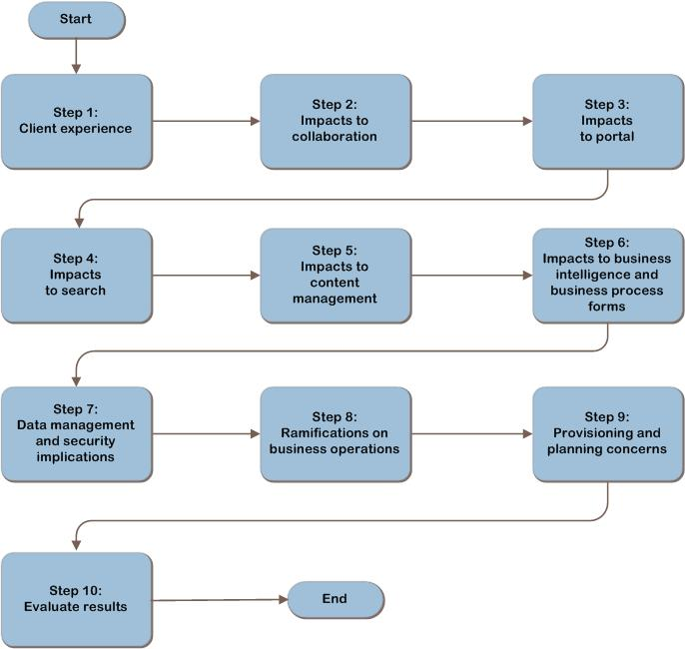
Evaluating SharePoint Online Decision Flow
Notes:
This is the SharePoint Online—Evaluating Software-plus-Services decision flow.
The first nine steps are not sequential and can be performed in any order, but all should be completed to obtain the full picture of the suitability and importance of the various technologies.
Within each step, each topic is subdivided into four elements:
Definition of the topic.
A rating of the importance of the topic to the business.
A comparison of the functionality available with the SharePoint Online Standard and Dedicated offerings and the on-premises technology.
A rating of how well each offering addresses the business’s requirements for the topic.
Additional context may also be included where relevant to help the decision maker evaluate the impact associated with the decision.
The 10th step will assist the reader in evaluating the results of the first nine steps. The next several slides provide an overview of the categories and topics for evaluation.

Slide 8
Using This Guide to Evaluate SharePoint Online
Read the introduction to the step.
Read the description for each topic.
Determine importance of each topic by reading importance rating section and record in the rating table provided.
Read the comparisons of on-premises, Standard, and Dedicated offerings in the solutions rating section and rate each solution. Record the answers in the rating table provided.
Repeat for Steps 2-9.
Use the tally sheet in the appendix to tally all scores. Evaluate and make decision.
Notes:
How to use the Microsoft SharePoint Online—Evaluating Software-plus-Services Guide
For the best results, technical decision makers should perform the following actions for each step:
Read the introduction to the step for a list of the topics covered within the section.
For each topic in the step, read the description of the topic and its function in the business.
In the “Importance Rating” section, determine how important the topic is to the organization by answering the provided question and recording the importance rating score for the topic in the table provided at the end of the section.
The importance rating options are 1–5:
1 = not important
2 = somewhat important
3 = important
4 = very important
5 = extremely important (must have)
In the “Solutions Rating” section, compare the functionalities of the SharePoint Online Standard and Dedicated offerings and the on-premises solution. Rate each on its potential effectiveness in meeting the organization’s needs and record the scores in the table provided at the end of the section for the topic. Note that in some cases, the Standard and Dedicated offerings have been combined to avoid redundancy in the reading, but they should still be scored individually.
The solution rating score options are 0–3:
0 = doesn’t apply/provides no benefit
1 = somewhat provides
2 = adequately provides
3 = exceeds expectations
Repeat the above process for the remainder of the steps and record the scores for each topic.
In the appendix, the “Tally Sheet Job Aid” lists all of the steps and their respective topics. Transfer each of the raw scores from the table in each topic section to this table and determine the weighted score for each topic. The weighted score is generated by multiplying the importance rating by each offering’s original (raw) rating score. The weighted scores provide a comprehensive view of the comparisons between the offerings, which will assist in deciding whether to stay with the on-premises solution or to migrate to either the SharePoint Online Standard or Dedicated solution. Evaluate the results and make a decision.

Slide 9
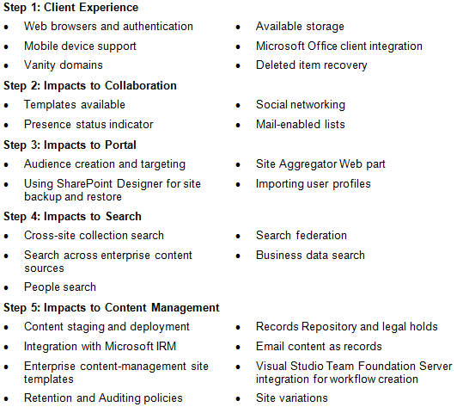
SharePoint Online – Steps and Topics
Notes:
Steps and Topics
This slide provides an overview of the first five areas of concern that will be discussed.
Refer to the guide for more details on each topic and the capabilities available with the on-premises, SharePoint Online Standard, and SharePoint Online Dedicated offerings.
Read through each topic in the sections and use the rating table provided at the end of each topic section to record the importance rating and scores for each offering and/or solution.

Slide 10
SharePoint Online – Steps and Topics (continued)
Notes:
Steps and Topics
This slide provides an overview of the remaining areas of concern that will be discussed.
Refer to the guide for more details on each topic and the capabilities available with the on-premises, SharePoint Online Standard, and SharePoint Online Dedicated offerings.
Read through each topic in the sections and use the rating table provided at the end of each topic section to record the importance rating and scores for each offering and/or solution.

Slide 11
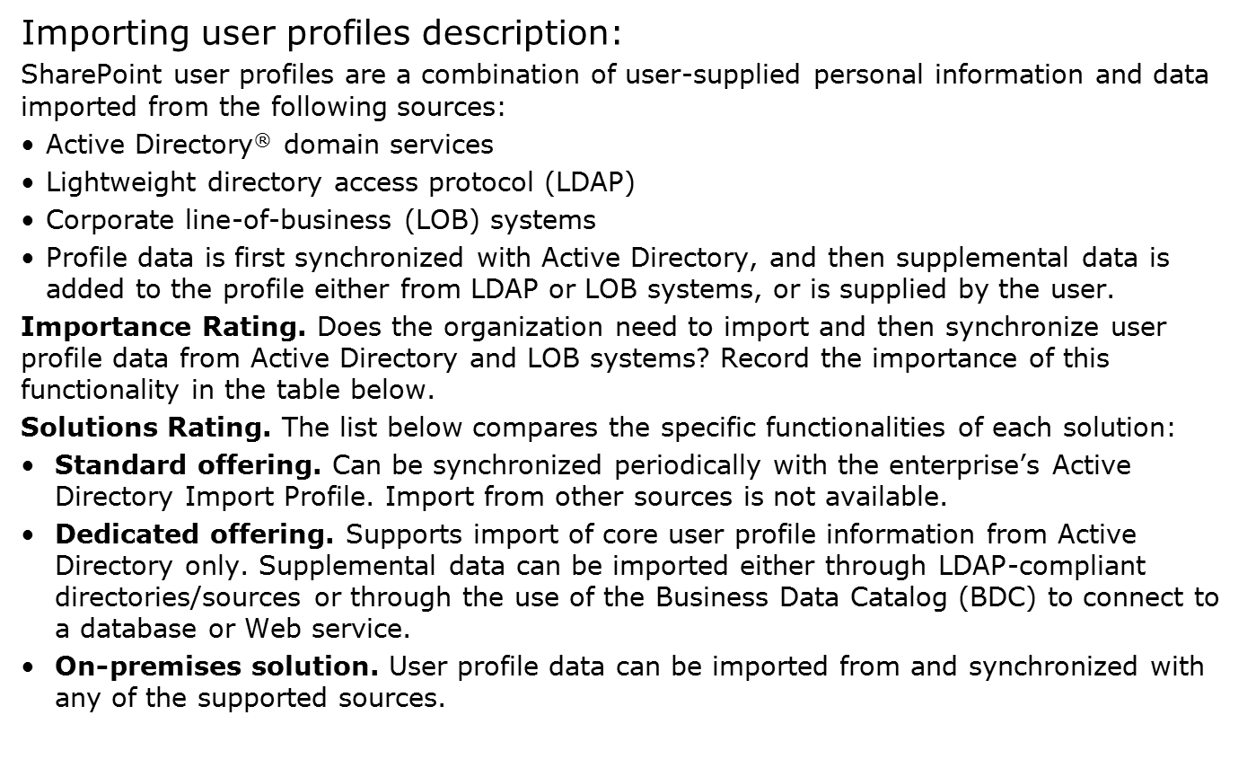
Example from Step 3: Evaluate Importing User Profiles
Notes:
In this example, we’ll take a look at how to rate and score a topic.
Evaluate Importing User Profiles
Read the “Importing User Profiles” description.
Read and record the importance of importing user profiles in the rating table.
Read the “Solutions Rating” section.
Review the information and record the score in the rating table for how the Standard offering meets your needs for importing user profiles.
Review the information and record the score in the rating table for how the Dedicated offering meets your needs for importing user profiles.
(continued on next slide)

Slide 12
Example from Step 3: Evaluate Importing User Profiles (continued)
Additional Context. SharePoint Online Dedicated will run a differential import weekly and will not update, alter, or process the information imported from the systems. It is the customer's responsibility to ensure that the source is accurate and complete. Any changes to the data must be made by the customer on the source systems. SharePoint Online Dedicated should not be the authoritative source for content also found in Active Directory or an LDAP directory.
Evaluate how well each of these offerings addresses the business’s requirement to support importing user profiles and record the ratings in the table below.
Notes:
In this example, we take a look at how to rate and score a topic.
Evaluate Importing User Profiles (continued from previous slide)
Review the information and record the score in the rating table for how the on-premises solution meets your needs for signing and encrypting messages.
Additional context may also be included where relevant to help the decision maker evaluate the impact associated with the decision.
Go to next slide to see how to use the tally sheet.

Slide 13
How to Use the Tally Sheet
Transfer the raw scores. Transfer the Importance Ratings and the Standard, Dedicated, and on-premises raw scores from the individual tables in each section to the tally sheet in the appendix.
Calculate weighted scores. Multiply the Importance Rating by each raw score to find the weighted scores. For example, multiply the Importance Rating for importing user profiles by importing the user profiles standard raw score (5 x 3 = 15) to get the standard weighted score for this topic. Record the standard weighted score in the appropriate box. Repeat for the Dedicated and on-premises solutions.
Total each section. After determining each of the weighted scores in a section, add the scores and record them in the Section Subtotals row. Repeat for each section.
Tally cumulative total. Finally, after using the formula to rate and score each topic throughout the “Tally Sheet Job Aid” in Appendix A of the guide, add up all of the totals from each section to get the cumulative scores. These cumulative totals should provide a definite picture of the solution that best fits the organization.
Notes:
Evaluate Results
In this step, the comparison ratings for each topic will be tallied so that a logical decision about which solution best fits the needs of the organization can be made. At this point, each of the topics has been rated in terms of its importance to the business. Each offering has been rated in its effectiveness to meet the business’s needs.
Weighted Scoring
The “Tally Sheet Job Aid” in Appendix A of the guide lists all of the steps and their respective topics. Transfer each of the raw scores from the table in each topic section to this table and determine the weighted score for each topic. The weighted score is generated by multiplying the importance rating by each offering’s original (raw) rating score. The weighted scores provide a comprehensive view of the comparisons between offerings, which will assist in deciding whether to stay with the on-premises solution or to migrate to either the SharePoint Online Standard or Dedicated solution. Totaling each column will reveal which offering has been rated to best meet the organization’s needs.
Analyze the Results
If one offering’s score is significantly higher than the rest, then this offering obviously best meets the needs of the organization. However, a set of similar scores may indicate that a particular offering does not necessarily better fit the needs of the organization than other offerings. In this case, it may be prudent to focus on the results of the topics that were rated to be most important to the company. During the course of evaluation, the organization may have also realized that there was a capability that it simply must have, and either on-premises or one of the SharePoint Online offerings did not provide it. This also can make the decision fairly obvious.

Slide 14
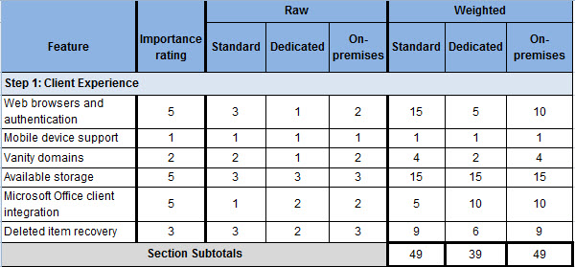
Example: Tally Sheet
Note: This Tally Sheet example is for illustrative purposes only and does not include all of the steps or topics in the SharePoint Online―Software-plus-Services Guide
Notes:
This is an example of a tally sheet. In this example, we see that the Dedicated score is significantly lower than the other offerings, indicating that perhaps there are some features important to the organization that might not be available. The Standard and On-premises scores are the same. At this point, the organization might want to review the topics rated most important to the organization to make sure critical features are available in both options and then run a cost-benefit analysis based on the organization’s personal estimates.

Slide 15
Next Steps
If the decision is to use an on-premises solution, the next step will be to determine which version, or versions, of SharePoint to implement.
A good starting point for that is the feature comparison matrix presented at http://office.microsoft.com/en-us/help/HA101978031033.aspx.
Notes:
Next Steps
If the decision is to use an on-premises solution, the next step will be to determine which version, or versions, of SharePoint to implement. A good starting point for that is the feature comparison matrix presented at http://office.microsoft.com/en-us/help/HA101978031033.aspx.
Although outside the scope of this document, a cost-benefit analysis may also be in order to determine which offering is the best fit for the organization from a financial standpoint.
Additional reading:
Microsoft Online Services Customer Portal: https://mocp.microsoftonline.com/
Microsoft Online Services Administration Center: https://admin.microsoftonline.com/
Microsoft SharePoint Online: http://www.microsoft.com/online/SharePoint-online.mspx
Microsoft Online Customer Portal: http://technet.microsoft.com/en-us/library/bb981188.aspx
Microsoft SharePoint Server 2007: http://www.microsoft.com/SharePoint/
Microsoft SharePoint Server 2007 on TechNet: http://technet.microsoft.com/en-us/library/cc303422.aspx

Slide 16
Summary and Conclusion
The software-plus-services strategy is about choice
The guide was designed to provide a technical decision maker with information about topics to consider when deciding whether to use an on-premises collaboration service or the Microsoft SharePoint Online Standard or Dedicated offering
Use the guide to weigh the advantages and disadvantages of each mode of delivery against the organization’s priorities
At the conclusion of the evaluation, the organization has an individualized appraisal to assist in making the decision whether to use on-premises SharePoint services or to migrate either in full or partially to SharePoint Online
Provide feedback to ipdfdbk@microsoft.com
Notes:
Summary and Conclusion
The software-plus-services strategy designed by Microsoft is about choice, creating freedom in functionality and delivery. In order for companies to choose a best fit, they need to weigh the advantages and disadvantages of each mode of delivery against their organization’s priorities. This guide was designed to provide technical decision makers with information about the available offerings and a means to document their organization’s requirements and goals when making the decision whether to use on-premises SharePoint services or to migrate either in full or partially to SharePoint Online.

Slide 17
Find More Information
Download the full document and other IPD guides:
www.microsoft.com/ipd
Contact the IPD team:
ipdfdbk@microsoft.com
Access the Microsoft Solution Accelerators Web site:
www.microsoft.com/technet/SolutionAccelerators

Slide 18
Appendix

Slide 19
Notes to Presenter
The following slides contain additional details on the topics so that you can customize the presentation to your own needs.
The steps have been broken out into separate slides, and the tallying process has been described in more detail.

Slide 20
Step 1: Client Experience
The Client Experience step addresses collaboration capabilities that most significantly influence the client experience
The topics covered in this step are:
Web browsers and authentication
Mobile device support
Vanity domains
Available storage
Microsoft Office client integration
Deleted item recovery
Notes:
Step 1: Client Experience
This step covers some of the major client experience features provided by SharePoint Online Standard and Dedicated and compares them with the functionality available through an on-premises system. The features are rated according to their effectiveness in fulfilling the business’s needs. The scores will help guide decision makers in objectively evaluating the impact of a change to SharePoint Online from a client’s perspective. Different features are available depending on which offering is chosen. An on-premises environment will offer the greatest level of customization.
Read through each topic in this section and use the rating table provided at the end of each topic section to record the importance rating and scores for each offering and/or solution.
In the next step, impacts to collaboration will be evaluated.

Slide 21
Step 2: Impacts to Collaboration
The Impacts to Collaboration step addresses some of the impacts to collaboration resulting from changing to a SharePoint Online environment
The topics covered in this step are:
Templates available
Presence status indicator
Social networking
Mail-enabled lists
Notes:
Step 2: Impacts to Collaboration
This step addresses some of the impacts to collaboration resulting from changing to a SharePoint Online environment. Different features are available depending on which offering is chosen. An on-premises environment will offer the greatest level of customization.
Read through each topic in this section and use the rating table provided at the end of each topic section to record the importance rating and scores for each offering and/or solution.
The next step discusses the portal impacts of moving to SharePoint Online.

Slide 22
Step 3: Impacts to Portal
This step addresses the impacts to a user portal resulting from changing to a SharePoint Online environment
The topics covered in this step are:
Audience creation and targeting
Using SharePoint Designer for site backup and restore
Site Aggregator Web part
Importing user profiles
Notes:
Step 3: Impacts to Portal
This step addresses the impacts to a user portal resulting from changing to a SharePoint Online environment. Different features are available depending on which offering is chosen. An on-premises environment will offer the greatest level of customization.
Read through each topic in this section and use the rating table provided at the end of each topic section to record the importance rating and scores for each offering and/or solution.
The next step discusses the search impacts of moving to SharePoint Online.

Slide 23
Step 4: Impacts to Search
This step addresses the impacts to search resulting from changing to a SharePoint Online environment
The topics covered in this step are:
Cross-site collection search
Search across enterprise content sources
People search
Search federation
Business data search
Notes:
Step 4: Impacts to Search
This step addresses the impacts to search resulting from changing to a SharePoint Online environment. Different features are available depending on which offering is chosen. An on-premises environment will offer the greatest level of customization.
Read through each topic in this section and use the rating table provided at the end of each topic section to record the importance rating and scores for each offering and/or solution.
The next step discusses the content management impacts of moving to SharePoint Online.

Slide 24
Step 5: Impacts to Content Management
This step addresses the impacts to content resulting from changing to a SharePoint Online environment
The topics covered in this step are:
Content staging and deployment
Integration with Microsoft IRM
Enterprise content-management site templates
Retention and Auditing policies
Records Repository and legal holds
Email content as records
Visual Studio® Team Foundation Server integration for workflow creation
Site variations
Notes:
Step 5: Impacts to Content Management
This step addresses the impacts to content resulting from changing to a SharePoint Online environment.
Read through each topic in this section and use the rating table provided at the end of each topic section to record the importance rating and scores for each offering and/or solution.
The next step discusses the business intelligence and business process impacts of moving to SharePoint Online.

Slide 25
Step 6: Impacts to Business Intelligence and Business Process Forms
This step addresses the impacts to business intelligence and business process forms resulting from changing to a SharePoint Online environment
The topics covered in this step are:
Business intelligence dashboards
Filtering Web parts
Report Center template
Excel® Services
Data connection libraries
Business Data Catalog
Business Data Web parts and Business Data Actions Web parts
Out-of-the-box workflows
Browser-based InfoPath® forms
Workflows built from custom code
Notes:
Step 6: Impacts to Business Intelligence and Business Process Forms
This step addresses the impacts to business intelligence and business process forms resulting from changing to a SharePoint Online environment.
Read through each topic in this section and use the rating table provided at the end of each topic section to record the importance rating and scores for each offering and/or solution.
The next step discusses the data management and security impacts of moving to SharePoint Online.

Slide 26
Step 7: Data Management and Security Implications
This step explores some of the data management and security implications of storing data either on-premises or in the Microsoft Online environment
The topics covered in this step are:
Network security
Network connectivity
Data isolation
Auditing
Notes:
Step 7: Data Management and Security Implications
This step explores some of the data management and security implications of storing data either on-premises or in the Microsoft Online environment.
Read through each topic in this section and use the rating table provided at the end of each topic section to record the importance rating and scores for each offering and/or solution.
The next step discusses the ramifications of moving to SharePoint Online for business operations.

Slide 27
Step 8: Ramifications on Business Operations
Before deciding whether to use online services, SharePoint on-premises, or a combination of both, it is important to carefully examine the ramifications of this decision on business operations
The topics covered in this step are:
Service continuity
Disaster recovery testing
Service level agreements
Adoption rate for new releases
Scheduled maintenance
Notes:
Step 8: Ramifications on Business Operations
These topics will be used in evaluating the business operations concerns in this step, but they do not necessarily represent a comprehensive list. Each organization must consider its unique environment and needs.
Read through each topic in this section and use the rating table provided at the end of each topic section to record the importance rating and scores for each offering and/or solution.
The next step discusses the provisioning and planning concerns associated with moving to SharePoint Online.

Slide 28
Step 9: Provisioning and Planning Concerns
Provisioning is the creation, modification, and deletion of distribution groups and contacts to address the needs within a system. Provisioning can happen through automation, delegated administrative portals, or manually with tools such as Active Directory Users and Computers.
The topics covered in this step are:
Active Directory Domain Services integration
Capacity and performance planning
Notes:
Step 9: Provisioning and Planning Concerns
Provisioning is the creation, modification, and deletion of distribution groups and contacts to address the needs within a system. Provisioning can happen through automation, delegated administrative portals, or manually with tools like Active Directory Users and Computers. Capacity and performance planning can be a challenge for IT departments as they try to balance future needs with budget limitations.
Read through each topic in this section and use the rating table provided at the end of each topic section to record the importance rating and scores for each offering and/or solution.
The next step will tally the results of the evaluation process.

Slide 29
Step 10: Evaluate Results
Weighted Scoring – Multiply the importance rating by each offering’s original (raw) rating score to find the weighted score. Weighted scores provide a comprehensive view of the comparisons between offerings.
Analyze Results – If one offering’s score is significantly higher than the rest, this offering will best meet the needs of the organization. However, a set of similar scores may indicate that a particular offering does not necessarily better fit the needs of the organization than other offerings.
Notes:
Step 10: Evaluate Results
In this step, the comparison ratings for each topic will be tallied so that a logical decision about which solution best fits the needs of the organization can be made. At this point, each of the topics has been rated in terms of its importance to the business. Each offering has been rated in its effectiveness to meet the business’s needs.
Weighted Scoring
The “Tally Sheet Job Aid” in Appendix A of the guide lists all of the steps and their respective topics. Transfer each of the raw scores from the table in each topic section to this table and determine the weighted score for each topic. The weighted score is generated by multiplying the importance rating by each offering’s original (raw) rating score. The weighted scores provide a comprehensive view of the comparisons between offerings, which will assist in deciding whether to stay with the on-premises solution or to migrate to either the SharePoint Online Standard or Dedicated solution.
Totaling each column will reveal which offering has been rated to best meet the organization’s needs.
Analyze the Results
If one offering’s score is significantly higher than the rest, then this offering obviously best meets the needs of the organization. However, a set of similar scores may indicate that a particular offering does not necessarily better fit the needs of the organization than other offerings. In this case, it may be prudent to focus on the results of the topics that were rated to be most important to the company.
During the course of evaluation, the organization may have also realized that there was a capability that it simply must have, and either on-premises or one of the SharePoint Online offerings did not provide it. This also can make the decision fairly obvious.

Slide 30
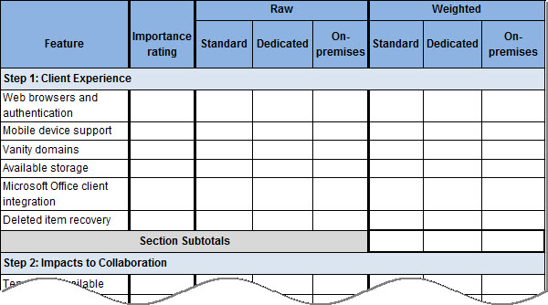
Example: Tally Sheet
Notes:
This is a sample of a tally sheet. The next slides will walk you through the process.

Slide 31
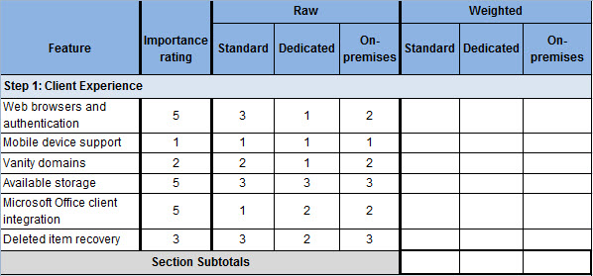
How to Use the Tally Sheet
Transfer the importance ratings and the Standard, Dedicated, and on-premises raw scores from the individual tables in each section and for each topic
Notes:
First, transfer each of the raw scores from the table in each topic section to the table in the appendix of the guide.

Slide 32
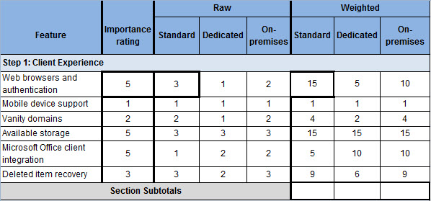
How to Use the Tally Sheet (continued)
Multiply the importance rating by each raw score to find the weighted scores. For example, multiply the Web browsers and authentication importance rating by the Web browsers and authentication Standard raw score (5 x 3 = 15) to get the Standard weighted score for the topic. Record the Standard weighted score in the appropriate box.
Notes:
Second, determine the weighted score for each topic. The weighted score is generated by multiplying the importance rating by each offering’s original (raw) rating score. The weighted scores provide a comprehensive view of the comparisons between offerings, with the greater emphasis given to the features the organization has deemed most important.

Slide 33
How to Use the Tally Sheet (continued)
After determining each of the weighted scores, add the scores and record in the Section Subtotals row.
Notes:
Third, add the Standard weighted score, Dedicated weighted score, and on-premises weighted score columns in each section.

Slide 34
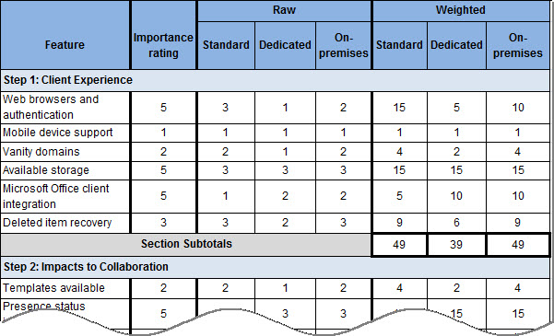
How to Use the Tally Sheet (continued)
Finally, after using the formula to rate and score each topic throughout the “Tally Sheet Job Aid,” add up all of the totals from each section to get the cumulative totals. These cumulative totals should provide a definite picture of the solution that best fits the organization’s needs.
Notes:
And lastly, add the subtotals in each column to reveal which offering has been rated to best meet the organization’s needs.
Analyze the Results
If one offering’s score is significantly higher than the rest, then this offering obviously best meets the needs of the organization. However, a set of similar scores may indicate that a particular offering does not necessarily better fit the needs of the organization than other offerings. In this case, it may be prudent to focus on the results of the topics that were rated to be most important to the company.
During the course of evaluation, the organization may also realize that there was a capability that it simply must have, and either on-premises or one of the SharePoint Online offerings did not provide it. This also can make the decision fairly obvious.

