Slide 1
Windows 10 for Enterprise: Deployment

Slide 2
The End of Wipe and Reload!
Managed in-place upgrade
Runtime configuration – customize without imaging
Reduced validation and deployment costs
Notes:
Microsoft knows that deploying a new version of Windows requires a lot of effort for organizations. Using a traditional wipe and reload process requires creating a custom Windows image for the organization, identifying and obtaining all the needed drivers and apps for reinstallation, and significant engineering effort to implement the process.
For Windows 10, they want to reduce that effort by moving to an in-place upgrade process for existing devices. Microsoft also wants to provide new capabilities to help with the configuration of new computers, avoiding the need for reimaging those devices. And to help with the application compatibility process, they want to provide new tools to help.

Slide 3
App & Device Compatibility
Hardware requirements are unchanged
Strong desktop app compatibility
Windows Store apps are compatible
Internet Explorer enterprise investments
Notes:
From a compatibility perspective, Microsoft believes strongly that all devices running Windows 7, Windows 8, or Windows 8.1 will be able to run Windows 10. [NOTE: There are some specific hardware requirements, unchanged since Windows 8.1, which could result in a very small percentage of devices not being able to run Windows 10. These are generally consumer devices or very old enterprise devices, e.g. Pentium D processors running Windows 7 x64, and are extremely uncommon in modern enterprises.]
For desktop apps, compatibility will also be very good, with a significant percentage of apps that “just work” on the new OS. (Microsoft would expect this to be in the high 90’s, percentage-wise. They can’t guarantee that all apps will work, as developers can always find a way to cause things to break, but this should be the exception. Microsoft’s experience with customers that have moved from Windows 7 to Windows 8.1 has shown very good desktop app compatibility, and it should be just as good when moving to Windows 10.)
For existing Windows Store apps, including modern line-of-business apps, these should just work as well. (As Microsoft makes changes to the Windows Runtime environment that these apps run in, Microsoft can try out existing apps from the Windows Store to ensure they don’t break anything. As a result, Microsoft knows pretty quickly if they’ve introduced any issues, and they can quickly resolve these before an organization even sees the issue.)
Microsoft knows that Internet Explorer has been a challenge for organizations, which is why they invested in Enterprise Mode IE to support the IE8 behaviors needed by many organization’s web apps. They will continue to make more investments in these types of capabilities to ensure that they continue to get better.

Slide 4
Enterprise Investments for Internet Explorer 11
Help with Compatibility Issues
Enterprise Mode, offering improved Internet Explorer 8 compatibility and document type overrides
Enterprise Site Discovery Toolkit, to better understand how users are browsing
All capabilities will be carried forward to Windows 10
A Natural Stepping Stone to Windows 10
Migrate to Internet Explorer 11 on Windows 7 (before 2016) to prepare
http://blogs.msdn.com/b/ie/archive/2014/08/07/stay-up-to-date-with-internet-explorer.aspx
Legacy Web Apps
Notes:
Many customers identify web application compatibility as a significant cost to upgrading, as web apps may need to be tested and upgraded before adopting a new browser. Enterprise Mode for Internet Explorer 11 provides improved Internet Explorer 8 compatibility for all SKUs of Windows 7 and Windows 8.1, and can be helpful for customers who want to upgrade to the latest version of Internet Explorer but have experienced compatibility issues.
Enterprise Mode is available as an update to all Internet Explorer 11 customers, but is turned off by default. Consumers and commercial customers won’t see Enterprise Mode unless it is turned on via Group Policy or registry keys.
In helping customers upgrade to the latest version of Internet Explorer, Microsoft is also helping to unlock the power of Windows 8.1, services like Office 365, and Windows tablets like the Surface Pro 2. Moving to IE11 on Windows 7 helps eliminate web app compatibility issues that may otherwise block upgrades to the latest technologies.
[ Note: Additional information on Enterprise Mode is available at http://infopedia/pages/EMIE.aspx. ]

Slide 5
Deployment Choices
Wipe-and-Load
Traditional process
Capture data and settings
Deploy (custom) OS image
Inject drivers
Install apps
Restore data and settings
Still an option for all scenarios
In-Place
Let Windows do the work
Preserve all data, settings, apps, drivers
Install (standard) OS image
Restore everything
Recommended for existing devices (Windows 7/8/8.1)
Provisioning
Configure new devices
Transform into an Enterprise device
Remove extra items, add organizational apps and config
New capability for new devices
Notes:
For Windows 10, Microsoft will provide a few deployment choices. For existing computers, they believe the easiest approach is to leverage the in-place upgrade process to move from Windows 7, Windows 8, or Windows 8.1 directly to Windows 10. This process lets Windows do all the work for you – leveraging existing software distribution or patch deployment capabilities to initiate and monitor the upgrade process.
Microsoft will still fully support the traditional wipe-and-load process too, for customers that prefer to go that route.
They will also provide new runtime provisioning capabilities to help transform a new device from its initial out-of-box configuration into a fully-configured enterprise device. That transformation can change the SKU, install apps, apply configuration, and more. Microsoft believes this will enable organizations to effectively support choose your own device (CYOD) policies, giving end users more choice in the types of Windows devices they use.

Slide 6
Moving In-place
Preferred option for enterprises
Simplified process, builds on prior experience
Supported with Windows 7, Windows 8, and Windows 8.1
Consumers use Windows Update, but enterprises want more control
Use System Center Configuration Manager or MDT for managing the process
Uses the standard Windows 10 image
Automatically preserves existing apps, settings, and drivers
Fast and reliable, with automatic roll-back if issues are encountered
Popular for Windows 8 to Windows 8.1
Piloted process with a customer to upgrade from Windows 7 to Windows 8.1, as a learning process
Feedback integrated into Windows 10 to provide additional capabilities for automation, drivers, logging, etc.
Working with ISVs for disk encryption
Notes:
The simplest approach is using an in-place upgrade. For those currently running Windows 7 or Windows 8, you’ll be able to do this through an automated in-place process initiated using the Microsoft Deployment Toolkit (MDT), System Center Configuration Manager, or any other software distribution tool.
The process will be fast and reliable, taking between 15 minutes and a couple of hours depending on device speed and network performance. (If by chance anything bad happens during the deploying, Windows will automatically roll back to the previous version of Windows with everything – apps, data, configuration – still intact.) Microsoft knows there is a strong demand for a deployment process like this, and they’ve already been piloting this approach, both with their internal deployments as well as with existing customers, to learn how they can make this process the best it can be for Windows 10.
(NOTE: Third-party disk encryption tools can present a challenge with this, as the in-place upgrade process won’t be able to access the encrypted disk. Microsoft is working with the ISVs to ensure that this end-to-end process can work, but there may be a few ISV-specific extra steps that need to be performed. Note that BitLocker will work with no extra steps required.)

Slide 7
Notes:
Here’s what we would expect to see, starting from an existing Windows 7 system. Notice that we have documents on the desktop, apps pinned to the task bar, and a customized desktop background.

Slide 8
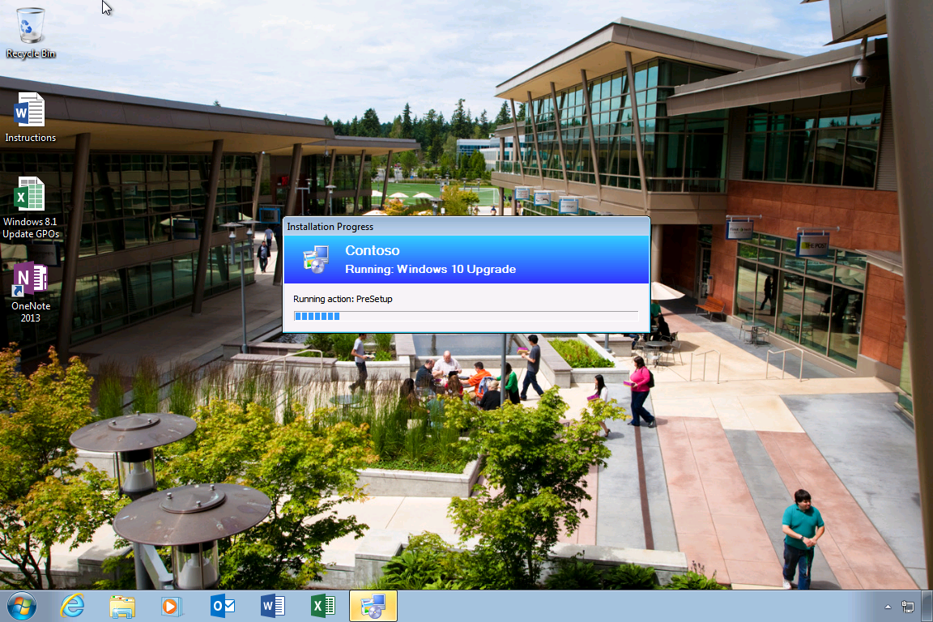
Notes:
In this case, we’re using System Center Configuration Manager to start the upgrade process. This could be pushed out to a group of machines (maybe to perform upgrades overnight), or could be manually initiated by the user at a time of their choice.
Before the upgrade actually starts, the Configuration Manager task sequence could take any steps necessary to get the machine ready for the upgrade. [By default, it needs to prepare the ConfigMgr client for the OS upgrade.]

Slide 9
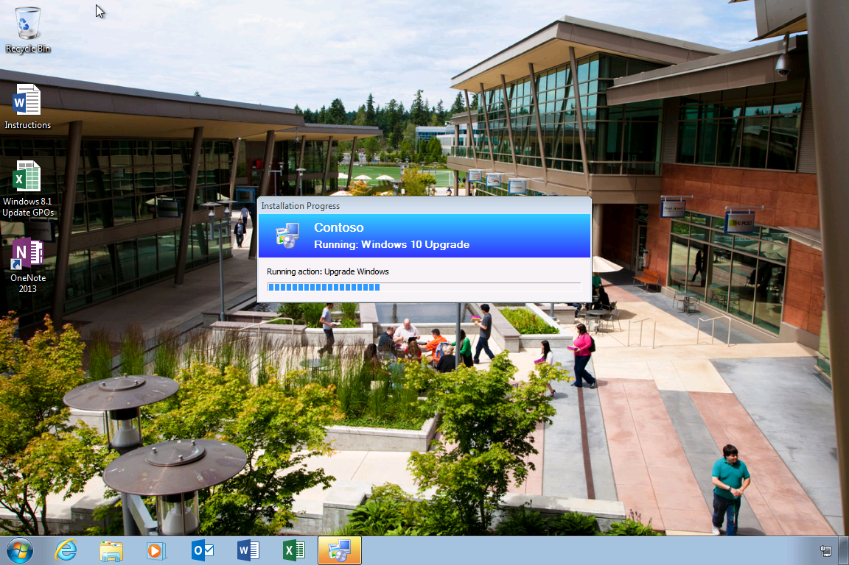
Notes:
After any initial preparation steps are completed, the Windows Setup process is initiated. This will take the new Windows 10 image and place it on the hard drive, before rebooting into a lightweight boot image to continue the upgrade process.

Slide 10
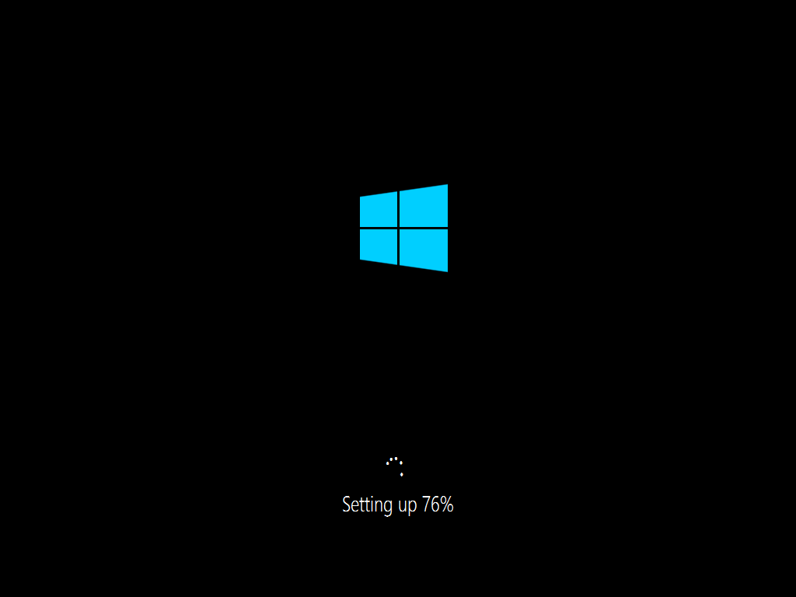
Notes:
All the existing apps, data, and settings will automatically be captured and restored during the upgrade process. If needed, drivers will be migrated forward as well. [Windows Setup will prefer new drivers included in Windows 10 if available, but will migrate older drivers when necessary. You can also specify your own drivers to inject during the upgrade process, if you know that there are some that need updating.]

Slide 11
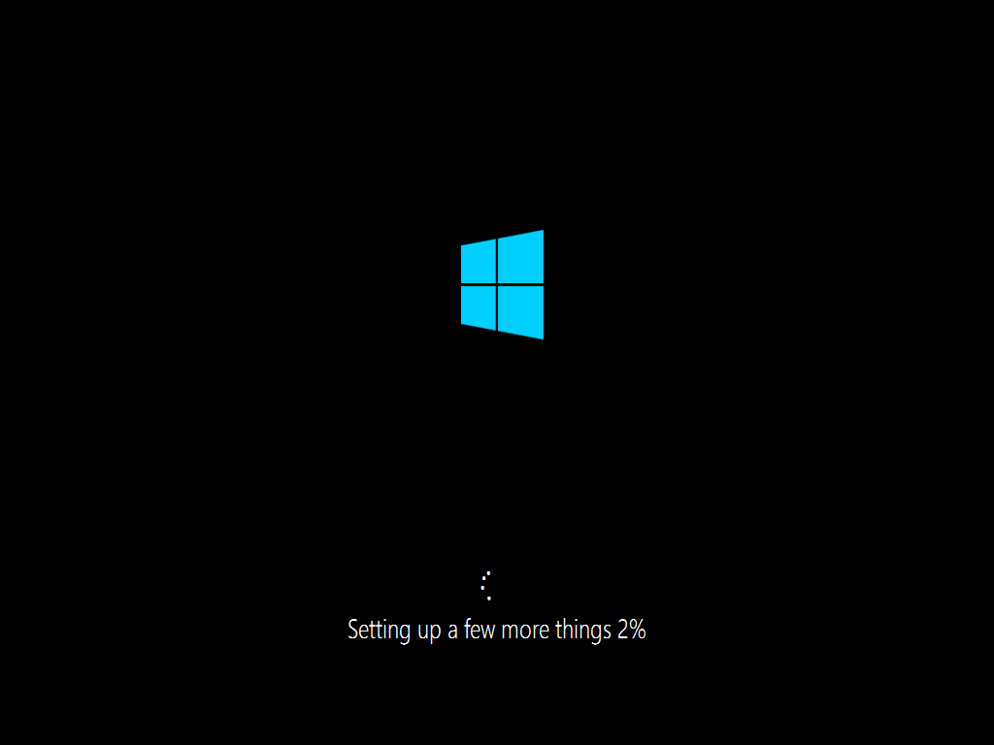
Notes:
Just a few more things…

Slide 12
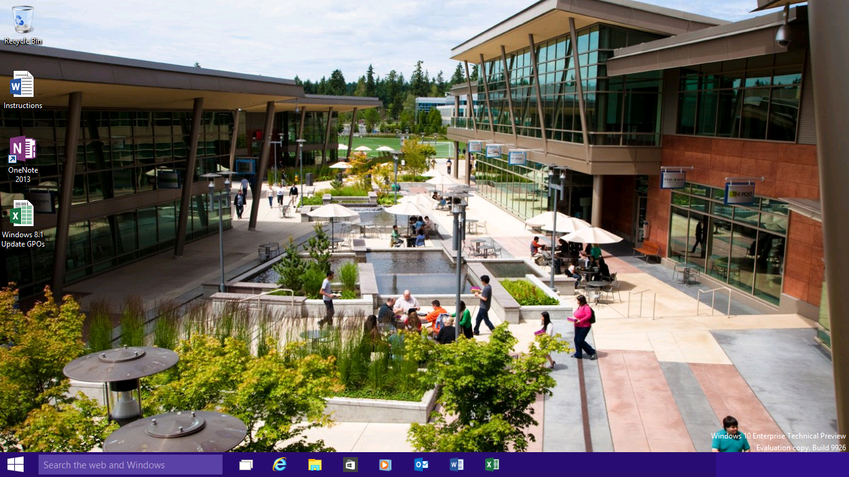
Notes:
Now the new Windows 10 OS is installed, with desktop icons preserved, pinned items on the task bar still there, and the custom background still in place. All existing apps and all data files have also been migrated…

Slide 13
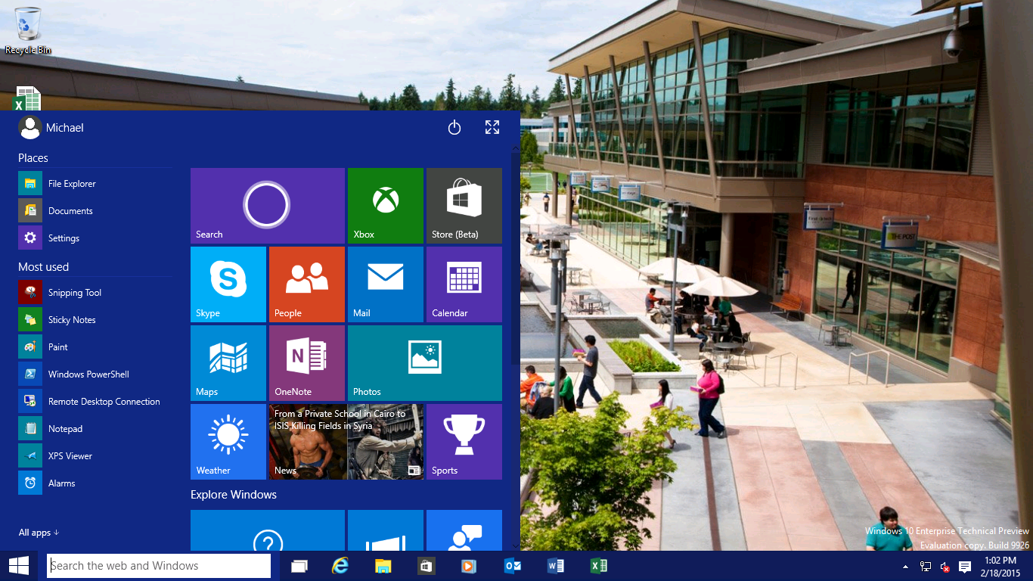
Notes:
…and the new Start menu is in place.
This whole process could take 1-2 hours, depending on the speed of the device and network conditions, which is comparable to traditional wipe-and-load deployment speeds (which spend less time migrating data but more time reinstalling apps and injecting drivers).
It’s very easy to set this whole process up, even with your existing Configuration Manager 2012 R2 environment. Just set up a new, simple task sequence, adding the Windows 10 installation files, and you’re ready to start piloting within an hour.

Slide 14
Provisioning, not reimaging
Take off-the-shelf hardware
Apply a provisioning package
Device is ready for productive use
Notes:
In-place upgrades are great for existing devices. But what about new ones? Today Microsoft knows most organizations buy new devices, typically running a standard Windows Pro operating system – which contains all the needed drivers and configuration necessary for that device. But because it is difficult to configure that device for the organization’s needs, the first step is usually to wipe the system and deploy a standard organization image to the device. That adds an extra cost, as it can take 1-2 hours to do this.
Microsoft wants to provide new tools to eliminate the wipe-and-load need. Instead, they want to be able to run through a simple provisioning process to transform the device into one that is ready for productive use. To do this, they want to enable a simple workflow:
Take a new device out of the box
Apply a provisioning package to it, turning it into a fully-configured enterprise device
Once done, hand the device off to the end user who can immediately be productive
Microsoft will provide new tools to enable this, with the Windows Imaging and Configuration Designer to create these provisioning packages with all the necessary configuration steps included in them. Once created, they’ll provide a variety of ways to deploy these packages, from simple double-click operations to fully-automated solutions.
It’s also worth noting that this process will be exactly the same for Windows 10 phone devices. With these, wipe-and-load isn’t possible (they come preinstalled from the phone OEM), so this is a simple way to perform the initial configuration, without manually needing to set up each device.
[Note that this isn’t designed for ongoing management of the device; it’s just for the initial setup. These provisioning packages can be used to enroll the device into a management system, e.g. using Mobile Device Management, with that handling the ongoing configuration, app management, and more.]

Slide 15
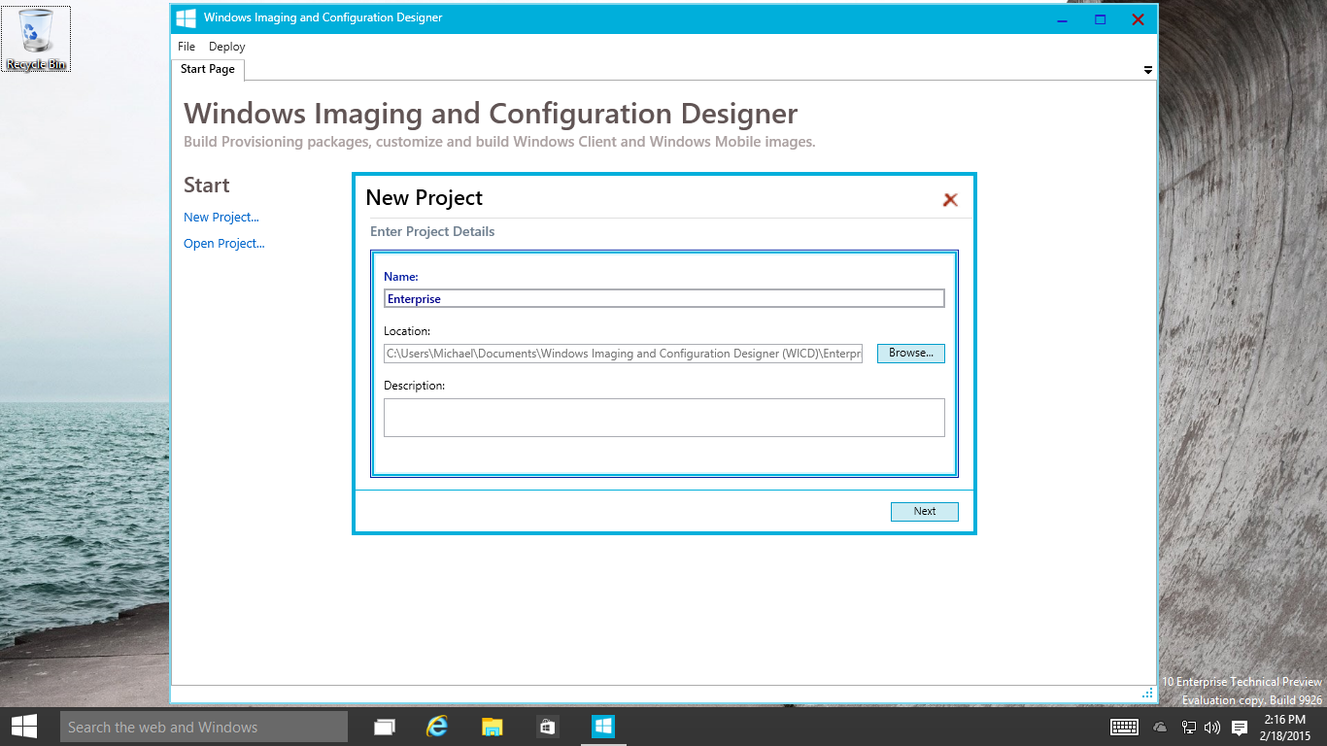
Notes:
Let’s walk through a very simple scenario to give you an idea of the steps needed to provision a device. First, I’m going to create a new project using the Windows Imaging and Configuration Designer (Windows ICD for short).

Slide 16
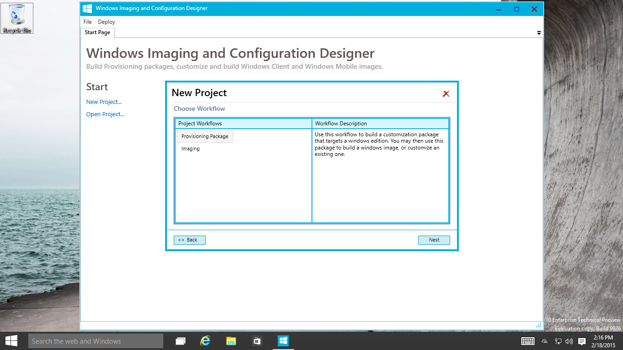
Notes:
I’m going to specify that I want this project to create a provisioning package. [Windows ICD also supports creating images, customized for easy mass deployment with minimal or no device variations. These capabilities primarily target device manufacturers, systems builders, etc., not enterprises.]

Slide 17
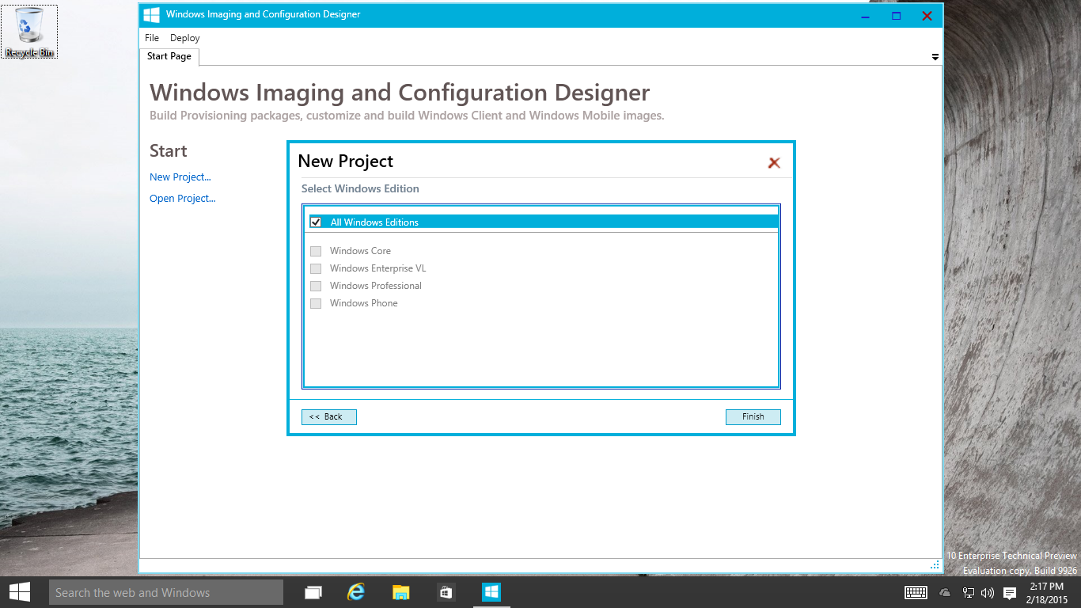
Notes:
I can select the Windows edition that I want to target with this provisioning package. In this case, I’ll choose All Windows Editions, because it doesn’t matter for what I’m going to configure.

Slide 18
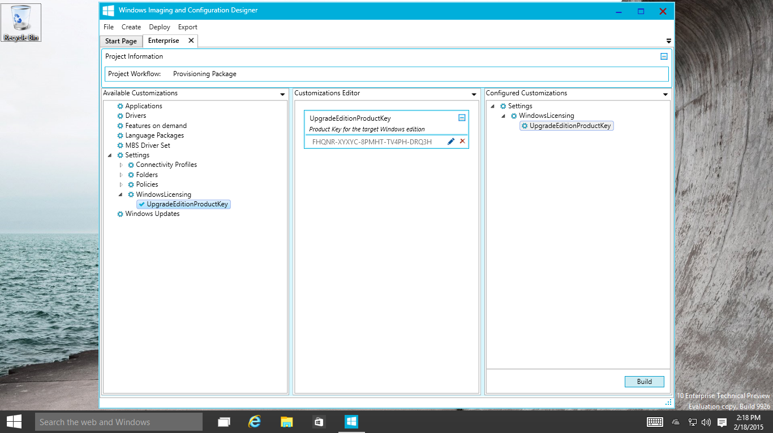
Notes:
Next, I can configure the various settings that I want to be included in the provisioning package. Here, I’m going to add a single setting that is used to upgrade the Windows edition. I have specified my Windows 10 product key (in this case, it’s a setup key, meaning that the device will activate with KMS after it is upgrade), and then clicked to save that into the “Configured Customizations.”

Slide 19
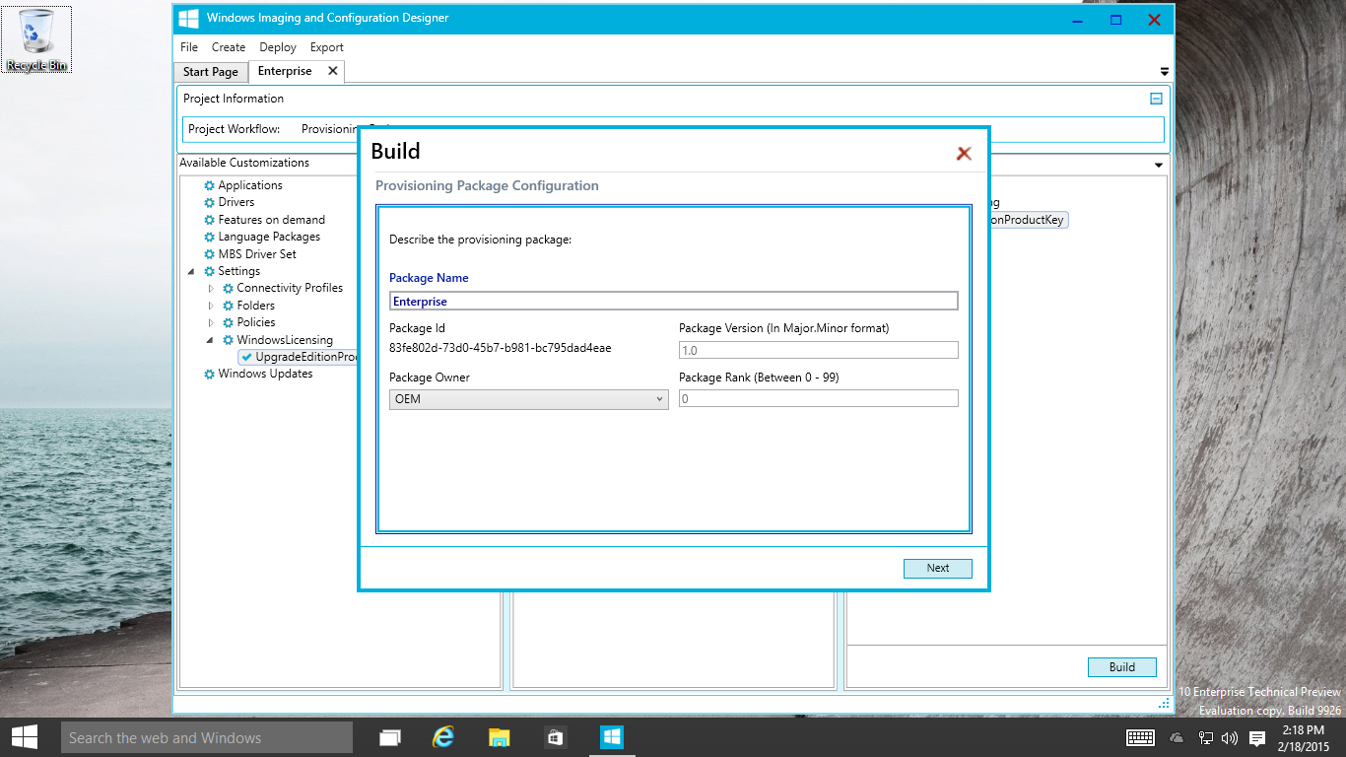
Notes:
Now I can build the provisioning package from that configuration, specifying a package name, output location, and other simple options…

Slide 20
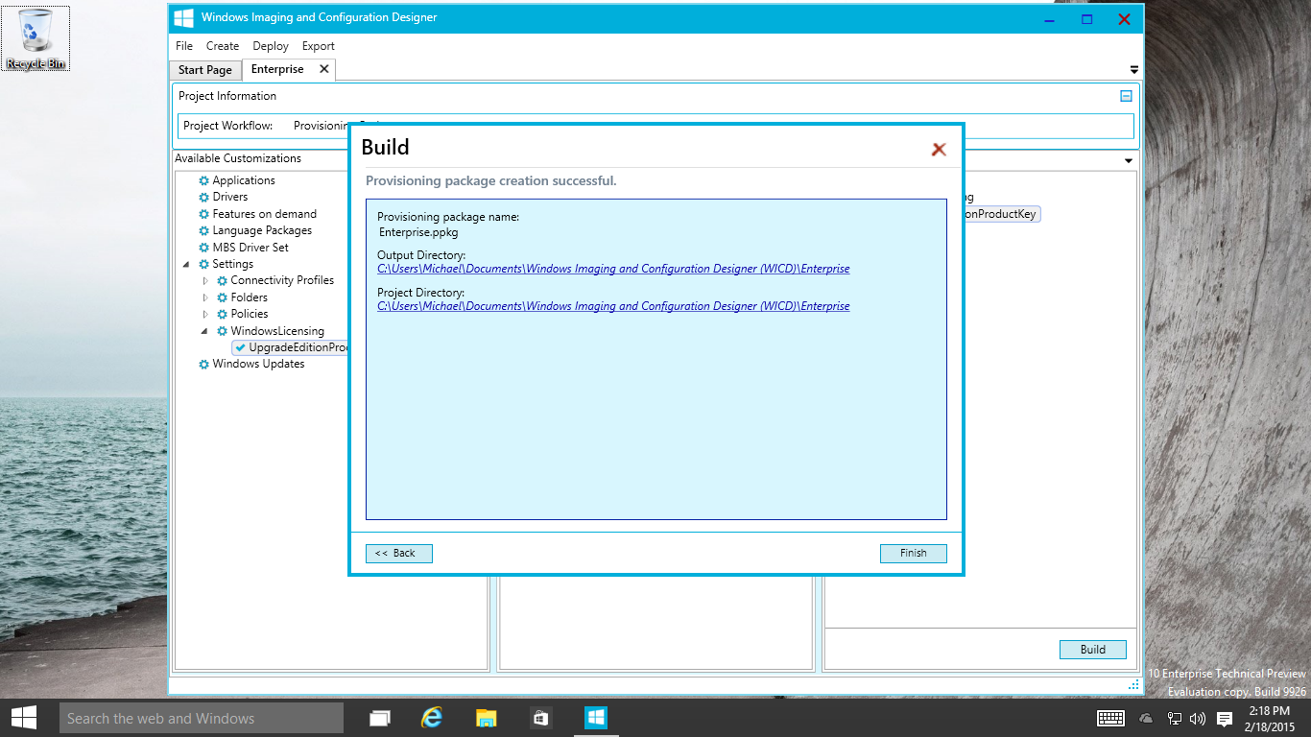
Notes:
Once built, the resulting provisioning package (a single file, with a .PPKG extension) is ready for deployment.
[Note that you might want to sign the package before deploying it, to indicate that this is a trusted package in your environment. If you don’t do this, the package can still be applied, but it will prompt the user for permission first.]

Slide 21
Sequences Shortened
Notes:
So now let’s switch over to a Windows 10 Pro Tech Preview device. I have copied the provisioning package to the device, and can double-click on it to install it (the simplest possible deployment option).
Note that in this case the video was edited to take out the boring parts. While the video is about a minute long, the actual process could take 5-15 minutes, depending on the speed of the device. Note that all the bits necessary to complete the upgrade are already present in Windows, so no internet or network access is needed.
[CLICK TO START VIDEO]
First it will prompt for elevation (since applying most configuration settings requires administrative rights to the device). Then it will ask the user to allow the installation [because this package hasn’t been signed to indicate that it is trusted].
After that, the processing will continue in the background. As soon as the upgrade edition action has been completed, the device will reboot to begin the upgrade process.
After a few minutes, the configuration will be complete and the device is now running Windows 10 Enterprise Tech Preview. That’s all there is to it.

Slide 22
Provisioning, not reimaging
Transform a Device
Install apps and enterprise configuration
Enroll the device to be managed via MDM
Flexible Methods
Using media, USB tethering, or even e-mail for manual distribution
Automatically trigged from the cloud or connection to a corporate network
Leverage NFC or QR codes
Notes:
That’s the process Microsoft envisions: Transforming a device from its out-of-the-box state into a fully-configured enterprise device. They’ll provide flexible ways for doing this, some manual and some automated.
You can try this out today yourselves, as the Windows ICD tool is available in the Assessment and Deployment Kit for Windows 10 preview release, available on the Microsoft download center.

Slide 23
Traditional Deployment
Enhancements to existing tools
Minimal changes to existing deployment processes
New Assessment and Deployment Kit includes support for Windows 10, while continuing to support down to Windows 7
Minor updates to System Center 2012 to add support
Minor updates to Microsoft Deployment Toolkit 2013 to add support
Will feel “natural” to IT Pros used to deploying Windows 7 and Windows 8.1
Drop in a Windows 10 image, use it to create your new master image
Capture a Windows 10 image, use it for wipe-and-load deployments
Notes:
For traditional deployment, Microsoft will update existing tools to support Windows 10. There is a new Assessment and Deployment Kit (ADK) for Windows 10 (available in preview now), which will support not only Windows 10 but also deployment of Windows 7, Windows 8, and Windows 8.1, to ensure that you don’t need to worry about using multiple sets of tools for older and newer OSes.
Microsoft will ensure that only minor updates are needed to deploy and manage Windows 10 using System Center Configuration Manager 2012 or 2012 R2, or using the Microsoft Deployment Toolkit. Microsoft knows that major infrastructure upgrades take time, so they want to avoid those.
The deployment process itself will not change significantly, so for those that already know how to deploy Windows 7 or Windows 8.1, the Windows 10 deployment process will feel natural – just drop in the new Windows 10 bits and go.
For MDT, Microsoft is planning to release a preview of MDT 2013 Update 1 soon that works with the new ADK and Windows 10 preview builds. For Configuration Manager, work is underway on updates for ConfigMgr 2012 and ConfigMgr 2012 R2 as well – stay tuned for more details on those.

Slide 24
Consider Your Deployment Approach
Running Windows 7?
Running Windows 8?
Evaluating, Deploying, or Running Windows 8.1?
Evaluate Windows 8.1 for touch scenarios today.
Upgrade to Internet Explorer 11 by January 2016. Plan for Windows 10 for all devices
Upgrade to Windows 8.1 by January 2016. Plan for Windows 10 for all devices.
Keep going!
Upgrade to Windows 10 when released across all devices
Notes:
All customers should begin planning for Windows 10 today, but there could be slightly different approaches depending on what operating system you are using today.
Microsoft knows many of you are running Windows 7, and they would encourage you to look at new touch-based devices running Windows 8.1 now. But at the same time, it’s important that you make sure you move to Internet Explorer 11, as that’s the first step needed for Windows 10. Also remember that earlier versions of Internet Explorer will no longer be supported on Windows 7 as of January 2016, so if you are running earlier versions, don’t delay – start upgrading now.
For those running Windows 8 who haven’t yet made the move to Windows 8.1, keep in mind that support for Windows 8 ends in January 2016 too. While it might be possible for you to move directly to Windows 10 by that time, it’s probably better to move to Windows 8.1 now and then make the leap to Windows 10 later.
For those already on Windows 8.1, you’re in great shape: Already running Internet Explorer 11 and Enterprise Mode, ready to move to Windows 10 once it’s released.

Slide 25
Enterprise preview process
Preview builds available to all organizations
For Evaluation And Feedback, Not For Broad Deployment
PREVIEW
Periodically updated through “flighting”
Enabling New Features As They Become Available
Fixing And Refining Existing Features And Functions
Actively Soliciting Feedback
WINDOWS INSIDERS
INTERNAL (MICROSOFT)
Rolled out in phases
Enabling New Features As They Become Available
Fixing And Refining Existing Features And Functions
Actively Soliciting Feedback
Notes:
With the enterprise preview now being available, it’s important to understand that Windows 10 is not yet complete. Microsoft will be releasing a variety of additional updates that continue to add new features and functionality (as well as fix bugs and respond to feedback).
These new capabilities will be deployed in phases, starting internally within Microsoft. They will then be deployed to anyone who signs up to be a “Windows Insider”. So be sure to sign up so that you receive new builds, called “flights”, as they are released.
Note that Windows 10 will occasionally ask for feedback on new functionality, in the form of quick surveys about your experiences with the new features. This feedback, as well as any bug reports that you submit, are critical for Microsoft to understand what they’ve got right and where they will need to improve. Not only do they welcome your feedback, they need it to ensure Windows 10 is everything organizations need.

