Slide 1
Windows Server® Virtualization
Infrastructure Planning and Design
Published: November 2007
Updated: February 2011
Notes:
Copyright © 2011 Microsoft Corporation. This documentation is licensed to you under the Creative Commons Attribution License. To view a copy of this license, visit http://creativecommons.org/licenses/by/3.0/us/ or send a letter to Creative Commons, 543 Howard Street, 5th Floor, San Francisco, California, 94105, USA. When using this documentation, provide the following attribution: Infrastructure Planning and Design is provided with permission from Microsoft Corporation.
This documentation is provided to you for informational purposes only, and is provided to you entirely "AS IS". Your use of the documentation cannot be understood as substituting for customized service and information that might be developed by Microsoft Corporation for a particular user based upon that user’s particular environment. To the extent permitted by law, MICROSOFT MAKES NO WARRANTY OF ANY KIND, DISCLAIMS ALL EXPRESS, IMPLIED AND STATUTORY WARRANTIES, AND ASSUMES NO LIABILITY TO YOU FOR ANY DAMAGES OF ANY TYPE IN CONNECTION WITH THESE MATERIALS OR ANY INTELLECTUAL PROPERTY IN THEM.
Microsoft may have patents, patent applications, trademarks, or other intellectual property rights covering subject matter within this documentation. Except as provided in a separate agreement from Microsoft, your use of this document does not give you any license to these patents, trademarks or other intellectual property.
Information in this document, including URL and other Internet website references, is subject to change without notice. Unless otherwise noted, the example companies, organizations, products, domain names, email addresses, logos, people, places and events depicted herein are fictitious.
Microsoft, Active Directory, Excel, Hyper-V, SQL Server, Windows, Windows Server, and Windows Vista are either registered trademarks or trademarks of Microsoft Corporation in the United States and/or other countries and regions.
The names of actual companies and products mentioned herein may be the trademarks of their respective owners.
You have no obligation to give Microsoft any suggestions, comments or other feedback ("Feedback") relating to the documentation. However, if you do provide any Feedback to Microsoft then you provide to Microsoft, without charge, the right to use, share and commercialize your Feedback in any way and for any purpose. You also give to third parties, without charge, any patent rights needed for their products, technologies and services to use or interface with any specific parts of a Microsoft software or service that includes the Feedback. You will not give Feedback that is subject to a license that requires Microsoft to license its software or documentation to third parties because we include your Feedback in them.

Slide 2
What Is IPD? Guidance that clarifies and streamlines the planning and design process for Microsoft infrastructure technologies
IPD:
Defines decision flow.
Describes decisions to be made.
Relates decisions and options for the business.
Frames additional questions for business understanding.
IPD guides are available at www.microsoft.com/ipd.
Notes:
Microsoft® Infrastructure Planning and Design (IPD) is a series of planning and design guides created to clarify and streamline the planning and design process for Microsoft infrastructure technologies.
Each guide in the series addresses a unique infrastructure technology or scenario.
These guides include the following topics:
Defining the technical decision flow (flow chart) through the planning process.
Describing the decisions to be made and the commonly available options to consider in making the decisions.
Relating the decisions and options for the business in terms of cost, complexity, and other characteristics.
Framing the decisions in terms of additional questions for the business to ensure a comprehensive understanding of the appropriate business landscape.
The guides in this series are intended to complement and augment Microsoft product documentation.

Slide 3
Getting Started
Windows Server Virtualization
Notes:
The guide was created to enable infrastructure planners to design virtualization infrastructure solutions. The guide includes specific design information.
Activities that encourage sound planning. Each activity includes:
Prerequisites and background on the activity.
Tasks that will be performed to complete the activity.
Reference information regarding the activity’s impact on characteristics such as cost, complexity, and capacity of the solution.
Questions to ensure business needs are captured and reflected in the solution.
The guide is written for information technology (IT) infrastructure specialists who are responsible for planning and designing a virtualized server infrastructure.

Slide 4
Purpose and Overview
Purpose
To provide design guidance for Windows Server 2008 Hyper-V™ technology
Overview
What’s New in Windows Server 2008 R2
Determine Workload Requirements
Design the Host Infrastructure
Notes:
The purpose of the guide is to focus on the considerations that organizations should take into account when designing a virtualization infrastructure.
This will be accomplished by enabling planners to determine workload requirements and, using those requirements, design a Windows Server® 2008 Hyper-V™ infrastructure.
Details about disaster recovery, server support, and server hosting are outside the scope of this guide.

Slide 5
What’s New in Windows Server 2008 R2
Windows Server 2008 R2 introduces new functionality and enhancements to Hyper-V virtualization, including:
Live migration.
Cluster Shared Volumes.
Dynamic virtual storage support.
Enhanced processor support.
Enhanced networking support.
Note: The guide’s design process is valid for both Windows Server 2008 and Windows Server 2008 R2 environments.
Microsoft Virtual Server R2 with Service Pack 1 is not supported in Windows Server 2008 R2.
Notes:
The guide’s design process is valid for both Windows Server 2008 and Windows Server 2008 R2 environments.
Windows Server 2008 R2 introduces new functionality and enhancements to Hyper-V virtualization that provide improved flexibility, increased performance, and greater scalability for users, including the following:
Live migration
Cluster Shared Volumes
Dynamic virtual storage support
Enhanced processor support
Enhanced networking support
Note that Microsoft Virtual Server 2005 R2 with Service Pack 1 (SP1) is not supported in Windows Server 2008 R2.
For more details on the changes, see http://technet.microsoft.com/en-us/library/dd391932(WS.10).aspx.

Slide 6
Why Use Virtualization?
Here are four virtualization scenarios:
Server consolidation
Application migration
Increased IT agility
Software development and training
Notes:
<Use this slide to discuss broad justifications for choosing server virtualization solutions.>
Most organizations explore virtualization for one of the following reasons:
Server consolidation . By consolidating multiple server instances on one set of hardware, efficiency is gained by more fully using the hardware.
Application migration. Some applications do not run on newer server operating systems, creating a need for the ability to host virtual instances of legacy operating systems to run these applications.
Increase IT agility. Provides the ability to rapidly add and move servers to respond to changing business needs.
Software development. By saving and restoring a set of template virtual hard disks (VHDs), developers can rapidly cycle through test scenarios during software development processes.

Slide 7
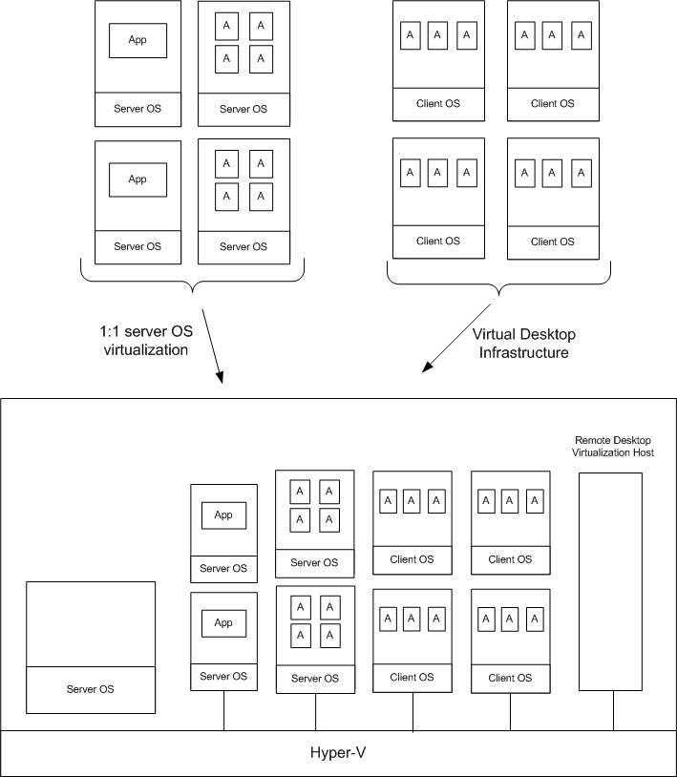
Windows Server Virtualization Architecture Example
SCM
ITA
Notes:
This diagram illustrates the relationship between the components that work together to provide an architecture for Windows Server Virtualization. They are shown together in one possible implementation for illustration purposes, but other configurations are possible.

Slide 8
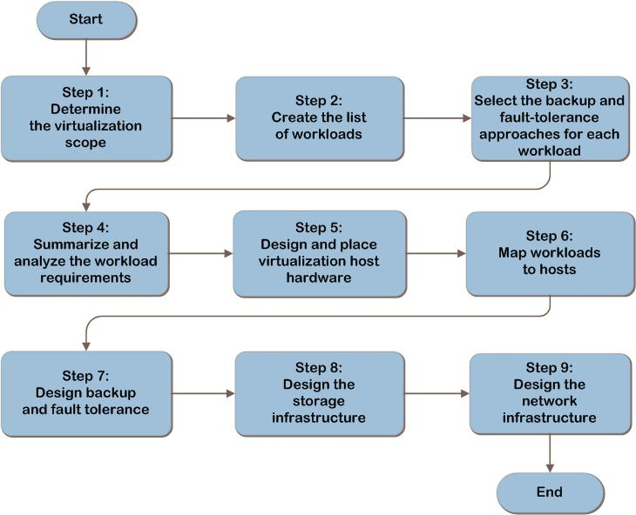
Windows Server Virtualization Decision Flow
MAP w/ CAL Tracker
SCM
ITA
Notes:
This slide depicts the entire planning and design flow for server virtualization. This sequence proceeds in a logical order to first determine requirements and then design an appropriate infrastructure.
Where a step represents decisions the organization must make, the guide presents a corresponding list of common response options. Other steps in this list represent tasks the organization must complete; they appear in the guide, because they are needed to complete the infrastructure design.

Slide 9
Tips for the Planning Process
Use a spreadsheet or database to track application and host server requirements.
Involve the entire organization:
Ensure management’s commitment to the virtualization project.
Gather requirements and business input.
Validate all assumptions with business and technical experts.
Notes:
<Use this slide as an opportunity to share best practices for infrastructure planning.>
Some tips:
A “Job Aid” spreadsheet or other data capture method is recommended, because most organizations will have many applications and scenarios for virtualization that need to be recorded.
Ensure that management stakeholders are made part of the planning process. This ensures that there is commitment to successful completion, that business needs are captured and reflected in the plan, and that budgets can be justified.

Slide 10
Step 1: Determine the Virtualization Scope
Task 1: Determine the Scope of the Project
Which part of the infrastructure will be virtualized?
Option 1: Enterprise
Option 2: Hub
Option 3: Satellite
Business validation:
Define virtualization goals/benefits
Define the scope and timeline for implementation
Notes:
Step 1: Determine the Virtualization Scope
Most infrastructure services can be broken down into smaller units to simplify planning. Virtualization technology can apply to all areas of an organization. In this step, businesses should document their primary goals for virtualization. By the completion of this step, an approach to virtualization should be identified and validated with the business.
Task 1: Determine the Scope of the Project
Many organizations will have the need to deploy virtualization using all three options. Specific design decisions in subsequent steps should keep these decisions in mind.
For the audience, define or explain:
Option 1: Enterprise—The entire organization
Option 2: Hub—Centralized location
Option 3: Satellite—Smaller location, possibly with limited connectivity to central office resources
Business Validation
What is the primary reason for implementing virtualization? Business goals should determine which portions of the infrastructure to virtualize—for example, reducing data center costs by reducing the number of physical servers as well as consolidating applications and workloads. Another business goal may be to centralize desktop workloads to reduce maintenance costs.
What is the expected timeline for moving to virtualization? In many cases, organizations start with a limited deployment in order to gain expertise with the technology and to test various configurations.

Slide 11
Step 2: Create the List of Workloads
Task 1: Create the List of Candidate Workloads
Current location
Admin contact
Operating system
Applications
Task 2: Determine Workload Compatibility
Map any constraints of specific technical requirements against any constraints in the virtualization technology.
Notes:
Step 2: Create the List of Workloads
Now that the project scope has been determined, decide which workloads will be run in the virtualized environment.
Task 1: Create the List of Candidate Workloads
Create a table of all the candidate workloads that are in-scope for virtualization. For each workload record the following in Table A-1 in Appendix A: “Job Aids” in the guide:
Current location. Used to determine the network bandwidth and connectivity requirements. Also used to evaluate whether there are restrictions on where the virtualized workload can be run.
Admin contact. The person who is responsible for administration of the workload. Can determine the suitability of workloads for virtualization.
Operating system. Used to determine whether the workload can be run and supported in a virtual machine (VM).
Applications. Used to determine whether workloads can be run and supported in a VM.
Once complete, this list will be used to examine the compatibility of each of the candidate workloads with the virtualization environment.
Task 2: Determine Workload Compatibility
For each workload, examine the specific technical requirements for the applications and the operating system and map those against any constraints in the virtualization technology. Factors include:
Special hardware requirements, such as access to USB devices or Host Bus Adapters. These are not available to VMs.
64-bit workloads. Windows Server 2008 Hyper-V can support 64-bit guests, but Microsoft Virtual Server 2005 R2 with Service Pack 1 (SP1) cannot.
Workloads that require more than 3.6 gigabytes of virtual memory. Windows Server 2008 Hyper-V can support this, but Virtual Server 2005 R2 with SP1 cannot.
Workloads that must, or should, run on multiple CPUs. Windows Server 2008 Hyper-V can support 64-bit guests, but Virtual Server 2005 R2 with SP1 cannot.
In addition to verifying technical compatibility, confirm that the operating systems and applications suppliers will support the workload and allow it to be licensed for use in a VM. Check also whether security and/or other business requirements may lead an organization to run a workload on physical hardware rather than virtually.

Slide 12
Step 2: Create the List of Workloads (Continued)
Task 3: Determine Resource Requirements
Option 1: The Microsoft Assessment and Planning Toolkit
Option 2: Microsoft System Center Virtual Machine Manager 2008
Option 3: Manually
Notes:
Step 2: Create the List of Workloads (Continued)
Task 3: Determine Resource Requirements
In this task, the technical requirements for each workload being virtualized will be collected. These requirements will be used in subsequent steps to design the host infrastructure.
The organization should plan to support the peak load of each workload to ensure that the host system can handle the full load of all of the workloads. It’s also recommended that a buffer amount be added when determining specific host requirements to ensure enough resources will be provided. This can be done by adding additional capacity for each application that is appropriate for its requirements, or by adding a fixed percentage that applies for all applications.
For existing production workloads, there are three ways to determine the resource requirements.
Option 1: The Microsoft Assessment and Planning (MAP) Toolkit
MAP is a planning toolkit that can be used to inventory a current server and workstation environment, determine which machines are underutilized, and then generate virtualization candidate assessments for implementation. It can also be used to model the environment on different hardware platforms.
Option 2: Microsoft System Center Virtual Machine Manager 2008 R2
System Center Virtual Machine Manager can be used to manage a virtualized server environment. It can analyze performance data and resource requirements both for workloads that will be virtualized and for existing virtualized workloads, which can be used to create deployment recommendations and to enable modeling workloads on existing virtualization hosts. To determine the resource requirements of a workload, a System Center Virtual Machine Manager agent must be installed on that workload.
Option 3: Manually
Use one or more of the following techniques to manually determine resource requirements:
Real-world performance data (based on monitoring existing workloads)
Specifications and requirements from application and operating system vendors
Results from application benchmark testing
Details that application developers and systems integrators provide
Load-testing based on expected use patterns and metrics

Slide 13
Step 3: Select the Backup and Fault-Tolerance Approaches for Each Workload
Task 1: Select the Backup Approach
Option 1: Application backup approach
Option 2: Workload backup approach
Option 3: Virtualization host backup approach
Notes:
Step 3: Select the Backup and Fault Tolerance Approaches for Each Workload
Task 1: Select the Backup Approach
There are three options available to meet the workload’s backup and restore requirements.
The reason for understanding the type of backup approach for each workload is to:
Allow for the possibility of grouping workloads with similar backup requirements onto the same hosts.
Determine the impact that backups will have on the host system from a resource perspective.
Backup can be performed in the following ways:
While the workload is running and in use. In that case, products such as Microsoft SQL Server® and Microsoft Exchange Server have specific backup application requirements to ensure that a complete backup is obtained. For example, transactions that are in memory must be backed up and transaction log files must be committed to the database.
The workload can be paused while a backup is completed. That will ensure a complete backup, but the applications will be unavailable to users while the backup takes place.
Option 1: Application Backup Approach
Performing application-level backups has the following characteristics:
The backup and restore process may be simplified, because administrators can use specific application-level capabilities to manage the backup and restore processes.
The backup files themselves can be significantly smaller than those generated from a guest- or host-level backup.
Application-specific backups can have a significant impact on the host system from a CPU, disk, and network usage perspective.
Option 2: Workload Backup Approach
In workload-level backups, the virtualized workload may include a backup agent such as Microsoft System Center Data Protection Manager 2007 that is responsible for transferring backups to a designated storage location, or the native Windows® Backup application can be used. Workload-level backups can have a significant performance impact on the host system from a CPU, disk, and network usage perspective.
Option 3: Virtualization Host Backup Approach
When performing backups at the virtualization host level, two options are available:
Offline backups. This approach requires turning off the VM or placing it in a saved state before copying files. After the copy process is complete, the VM can be started again. This approach involves downtime for each VM, but it provides a simple method for implementing complete backups.
Online backups. This approach uses System Center Data Protection Manager, which takes a snapshot using Volume Shadow Copy Service (VSS), while the VM is running. Using this method avoids downtime but may affect performance momentarily.

Slide 14
Step 3: Select the Backup and Fault Tolerance Approaches for Each Workload (Continued)
Task 2: Select the Fault Tolerance Approach
Option 1: Network Load Balancing
Option 2: Application-specific clustering
Option 3: Host clustering
Notes:
Step 3: Select the Backup and Fault Tolerance Approaches for Each Workload (Continued)
Task 2: Select the Fault Tolerance Approach
Select the most appropriate fault tolerance approach for each workload that will be virtualized. The technical approach can vary based on the details of the underlying operating system and applications that will run in the virtualized environment. Complete this task for each workload and record the option selected in Table A-4 in Appendix A in the guide.
Option 1: Network Load Balancing (NLB)
Stateless applications such as web servers can have fault tolerance support by establishing NLB across multiple identical instances of the application. NLB technology distributes the inbound traffic headed for the application across multiple machines running the same application, which allows for one server to fail and the remaining servers to pick up the load. Windows Server has a software implementation of NLB built in.
A hardware NLB solution can distribute requests based on a variety of load-distribution algorithms. It can also monitor various nodes in the server farm and ensure that they are operating properly before sending requests to them. This option requires that at least one additional VM be added for each application using NLB.
Option 2: Application-specific Clustering
Many enterprise applications that customers consider mission critical have fail over capabilities built into them through cluster awareness. These applications were designed and built to run on a Microsoft Failover Cluster service. Examples include SQL Server and Exchange Server. A cluster can be configured by using multiple VMs that have a common shared disk. This option requires that at least one additional VM be added for each workload that is being clustered.
Option 3: Host Clustering
The physical virtualization hosts can be configured with Microsoft Failover Cluster service as a failover cluster using shared storage. In this configuration, if the host server running the VMs fails, the virtualization host and all its VMs fail over to another host in the cluster. The cluster would then attempt to restart each VM on the new node of the cluster.
Note: The applications inside each VM are not cluster aware, so there is no guarantee that the application will restart in the correct manner.

Slide 15
Step 4: Summarize and Analyze the Workload Requirements
Task 1: Group Workloads
Group workloads with similar requirements to determine whether they might be able to run concurrently on the same virtualization host servers.
Task 2: Summarize Workload Hardware Resource Requirements
Determine total resource requirements of virtualization host hardware by summing requirements of each workload that will run in the virtual infrastructure.
Notes:
Step 4: Summarize and Analyze the Workload Requirements
In this step, the information collected in the previous steps will be combined to summarize the overall requirements for the solution. By the end of the step, the information will be available to start designing the virtualization host infrastructure.
Task 1: Group Workloads
Group workloads based on similarities in:
Physical isolation requirements. Separate workloads that must be isolated from each other into different groups.
Coexistence and compatibility of workloads. Add workloads to groups with which they share attributes—for example, where the workloads service users in the same geography.
Backup requirements and approach. Group workloads that are backed up in the same way to simplify backup procedures.
Fault tolerance requirements. Add workloads to groups with which they share fault tolerance requirements, which may enable a single fault-tolerant solution to be applied to each group, thereby simplifying operations.
Group workloads that have similar requirements to determine whether they might be able to run concurrently on the same virtualization host servers.
Task 2: Summarize Workload Hardware Resource Requirements
For each group of workloads, use the output of Step 2 to determine the total resource requirements of the virtualization host hardware by summing the requirements of each workload that will run in the virtual infrastructure:
CPU. Total the CPU requirements. The final number represents the total CPU capacity requirements for the host hardware pool.
Memory. Total the physical RAM requirements that were obtained by using application estimates or production performance data. The result will be a value for the total amount of memory in gigabytes that the VMs require.
Disk (storage capacity). The specific storage requirements should include the required amount of disk space for all the VHDs created for VMs.
Disk (performance). Total the input/output per second (IOps) requirements to obtain a view of the total disk performance requirements.
Network. To determine host network requirements, total the peak values of network bandwidth use. Express the result in megabits per second and the number of network adapters.
To provide a safeguard against underestimating resource requirements, add buffer amounts when determining specific virtualization host requirements. Obtain this by adding additional capacity for each workload or by using a percentage or constant adjustment for all workloads.

Slide 16
Step 5: Design and Place Virtualization Host Hardware
Task 1: Determine the Scale Strategy
Task 2: Select the Server Hardware
Task 3: Place the Virtualization Servers
Task 4: Apply Fault Tolerance Requirements
Notes:
Step 5: Design and Place Virtualization Host Hardware
In this step, the most appropriate type of virtualization host hardware on which to deploy the VMs will be determined.
Task 1: Determine the Scale Strategy
Review whether the organization has a policy for server scaling and, if so, whether that policy is to scale up or to scale out. Fewer servers with large memory and CPU support can be easier to manage and can be more cost-efficient for some infrastructures. Using smaller commodity servers with lower capacity can involve a smaller capital investment but often requires additional management effort.
Task 2: Select the Server Hardware
Select server hardware that supports the prerequisites for the virtualization platform that will be used: Windows Server 2008 R2 Hyper-V or Virtual Server 2005 R2 with SP1. Then, refer to the fault tolerance approach for the workloads that was determined in Step 3. If Hyper-V live migration will be used to migrate workloads within a failover cluster, both hosts in a live migration pair must use processors from the same manufacturer.
Task 3: Place the Virtualization Servers
Review the organization’s overall goals relative to centralization, regionalization, and decentralization of workloads. Then, for each workload that will be virtualized, use the output of Step 4, Task 1 and the following to determine the ideal location for each server that would host that workload:
User location, if users are concentrated in a few locations.
Regulatory or business requirements.
Availability of skills and resources to operate the servers.
Maintenance strategy. If Hyper-V live migration will be used to move workloads between hosts (for example, to enable planned downtime on one of those hosts), then the hosts must be connected in a failover cluster on the same local area network segment, with access to a shared logical unit number.
After completing this task, the location of the servers will have been determined.
Task 4: Apply Fault-Tolerance Requirements
Review the requirements for fault tolerance that were determined in Step 3. The hosts in the failover cluster may require access to shared storage, in which case both hosts in a failover pair may need to be sited local to each other.

Slide 17
Step 6: Map Workloads to Hosts
Task 1: Determine Host Resource Threshold/Buffer Limits
Task 2: Map Workloads to the Form Factor
Notes:
Step 6: Map Workloads to Hosts
The purpose of this step is to determine which workloads will be placed on which physical hosts and how many of those hosts will be required.
Task 1: Determine Host Resource Threshold/Buffer Limits
Decide on the optimum host resource use levels for CPU and memory, since that will determine how many workloads can fit on any given host.
Task 2: Map Workloads to the Form Factor
Map all of the workloads onto as few physical servers as possible in each geography, while respecting the needs for server buffer, isolation, availability, backup type, and geographic location. To do this, refer to Step 2 and the method that was used to collect the workload requirements. If System Center Virtual Machine Manager or MAP were used, they can be used here to model and recommend workload placement. If these tools are not available or not appropriate, then this task must be performed manually. Start by categorizing the workloads based on their CPU and memory requirements.
Next, combine or separate workloads based on their backup, availability, and isolation requirements. For example, if entire VM backup is required, deploy the workload onto virtualization host servers designated for that task. System Center Data Protection Manager provides this capability to back up an entire VM. Ideally, this process would be likened to an automatic coin counter where all of the coins are put in a funnel in the top of the machine and the coins are automatically separated into their respective denominations and stacked in sizes that fit the coin wrappers. When a stack is full, the machine stops until the full wrapper is removed and a new one is positioned.
At the end of this exercise, all workloads and requirements should be accounted for and the number of physical servers should be identified. Additional servers may be required to meet fault tolerance requirements. These are addressed in the guide. It may be appropriate to iterate through this process using different form factor designs to find the optimal configuration.

Slide 18
Step 7: Design Backup and Fault Tolerance
Task 1: Select the Backup Approach
Virtual hard disk copy
Volume Shadow Copy Service snapshot
Task 2: Design Fault Tolerance
Notes:
Step 7: Design the Network Connections
Task 1: Select the Backup Approach
The following items provide more information to consider relative to designing the backup approach:
Data loss tolerance. How much data can the business afford to lose (minutes, hours, or days)? Frequent backups increase the cost and complexity of the implementation.
Speed of data recovery. How quickly must the organization’s data be recovered after a problem occurs?
VHD copy. Because the entire contents of a VM are encapsulated in VHD and configuration files, a simple method of performing backups is to copy these files from the host computer’s file system.
VSS snapshot. System Center Data Protection Manager uses the VSS writer in Windows Server 2008 Hyper-V or Virtual Server 2005 R2 with SP1 to make consistent backups of VMs while they are in use.
Task 2: Design Fault Tolerance
Plan for load balancing. For each workload identified requiring NLB, determine how many additional instances of the workload are needed, and map them onto physical host systems. Load balanced VMs should be distributed across multiple hosts to protect against the failure of a single host taking down all instances of the load-balanced application.
Plan for application-specific clustering. For applications requiring fault tolerance through clustering, determine how many additional instances of the application are needed and map them onto physical host systems.
Plan for host clustering. If Microsoft Failover Cluster service will be used, count the number of servers that have workloads requiring host clustering. Create a cluster plan supporting the defined number of active nodes. Each cluster will require at least one additional physical host server to act as the passive node in the cluster.

Slide 19
Step 8: Design the Storage Infrastructure
Task 1: Plan for Performance
Task 2: Plan for Capacity
Task 3: Select an Input/output Subsystem
Notes:
Step 8: Design the Storage Infrastructure
In this step, the input/output (I/O) performance and capacity requirements of the VMs that will run on each virtualization server will be used to design the I/O subsystem for the servers.
Task 1: Plan for Performance
The goal of designing storage to meet disk performance requirements is to support the required number of IOps. This information was collected in Step 2 and was recorded in Table A-2 in Appendix A: “Job Aids” in the guide. In this task, calculate the total IOps requirement for each virtualization server by totaling the IOps requirements for each VM that will run on that server. Remember to account for host-based activities in the planning, such as the impact of backup operations on disk performance, as well as adding an appropriate buffer to protect the system in the event of any system performance anomalies.
Task 2: Plan for Capacity
In this task, calculate the disk capacity requirements for each virtualization server by totaling the capacity requirements for each workload that will run on the server plus the space that backups need (if any). The capacity requirement for each workload was collected in Step 2 and was recorded in Table A-2 in Appendix A: “Job Aids’ in the guide.
Task 3: Select an I/O Subsystem
The choice of the form factor for the storage system should reflect the ability to provide the performance and capacity requirements as well as clustering support, if applicable, and VSS snapshot backup capabilities, if required. Record the selection for each host server in Table A-5 in Appendix A: “Job Aids” in the guide.

Slide 20
Step 9: Design the Network Infrastructure
Task 1: Determine Host Connectivity Requirements
Task 2: Determine Host Throughput Requirements
Task 3: Plan for Network Reliability and Availability
Notes:
Step 9: Design the Network Infrastructure
In this step, the network infrastructure will be designed.
Task 1: Determine Host Connectivity Requirements
Refer to Step 2, where the requirements for network connectivity were determined for each workload. Windows Server 2008 Hyper-V and Virtual Server 2005 R2 provide the ability to configure network settings based on workload requirements.
The following options exist for defining network access settings for VMs:
No network connectivity. In this configuration, the VM does not have network access to other VMs or physical servers.
VM-only (logical) networks. For security purposes, VMs can be configured to communicate only with other VMs that are on the same virtualization host computer.
Physical network access. This method allows VMs to access one or more physical networks to which the virtualization host is connected.
Design the number and types of network connections that will be required for each virtualization host based on the needs of the VMs that will run on it.
Task 2: Determine Host Throughput Requirements
In Step 2, the network bandwidth required for each workload was established. Translate this information into specific host network requirements based on which VMs will reside on which servers.
Task 3: Plan for Network Reliability and Availability
In addition to providing multiple network connections based on functional needs, ensure that physical host network connections meet reliability and availability needs. For each virtualization host, calculate the number of physical network adapters required. The determinations made for this step may inform changes in the host server design if the selected host chassis cannot support the number of physical network adapters required.

Slide 21
Summary and Conclusion
Organizations should base the design of their virtualization infrastructure on business and technical requirements.
Considerations should include:
The scope of virtualization.
Technical requirements and considerations.
Additional business requirements.
Designing a host infrastructure to meet those requirements.
Validating the overall approach.
Provide feedback to ipdfdbk@microsoft.com.
Notes:
Stress the need for ensuring that a virtualized infrastructure serve the requirements of the business. It should not be virtualized for the sake of virtualization but should solve some need for reducing cost, improving performance or reliability, or reducing complexity.

Slide 22
Find More Information
Download the full document and other IPD guides:
www.microsoft.com/ipd
Contact the IPD team:
ipdfdbk@microsoft.com
Access the Microsoft Solution Accelerators website:
http://www.microsoft.com/technet/SolutionAccelerators

Slide 23
Questions?

Slide 24
Addenda:
Benefits for consultants or partners
IPD in Microsoft Operations Framework 4.0
Windows Server Virtualization in Microsoft Infrastructure Optimization

Slide 25
Benefits of Using the Windows Server Virtualization Guide
Benefits for Business Stakeholders/Decision Makers
Most cost-effective design solution for implementation
Alignment between the business and IT from the beginning of the design process to the end
Benefits for Infrastructure Stakeholders/ Decision Makers
Authoritative guidance
Business validation questions ensuring solution meets requirements of business and infrastructure stakeholders
High integrity design criteria that includes product limitations
Fault-tolerant infrastructure
Infrastructure that’s sized appropriately for business requirements
Notes:
Benefits of Using the Windows Server Virtualization Guide
Benefits for Business Stakeholders/Decision Makers:
Most cost-effective design solution for an implementation. IPD eliminates over-architecting and over-spending by precisely matching the technology solution to the business needs.
Alignment between the business and IT from the beginning of the design process to the end.
Benefits for Infrastructure Stakeholders/Decision Makers:
Authoritative guidance. Microsoft is the best source for guidance about the design of Microsoft products.
Business validation questions to ensure the solution meets the requirements of both business and infrastructure stakeholders.
High integrity design criteria that includes product limitations.
Fault-tolerant infrastructure, where necessary.
Proportionate system and network availability to meet business requirements. Infrastructure that is sized appropriately to meet business requirements.

Slide 26
Benefits of Using the Windows Server Virtualization Guide (Continued)
Benefits for Consultants or Partners
Rapid readiness for consulting engagements
Planning and design template to standardize design and peer reviews
A “leave-behind” for pre- and post-sales visits to customer sites
General classroom instruction/preparation
Benefits for the Entire Organization
Using the guide should result in a design that will be sized, configured, and appropriately placed to deliver a solution for achieving stated business requirements
Notes:
Benefits of Using the Windows Server Virtualization guide (continued)
Benefits for Consultants or Partners:
Rapid readiness for consulting engagements.
Planning and design template to standardize design and peer reviews.
A “leave-behind” for pre- and post-sales visits to customer sites.
General classroom instruction/preparation.
Benefits for the Entire Organization:
Using the guide should result in a design that will be sized, configured, and appropriately placed to deliver a solution for stated business requirements, while considering the performance, capacity, manageability, and fault tolerance of the system.

Slide 27
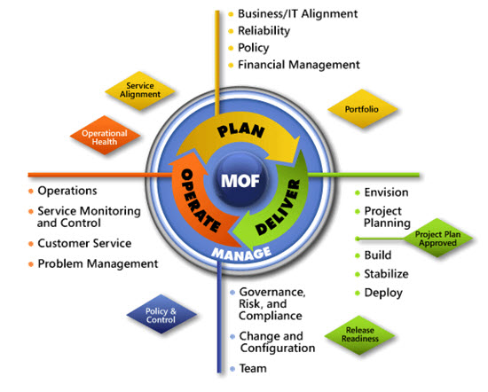
IPD in MOF 4.0
Use MOF with IPD guides to ensure that people and process considerations are addressed when changes to an organization’s IT services are being planned.
Notes:
For more information about Microsoft Operations Framework 4.0, go to www.microsoft.com/mof.

Slide 28
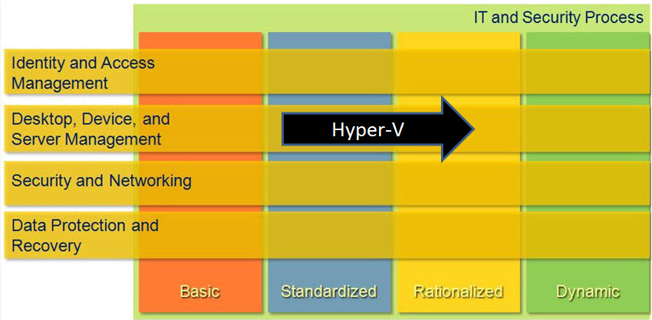
Windows Server Virtualization in Microsoft IO
Notes:
<This slide shows the effect that Windows Server Virtualization has on infrastructure maturity as reflected in the Core Infrastructure Optimization (IO) Model.>
The Microsoft IO Model groups IT processes and technologies across a continuum of organizational maturity. (For more information, see http://www.microsoft.com/infrastructure.) The model was developed by industry analysts, the Massachusetts Institute of Technology (MIT) Center for Information Systems Research and Microsoft's own experiences with its enterprise customers. A key goal for Microsoft in creating the IO Model was to develop a simple way to use a maturity framework that is flexible and can easily be applied as the benchmark for technical capability and business value.
IO is structured around three information technology models: Core IO, Application Platform Optimization, and Business Productivity IO. According to the Core IO Model, organizations that are actively pursuing server consolidation for production workloads with virtualization are meeting one of the requirements necessary to move to the Rationalized level.

