Slide 1


AZR201
Mastering Azure Functions
@Bob1German
@SharePointFest

Slide 2

Agenda
Azure Functions Concepts
Life on the client side …
Big scenarios where you may miss the server:
  Timer job
  Elevating privileges
  Hiding API keys with Function Proxies
Resources – including all the code!

Slide 3



…if cloud computing was transportation
IaaS
PaaS
Serverless
…you can buy or lease a car and maintain it yourself

Slide 4
…if cloud computing was transportation
IaaS
PaaS
Serverless
…you can buy or lease a car and maintain it yourself
…you can rent a car
…you can rent a car and pay for having it around even when you are not driving

Slide 5
…if cloud computing was transportation
IaaS
PaaS
Serverless
…you can buy or lease a car and maintain it yourself
…you can rent a car
…you can use a ride sharing app pay only for transportation
…you can rent a car and pay for having it around even when you are not driving

Slide 6
Azure Functions Architecture
Your part of app
Function
Function
Function
Proxy
Bindings
URL Path
Code
Function App
Authentication
Runtime Version
Edit Mode
Slots
Functions Runtime
App Service
Authentication
App Settings
URL hostname
CORS
IIS
App
App Service Plan
Scale Up
Scale Out
Storage
Server farm
Virtual Machines
What is it really?
What can I configure?

Slide 7
Best practices for the “Functions” programming model
Functions should “do one thing”
Functions should be stateless and idempotent
Functions should finish as quickly as possible
1

Slide 8

Azure Functions - Languages
 | Functions 1.x | Functions 2.x
C# | GA | Preview
JavaScript | GA | Preview
F# | GA | Preview
Java |  | Preview
PowerShell | Experimental
Python | Experimental
PHP | Experimental
TypeScript | Experimental
Batch (.cnd, .bat) | Experimental
Bash | Experimental
Experimental
options
  Don’t scale well
  Don’t support all bindings
  v1 only (there will be no v2 Experimental options)
  Not supported – officially not for production use!
  Yet … everybody uses them! ☺

Slide 9
Azure Function
Bindings
Type | 1.x | 2.x | Trigger | Input | Output
Microsoft Graph Outlook email |  | ✔ |  |  | ✔
MS Graph Events |  | ✔ | ✔ | ✔ | ✔
MS Graph Auth tokens |  | ✔ |  | ✔
Mobile Apps | ✔ | ✔ |  | ✔ | ✔
Notification Hubs | ✔ |  |  |  | ✔
Queue storage | ✔ | ✔¹ | ✔ |  | ✔
SendGrid | ✔ | ✔ |  |  | ✔
Service Bus | ✔ | ✔ | ✔ |  | ✔
Table storage | ✔ | ✔¹ |  | ✔ | ✔
Timer | ✔ | ✔ | ✔
Twilio | ✔ | ✔ |  |  | ✔
Webhooks | ✔ |  | ✔ |  | ✔
Type | 1.x | 2.x | Trigger | Input | Output
Blob Storage | ✔ | ✔¹ | ✔ | ✔ | ✔
Cosmos DB | ✔ | ✔ | ✔ | ✔ | ✔
Event Grid | ✔ | ✔ | ✔
Event Hubs | ✔ | ✔ | ✔ |  | ✔
External File² | ✔ |  |  | ✔ | ✔
External Table² | ✔ |  |  | ✔ | ✔
HTTP | ✔ | ✔¹ | ✔ |  | ✔
Microsoft Graph Excel tables |  | ✔ |  | ✔ | ✔
Microsoft Graph OneDrive files |  | ✔ |  | ✔ | ✔

Slide 10
Platform and scaling
Dynamic
Platform handles scalability
Pay based on
# of executions
Amount of memory
Duration of execution
Dedicated
Choose any of the App Service plan tiers
Basic, Standard, Premium
Pay based on # and size of reserved VMs
You’re responsible for scale
Popular!
Great if you already have an app service

Slide 11
Authorization Models
Azure Function App
Function (pass a function key)
Admin (pass function app’s host key)
System (pass function app’s master key)
Anonymous (can be used in conjunction with App Service authN)
Coming soon: User – this will be token based
App Service “EasyAuth”
Azure AD
Microsoft Account (MSA)
Facebook
Twitter
Google
Not secure in browser or native app!
Secure from web browser

Slide 12
Azure Functions Architecture
Functions
Runtime
Functions Programming Interface
Input Bindings
Triggers
Output Bindings
App Service
App Hosting Plans

Slide 13
What’s in a Function?
File | What it does
host.json | Host settings
local.settings.json | Settings during local debug (replaced by Application Settings at runtime)
<folder>/function.json | Define function, bindings
proxies.json | Define function proxies
package.json/package-lock.json | (JavaScript only) – npm packages

Slide 14
Use bindings in your code
run.csx
function.json
public static void Run(byte[] image, string filename,
Stream outputBlob, TraceWriter log)
{
log.Info($"Processing image: {filename}");
var imageBuilder = ImageResizer.ImageBuilder.Current;
imageBuilder.Build(
image, outputBlob,
new ResizeSettings(640, 400, FitMode.Max, null), false);
}
{
"bindings": [
{
"name": "image",
"type": "blobTrigger",
"direction": "in",
"path": "card-input/{filename}.jpg",
"connection": "AzureWebJobsStorage"
},
{
"type": "blob",
"name": "outputBlob",
"path": "card-output/{filename}.jpg",
"connection": "AzureWebJobsStorage",
"direction": "out"
}
]
}

Slide 15
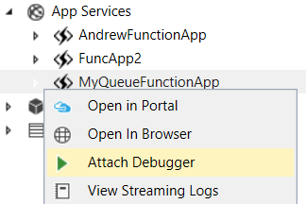
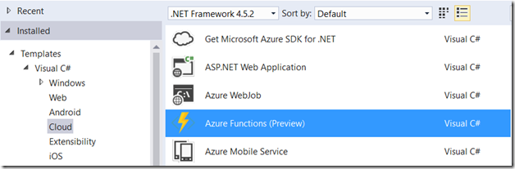
Azure Function Visual Studio Integration
Functions project and templates
Uses Azure Functions Developer Tools
Run and debug locally or in Azure
Trigger on events in Azure
  Example: add a new queue item in Azure and hit a breakpoint within your function code!
DEMO:
Function in C# elevates permission in SharePoint

Slide 16
Elevating Permissions
SPFx Solution
SharePoint Online Client Extensibility
Azure Function
Azure Function Application
Graph
Client
Application
Graph API

Slide 17
Elevating Permissions
SPFx Solution
SharePoint Online Client Extensibility
Azure Function
Azure Function Application
Graph
Client
Application
Managed Service Identity
Graph API
Key Vault

Slide 18

The secrets we keep…
Connection strings
Application keys / Client secrets
Certificates, and passwords to certificate private keys
Encryption keys
Service account passwords

Slide 19
Azure AD Managed Service Identity*
KeyVault access is controlled using Azure AD
In Public Preview
Automatically generates and manages
an App Registration and Service
Principal for your App Service
or Function
In KeyVault, grant applications and
admins access to only the
secrets they need
I need to get my secrets from KeyVault
What’s the app key that has access to KeyVault?
* in preview

Slide 20
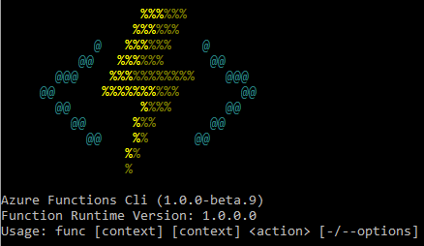
Azure Functions Developer Tools*
Create/ Develop / Manage Azure Functions
Run and debug locally
  Run the Functions runtime on your local machine
  Functions invoked (triggered) based on events in Azure
  Not an emulator or simulator –
  same code that runs your Function Apps in Azure!
Do try this at home!
http://bit.ly/AzFuncTools
Want to not elevate permissions? Learn about “On Behalf Of” flow in this great blog series by Vardhaman Deshpande
http://bit.ly/AzFuncOnBehalfOf
DEMO:
Function in Node elevates permission in SharePoint
Using App Services authentication and deployment
Consuming from SPFx
* Formerly known as Azure Functions CLI

Slide 21

Azure Function Proxies
Light-weight API management
Change URL, manipulate request and response
Inherits the configuration of your Function App
(e.g. authentication)
DEMO:
Hide API key in an Azure Function Proxy

