Slide 1
McAfee MVISION Cloud
Office 365 Use Case

Slide 2
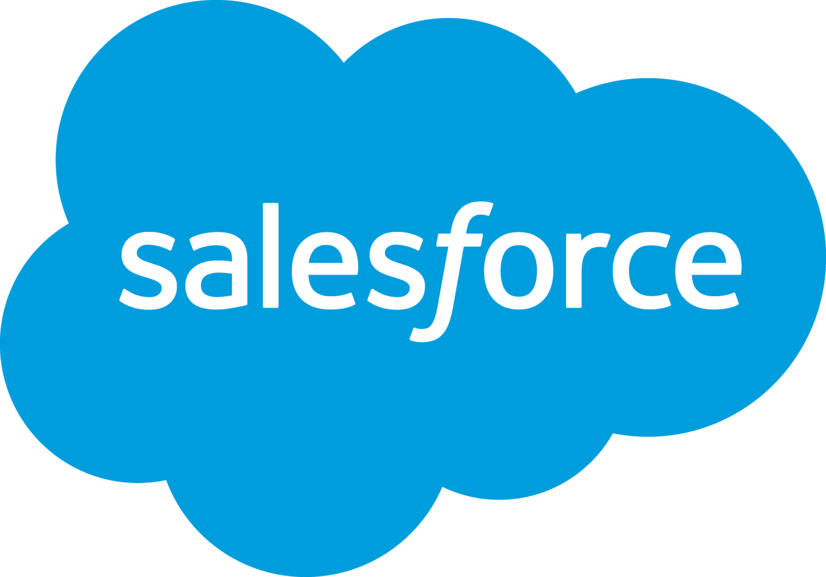

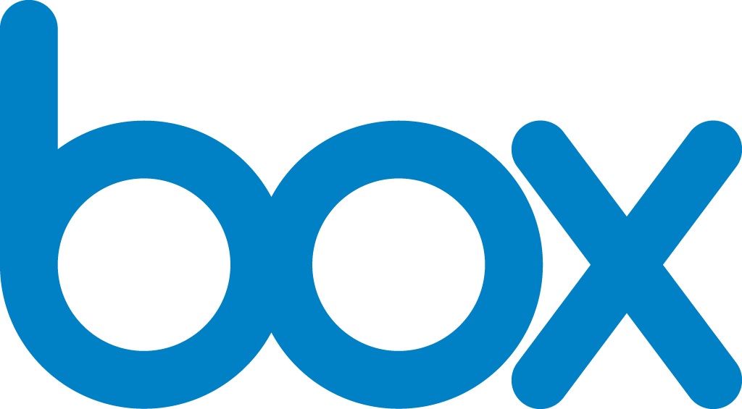
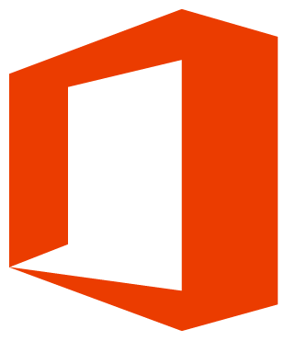
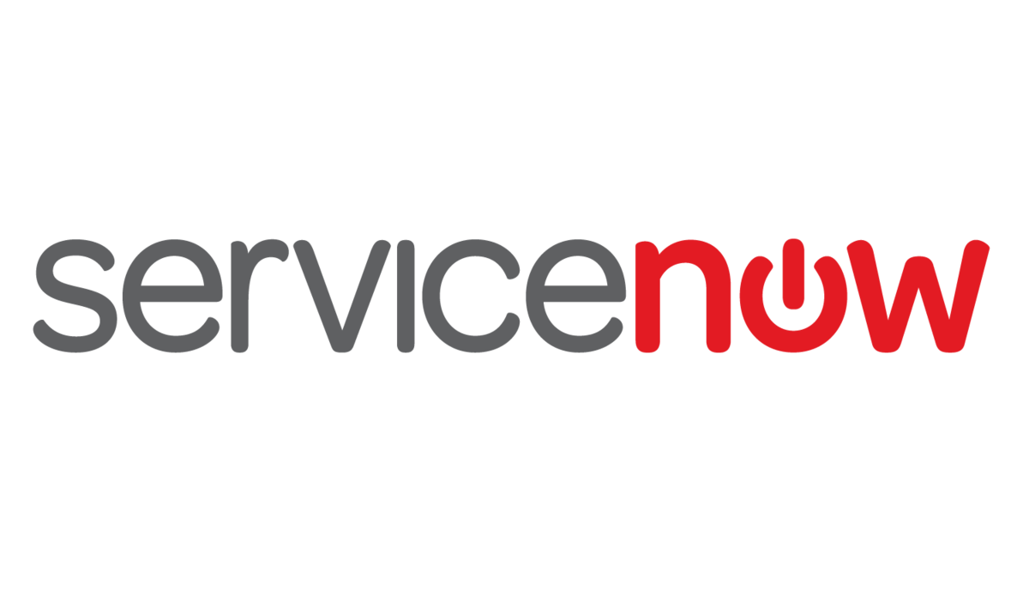

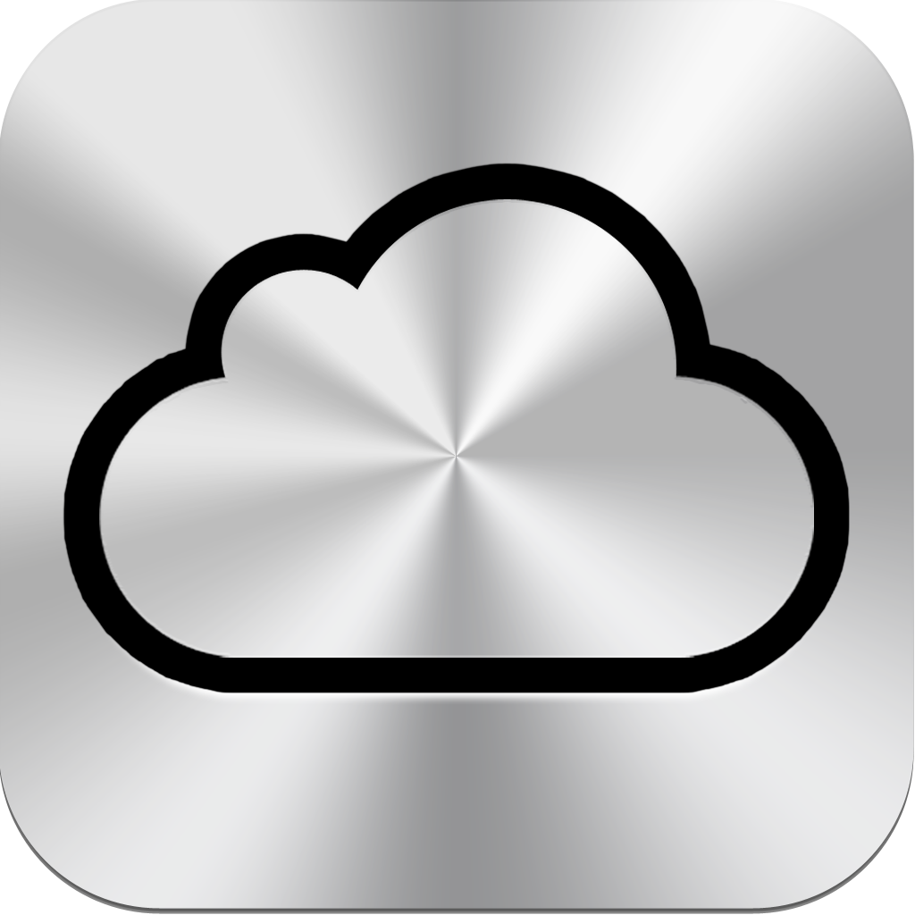
Customer Drivers for Cloud Adoption
1
SaaS
Business Agility
2
IaaS/PaaS
Business Transformation
3
Consumer
Personal Productivity
Approved SaaS
IaaS/PaaS
Shadow SaaS

Slide 3
Med/Low-Risk
Shadow
High-Risk
Shadow
Custom Apps
ServiceNow
5%
11%
5%
Visibility
8%
AWS
13%
Where is enterprise sensitive data in the cloud?
Salesforce
16%
2%
Slack
2%
Google Docs
7%
Box
31%
Office 365

Slide 4
The Cloud (First) Enterprise Challenges
Cloud-to-Cloud traffic
1
Data Creation and Access in the Cloud Bypasses Existing Network Security Infrastructure
95% of Network Traffic
SaaS
IaaS/PaaS
Network Controls
Notes:
Cloud Network Traffic to reach 95% of all data center traffic by 2012
Source Cisco : https://betanews.com/2018/02/05/cloud-data-center-traffic/

Slide 5
The Cloud (First) Enterprise Challenges
IaaS
PaaS
SaaS
2
Customers Are Still Responsible for Security
Data Classification & Accountability
Client & End-Point Protection
Identity & Access Management
Application Level Controls
Network Control
Customer Responsibility
Host Infrastructure
Service Provider Responsibility
Physical Security
Cloud Shared Responsibility Model
Notes:
The second challenge to the cloud first strategy is based on the “Shared Responsibility Model”. This means that when you sign a contract with your cloud service provider each of you has certain responsibilities as it relates to security.
What is one thing that 100% of cloud service providers are not responsible for? Your companies data, your users security (in other words their compromised accounts) and what your employees do in the cloud (Are they putting sensitive data there? Are they sharing it with the wrong people, are they stealing it?). So bottom line, your IT organization still owns a huge responsibility even though you are moving to the cloud.
Examples
Rogue Employee
Stolen Employee Credential
Email Synced to BYOD device

Slide 6
“Through 2020, 95% of cloud security failures will be the customer’s fault.”
Gartner Magic Quadrant for CASB—2017
Notes:
The cloud services providers are protecting their infrastructures and following best practices best they know how and they do a darn good job. But the problem is, as stated before that it is a shared responsibility model and what Gartner predicts that through 2020 99% of cloud security failures (data loss, exposures, breeches) will be due to the customer not managing their end of the responsibility.
The other thing that is relevant is that cloud technology is so new that existing developers, IT, and security folks have not worked with the cloud before. Being that they never worked with it before they do not know what does into securing the application.

Slide 7
McAfee MVISION Cloud

Slide 8
MVISION Cloud enables organizations to accelerate their business by giving them total visibility and control over their data in the cloud and protecting them from cloud threats
Notes:
With MVISION Cloud , I’ll start with our mission, which is to enable organizations to accelerate their business by giving them total control over their data in the cloud. For too long IT Security has been seen as an inhibitor to productivity and innovation, but with McAfee, IT security is able to enforce the controls required to securely move to the cloud. And with total control over their data, they are able to unleash the power of the cloud – the performance, the scalability, the agility, the cost savings, the cloud delivers, which significantly accelerates their businesses.

Slide 9
Visibility
Control
MVISION Cloud
What: Data, Apps, Users, Devices
Who
Where
When
DLP
Delete/Quarantine
Encryption
Access
Configuration
SaaS
IaaS/PaaS
Shadow

Slide 10
McAfee MVISION Cloud protects ALL customer data in the cloud
Shadow
Apps
Long Tail SaaS
Lift & Shift Apps
CASB Connect APIs
CASB Reverse Proxy
Enterprise SaaS
Cloud Native IaaS/PaaS
Compliance & Risk Assessment
Reporting
Orchestration
DLP
Config Audit
Classification
UEBA
Malware Protection
Access Control
Encryption
Activity Monitoring
Data Protection
Threat Protection
Common Security Services

Slide 11








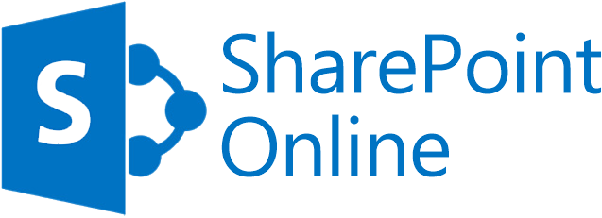
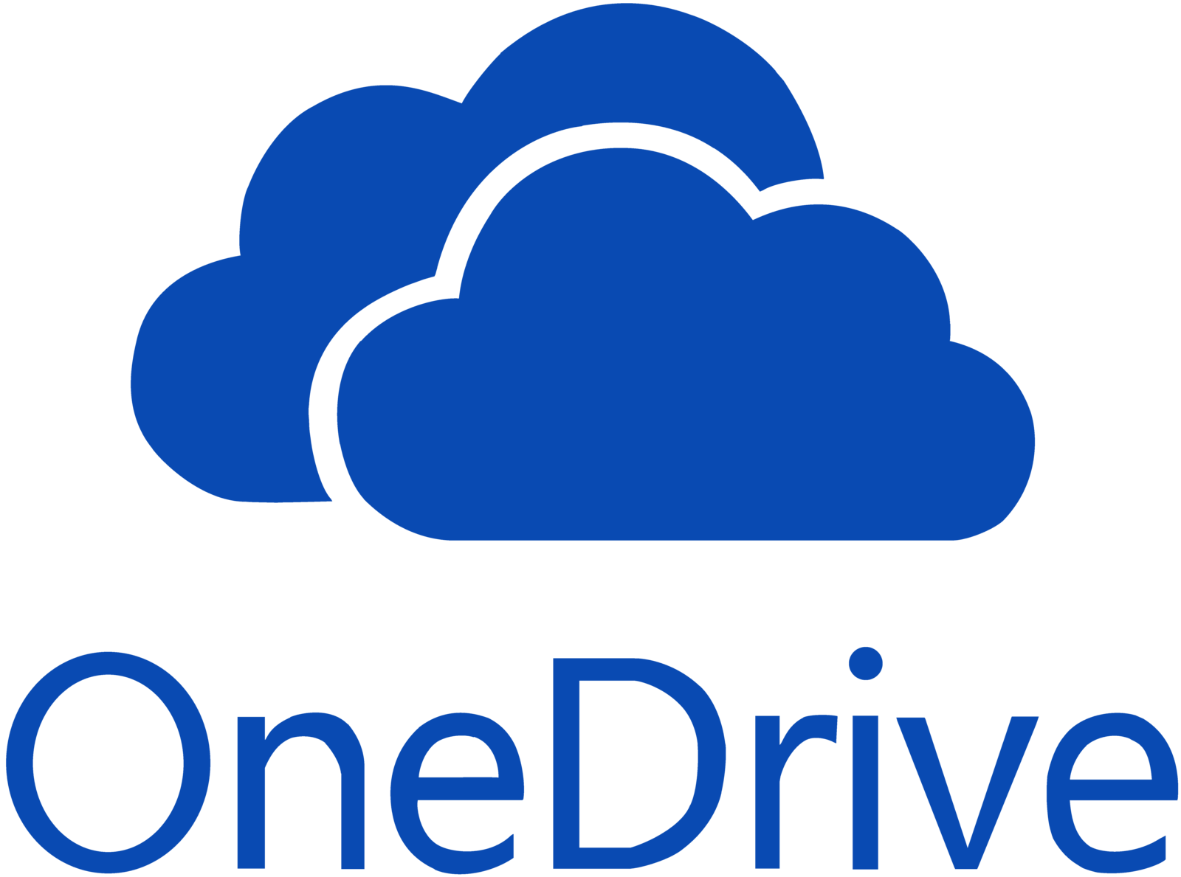
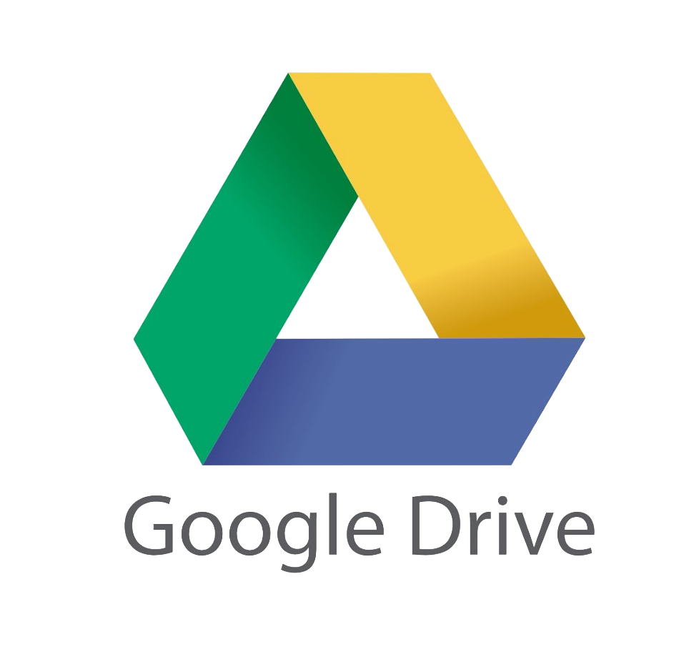
McAfee MVISION Cloud protects ALL customer data in the cloud
Long Tail SaaS
Enterprise SaaS
MVISION Cloud

Slide 12
MVISION Cloud
SaaS
IaaS/PaaS
Shadow
Visibility
Apps: Name, Configuration, Posture, Risk
Data: Classification, Tagging, Metadata
Users: Role, Activity, Collaborators
Activities: Access, Read, Write, Download, Upload…
Workloads: Details, Location, Posture
Network: Traffic, Topology
Device: Managed, Unmanaged
Location: Where, When

Slide 13
MVISION Cloud—
100% Cloud Security Coverage
Shadow
IT, 10%
5%
5%
IaaS,
24%
Business
SaaS, 24%
Collaboration SaaS,
42%
Source: McAfee Cloud Adoption Report, Nov 2018
Notes:
Office 365 is the most common home for sensitive information. Followed by Salesforce.
5% of sensitive data in the cloud goes to high risk shadow apps with limited security controls

Slide 14
5%
11%
5%
8%
Collaboration SaaS
Office 365 and Collab Apps contain the most sensitive data, at 42%
13%
16%
2%
2%
7%
Collaboration SaaS,
42%
31%

Slide 15
5%
11%
5%
8%
Collaboration SaaS Security
13%
16%
2%
2%
7%
Collaboration SaaS,
42%
31%

Slide 16
Negative Implications
22%
of Cloud Users share files
5%
11%
5%
8%
13%
48%
of all Sensitive Data in the cloud is shared over time
16%
2%
2%
7%
Collaboration SaaS,
42%
of files in the cloud are accessed within 5 minutes of being shared
21%
31%

Slide 17
Cloud is the new favorite target of threat actors
Source: McAfee Cloud Adoption Report, Nov 2018

Slide 18
Collab SaaS Use Cases
1. Data Protection
Prevent sensitive data from being stored and shared externally
5%
11%
5%
8%
2. Advanced Threat Protection
Detect Malware, compromised accounts, insider/privileged threats
13%
16%
2%
2%
7%
Collaboration SaaS,
42%
3. Contextual Access Control
Block sync/download of corporate O365 data to personal devices
31%

Slide 19
Device-to-Cloud Data Protection
MVISION Cloud
Sky Link
Visibility
SaaS
Where is the data across devices and cloud
What data is confidential?
What actions are performed on the data
Unified Incident Management
Control
Unified Policies in ePO
Delete and Quarantine
Device to cloud DLP
Encryption
McAfee ePO
Managed Devices

Slide 20
SaaS Security—Collaboration Control
MVISION Cloud
McAfee
Lightning Link
SaaS
Visibility
Control
Where is the data?
What data is confidential?
Who accesses it?
From where?
From which device?
Block and/or Revoke Collaboration
Change Permission
Compromised Accounts and Threat Protection
Unmanaged
Managed

Slide 21
Cloud Service APIs Are Delayed
Enforcement Gap
Others CASBs API
00:00
User shares file
05:00
Remediation
McAfee Sky Link
00:00
User shares file
00:30
Remediation
McAfee Lightning Link
00:00
User shares file
Remediation

Slide 22

Manual Remediation Relies on IT
User performs action that violates policy
User unable to access file or correct the incident
Alert is triggered
End
User
IT
User
IT security reviews alert
IT contacts end user to investigate
IT resolves
incident alert

Slide 23

Autonomous Remediation Relies on End User
User performs action that violates policy
User is notified to correct the incident
User corrects
the incident
Incident alert is resolved
Alert is triggered
End
User
IT
User
IT not involved

Slide 24
SaaS Security—Access Control
MVISION Cloud
SaaS
McAfee Sky Gateway
Universal Mode
Visibility
Control
Which User?
What group?
Is the device managed?
From what location?
Which OS?
Access Control
  Yes/No
  Read-only
  DRM on download
Example: Only managed device can access and download data
Unmanaged
Managed

Slide 25
Collaboration SaaS Security Differentiators
Frictionless
Data Protection
Integrated DLP
across Cloud
and Endpoint
User Centric

Slide 26
Shadow IT
McAfee (Skyhigh) customer since 2016
63,500 Employees
Why McAfee MVISION Cloud
Data Loss Prevention
Collaboration Control
Governance
Project Champion
Todd Fennel (VP, InfoSec)
  Won CSO50 Award for use of MVISION Cloud to accelerate business
Notes:
One of top 3 strategic partners, along with Microsoft
More to come
Todd Fennel won the CSO50 award

Slide 27


The only “Leader” in ALL three CASB reports
Notes:
And it’s not just Gartner that’s recognizing Skyhigh as the Leading CASB – in fact Skyhigh is the only CASB that was names a leader by all three major analysts in this space – Gartner, Forrester, and IDC. Each analysts has their own process for evaluating solutions and each talks to a different set of end users and clients, so it’s quite telling that the one thing they all agreed upon was that Skyhigh is the leader in this market

Slide 28



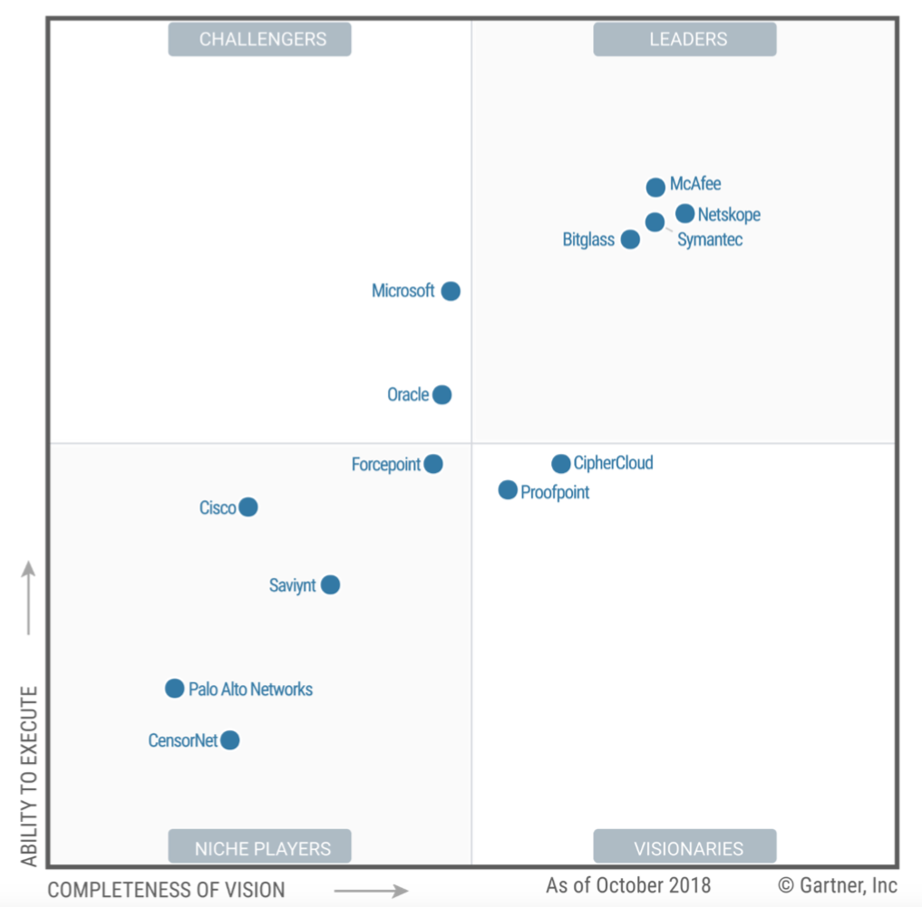
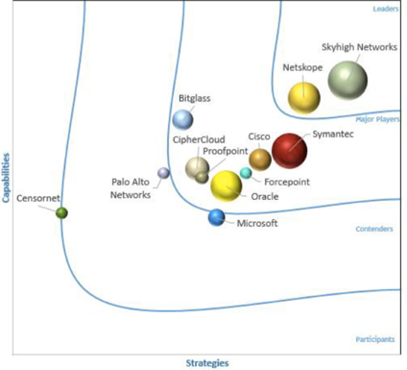
The Only Leader in ALL Three CASB Reports
McAfee
McAfee
McAfee
NOTE: As of January 2018, Skyhigh Networks is the now part of McAfee.
Notes:
And it’s not just Gartner that’s recognizing Skyhigh as the Leading CASB – in fact Skyhigh is the only CASB that was names a leader by all three major analysts in this space – Gartner, Forrester, and IDC. Each analysts has their own process for evaluating solutions and each talks to a different set of end users and clients, so it’s quite telling that the one thing they all agreed upon was that Skyhigh is the leader in this market

Slide 29
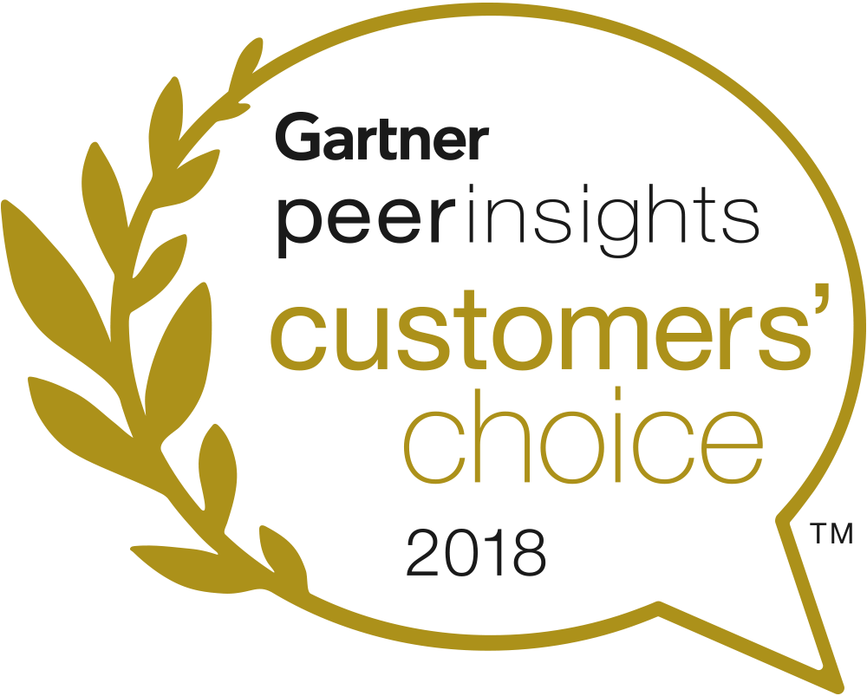
McAfee recognized
as the ONLY 2018
Gartner Peer Insights Customers’ Choice for Cloud Access Security Brokers (CASB)
Notes:
Gartner Peer Reviews Site https://www.gartner.com/reviews/market/cloud-access-security-brokers
Blog https://www.skyhighnetworks.com/cloud-security-blog/mcafee-named-a-2018-gartner-peer-insights-customers-choice-for-cloud-access-security-brokers-casb/

Slide 30

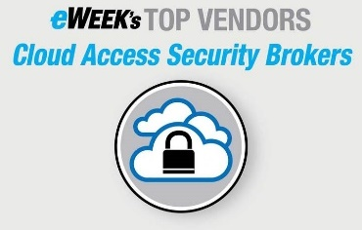
Q1’19 Awards & Accolades—MVISION Cloud
Trust Award for Best Cloud Computing Security Solution
Mar 2019
INFOSEC
Rajiv—Next Gen Security Expert of the Year
Mar 2019
Gartner
Feb 2019
Cybersecurity Excellence for Cloud Security
Feb 2019
CRN
Feb 2019
eWeek
Nov 2018

Slide 31








































































600+ Customers Including 30% of the Fortune 100
Notes:
And this is readily apparent when you look at our customer base today, which included over 600 enterprise customers and 30% of the Fortune 100. To us this is the greatest honor, and you’ll notice that these customers are not specific to just regulated industries like financial services and healthcare – the common thread between all of these companies is they have sensitive and valuable data that they need to protect in the cloud.

Slide 32
McAfee MVISION Cloud for Office 365
Vittorio Viarengo
Vice President Marketing, Cloud Business Unit

Slide 33
“Strongly consider a CASB to add more robust DLP, user behavior analytics (UBA) and policy enforcement capabilities for Office 365.”
—Gartner
Notes:
Gartner has taken a hard look at both the native and add-on security capabilities of Office 365 and is seeing some major gaps in what’s available from Microsoft. They are actively advising their clients to strongly consider a CASB to “add more robust DLP, User Behavior Analytics, and policy enforcement capabilities for O365”. This echoes what we’re hearing from customers. I was speaking with Jason Witty, the CISO of US Bank recently and he summed it up by saying – “O365 has consumer grade security for what is our enterprise’s most important cloud service. It just doesn’t cut it, no matter what license level your on. That’s why we brought in Skyhigh to fill the significant gaps.”

Slide 34
Over 50% of cloud security incidents bypass network security
IT admin accesses exec’s OneDrive from home
Corporate IP
shared externally
via SharePoint
An attacker uses a phished password to access data
Customer PII
added to Excel
Online
Q3 financial
results downloaded
to personal device
Notes:
Here are a few examples of very common security incidents that bypass network security controls like an SWG or a forward proxy. There are many specific types of O365 security incidents of course, but here are a few illustrative examples:
Click: an employee edits a doc in Excell online and inputs customer PII that should not be housed in the cloud
Click: An employee shares corporate IP with an external third party directly from SharePoint Online
Click: An IT Admin inappropriately views confidential corporate data in an Exec’s OneDrive Account from home
Click: Or you have an executive or board member who downloads confidential financial data directly to the own personal device.
So, the challenge with O365 is much more complex than simply defining which documents can be uploaded and downloaded to the cloud from users at the office

Slide 35

McAfee’s agentless, frictionless CASB covers all use cases
Customer PII added to Excel Online
Lightning Link
Corporate IP shared externally via SharePoint
Sky Gateway
Universal Mode
IT admin accesses exec’s OneDrive from home
McAfee
MVISION Cloud
Sky Gateway
Email Mode
An attacker uses a phished password to access data
Q3 financial results downloaded to personal device

Slide 36
Top CASB O365 Security Use Cases
Customer PII added to Excel Online
Corporate IP shared externally via SharePoint
Q3 financial results downloaded to personal device
An attacker uses a phished password to access data
IT admin accesses exec’s OneDrive from home
Notes:
So, let’s map the specific security incidents we outlined to the general O365 Security use cases they exemplify

Slide 37
Top CASB O365 Security Use Cases
1. Confidential Data Control
Prevent regulated/high-value data from being stored in the cloud
Customer PII added to Excel Online
2. Real-time Data Guard
Prevent unauthorized/sensitive data from being shared externally
Corporate IP shared externally via SharePoint
3. Contextual Access Control
Block sync/download of corporate O365 data to personal devices
Q3 financial results downloaded to personal device
4. Advanced Threat Protection
Detect compromised accounts, insider/privileged user threats, malware
An attacker uses a phished password to access data
5. Activity Monitoring and Forensics
Capture and categorize an audit trail of activity for forensic investigations
IT admin accesses exec’s OneDrive from home
Notes:
Click: Here’s a list of the top 5 security use case for Office 365, where IT Security needs to pull CASB. I’ve listed these in order of frequency from what we hear from our customers.
[in order to inform which of the following slides you’ll spend the most time on, ask] Which of these use cases are the most important to your organization?

Slide 38
Best practice architecture from 100+ deployments
O365 Security Use Cases | API Lightning Link | Reverse Proxy Sky Gateway | Agent / FWD Proxy Sky Gateway | SWG
Confidential Control Prevent regulated/high-value data from being stored in the cloud | •
Real-Time Data Guard Prevent unauthorized data from being shared externally | •
Contextual Access Control Block sync/download of corporate O365 data to personal devices |  | •
Advanced Threat Protection Detect compromised accounts, insider threats, malware | •
Activity Monitoring and Forensics Capture an audit trail of activity for forensic investigations | •
Shadow IT Access Control Prevent access to personal O365 instances |  |  |  | •
Notes:
Skyhigh supports API, Reverse Proxy, Agents/Forward Proxies, and integrates with SWGs, and based on the coverage model we just reviewed and the best practices we’ve learned from deploying CASBs for O365 at over 100 different companies over the last 4 years – we have a strong recommendation on how CASB should be deployed for O365
API is the best deployment mode for almost every use case, especially if you can use Lightening Link, which enforces collaboration controls in real-time. The one exception here is contextual access control, which necessarily requires an inline solution. But rather than trying to use agents/fwd proxies which cause a ton of friction and are impossible for third party users, enterprise have found the frictionless reverse proxy works beautifully. Occasionally, customers will ask about blocking access to personal O365 instances, which is really a shadow IT use case, because a personal O365 instance is really no different than a personal Dropbox instance. Skyhigh can solve this use case, but in all honesty, this is best addressed with your SWG and we can show you how to configure your SWG to enforce these controls for Shadow IT.

Slide 39
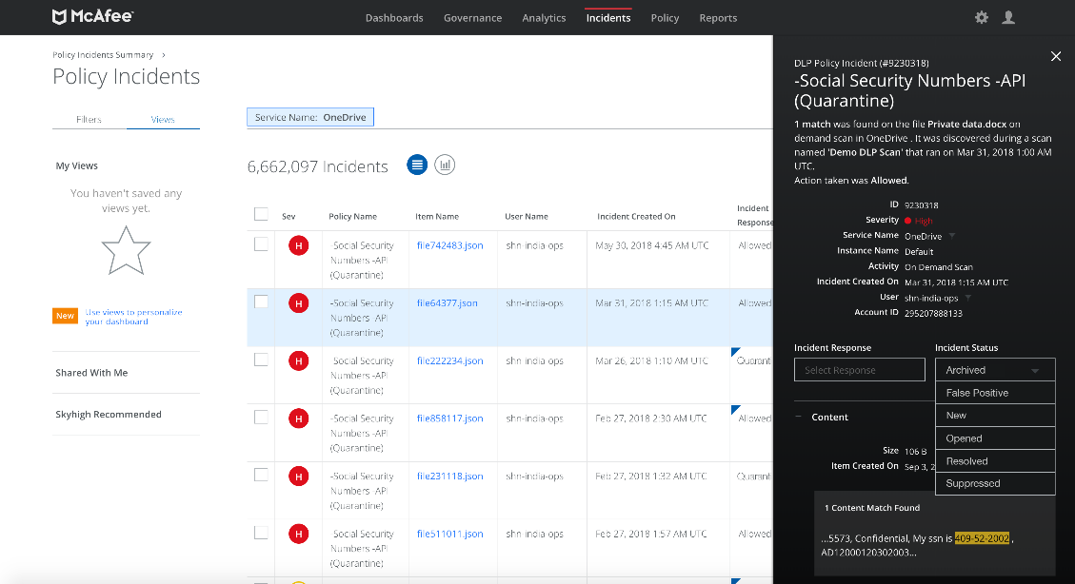
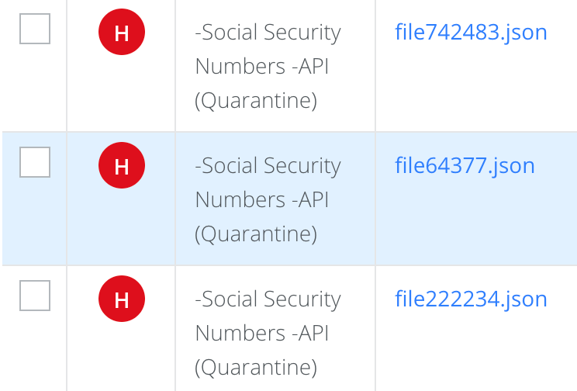
1. Confidential Data Control
Prevent regulated/high-value data being stored in the cloud
Enforce DLP based on keywords, data identifiers, IDM, EDM, RegEx

Slide 40
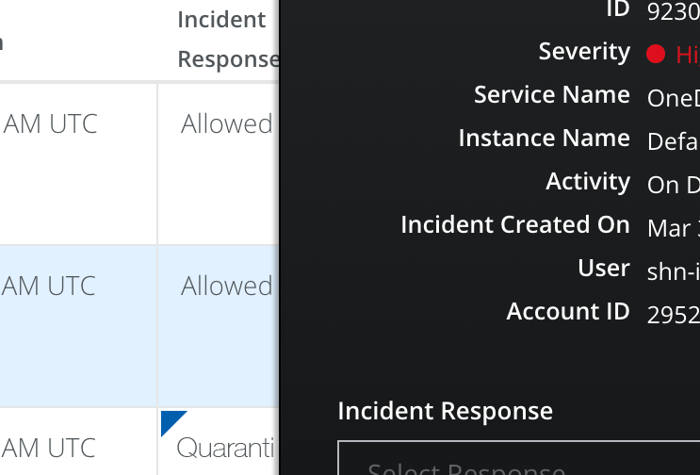
1. Confidential Data Control
Prevent regulated/high-value data being stored in the cloud
Multi-tier remediation on severity (quarantine, delete, coach user, etc.)

Slide 41
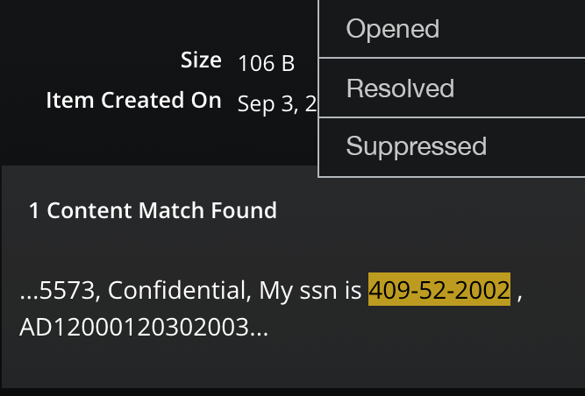
1. Confidential Data Control
Prevent regulated/high-value data being stored in the cloud
Review highlighted excerpts showing content that triggered the violation

Slide 42
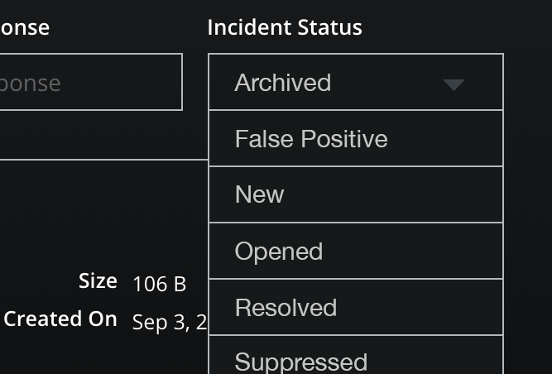
1. Confidential Data Control
Prevent regulated/high-value data being stored in the cloud
Rollback an automated enforcement action or take manual action

Slide 43
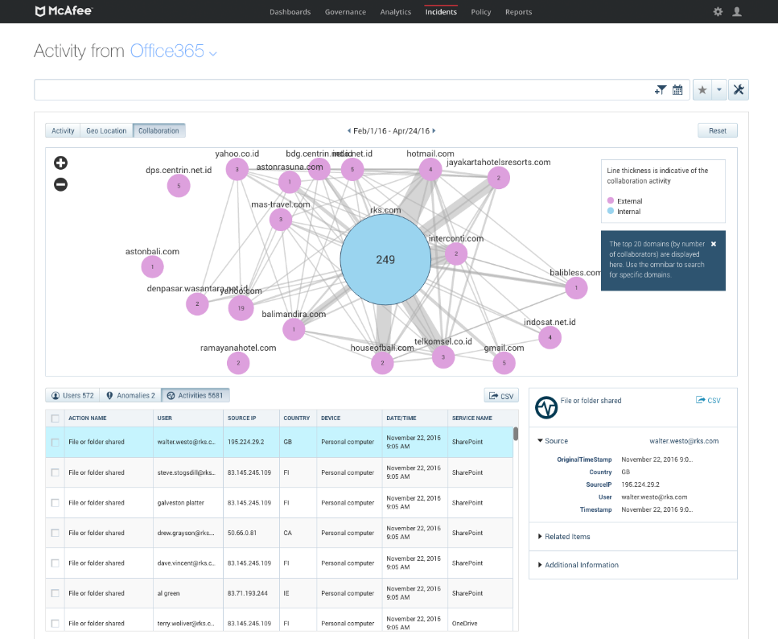
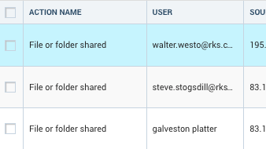
2. Real-Time Data Guard
Prevent unauthorized data from being shared externally
Real-time enforcement of sharing policies via API prevents exposure

Slide 44
2. Real-Time Data Guard
Prevent unauthorized data from being shared externally
Coach user, block link, limit sharing, notify administrator

Slide 45
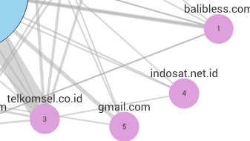
2. Real-Time Data Guard
Prevent unauthorized data from being shared externally
DLP powered content-aware collaboration policies to prevent data loss via sharing/links

Slide 46
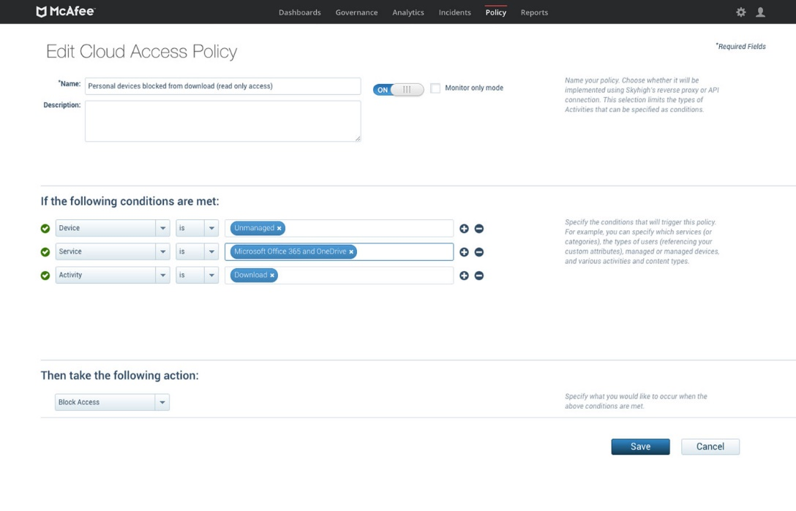
3. Contextual Access Control
Block sync/download of corporate data to unmanaged devices
Enforce distinct policies for managed devices and unmanaged devices

Slide 47
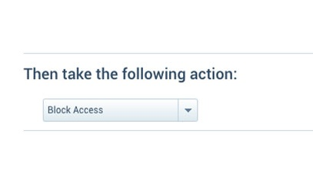
3. Contextual Access Control
Block sync/download of corporate data to unmanaged devices
Block access to Office 365, including via the native app, on unmanaged devices

Slide 48
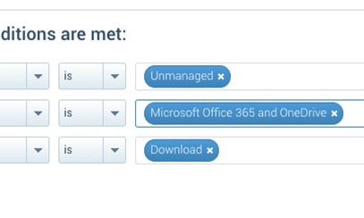
3. Contextual Access Control
Block sync/download of corporate data to unmanaged devices
Allow preview of content in the browser but disable download

Slide 49
3. Contextual Access Control
Block sync/download of corporate data to unmanaged devices
Check MDM/EMM certificate and validate user-device mapping

Slide 50
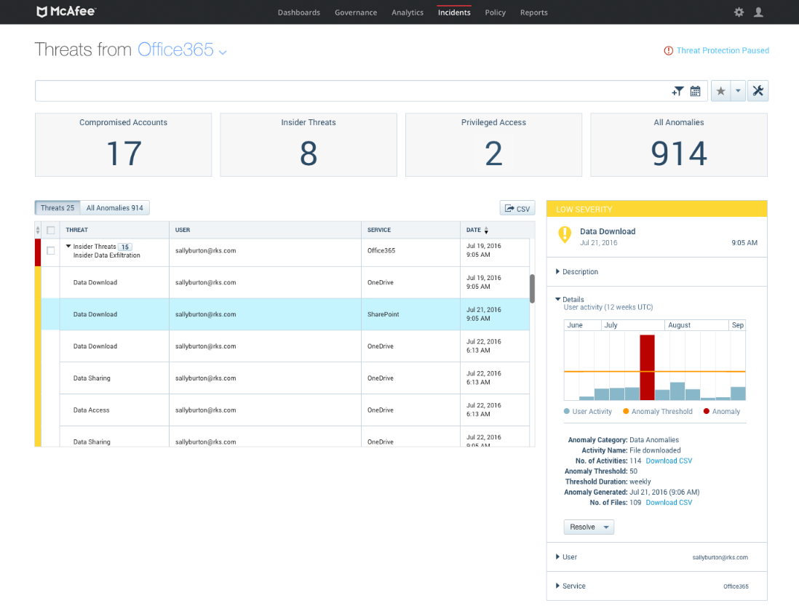
4. Advanced Threat Protection
Detect compromised accounts, insider threats, and malware
Leverages machine learning and user and entity behavior analytics (UEBA)

Slide 51
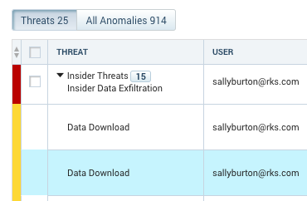
4. Advanced Threat Protection
Detect compromised accounts, insider threats, and malware
Threat funnel correlates multiple anomalies, minimizing false positives

Slide 52
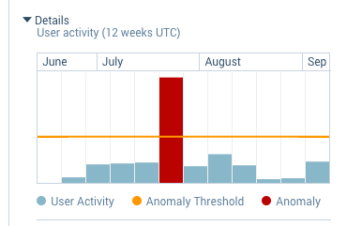
4. Advanced Threat Protection
Detect compromised accounts, insider threats, and malware
No pre-defined policies or thresholds, automatic models based on activity

Slide 53
4. Advanced Threat Protection
Detect compromised accounts, insider threats, and malware
Sandboxing to identify malware that signature-based solutions miss

Slide 54
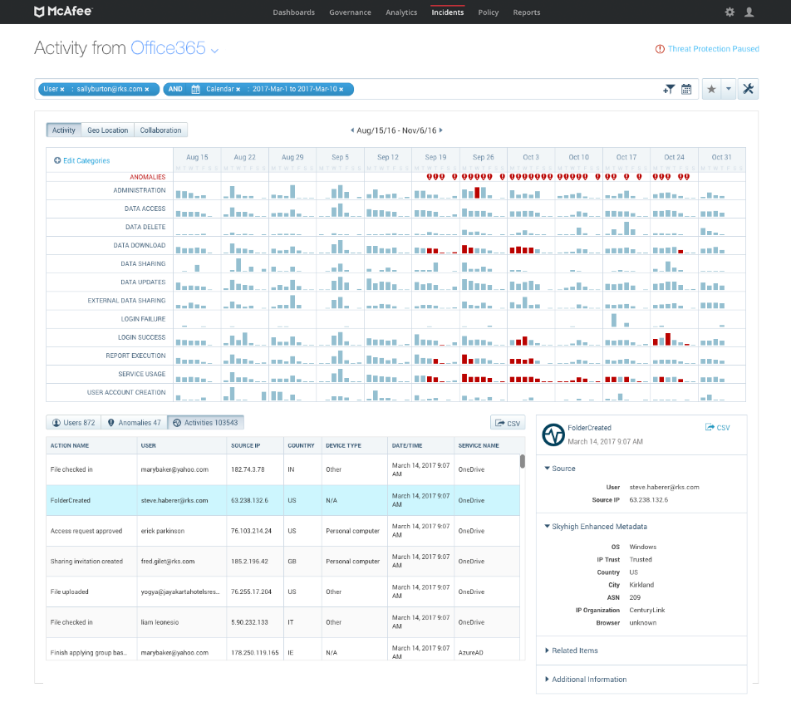
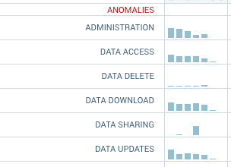
5. Cloud Activity Monitoring and Forensics
Capture an audit trail for forensic investigations
Categorizes all 600+ activities into 13 categories for easy filtering/navigation

Slide 55
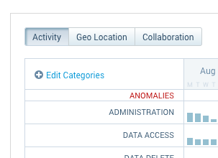
5. Cloud Activity Monitoring and Forensics
Capture an audit trail for forensic investigations
Expand the scope of an investigation and browse a geo-location map

Slide 56
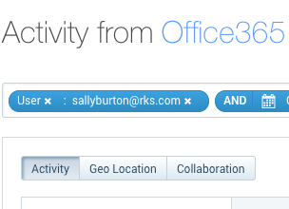
5. Cloud Activity Monitoring and Forensics
Capture an audit trail for forensic investigations
Investigate activities for a specific user centered around an incident

Slide 57
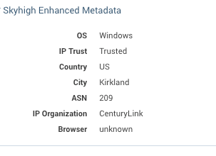
5. Cloud Activity Monitoring and Forensics
Capture an audit trail for forensic investigations
IP reputation to identify access by a malicious IP such as a TOR network

Slide 58
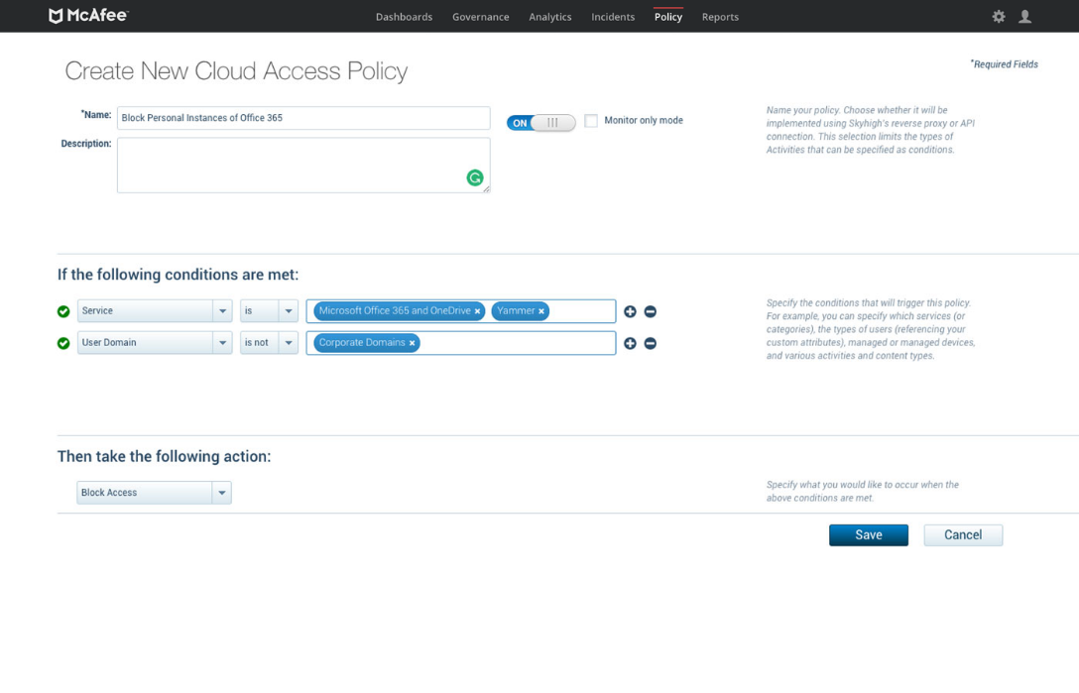
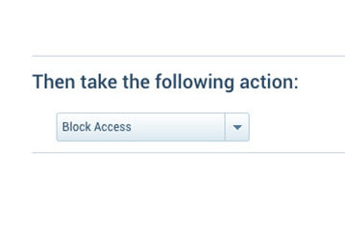
6. Prevent access to personal Office 365 instances
Instance-level control to prevent access to personal Office 365 accounts

Slide 59
6. Prevent access to personal Office 365 instances
Enforce policies across all on-network and all managed corporate devices

Slide 60
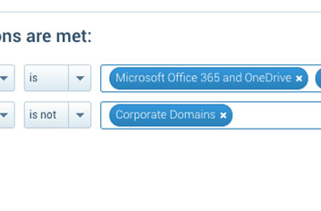
6. Prevent access to personal Office 365 instances
Permit access to corporate instances of Office 365

Slide 61
6. Prevent access to personal Office 365 instances
Supports web application access well as native application access

Slide 62
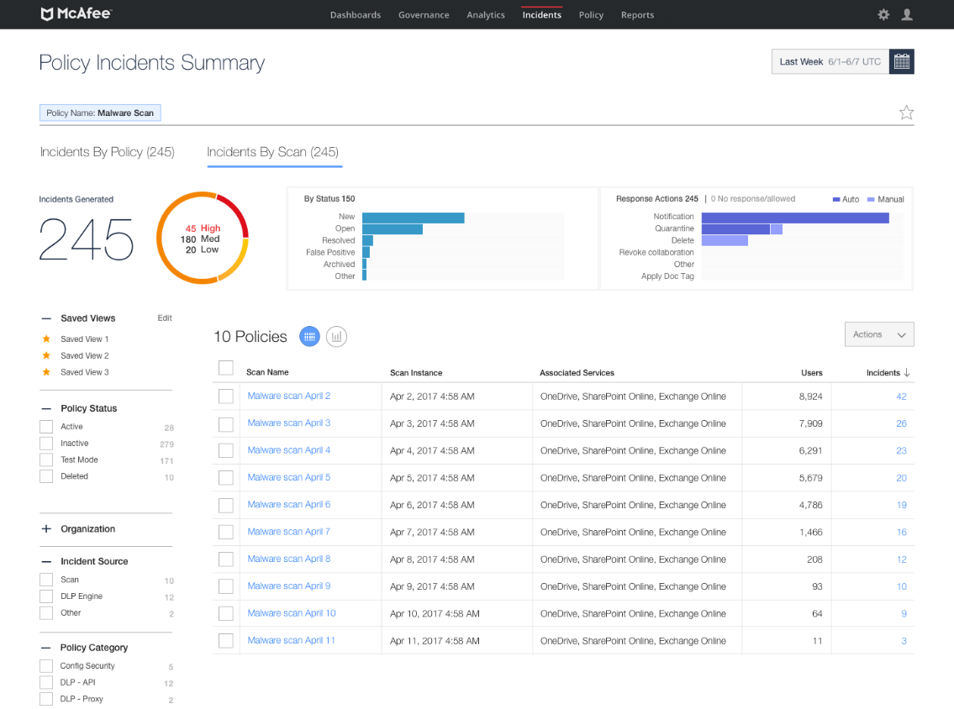
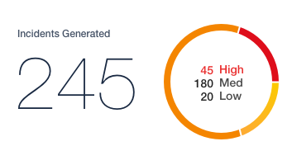
7. Prevent proliferation of malware
Sandboxing to identify malware that signature-based solutions miss

Slide 63
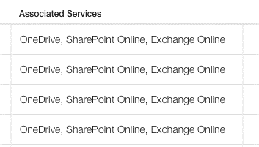
7. Prevent proliferation of malware
Scans files in OneDrive, SharePoint Online, or Exchange Online

Slide 64
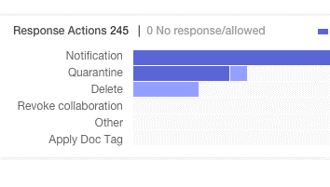
7. Prevent proliferation of malware
Quarantine or delete malware infected files in Office 365

Slide 65
7. Prevent proliferation of malware
Identifies 10-20% more malware than Microsoft’s built-in antivirus engine

Slide 66
Top CASB O365 Security Use Cases
1. Confidential Data Control
Prevent regulated/high-value data from being stored in the cloud
2. Real-time Data Guard
Prevent unauthorized/sensitive data from being shared externally
3. Contextual Access Control
Block sync/download of corporate O365 data to personal devices
4. Advanced Threat Protection
Detect compromised accounts, insider/privileged user threats, malware
5. Activity Monitoring and Forensics
Capture and categorize an audit trail of activity for forensic investigations

Slide 67
Office 365 Diagrams

Slide 68
McAfee MVISION Cloud Architecture
Sky Link
Lightning Link
Visibility
Sky Gateway
Universal Mode
McAfee
MVISION Cloud
Sky Gateway
Email Mode
Control
Ground Link
Notes:
McAfee Sky Gateway
Enforces policies inline for data in motion in real-time.
Email mode
Leverages the native mail flow to enforce policies across all messages sent by Exchange Online inline or in passive monitoring mode.
Universal mode
Sits inline between the user and Office 365 and steers traffic after authentication to cover all users and all devices, without agents.
McAfee Sky Link
Connects to Office 365 APIs to gain visibility into data and user activity, and enforce policies across data uploaded or shared in near real-time and data at rest.
McAfee Lightning Link
Establishes a direct out-of-band connection to Office 365 to enforce policies in real-time with comprehensive data, user, and device coverage.
McAfee Ground Link
Brokers the connection between McAfee and on-premises LDAP directory services, DLP solutions, proxies, firewalls, and key management services.

Slide 69
McAfee MVISION Security Cloud Architecture
Sky Link
Lightning Link
Sky Gateway
Universal Mode
McAfee
MVISION Cloud
Sky Gateway
Email Mode
Ground Link

Slide 70
Customers

Slide 71


Shadow IT
McAfee (Skyhigh) customer since 2014
65,000 Employees
Why McAfee MVISION Cloud
Collaboration Control
Data Loss Prevention
Governance
Project Champion
Jeff Haskill (Group CSO)
  Won CSO50 Award for use of Skyhigh to accelerate business

Slide 72


Prevent Data Loss due to usage of Personal Devices
Enable BYOD while preventing data loss from Salesforce, ServiceNow, O365, Box, and Google via lost or stolen devices.
  Check for device certificate, confirm user/device mapping
  Limit access based on device or location
  Block access or limit to view-only
Notes:
This was incredibly important to Caesar's Entertainment when they deployed O365. They supported BYOD but needed to make sure that they weren’t exposing themselves to data loss when employees’ unmanaged devices were lost or stolen. There were two big advantages they identified when evaluating different CASBs for this use case.
The first was the rich user-device mapping check, which ensures that savvy users cannot circumvent your access control policies by spoofing an MDM/EMM certificate on a personal device. After checking for the certificate, Skyhigh confirms the device is whitelisted by the MDM/EMM provider and associated to the user attempting access.
Maintaining agents on even 1,000 personal devices is impossible given the churn in devices, not to mention the legal and privacy concerns. With over 150,000 employees and more than 2-3 devices per employee, they required a completely frictionless method to enforce their access control policies at scale and Skyhigh had the only solution that could enforce their unmanaged device access controls without requiring an endpoint agent.

Slide 73


Support Investigations by Tracking all Activity within Sanctioned Cloud Services
Created forensic live log of O365 activity to quickly resolved security incident investigations provide auditability.
Activities organized into 13 categories for easy navigation
Drill down into specific user and groups
Activity data enriched with geographic location
Notes:
CASB consumes microsoft Graph API which gives visibility into 600+ activity types.
DuPont uses Skyhigh to investigate employees’ activity in O365 whenever a security incident occurs, even in cases where the incident occurred outside of O365.
They selected Skyhigh because we’ve made it incredibly easy to explore activities and drill down into specific users, groups, or activity types so they can follow various threads of an investigation
One of the other big differentiators for them was our categorization of activity types and the fact that we apply consistent categorizations across multiple services aside from O365, like Box and Salesforce, so they can expand investigations across various cloud services to get a full picture of an employee’s activities. With hundreds of activities, it’s invaluable to filter just to ones related to data deletion, data upload, etc.
And certain activities are more concerning when they originate from untrusted locations, so Skyhigh’s unique ability to enrich the activity data gathered via Microsoft’s APIs with geographic data was incredibly valuable to them.

Slide 74


Protect Against Threats to Cloud Data
Prevented data loss from Salesforce, Box, and O365 due to compromised accounts, insider threats and privileged user threats.
Analyze usage across multiple cloud services
Leverage UEBA to identify threats without pre-defined policies or thresholds
Adjust sensitivity with real-time preview

