Slide 1
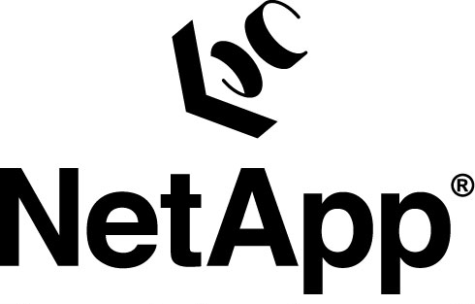

Slide 2
Growth through Product Innovation
Content from Analyst Day
November 2004 NY

Slide 3
Pressures on IT Groups
Do more with less
Keep running globally 24x7
Adapt rapidly to changes
Maximize value of information
IT managers need storage solutions designed to:
Consolidate storage and data
Scale non-disruptively
Protect data and enable compliance
Simplify management
Notes:
Over that last few years, a few key technology trends have been fundamentally reshaping the IT infrastructure of most large Enterprises.
First, over the last few years, CPU has become virtually free. This is resulting in a significant shift in how applications are deployed and servers are architected. Specifically, large SMP machines are giving way to farms of servers and blade servers, that will become mainstream over the next few years
Second, Linux is becoming mainstream. From an IT infrastructure perspective, Linux started making in-roads into technical computing environments, but is rapidly becoming an OS of choice for commercial database applications.
Third, over the last decade, networks have become ubiquitous. Consequently, storage is rapidly migrating from being direct attached to networked storage. More importantly, this was largely a data center phenomenon, but the emergence of standards such as iSCSI will enable a much more rapid pace of transition. A second outcome of ubiquitous networks is that it facilitates globalization of IT infrastructure. Today, no large Enterprise operates out of a single centralized data center – almost all Enterprises have their IT infrastructure distributed across several large data centers. The challenge is to make distributed data management as easy as centralized data management.
Fourth, with disk costs approaching tape costs, it becomes possible to architect a tiered storage model that becomes the facilitator for ILM. The whole idea of ILM is to ensure that classes of data are mapped to the appropriate classes of storage to balance the value of data versus the cost of the associated storage.

Slide 4
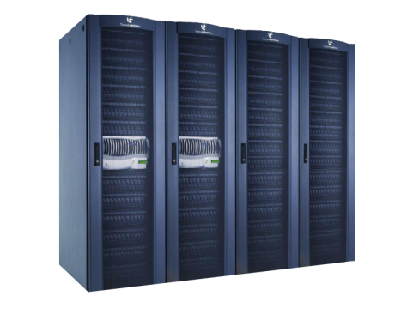
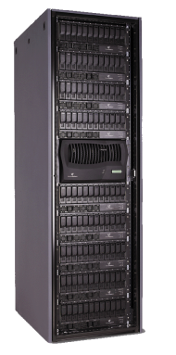
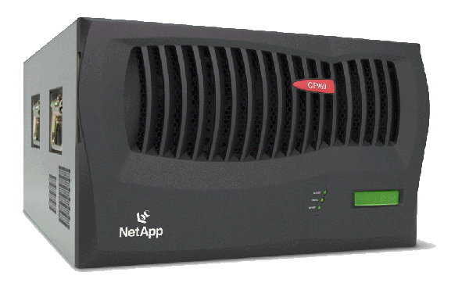
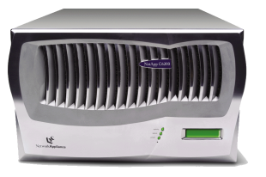
NetApp Product Lines
Primary Storage
Remote/ Small Office
Nearline Storage
Heterogeneous Storage Gateway
Content Delivery
FAS900 Series
Unified data center class storage
FAS200 Series
Remote office and small business storage
NearStore®
Economical secondary storage
gFiler™
Intelligent gateway for existing storage
NetCache®
Accelerated and secure access to Web content
Data ONTAP™ operating system – SAN, NAS, iSCSI, caching
Notes:
Slide updated 11Mar04

Slide 5
NetApp Storage Software Suite
Common software architecture; comprehensive portfolio
Storage consolidation
HA: Clustered failover
Data Access: FCP, iSCSI, NFS, CIFS
Data Cloning: FlexClone
Migration: SnapMover
RAID / Volume Mgmt: RAID-DP, SyncMirror, MultiStore, FlexVol
Data protection
Backup and recovery: Snapshot, SnapRestore, SnapVault
Disaster recovery: SnapMirror, MetroCluster
Storage management
SRM: DataFabric Manager, SnapDrive
Global namespace: Virtual File Manager
Application integration: SnapManager, Single Mailbox Restore
Compliance
Data permanence: SnapLock, LockVault
Notes:
Slide updated 11Mar04

Slide 6
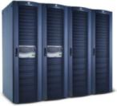
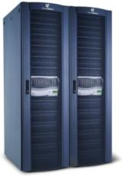
Upgrade paths
FAS980
FAS940
FAS920/c
Flexible upgrade options
Easy data migration
Investment protection
FAS270
FAS250
Notes:
This slide reiterates the flexibility of our upgrade program. A customer with an existing F700 series filer can trade that system if they should reach the maximum supported capacity of that system or require increased performance.
What isn’t shown is also the ability for the customer to trade in older generations of NetApp filers as well and offer credit towards the purchase of new NetApp filers. See your price list for trade-in credits.
The ease and flexibility of the trade-in program provides the customer with and quick upgrade path to higher capacities and increased performance. This is done by ensuring new generation filers are compatible with previous generation fibre channel disk subsystems. The F700 and F800 series disk subsystems are all compatible with each of the previous generations of filer allowing the customer to retain existing disk subsystems and data and only upgrade the filer itself.
By allowing the customer to keep their existing FCAL disk subsystem the only necessary swap out is for the filer head….allowing customers to continue the use of existing data without having to migrate that data.
Overall the flexibility of the upgrade program allows customers to decrease their management overhead and TCO as well as providing investment protection on existing systems.
We also offer a competitive trade in program…taking old or new Auspex, Compaq, or even EMC equipment off of the customers hands and giving them credit towards new NetApp systems. See your price list for upgrade program details and credit amounts for trade-ins.

Slide 7
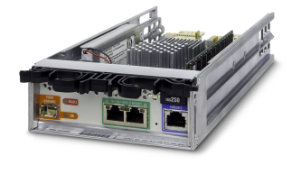
Starting at FAS250
FC (Cu)
2X GbE Cu NICS
Console port

Slide 8
FAS270c - Rear
Filer #2
Filer #1

Slide 9
Small to Large Scaling

Slide 10
NAS Basics

Slide 11
Server Consolidation and NAS
Managing an Appliance vs Server
OS management and licensing
Storage and volume management
Data management and protection
Performance per/controller
Act-Act protection vs Act-Pass
Not all Act-Act solutions are the same
Multi-Site management
ONTAP microkernel
No service packs and hotfixes
No patch level management
Data-path redundancy and resiliency
File-system journaling
Snapshot features
Rolling upgrades on CFO
SFS97_R1 specs / NetBench
Network-to-RAID storage efficiency
10s of 1000s of users all with “like local disk performance”
CFO vs DM configurations
Replication / SnapMirror
Incr blk efficiency

Slide 12
Performance on Scalability

Slide 13
Data Protection with Replicas
255 SnapShots per vol
Zero performance impact
Efficient space consumption
SnapReserve is always flexible
Roll back entire vol in <1sec (8TB-16TB) w/SnapRestore
Instantly available files/dirs for recovery
Higher quality of service to end-user
Available as User or Admin operations (superusers/power-users)

Slide 14
Design Differences More than just a performance issue
Other snapshot (file-system retrofit?)
NetApp SnapShots
Fixed allocation of phsy blks in a formatted
/SnapVol
Soft allocation of X no. of blocks

Slide 15
SnapShot (things to test)
Create a snap schedule with 28 snapshots
retain 10 hourly, 14 nightly, 4 weekly
dump 20% new data on the volumes
resize the SnapReserve on the fly to add 15% more reserve
delete 30% of the data and resize SnapReserve back to the original
delete 50% of the data, and run a SnapRestore
Try to hurt performance with sporadic Snapshot events
Create 100 snapshots manually… what happens to performance?
Run plenty of create/change/modify operations, and create another 100 snapshots
Delete any odd number of snapshots
What happens to performance, snapshot maintenance, and file-system fragmentation?

Slide 16
Block Level Replication Even greater affect on Recovery and Resync

Slide 17
SnapMirror Highlights
Things that are easy to test…
Robust incremental block replication
volume and qtree level
dynamic bandwidth management
resilient network congestion handling
Bi-directional Resynchronization
break a mirror, update the DR side, bring the new changes back to the original site
Scalable and Flexible
Asynchronous over IP, semi-sync, and Full-Synchronous
IP or FC transports

Slide 18
Growth Drivers
Rethinking storage economics:
The Basics
Investment protection:
Unified storage
Redefining data protection:
NearStore
Next generation storage:
Storage Grid

Slide 19
Rethinking Storage Economics

Slide 20
Tiered Storage
FC-based Storage
ATA Primary Storage
Availability and Performance
ATA-based
Nearline
Storage
Cost

Slide 21
RAID-DP Disruptive Approach Enabling ATA for Primary Storage
Bits Per RAID Group
Industry: Mirroring
NetApp: RAID-DP
4000X better protection
<1% performance impact
Comparable economics
Assumes 8-drive (7+1) RAID group
1.0E+16
1.0E+15
Uncorrectable error rate = risk of data loss
1.0E+14
1.0E+13
1.0E+12
1.0E+11
1.0E+10
1.0E+09
36GB
73GB
147GB
250GB
300GB

Slide 22
RAID-DP Overview
Description
Two parity drives per RAID group
Extension of RAID 4
Standard feature
Primary Benefits
>4,000X better protection
<1% performance impact
Comparable economic efficiency
Secondary Benefits
Effortless conversion
Lowers RAID reconstruction impact
Seamless integration with NetApp SyncMirror™

Slide 23
Resilient Storage Reconstruction vs. Rapid RAID Recovery
Reconstruction
Read each block from each of the remaining drives
Compute block for missing drive
Write block to spare
For example, a 8-drive RAID group of 144GB drives (136GB usable) requires data transfers of:
7 x 136 GB read plus 1 x 136 GB writes = 1088 GB, and
Computes parity for 2.44 x10⁸ blocks!
Rapid RAID Recovery
Copy the “sick disk” to a spare
Reconstruct the few blocks that cannot be read
For example, a 8-drive RAID group of 144GB drives (136 GB usable) requires data transfers of:
1x136 GB read plus 1x136 GB writes = 272 GB, and
Computes parity for just a few blocks.

Slide 24
FlexVol Dramatically Higher Utilization
Volumes: not tied to physical storage
One command to create, expand, shrink volumes
Dynamic reclamation of unused space
Disks
Disks
Disks
Pooled Physical Storage

Slide 25
FlexVol™ Volumes: Improving Space Utilization
Vol 1
Vol 2
Vol 3
Vol 4
Regular volumes
Free space fragmented across volumes
Free space not available to other volumes
Vol 1
FlexVol volumes
No preallocation of free space
Free space available for use by other or new volumes
Vol 2
Free
Vol 3
Vol 4
Notes:
One of the most immediate benefits that Flexvol provides is the ability to improve the space utilization on a given system by pooling all of the free space together. In the past, the free space inside of a filer was fragmented across multiple volumes and it was very hard to get at that space – reallocation of space was a time-consuming operation often requiring recopying of data in cases where you needed to shrink the size of a volume.
With flexible volumes reallocation of space is a non-disruptive operation. It is easy to shrink all the volumes of a system to generate enough free space for example for a new volume.
Also, since space flows freely between volumes, allocating disks is not a big decision. An administrator can with ease of mind allocate all of the disks in a system (short of one or two spares) knowing that the space can be reclaimed easily if there is a need.

Slide 26
Before: Large Enterprise SW Developer
Production
Challenges
Copies consume lots of disk
< 10% unique data
Copies take a lot of time
Slower time to market
Mirrored Copy
…
Dev 1
Dev 2
Dev N
…
Test 1
Test 2
Test N
Notes:
Individuals can run their own tests for dramatic improvement in application test, simulation and development environments. By being able to test faster and more often, companies can improve time to market and do so with better quality assurance and less cost.
Testing: for database environments using SW like : SAP, Peoplesoft, Siebel- to work out bugs and issues before trying on real data
Development ex: chip development, where 20-30 variations on a core design are needed (a variation for each different manufacturer or use)
Simulation: crash testing a car (front, side, rear)
Traditionally cloning data is difficult. Because it’s space, time and resource consuming many companies choose between doing the exhaustive quality testing and getting their product to market faster.
Data ONTAP 7G enables users to make many copies quickly using minimal physical space. This allows multiple people to run their own tests without impacting core data. The benefit is more tests running faster and less expensively for improved quality.
(build)
Many copies instantaneously: Traditionally cloning might take hours or even days to make a single copy of a dataset. FlexClones allow DBAs to create one clone or many in minutes without disrupting the system. Since they take only minutes to make they can save you 5-10 times the cost of your current storage.
Space efficient: Traditional clones occupy 100% of their space. Ours don’t use space until you begin making changes to either the original data or the clone.
Clones are cloneable: This allows changes in the FlexVol to branch in ways similar to the way SW engineers branch source code trees- a capability you really appreciate with complex design tasks or larger teams.
Let’s summarize some of the many ways Data ONTAP 7G makes data management simpler and more cost effective.

Slide 27
After FlexClone
Production
Mirrored Copy
Solution
FlexClone
Instantaneous copies
Low storage overhead
Faster TTM
Higher quality
Lower cost
Develop 1
Develop 2
Test 1
Test 2
QA
Notes:
Individuals can run their own tests for dramatic improvement in application test, simulation and development environments. By being able to test faster and more often, companies can improve time to market and do so with better quality assurance and less cost.
Testing: for database environments using SW like : SAP, Peoplesoft, Siebel- to work out bugs and issues before trying on real data
Development ex: chip development, where 20-30 variations on a core design are needed (a variation for each different manufacturer or use)
Simulation: crash testing a car (front, side, rear)
Traditionally cloning data is difficult. Because it’s space, time and resource consuming many companies choose between doing the exhaustive quality testing and getting their product to market faster.
Data ONTAP 7G enables users to make many copies quickly using minimal physical space. This allows multiple people to run their own tests without impacting core data. The benefit is more tests running faster and less expensively for improved quality.
(build)
Many copies instantaneously: Traditionally cloning might take hours or even days to make a single copy of a dataset. FlexClones allow DBAs to create one clone or many in minutes without disrupting the system. Since they take only minutes to make they can save you 5-10 times the cost of your current storage.
Space efficient: Traditional clones occupy 100% of their space. Ours don’t use space until you begin making changes to either the original data or the clone.
Clones are cloneable: This allows changes in the FlexVol to branch in ways similar to the way SW engineers branch source code trees- a capability you really appreciate with complex design tasks or larger teams.
Let’s summarize some of the many ways Data ONTAP 7G makes data management simpler and more cost effective.

Slide 28
Investment Protection:
Unified Storage

Slide 29
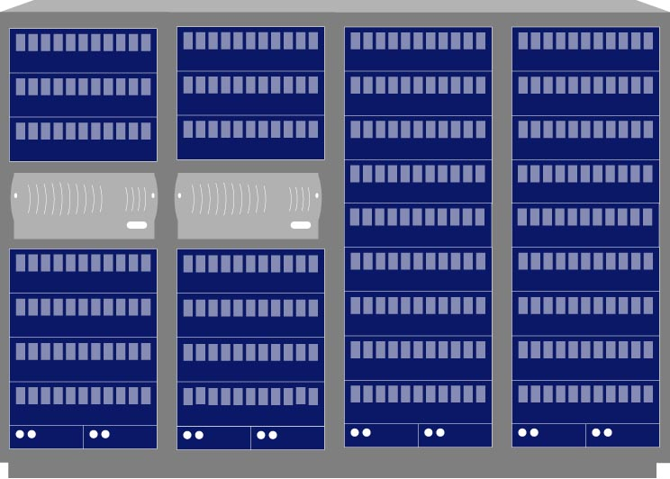
Unified Storage: Investment Protection
SAN
NAS
Enterprise
Departmental
Enterprise
Departmental
iSCSI
Fibre Channel
Dedicated Ethernet
SAN (Block)
NAS (File)
NetAppFabric Attached Storage

Slide 30
Backup
4th Case Study
Add if we have time or try to combine into the 1st

Slide 31
Large Service Provider Before Data ONTAP 7G
Application Overview
Storage utility
Growing at 1.75 TB/day
Large FC SAN
Challenges
Backup window
Manpower for backup
Timely data recovery
Complex provisioning
Costs
Windows and UNIX Hosts
FC SAN
Notes:
Individuals can run their own tests for dramatic improvement in application test, simulation and development environments. By being able to test faster and more often, companies can improve time to market and do so with better quality assurance and less cost.
Testing: for database environments using SW like : SAP, Peoplesoft, Siebel- to work out bugs and issues before trying on real data
Development ex: chip development, where 20-30 variations on a core design are needed (a variation for each different manufacturer or use)
Simulation: crash testing a car (front, side, rear)
Traditionally cloning data is difficult. Because it’s space, time and resource consuming many companies choose between doing the exhaustive quality testing and getting their product to market faster.
Data ONTAP 7G enables users to make many copies quickly using minimal physical space. This allows multiple people to run their own tests without impacting core data. The benefit is more tests running faster and less expensively for improved quality.
(build)
Many copies instantaneously: Traditionally cloning might take hours or even days to make a single copy of a dataset. FlexClones allow DBAs to create one clone or many in minutes without disrupting the system. Since they take only minutes to make they can save you 5-10 times the cost of your current storage.
Space efficient: Traditional clones occupy 100% of their space. Ours don’t use space until you begin making changes to either the original data or the clone.
Clones are cloneable: This allows changes in the FlexVol to branch in ways similar to the way SW engineers branch source code trees- a capability you really appreciate with complex design tasks or larger teams.
Let’s summarize some of the many ways Data ONTAP 7G makes data management simpler and more cost effective.

Slide 32
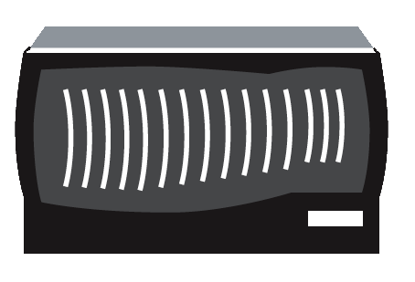
Large Service Provider after Data ONTAP 7G
Solution
gFiler SAN Virtualization
Snapshot
SnapMirror
gFiler-based back-up
Improved Productivity
Simpler provisioning
4x faster backup
Improved SLA
Faster roll-outs
Faster recovery
Windows and UNIX Hosts
UNIX
Hosts
gFiler SAN
Virtualization
FC
SAN
FC SAN
Notes:
Individuals can run their own tests for dramatic improvement in application test, simulation and development environments. By being able to test faster and more often, companies can improve time to market and do so with better quality assurance and less cost.
Testing: for database environments using SW like : SAP, Peoplesoft, Siebel- to work out bugs and issues before trying on real data
Development ex: chip development, where 20-30 variations on a core design are needed (a variation for each different manufacturer or use)
Simulation: crash testing a car (front, side, rear)
Traditionally cloning data is difficult. Because it’s space, time and resource consuming many companies choose between doing the exhaustive quality testing and getting their product to market faster.
Data ONTAP 7G enables users to make many copies quickly using minimal physical space. This allows multiple people to run their own tests without impacting core data. The benefit is more tests running faster and less expensively for improved quality.
(build)
Many copies instantaneously: Traditionally cloning might take hours or even days to make a single copy of a dataset. FlexClones allow DBAs to create one clone or many in minutes without disrupting the system. Since they take only minutes to make they can save you 5-10 times the cost of your current storage.
Space efficient: Traditional clones occupy 100% of their space. Ours don’t use space until you begin making changes to either the original data or the clone.
Clones are cloneable: This allows changes in the FlexVol to branch in ways similar to the way SW engineers branch source code trees- a capability you really appreciate with complex design tasks or larger teams.
Let’s summarize some of the many ways Data ONTAP 7G makes data management simpler and more cost effective.

Slide 33
Data ONTAP 7G
FlexClone
Disks
Snapshot
Pooled Physical Storage
Active volume
FlexVol™
FlexClone™
gFiler™
Granular data management
Improved utilization
Better performance
Highly flexible
Instantaneous copies
Low storage overhead
Heterogeneous storage virtualization
Support for leading vendors

